Slide 1
Mass Spectrum Protein Matching with Neural Networks
Matt Peter
Jonah Kubath

Slide 2

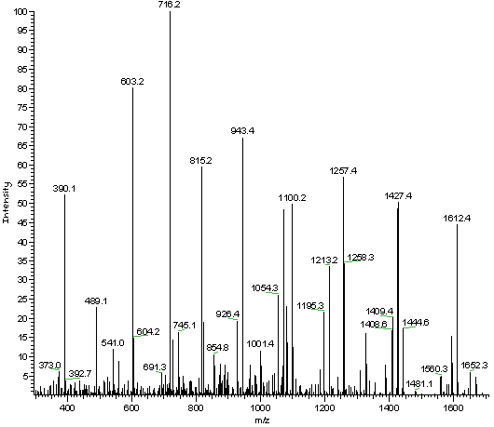
Proteomics
Mass Spectrometry
Proteins are broken into Peptide Sequences
Peptide are broken down into ions
Ions are then fragmented, separated, and detected

Slide 3
Data Augmentation
Yeast protein database was chosen
Protein sequences broken into peptide sequences with protein labels
Generate MS2 data for each peptide
LABEL Theoretical MS2
sp|P38149|DUG2_YEAST “27,44,71,72,84,88,93,101,102, …”

Slide 4
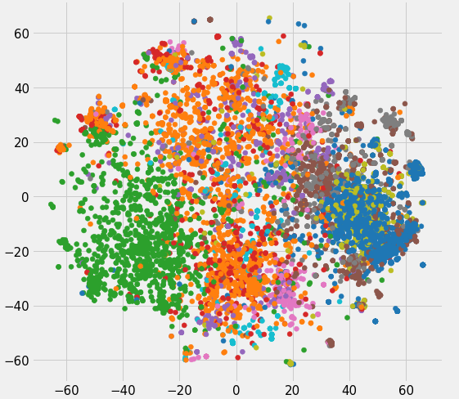
Embeddings
Represent ”words” in a multi-dimensional space
Similar words are grouped
In text, ”king” and “queen” are often used similarly
Input: “27,44,71,72,84,88,…”

Slide 5
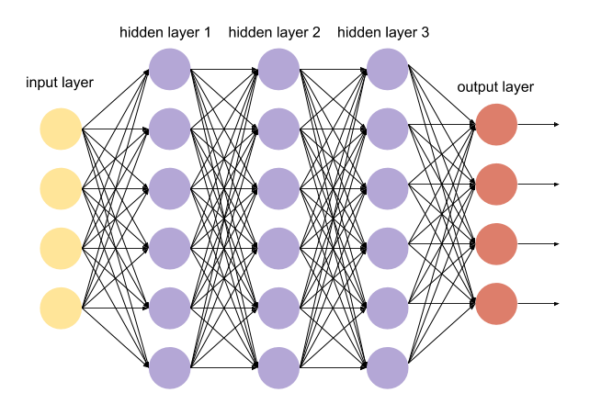
Design 1: Dense Network
Input Embedding layer
Multiple densely connected layers
50 nodes – 5000 nodes
Dense output layer
Each output neuron is protein label

Slide 6

Design 2: Convolutional Network
Input Embedding layer
Multiple convolutional 1D layers
Filters: 256
Kernel size: 8
Pooling layer
Pooling size: 2
Dense output layer
Each output neuron is protein label

Slide 7
Results
Convolutional 1D network worked the best
Dense network had higher learning capacity
Slower learning rate
With MS2 test data, %30 accuracy for predicted protein label

Slide 8
Future Research
Train with larger data sets
2.7 million peptides were generated from the yeast database
Increase convolutional layers
Add noise to training data
Train for more epochs

Slide 9
Mass Spectrum Protein Matching with Neural Networks
Matt Peter
Jonah Kubath

