Slide 1
Mass Spectrum Protein Matching with Neural Networks
Matt Peter
Jonah Kubath

Slide 2

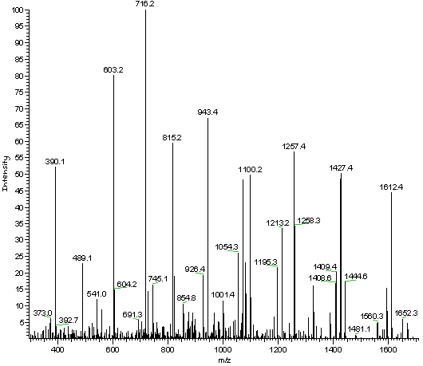
Proteomics
Mass Spectrometry
Proteins are broken into Peptide Sequences
Peptide are broken down into ions
Ions are then fragmented, separated, and detected

