Slide 1
Mass Spectrum Protein Matching with Neural Networks
Matt Peter
Jonah Kubath

Slide 2

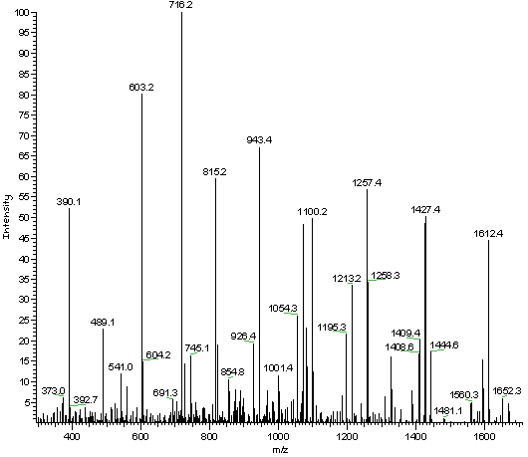
Proteomics
Mass Spectrometry
Proteins are broken into Peptide Sequences
Peptide are broken down into ions
Ions are then fragmented, separated, and detected

Slide 3
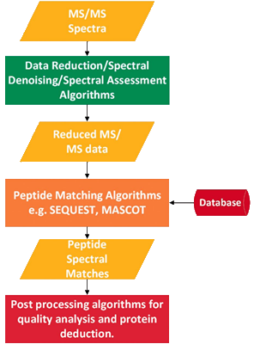
MS-REDUCE
Used to reduce noise in MS2 data
Consists of a three-stage pipeline
Spectral Classification
Peak Quantization
Weighted Random Sampling

Slide 4
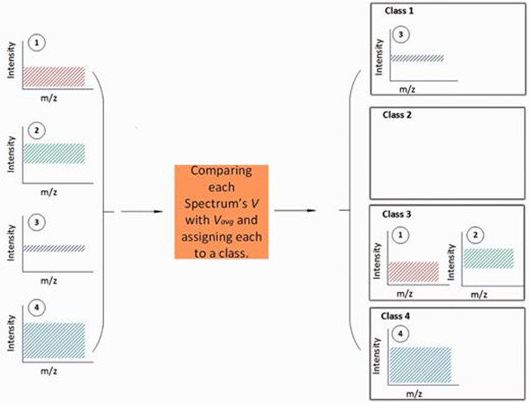
Spectral Classification
Spectra placed into one of four classes based on intensity spread
Boundaries of classes based on average intensity spread

Slide 5
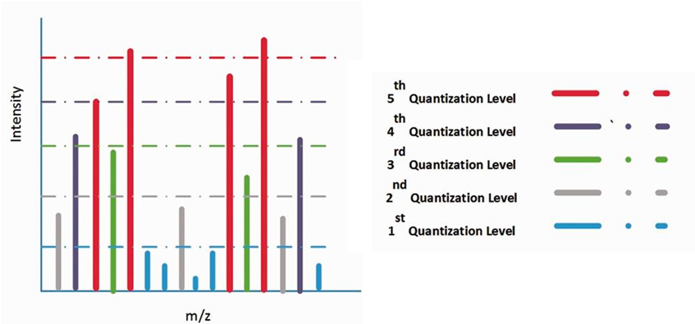
Peak Quantization
Peaks placed into one of n levels
Boundaries of levels based on average intensity of highest ten peaks

Slide 6
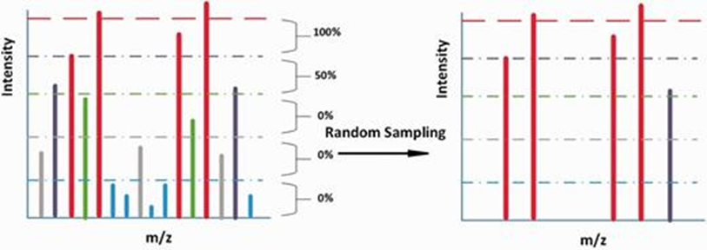
Weight Random Sampling
Percentage of peaks selected from spectrum
Peaks selected from highest quantization level first
Result is a partially randomized sample of original spectra

Slide 7
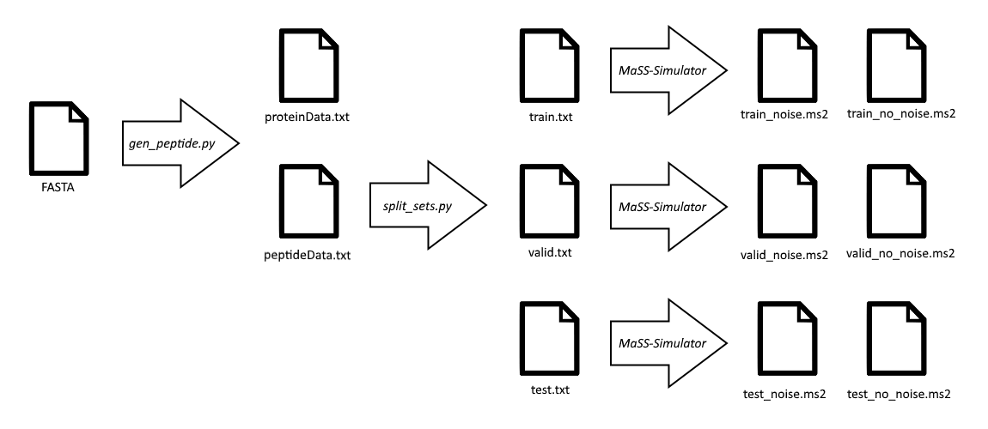
Generating MS2 Data

Slide 8
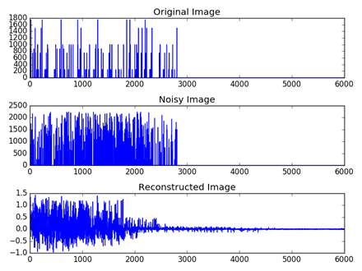
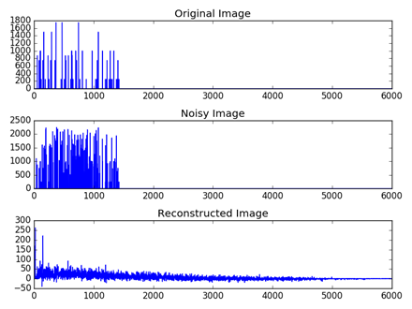
Testing the Neural Network
Performed 32 tests with varying levels of input data, epochs, and layers

Slide 9

Future Research
Performing larger tests
Trying other neural network layouts
Scaled data representation (peaks range from 0 to 1)

Slide 10
Mass Spectrum Protein Matching with Neural Networks
Matt Peter
Jonah Kubath

