Slide 1
IoT Device Audio Streaming to AWS Hosted Server with Elastic Load Balancer
By: Jonah Kubath
CS6030 Big Data, IoT, and Cloud Computing
Western Michigan University

Slide 2
Preparing the IoT Device for Streaming
Device: Raspberry Pi 3+
Supports Bluetooth connectivity
Create a script to periodically scan for Bluetooth connections
Create a link from the Pi to the device (phone)
Encode and stream the audio over RTMP
Real-Time Messaging Protocol

Slide 3



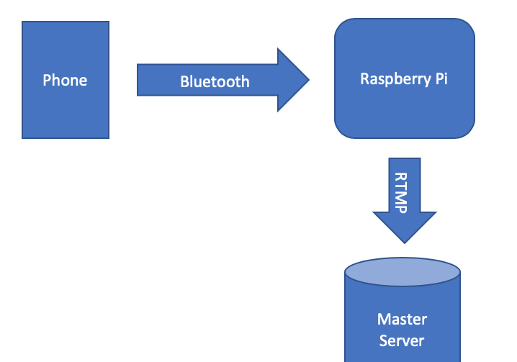
Prepare the “Master” server
Purpose: Receive the audio stream over RTMP
Make the stream public to “Listener” servers

Slide 4
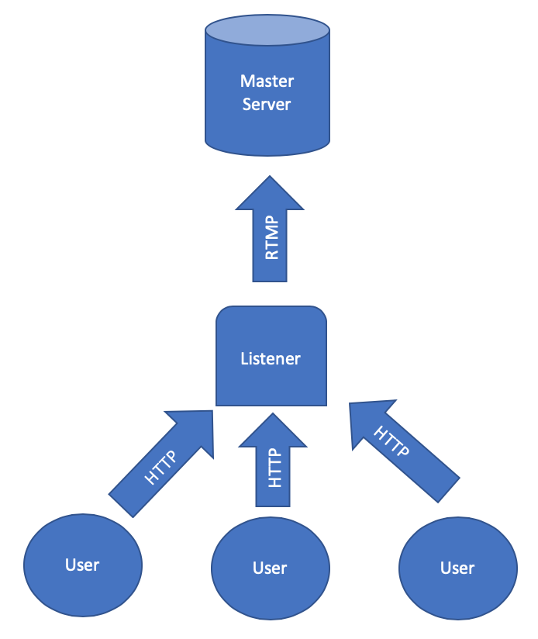
Prepare the “Listener” servers
Purpose: Connect to the “Master” server
Pull the RTMP stream
Make the stream available to clients
Transfer over HTTP

Slide 5
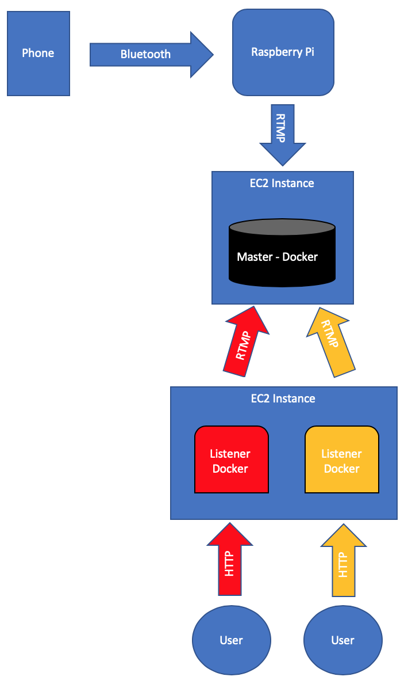
Docker Containers
Purpose: Docker containers are comparable to virtual machines
Contain all the needed software in their own environment
Don’t require their own operating system
More efficient utilization of hardware components

Slide 6
Dockerfile
Install dependencies
Curl, GCC, MAKE, …
Download NGINX to handle streaming
Download NGINX-RTMP module
Compile NGINX and RTMP module
Download and compile FFMPEG
Allows “Listener” servers to pull RTMP stream
Copy over NGINX.config file
Expose needed ports – 1935, 80
Run NGINX on startup

Slide 7
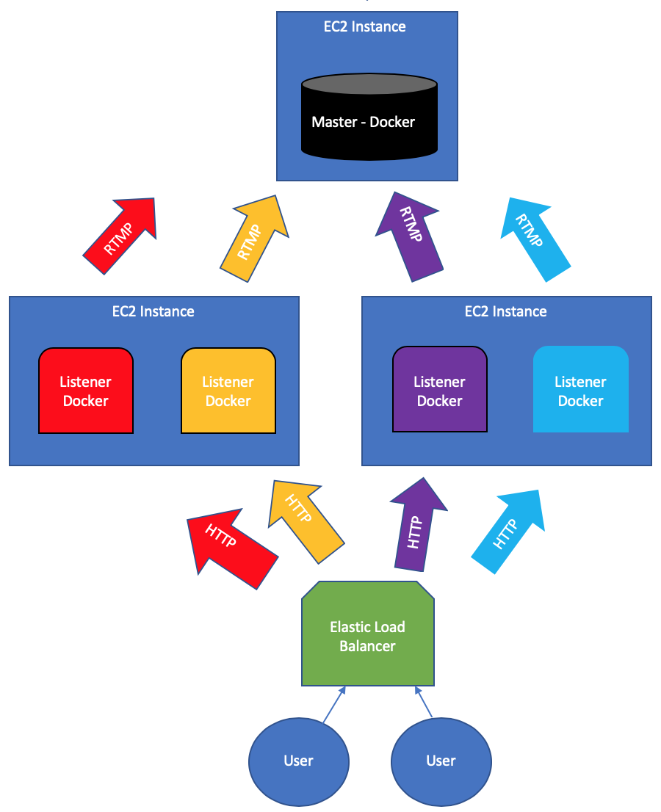
Elastic Load Balancer
Purpose: Distribute load over multiple “Listener” servers

Slide 8
Auto Balance
Purpose: Dynamically scale resources based on demand
Auto Balancer will monitor the ”Listener” target group
When CPU utilization reaches a threshold
Create more “Listeners”
Saves money from having idle hardware / servers
Load Balancer will spread load over current target group

Slide 9
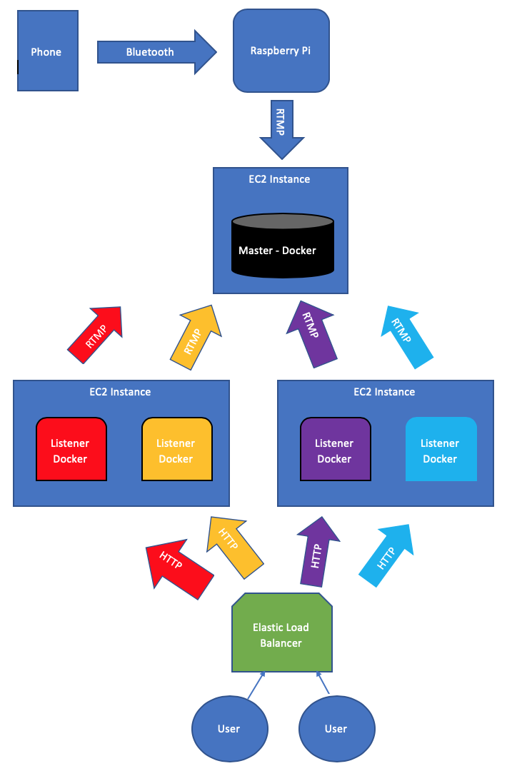
Workflow
Stream connection
iPhone to Raspberry Pi
Raspberry Pi to “Master” server
“Listener” servers to “Master”
Auto Balancer monitors “Listeners”
Client Connections
Client connects to Load Balancer
Load Balancer selects a “Listener”

Slide 10
References
Pi
https://www.raspberrypi.org/documentation/configuration/wireless/wireless-cli.md
https://www.raspberrypi.org/forums/viewtopic.php?t=156120
https://www.raspberrypi.org/forums/viewtopic.php?t=68779
https://www.raspberrypi.org/forums/viewtopic.php?p=635509#p635509
Stream
https://opensource.com/article/19/1/basic-live-video-streaming-server
https://www.iamjack.co.uk/blog/post/setting-multistream-server-nginx
Create Docker containers
https://github.com/alfg/docker-nginx-rtmp
https://docs.nginx.com/nginx/admin-guide/installing-nginx/installing-nginx-docker/
https://hub.docker.com/_/nginx

Slide 11
IoT Device Audio Streaming to AWS Hosted Server with Elastic Load Balancer
By: Jonah Kubath
CS6030 Big Data, IoT, and Cloud Computing
Western Michigan University

