Slide 1

Diagnosis of Brain Tumour Using YOLO
SRKR ENGINEERING COLLEGE (A)

Slide 2
Diagnosis of Brain Tumour Using YOLO
Project Guide:
Sri BNV.Narasimha Raju
Assistant Professor
SRKR Engineering College
Team Members:
19B91A0586 -K.Jaswanth Kumar
19B91A05C4 -K.S.N Vinay Varma
19B91A05C6 -K.Tarun Kumar
19B91A05C7 -K.B.Sai Rohith

Slide 3
CONTENTS
Abstract
Introduction
Literature Survey
Problem Statement
Existing Solution
Proposed Solution
Methodology
System Design
Implementation
Result Analysis
Conclusion
References

Slide 4
ABSTRACT
Brain cancer is a rare and deadly disease with a slim chance of survival.
One of the most important tasks for neurologists and radiologists is to detect brain tumors early.
Early detection of brain tumors is critical in a patient's treatment and makes it possible to save his or her life.
Manually detecting brain tumors from brain magnetic resonance imaging (MRI) scans can be difficult and inaccurate.

Slide 5
Due to this, an automatic brain tumor detection and segmentation system built with some of the world's most popular deep learning-based object detection algorithms.
Usage of transfer learning approaches for a deep learning model to detect malignant tumors such as glioblastoma using MRI scans.
A deep learning-based approach for brain tumor identification and classification, utilizing the cutting-edge object detection framework YOLO (You Only Look Once).

Slide 6
INTRODUCTION
Brain tumors are one of the leading causes of death and disability worldwide because they invade the most vital organ of the human body.
Brain cancer is currently the tenth leading cause of death from tumors in both men and women .
Brain tumors can be fatal, affecting patients' and their loved ones' quality of life and changing everything as shown in figure 1.
A cutting-edge object detection framework YOLO to identify and classify brain tumors using a deep learning-based approach.

Slide 7
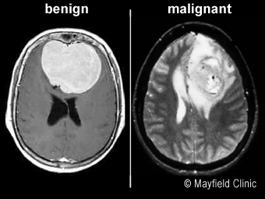
A deep learning-based approach for brain tumor identification and classification, utilizing the cutting-edge object detection framework YOLOv4 (You Only Look Once).
Fig 1. Types of Brain Tumour

Slide 8
LITERATURE SURVEY
S.No | Author | Paper Name | Key Findings | Year of Publication
1 | Amran Hossain,et.al | A YOLOv3 Deep Neural Network Model to Detect Brain Tumor in Portable Electromagnetic Imaging System | The researchers collected fifty sample images from various head regions and augmented them to create a dataset. The dataset included fifty samples with either single or double tumours. The researchers used 80% of the images for training, 10% for validation, and the remaining 10% for testing the network's performance. | 2021
2 | Sethuram Rao.Grishi , et.al | Brain Tumor Detection Approaches: A Review using Artificial Neural Network (ANN) and Support Vector Machine (SVM). | Tumor can be detected using medical imaging techniques like Magnetic Resonance Imaging (MRI) .Hence for accurate analysis of Brain tumor, so this paper proposes the use of Segmentation which is Brain Tumor Detection . | 2018
3 | Sunil Kumar, et.al | Brain Tumor Detection Analysis Using CNN: A Review using CNN classification technique and has been used to disregard the dataset picture algorithm error | The implementation of the Image Restoration and Image Enhancement is applied in the Python and TensorFlow environment and Algorithms and methodologies used to solve specific research problems. | 2021
4 | Mohammad Omid Khairandish Vydeki.D , et.al | The Performance of Brain Tumor Diagnosis Based on Machine Learning Techniques. | the methodology of this study was to answer the real performance of brain tumors, and with help of different approaches and study of research studies with varied criteria. | 2020

Slide 9
S.No | Author | Paper Name | Key Findings | Year of Publication
5 | Parveen, et.al | Detection of brain tumor in MRI images, using combination of fuzzy c-means and SVM. | A new hybrid technique based on the support vector machine (SVM) and fuzzy c-means for brain tumor classification the image is enhanced using enhancement techniques such as contrast improvement, and mid-range stretch | 2015
6 | Mohammad Shahjahan Majib , et.al | VGG-SCNet: A VGG Net-Based Deep Learning Framework for Brain Tumor Detection on MRI Images | The proposed VGG-SCNet’s (VGG Stacked Classifier Network) precision, recall, and f1 scores were found to be 99.2%, 99.1%, and 99.2% respectively . | 2021
7 | M.O. Khairandish , et.al | A Hybrid CNN-SVM Threshold Segmentation Approach for Tumor Detection and Classification of MRI Brain Images. | The proposed hybrid model, with consideration of both CNN and SVM model advantages which is alternate approach of other [1-5], shows significant improvement. | 2022
8 | Simon Podnar, et.al | Diagnosing brain tumors by routine blood tests using machine learning | Using routine blood tests from 15,176 neurological patients we built a machine learning predictive model for the diagnosis of brain tumors. The sensitivity and specificity of the adapted tumor model in the validation group were 96% and 74%, respectively. | 2019

Slide 10
PROBLEM STATEMENT
Health care sector is totally different from other industry. It is on high priority sector and people demand the best care and service regardless of cost.
Deep learning is now giving innovative solutions with high accuracy for medical imaging and is a significant technique for upcoming applications in the health sector as a result of its success in other real-world applications..
Because of its complex position and size variations, detecting an automated brain tumor in an MRI is difficult.

Slide 11
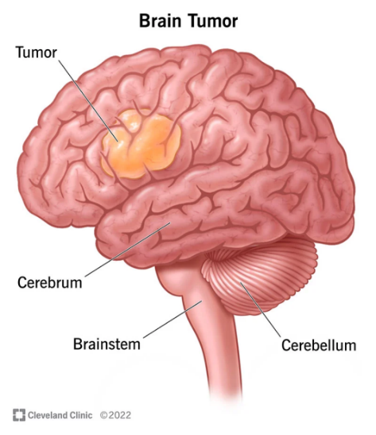
Brain tumors are identified using YOLO (You Only Look Once), a cutting-edge object recognition framework, and are classified using CNN.
Fig 2. Brain Tumour

Slide 12
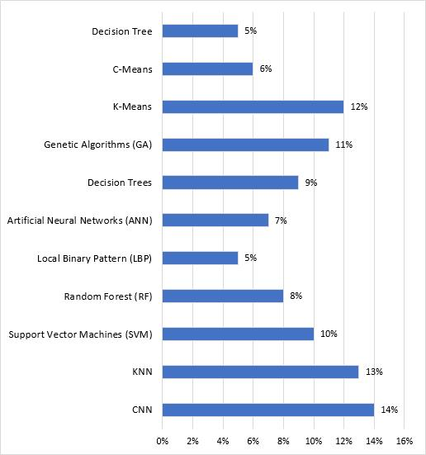
EXISITING SOLUTION
In recent years, machine learning (ML) algorithms have been developed to help detect and diagnose brain tumors. These methods use data from imaging studies, such as CT scans and MRI, to create models that can identify the presence and characteristics of brain tumors
One example of an ML method for brain tumor detection is using a convolutional neural network (CNN) to analyze images of the brain and classify them as either normal or containing a tumor.
Fig 3. Method wise trends since
2012–2019

Slide 13
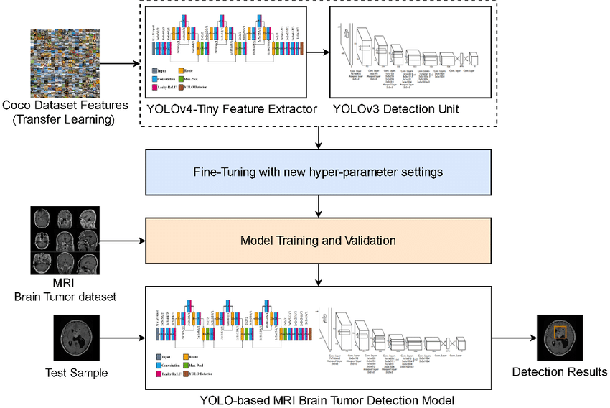
PROPOSED SOLUTION
A combination of the YOLOv4 (You Only Look Once version 4) object detection algorithm and a Convolutional Neural Network (CNN) for classification. YOLOv4 is a state-of-the-art object detection algorithm that can detect objects in images and video in real-time. It works by dividing an image into a grid and predicting the presence and class of objects in each grid cell.
Fig 4. YOLO V4 Model

Slide 14
METHODOLOGY
Data Acquisition
Data Pre-processing
Training Model using YOLO Model
Classifying using CNN Model

Slide 15
DATA ACQUISITION
There is an manual dataset which consists of Images of different MRI taken from different datasets, and of different sizes.
The data in this dataset is less efficient for performing the detection and classification of brain tumours.
It requires multiple pre-processing steps to get all images to a efficient format for training a model.

Slide 16
Training Model using YOLO Model
Pre-process the MRI image
Object detection
Non-maximal suppression
Postprocess the output
Classify the detected objects

Slide 17
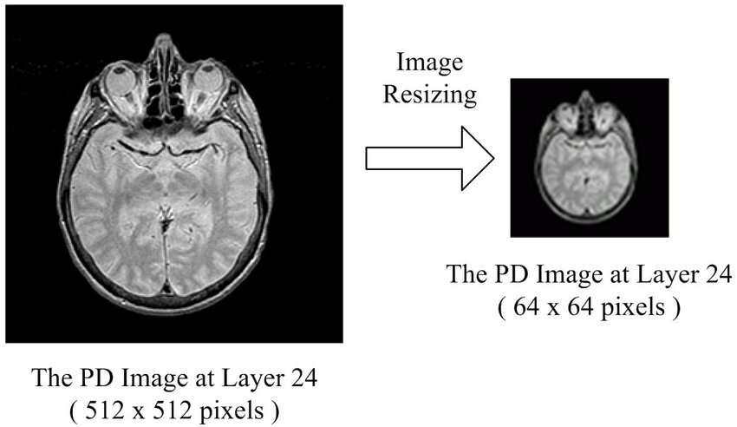
Pre-process the MRI image
Fig 5. Image Resizing

Slide 18
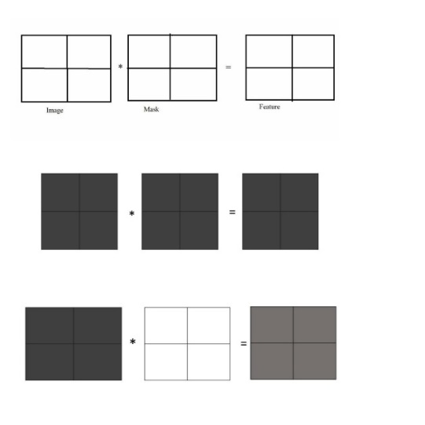
Object detection
The formula for the softmax function is as follows:
softmax(x) = exp(x) / sum(exp(x))
Non-maximal suppression
Non-maximal suppression is also called Masking
Masking acts as a filter and also as instance segmentation (real-time segmentation).
Fig.6. MASKING

Slide 19
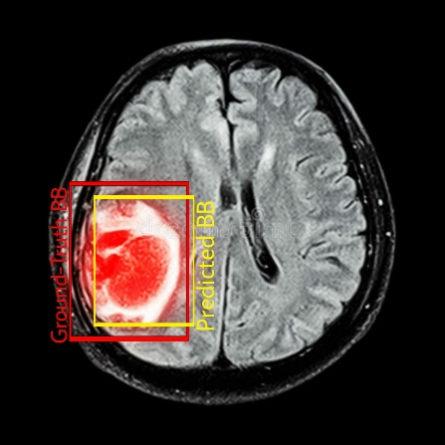
Postprocess the output
The IoU of these two boxes is calculated as follows:
IoU = (overlap area) / (union area)
Classifying using CNN Model
Fig.7. Intersection Over Union
A CNN is a type of neural network specifically designed for image classification tasks. It can learn features from images and use them to classify the images into different categories.

Slide 20
Benign and Malignant Tumor Images as Brain Abnormalities
Tumor Object Labelling as YOLO Format
YoloV4 algorithms Models
Collected MRI Image Samples
Image pre-processing
Classification
Malignant Tumor
Benign
Tumor
Fig 8.SYSTEM ARCHITECTURE

Slide 21
YOLO algorithm works using the following three techniques:
Residual blocks
Bounding box regression
Intersection Over Union (IOU)

Slide 22
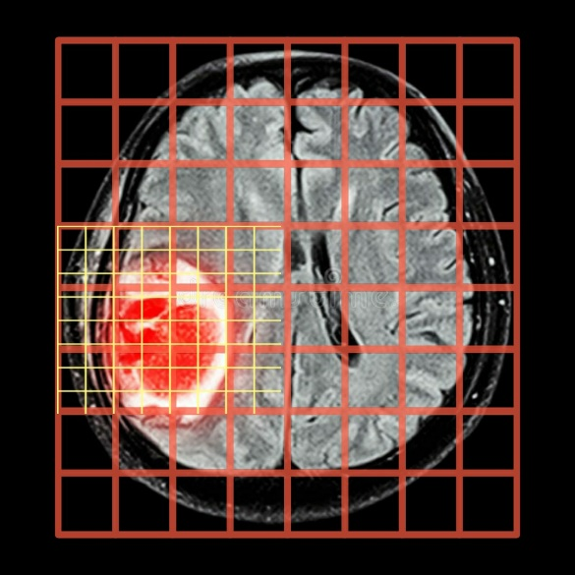
Residual blocks:
First, the image is divided into various grids. Each grid has a dimension of S x S.
Fig 9. Residual Blocks

Slide 23
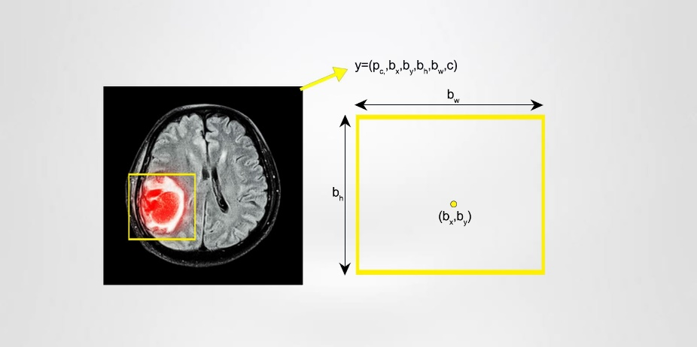
Bounding box regression:
A bounding box is an outline that highlights an object in an image.
Every bounding box in the image consists of the following attributes:
Width (bw)
Height (bh)
Class
Bounding box center (bx,by)
Fig 12.Bounding Box regression

Slide 24

Intersection over union (IOU):
Intersection over union (IOU) is a phenomenon in object detection that describes how boxes overlap as shown in figure 8. YOLO uses IOU to provide an output box that surrounds the objects perfectly. Each grid cell is responsible for predicting the bounding boxes and their confidence scores.
Fig 13. Intersection over union

Slide 25
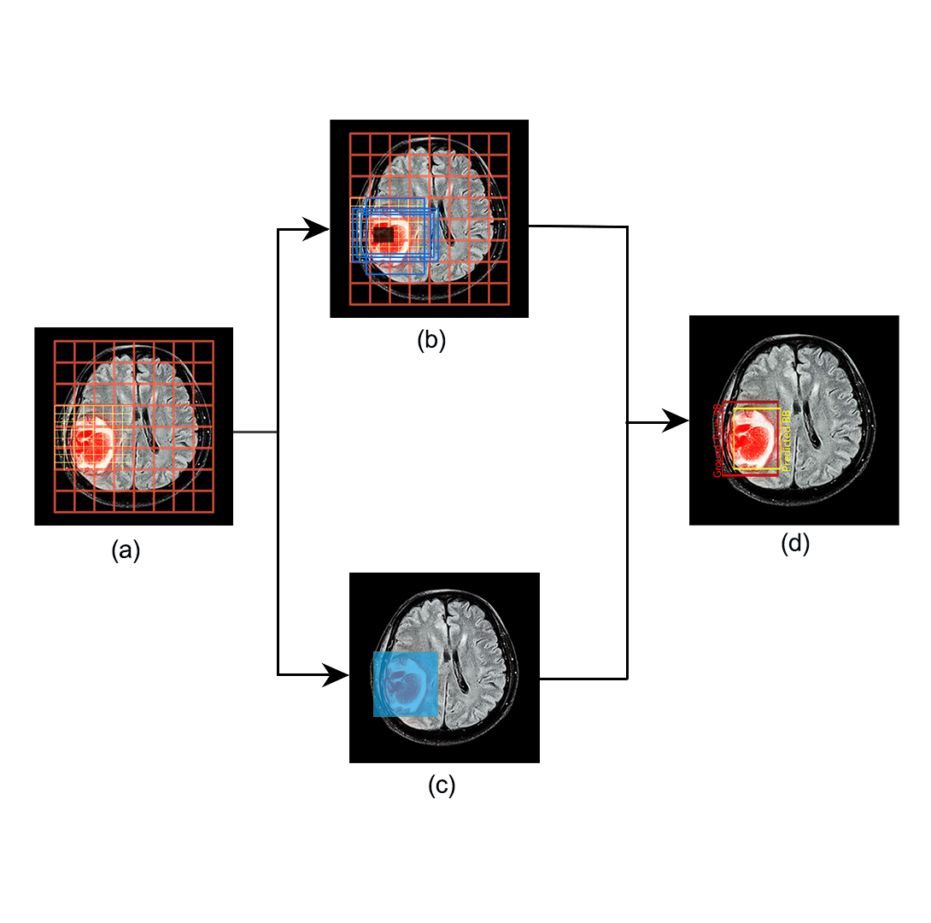
Combination of Three Techniques
Fig 14. Combination of three techniques

Slide 26
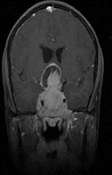
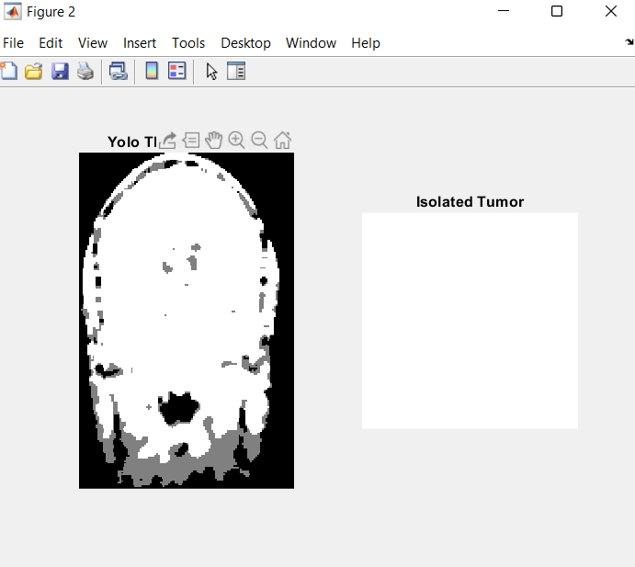
IMPLEMENTATION
DATA COLLECTION:
THRESHOLDING:

Slide 27
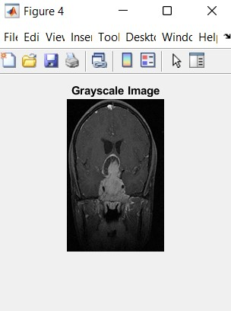
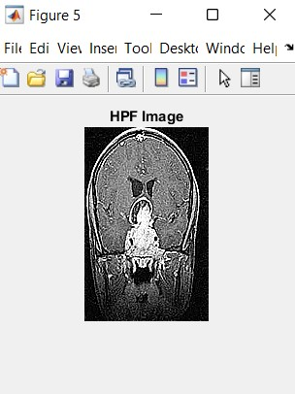
GREY SCALE CONVERSION:
HIGH PASS FILTER:

Slide 28
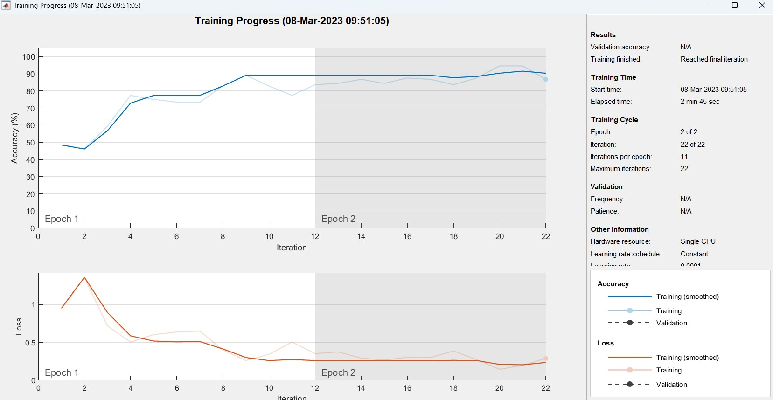
TRAINING PROGRESS:

Slide 29
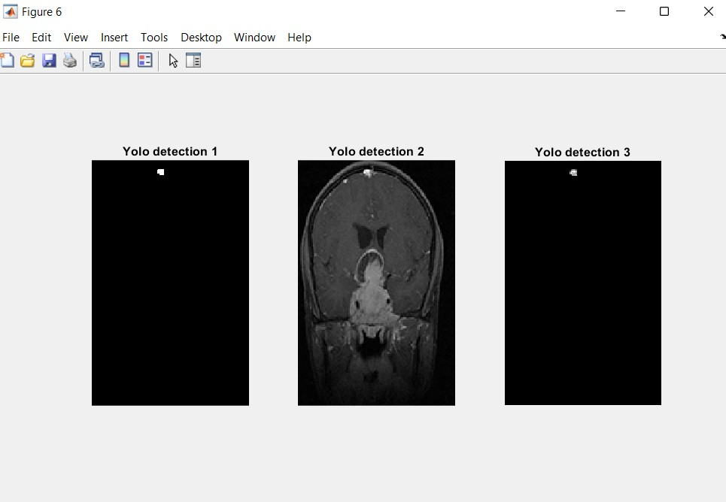
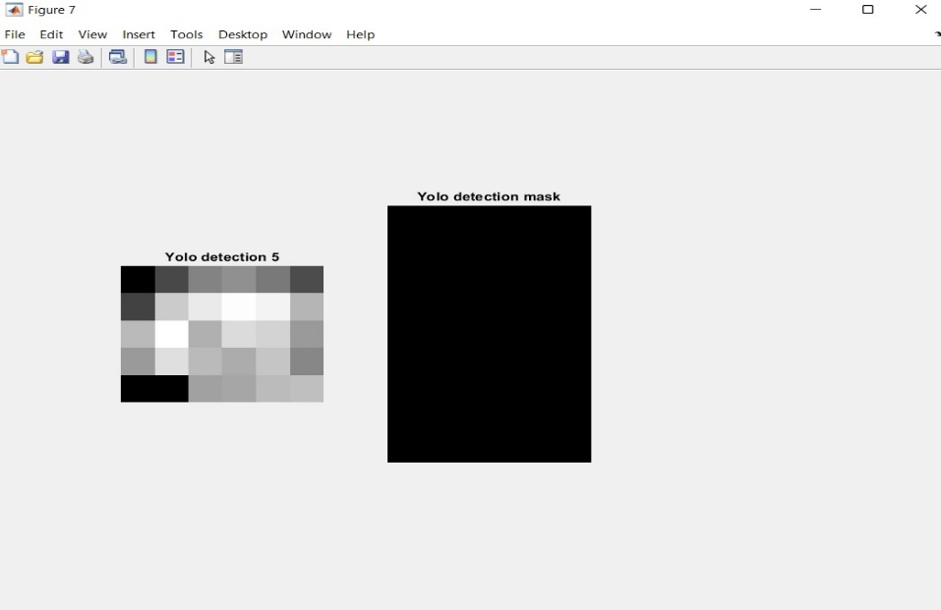
YOLO DETECTION:
MASKING:

Slide 30
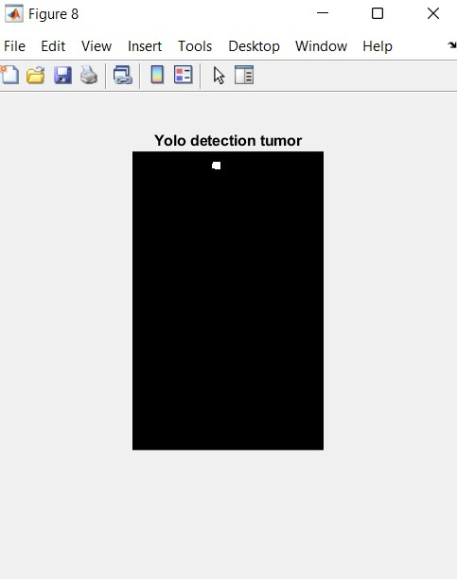
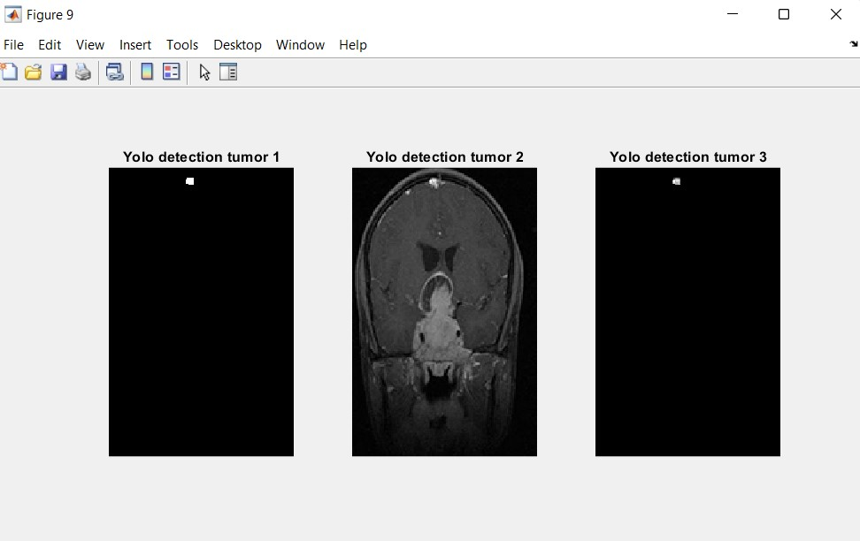
YOLO DETECTED TUMOUR AFTER MASKING:
YOLO DETECTORS AFTER MASKING:

Slide 31
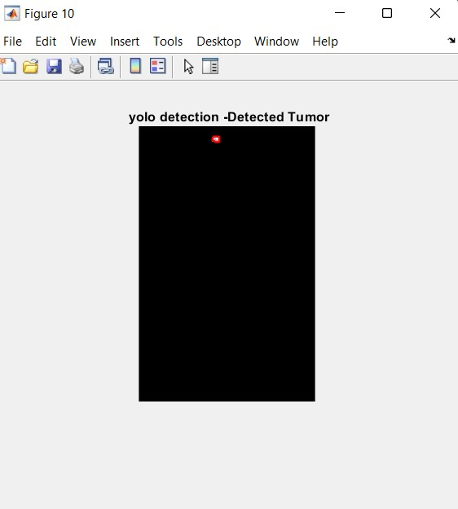
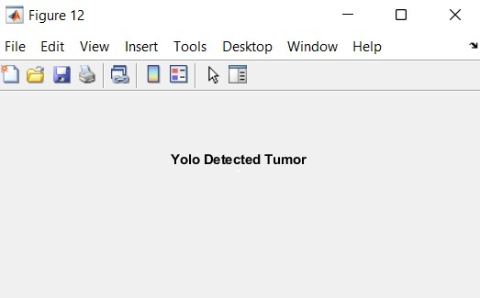
DETECTED TUMOUR WITH BOUNDARY:
TUMOUR DETECTED USING YOLO:

Slide 32
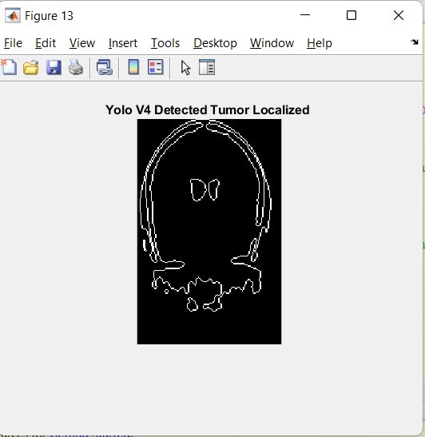
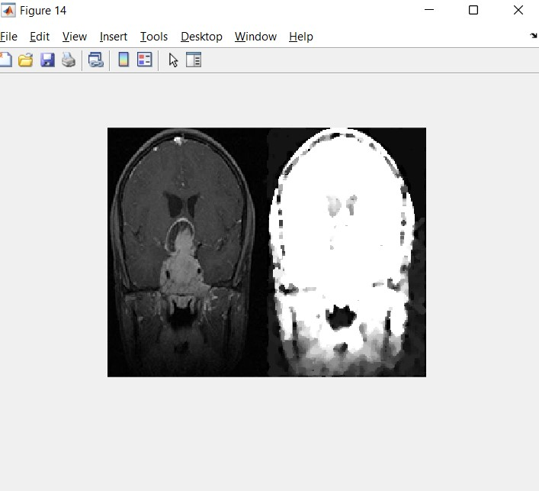
LOCALIZATION:
CNN CLASSIFICATION:

Slide 33
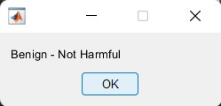
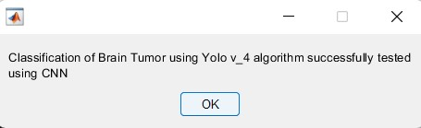
BENIGN TUMOUR:
CLASSIFIED USING CNN AND DETECED USING YOLO:

Slide 34
RESULT ANALYSIS
Training Progress of YOLO+CNN:

Slide 35
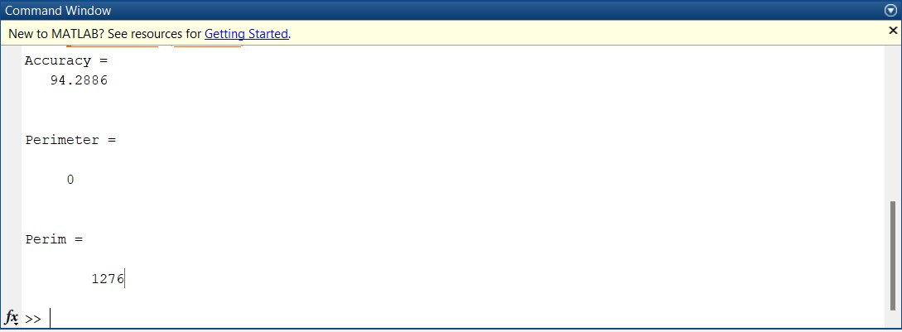
Accuracy for YOLO-CNN:

Slide 36
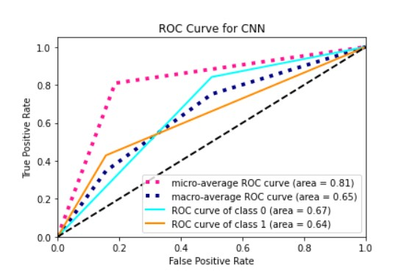
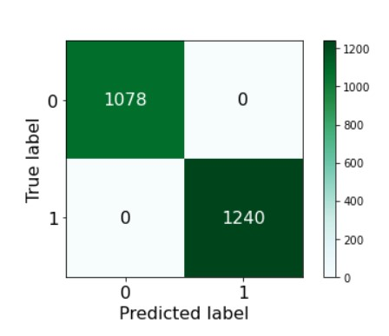
ROC Curve for Random Forest:
Confusion Matrix for Random Forest:

Slide 37
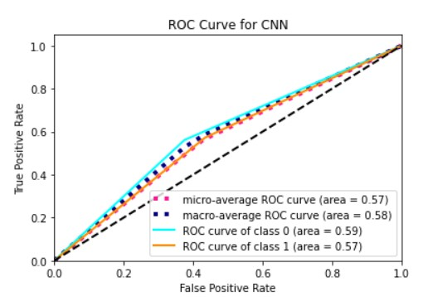
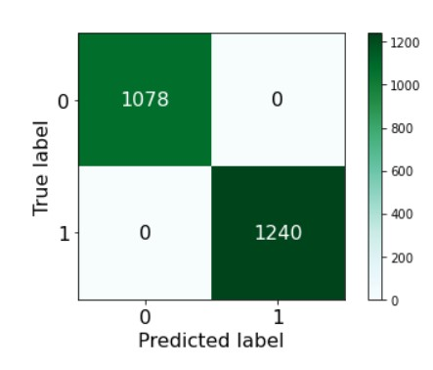
ROC Curve for KNN:
Confusion Matrix for KNN:

Slide 38
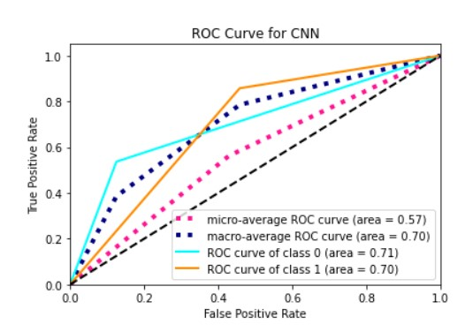
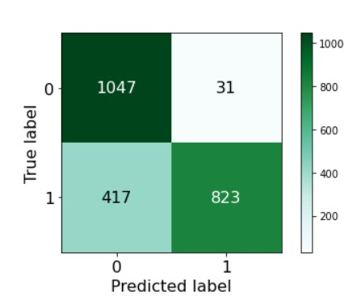
ROC Curve for ANN:
Confusion Matrix for ANN:

Slide 39
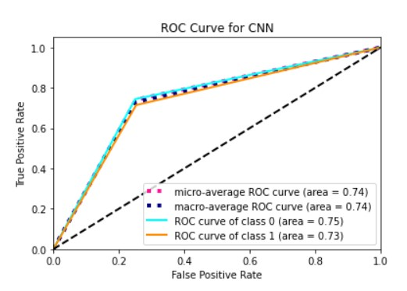
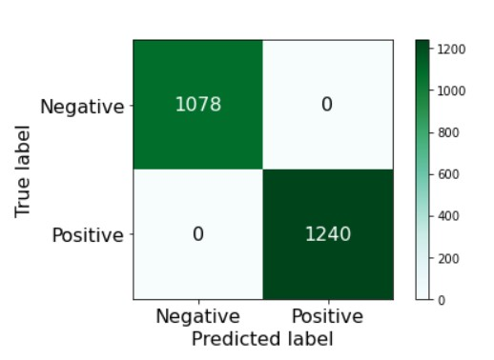
ROC Curve for Decision Tree:
Confusion Matrix for Decision Tree:

Slide 40
S.No | Model | Accuracy
1 | YOLO-CNN | 94-96
2 | Random Forest | 86
3 | Decision Tree | 75
4 | KNN | 73
5 | ANN | 72

Slide 41
CONCLUSION
In conclusion, the use of YOLO and CNN in brain tumour detection and classification has shown promising results. YOLO can accurately locate the tumour within a medical image, while CNN can classify the tumour into different categories based on its characteristics.

Slide 42
REFERENCES
Amran Hossain, Mohammad Tariqul Islam, Mohammad Shahidul Islam, Muhammed E. H. Chowdhury, ALI F. Almutairi, Norbahiah Misran,” A YOLOv3 Deep Neural Network Model to Detect Brain Tumor in Portable Electromagnetic Imaging System”. Published in 2021 Digital Object Identifier 10.1109/ACCESS.2021.3086624
Sethuram Rao.Grish, Vydeki.D,” Brain Tumour Detection Approaches: A Review using Artificial Neural Network (ANN) and Support Vector Machine (SVM)”.Published in 2018 International Conference on Smart Systems and Inventive Technology (ICSSIT).
Sunil Kumar, Renu Dhir, Nisha Chaurasia ,” Brain Tumor Detection Analysis Using CNN: A Review using CNN classification technique and has been used to disregard the dataset picture algorithm error”.
Mohammad Omid Khairandish, Meenakshi Sharma, Kusrini Kusrini,” The Performance of Brain Tumor Diagnosis Based on Machine Learning Techniques”.

Slide 43
Parveen, Amritpal Singh,” Detection of brain tumor in MRI images, using combination of fuzzy c-means and SVM”.
Mohammad Shahjahan Majib, Md Mahbubur Rahman, T. M. Shahriar Sazzad, Nafiz Imtiaz Khan, Samrat Kumar Dey “VGG-SCNet: A VGG Net-Based Deep Learning Framework for Brain Tumor Detection on MRI Images”.
M.O. Khairandish, M. Sharma, V. Jain , J.M. Chatterjee, N.Z. Jhanjhi,” A Hybrid CNN-SVM Threshold Segmentation Approach for Tumor Detection and Classification of MRI Brain Images”.
Simon Podnar, Matjaž Kukar, Gregor Gunčar, Mateja Notar, Nina Gošnjak, Marko Notar,

Slide 44


