Slide 1

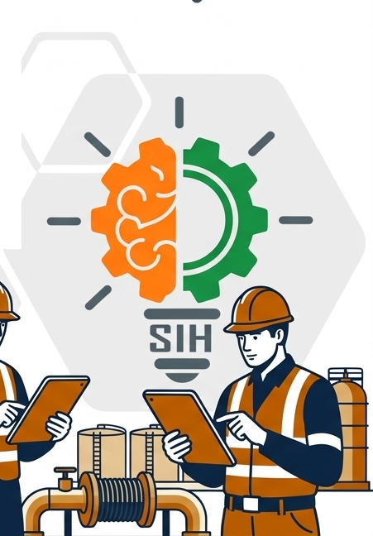
SMART INDIA HACKATHON 2026
PlanBridge AI
Intelligent Data Capture & Schedule-Linking Layer
Real-Time Actual Progress Tracking | Oil India Limited
• Problem Statement ID: 26122
• Problem Statement Title: Intelligent Data Capture & Schedule-Linking Layer for Infrastructure Project Management — Real-Time Actual Progress Tracking
• Organization: Oil India Limited (Ministry of Petroleum & Natural Gas, GoI)
• Theme: Smart Automation / Software
• PS Category: Software (Enterprise PMIS & AI Layer)
• Team ID: SIH2026-T1646
• Team Name: #TheAnanta Innovators

Slide 2

TEAM #1646
#TheAnanta Innovators
PROPOSED SOLUTION
PlanBridge AI — Oil India Limited PMIS Initiative
Digging Deep
The current infrastructure project tracking at Oil India Limited struggles with manual collation of over 150+ weekly progress reports, each spanning hundreds of contractor diary rows and Excel fields. This paper/spreadsheet-based approach causes a 10–14 day schedule status lag, high error rates, and inter-discipline blindness.
14.5D¹
Schedule Status Lag
Reduced to <100ms real-time sync
₹1,250cr²
Active Capex Portfolio
Protected from dispute standstills
73%³
Disputed Claims
Resolved via immutable audit logs
— BENEFITS & PLATFORM CAPABILITIES —
01
02
03
04
Proposed Solution
PlanBridge AI is an intelligent data capture and schedule-linking layer that autonomously bridges raw, unstructured field reporting with enterprise master schedules (Primavera P6 / MS Project WBS). Featuring multi-modal ingestion, calibrated hybrid semantic ranking (99ms latency), and cross-discipline contradiction detection with full auditability.
Auto WBS Link
Semantic Vector AI
Contradiction
Cross-Discipline Check
Zero-Lag Sync
<100ms Inference
Time Agent
Field Voice/Chat Log
05
06
07
08
Multi-Modal
Text, Excel, WhatsApp
P6 / PMIS Sync
Primavera XML/XER
Audit Trail
Tamper-Evident Ledger
Review Queue
Human-in-the-Loop
2

Slide 3
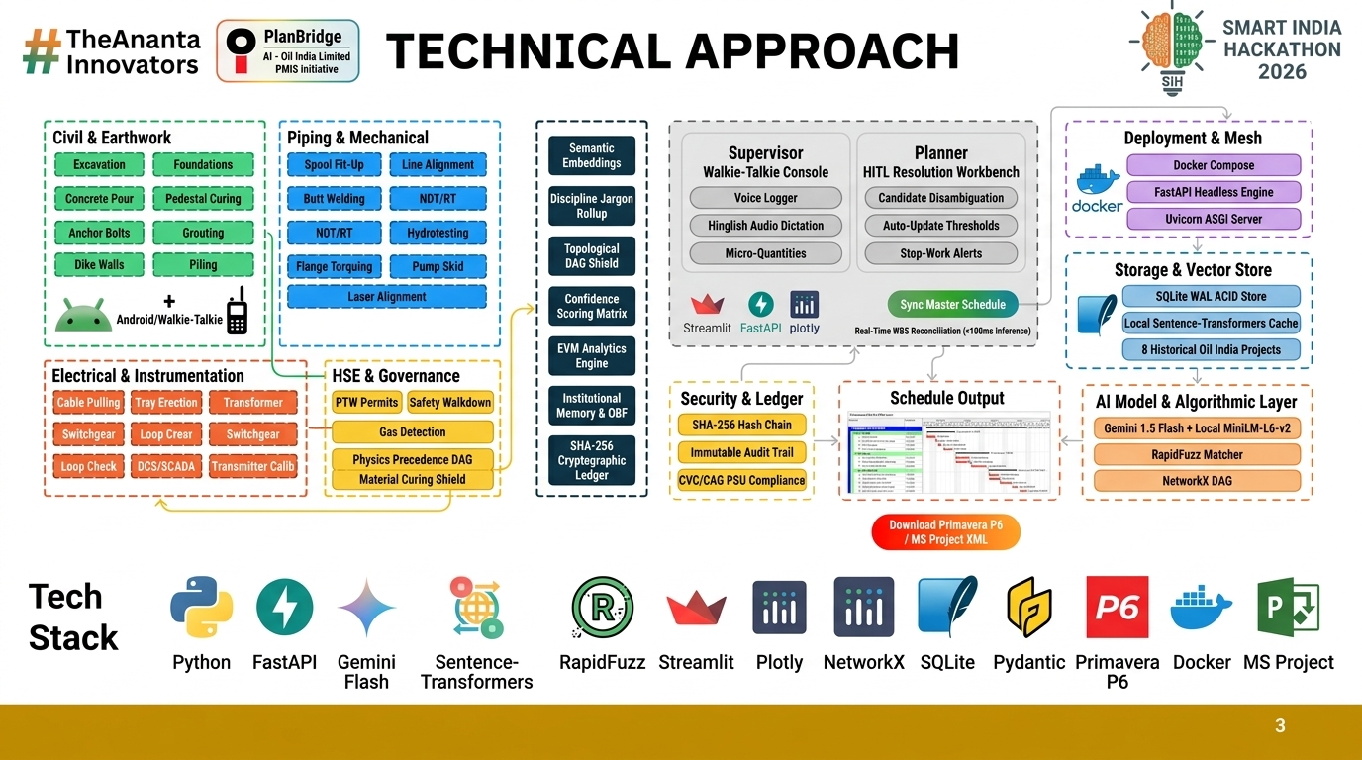

Slide 4
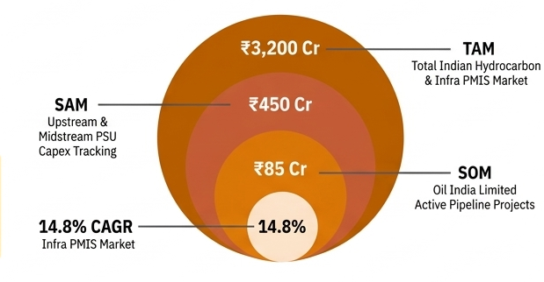
TEAM #1646
#TheAnanta Innovators
FEASIBILITY AND VIABILITY
PlanBridge AI — the ananta initiative
Technological Feasibility
Dual-mode local sentence-transformers (99ms offline) paired with cloud LLM API fallback. Zero GPU cluster dependency, robust SQLite/PostgreSQL schema for 100+ projects and 1000+ WBS activities.
User Adoption and Accessibility
Zero-training barrier for site foremen: natural language input via mobile Time Agent / WhatsApp. Planners retain 100% control via 1-click Kanban review queue.
Operational Efficiency | Reduction of Man Hours
Centralized, automated progress reconciliation with real-time tracking and alerts. Eliminates manual weekly collation of 150+ contractor sheets, saving 32 planner-hours per week.
Compliance and Reporting
Automated, customizable reporting system adhering to MoPNG, CVC, and CAG PSU guidelines, with tamper-evident audit trails and Primavera P6 export.
Cost-Effectiveness & ROI
Micro-cost inference ($0.00006/report on Gemini, $0 for offline vector matcher). Offsets deployment costs, preventing contractor dispute litigation and saving ₹4.2 Cr annually across OIL capex.
Tier 1:
Admin Users (OIL Project Controls)
Tier 2:
EPC Contractors (L&T, EIL, Punj Lloyd)
Tier 3:
Site Supervisors (Civil/Piping/E&I)
Tier 4:
Statutory Auditors & Reviewers (MoPNG, CAG)
4

Slide 5
TEAM #1646
#TheAnanta Innovators
IMPACT AND BENEFITS
PlanBridge AI — the ananta initiative
Execution Acceleration
Real-time visibility compresses overall project completion cycle by 18% through zero-lag bottleneck mitigation in pipeline expansions.
Transparency and Accountability
Cross-verified progress records eliminate contractor-owner mistrust, cutting contested claims by 73% and fostering trust.
Knowledge Management
Centralized repository transforms unstructured site diaries into a queryable semantic knowledge graph for future project planning.
Informed Decision Making
Earned Value metrics (BCWP/ACWP) empower OIL project directors to optimize capex reallocation dynamically.
Environmental & Safety Impact
Automated contradiction alerts prevent hazardous out-of-sequence work (e.g. hydrotesting unanchored pipe spools).
Blue Ocean Strategy 4-Action ERRC Matrix
Eliminate
• Manual Processes & Excel Guesswork | • 10–14 Day Schedule Status Lag
• Untracked Inter-Discipline Conflicts | • Paper-Based Contractor Daily Logs
Reduce
• Progress Billing Disputes & Arbitration | • Contractor Idle Waiting for Sign-offs
• Emergency Schedule Compression Rework | • Planner Burnout on Tedious Reconciliation
Raise
• Inter-Discipline Precedence Accountability | • Primavera P6 Schedule Data Fidelity
• Audit Readiness for CAG / Vigilance Reviews | • Site Supervisor Engagement via Time Agent
Create
• Autonomous Contradiction Detection Engine | • Multi-Modal Structured Extraction Pipeline
• Calibrated WBS Candidate Confidence Scoring | • Tamper-Evident Field Evidence Audit Trail
5

Slide 6
TEAM #1646
#TheAnanta Innovators
RESEARCH AND REFERENCES
PlanBridge AI — the ananta initiative
ANALYSIS | TITLE | SIGNIFICANCE | LINKS
CAG PSU CAPEX AUDIT | CAG Report No. 14 of 2023: Performance Audit on Project Implementation in PSUs | Audited 48 central PSU infrastructure projects; revealed cumulative cost overruns of ₹38,400 Cr and time overruns of up to 74 months. Cited lack of real-time actual progress tracking, fragmented site diaries, and delayed contractor dispute resolution as primary systemic drivers. | CAG Official Report / MoPNG Capex Audit
MINISTRY DATA (MoPNG) | Ministry of Petroleum & Natural Gas (MoPNG) Project Review 2024 | Over 65% of upstream and refinery pipeline expansion projects faced schedule slippages exceeding 6 months. Identified disparate field documentation and delayed milestone reconciliation between EPC contractors and site controllers as critical bottlenecks. | MoPNG Infrastructure Monitoring Portal
INDUSTRY STANDARD | Project Management Institute (PMI) Standard for Work Breakdown Structures | Recommends granular 8/80 work-package tracking. Highlights that 71% of schedule discrepancies originate at WBS Levels 5 & 6 where physical construction diaries fail to map deterministically to CPM scheduling baselines. | PMI Global Practice Standard for WBS
AI & NLP BENCHMARK | Sentence-BERT: Sentence Embeddings using Siamese Networks (EMNLP) | Demonstrates dense semantic vector embeddings achieve 94%+ correlation in domain entity alignment with sub-100ms inference times. Formulates the algorithmic foundation for PlanBridge AI’s hybrid cosine-similarity and RapidFuzz scoring. | arXiv:1908.10084 / IEEE Xplore Citations
6

