Slide 1

Smart Traffic
Praposal
By Naga Jyothi Kunaparaju

Slide 2
Novel Contribution
The goal of this project is to determine dynamic traffic relationship from one road point to another with vehicle traffic.
Based on the relationship we propose traffic clustering models
to divide road points into temporal clusters
We aim to show the traffic within the group is spatially correlated.

Slide 3
Novel Contribution Contd..
Creating analytics platform to study real time traffic data, that learned clusters are able to reveal the true patterns among road points and find out good traffic predictions.
Another goal of this project is to make user interaction easy by creating web application for citizens and domain experts.

Slide 4
Work by Competitors
Smart City solutions utilize IoT and Social Media data to deliver higher-quality citizen services efficiently.
CityPulse is one of such project. It processes large-scale data from Internet of Things and social networks.
This project is developed by a nine different organizations for Cities in Denmark.

Slide 5
Work by Competitors
Journey Planner
Social media analyzer
CityPulse Dashboard
Tourism Planner
Pickup Planner (Vehicle app and Client app )
Event Publisher
These are the tools and applications Citypulse project provides. We concentrate and extend the functionality of CityPulse dashboard application.

Slide 6
City pulse Dashboard
City Pulse dashboard is an application which visualizes traffic, parking and event information.
There are three different sections in the dashboard.
Left section is a placeholder for user selection. User can select various criteria, which will be used to query data from backend and display information in the map
Map with city traffic information appears in the middle.

Slide 7
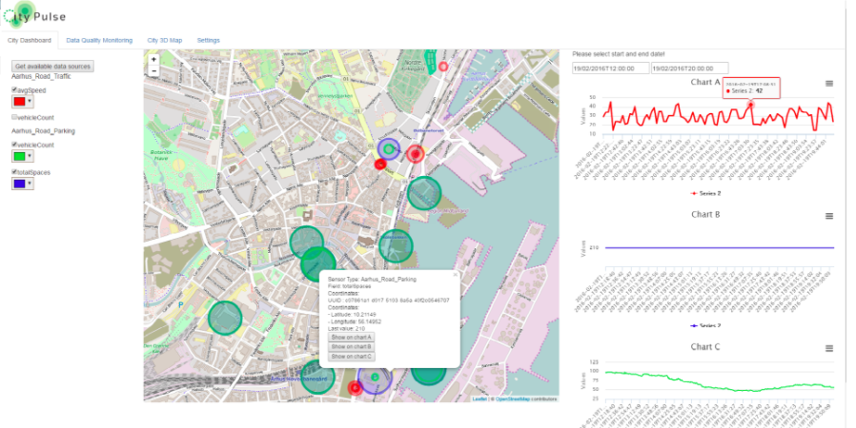
City Pulse DashBoard
https://github.com/CityPulse/CityPulse-City-Dashboard
Notes:
Now we are going to use Road data set created by city pulse project we focus on dashboard application.

Slide 8
City Pulse dashboard contd..
The rightmost section is for visual analytics from historical data.
When a user chooses Aarhus city, list of available data sources are populated. After selecting datasources he/she will be able to choose color of the marker to display in map.
After submitting the request, map will be populated with markers for each sensor. Size of the marker will be proportional to size of the data.

Slide 9
City Pulse dashboard contd..
When user hovers over the sensor, the tooltip will be displayed with more details about the sensor. For example, Geographic data like Latitude, Longitude, Street Name etc.
Rightmost part of the screen, there is a section where domain expert can view some visualizations of historic data.

Slide 10
Data
Road data consists of two different types of data files.
First type is metadata. There is a separate metadata file for each individual city.
Metadata file consists of streets geographical information of a city and Report_ID.

Slide 11
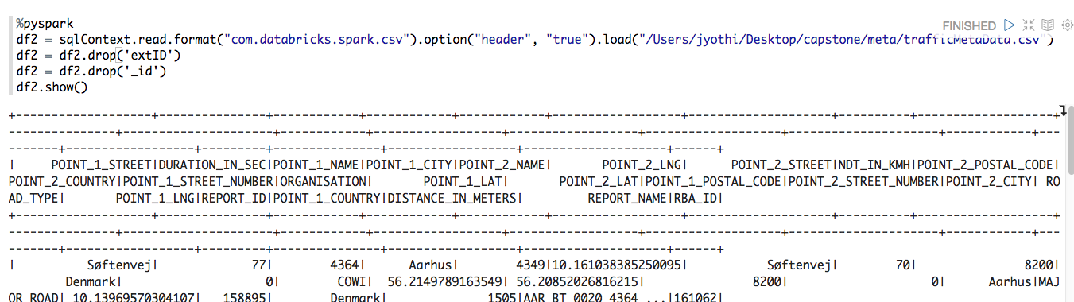
Metadata

Slide 12
Traffic Data
Other type of data is street traffic data, which is in csv format. Each file represents individual street traffic information.
Each line abstracts traffic information of every five minutes.
Important attributes in this file, are timestamp, average speed, number of vehicles, REPORT_ID.
Both datasets can be combined by REPORT_ID

Slide 13
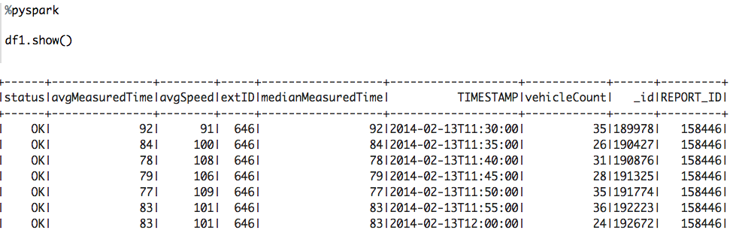
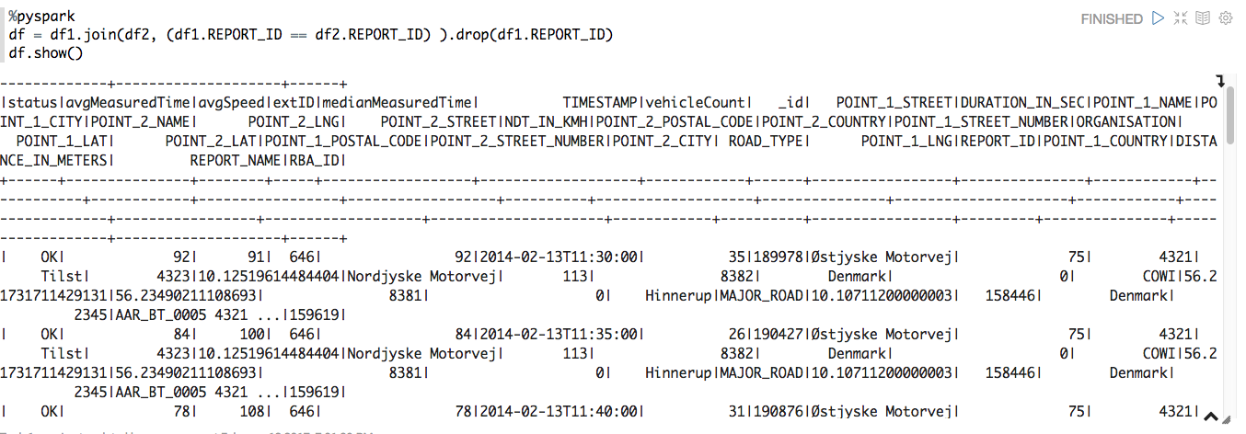
Traffic Data
Merged Data

Slide 14
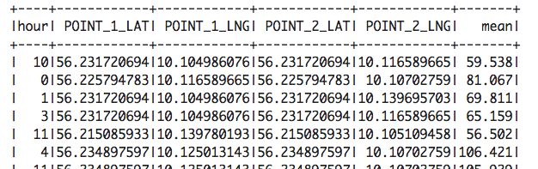
Method
Pre-process Data: In the previous section, we showed how datasets are Merged. Now we pre-process data set for clustering.
The merged dataset is raw dataset which contains many columns.
First, we will delete columns which are not useful to build the model.
Now we convert Timestamp data from String to DateTime.
Calculate average speed by an hour.
Round the columns to nearest
Now data set looks like this

Slide 15
Method
Data cleansing and Formatting done. Now we will look into, how to build a model.
We use Unsupervised learning to build our model.
K-means clustering is one way of implementing unsupervised learning. It is more efficient than many others clustering methods. One advantage of this algorithm is, it always converges.
This technique is used, when there are no labels in the data and when output result is undermined.

Slide 16
Method contd..
Clustering divides data into different groups. Data within groups are similar than other groups
Clustering is done based on the Euclidean distance method. Number of clusters (K) needs to be chosen before clustering.
There are two main steps in this process. Assignment step and Update step.

Slide 17
Method contd..
In Assignment step, points assigned to clusters.
After Assignment step, in update step centroids calculated again with newly assigned points.
This process repeats until centroids don't move further, this is how algorithm converges.
K-Means

Slide 18
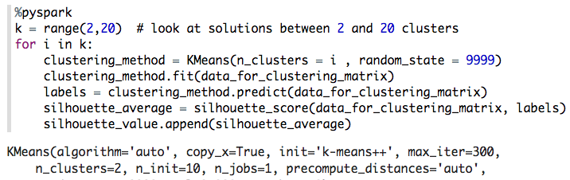
Scikit-learn
We use scikit sklearn.cluster to do clustering
This algorithm iterate 300 times to find best k value between 2 to 20.
Silhouette_values are the measure to find best K value

Slide 19
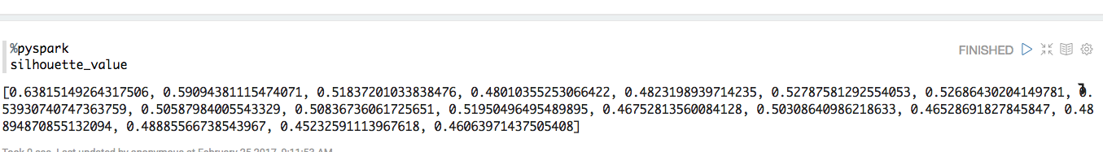
Scikit-learn
Silhouette_value closer to 1 is better the fit.
From Silhouette_values K-value chosen as 2.
We ran K-Means with n_clusters =2

Slide 20
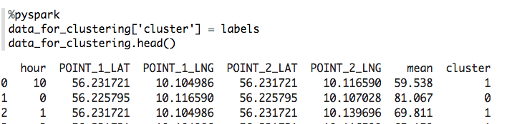
Data after clustering Shown below. Each row assigned to a cluster. We have to analyze this data whether these groups will predict traffic road segments.

Slide 21
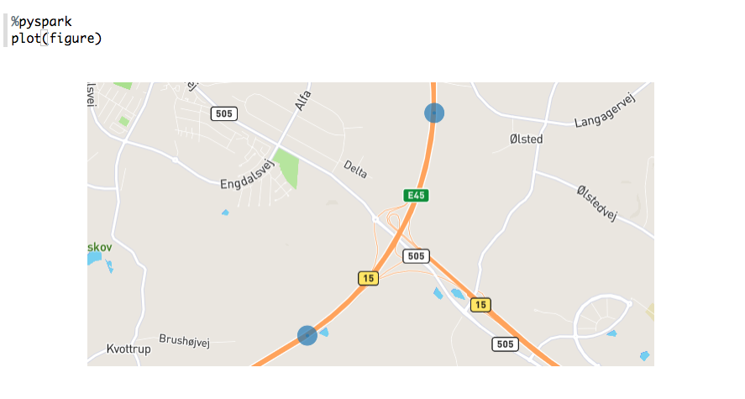
Graphs - Maps
Fig shows one street map for one row in the dataset. The map is generated using google maps API.
The goal to is to plot all points in the cluster on a map to identify various road segments within the time frame.

Slide 22
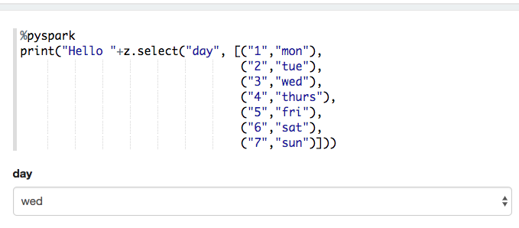
Create map from Data
To make user interaction, we need to build a web form to get user input.
Zeppelin provides a way to interact with Html.
When a user enters criteria, the request processed by spark and maps displayed by javascript, google maps API call.

Slide 23
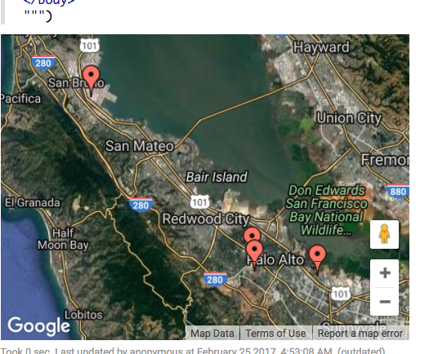
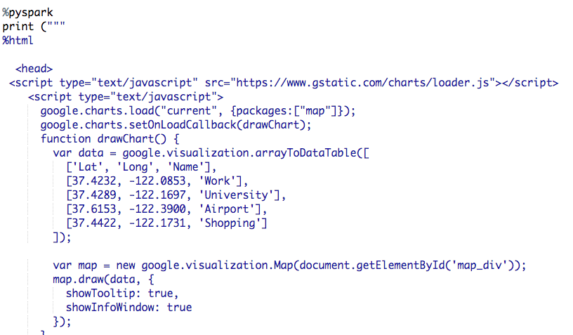
Graphs and Maps from User input
By using Javascript, google maps api call, generates maps based on user criteria.

Slide 24
Future Work :
Whole analysis to be done on complete dataset.
Build analytics platform.
User interface design.
Interpret the clusters, visualizing graphs and maps.

