Slide 1

Apache Hive with Amazon S3
NagaJyothi Kunaparaju

Slide 2
Introduction - Hadoop/Hive
The Apache Hadoop is a framework for distributed processing of large data sets across clusters of computers.
Hadoop Common: These are 3 in built modules in HADOOP.
Hadoop Distributed File System (HDFS): A distributed file system that provides high-throughput access to application data.
Hadoop YARN: A framework for job scheduling and cluster resource management.
Hadoop MapReduce: API that provides parallel processing of large data sets
Hadoop-related projects at Apache for data management systems include :
Cassandra: A scalable multi-master database with no single points of failure.
HBase: A scalable, distributed database that supports structured data storage for large tables.
Hive: A data warehouse infrastructure that provides data summarization and ad hoc querying.
Pig: A high-level data-flow language and execution framework for parallel computation.
Notes:
throughput - reliability of jobs over a long-time scale
ad hoc querying - Dynamic querying

Slide 3
Method
In this project we will see :
How hive process data:
Create Hive external table with file located in S3 bucket
Transfer this table data to local file system.
Upload a file from local file system to S3 bucket programmatically:
Create IAM user role and grant permissions to upload file from local.
Use this key in program and upload file from local to S3 and run program
Verify file upload in S3

Slide 4
Difference between Hive External and Internal table creation:
When we create External Tables Hive does not move the data into its warehouse directory. It will create a pointer to that data storage and creates metadata information in Hive.
Internal tables Hive moves data into its warehouse directory. If the table is dropped, then the table metadata and the data will be deleted.
Notes:
(scale out with more machines added dynamically to the Hadoop cluster),

Slide 5
Creating Hive external table
Create Cluster
Uploaded actor.txt into s3 bucket.
ssh to cluster, log in to hive and create external table using command
hive> CREATE EXTERNAL TABLE actor (actor_id VARCHAR(45),first_name VARCHAR(45),last_name VARCHAR(45),last_update VARCHAR(45)) ROW FORMAT DELIMITED FIELDS TERMINATED BY '\t' LINES TERMINATED BY '\n' LOCATION 's3://jyothikunaparaju/new';
Verified data loaded into hive by using command Select * from actor;
Ran $hive -e "select * from actor " > ~/sample_output.txt command to create sample_output txt file with actor data

Slide 6
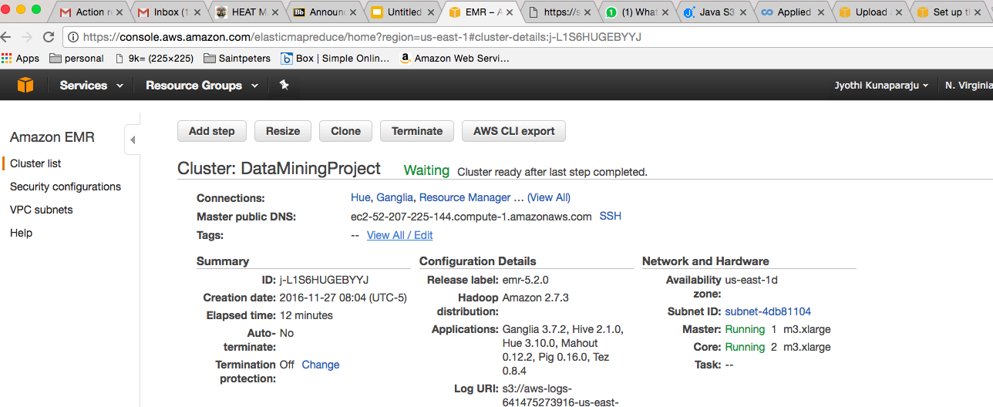
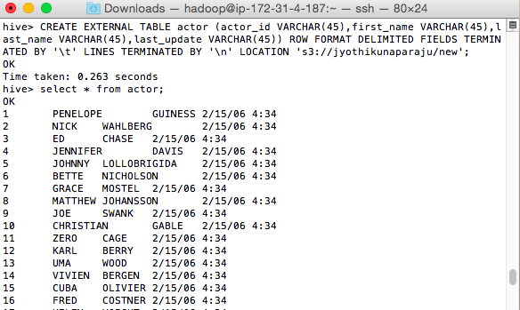
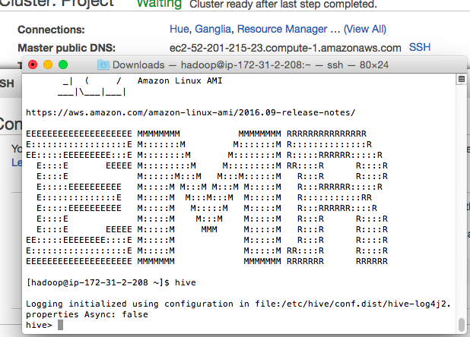
EMR Cluster
Create External table
SSH to EMR

Slide 7


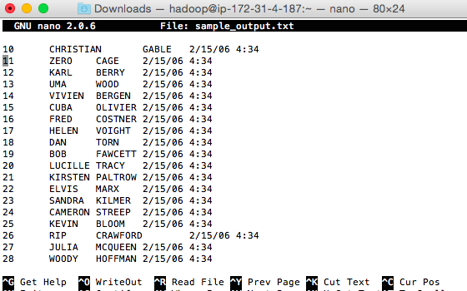
Transfer file from Cluster to Local

Slide 8
Upload a file from local to S3 bucket programmatically
Created IAM user with permissions for Java program to upload file.
Integrate AWS SDK with Eclipse
Create AWS SDK Java Project
Create a New Directory in S3 for output File.
Update credentials, new S3 folder and input file Location
Run program, verify out file created in S3.

Slide 9
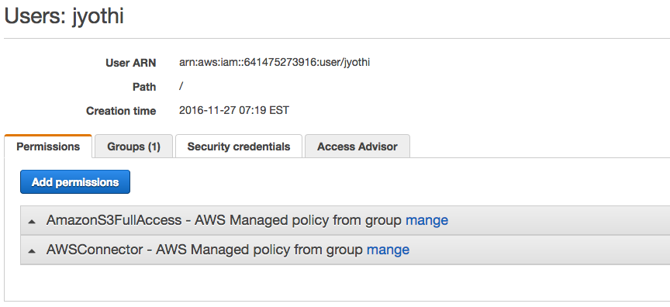
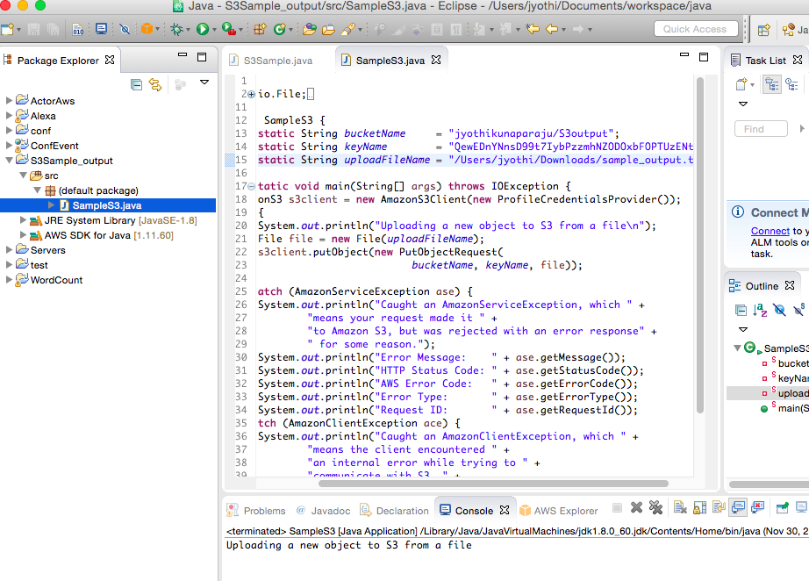
Create Permissions :
Java Program to Upload file:
Create AmazonS3Client Object.
s3client.putObject( new PutObjectRequest(bucketName,keyName,file)

Slide 10
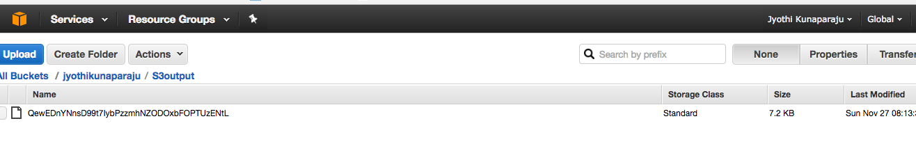
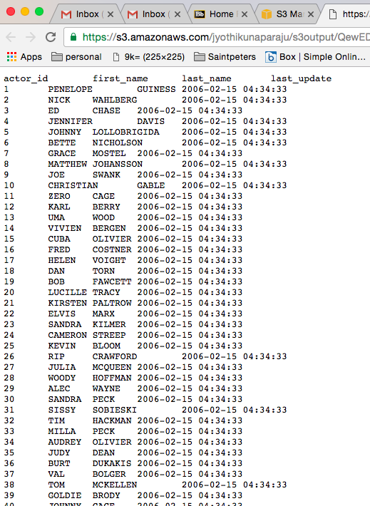
Output file in S3 bucket
<<<<----------Output File

