Slide 1
Project Report Make a secure website
Group 9
Minde Hansen
Stig Helle
Anders Mikalsen
Jari Kunnas

Slide 2
Contents
HTML drafts
database

Slide 3
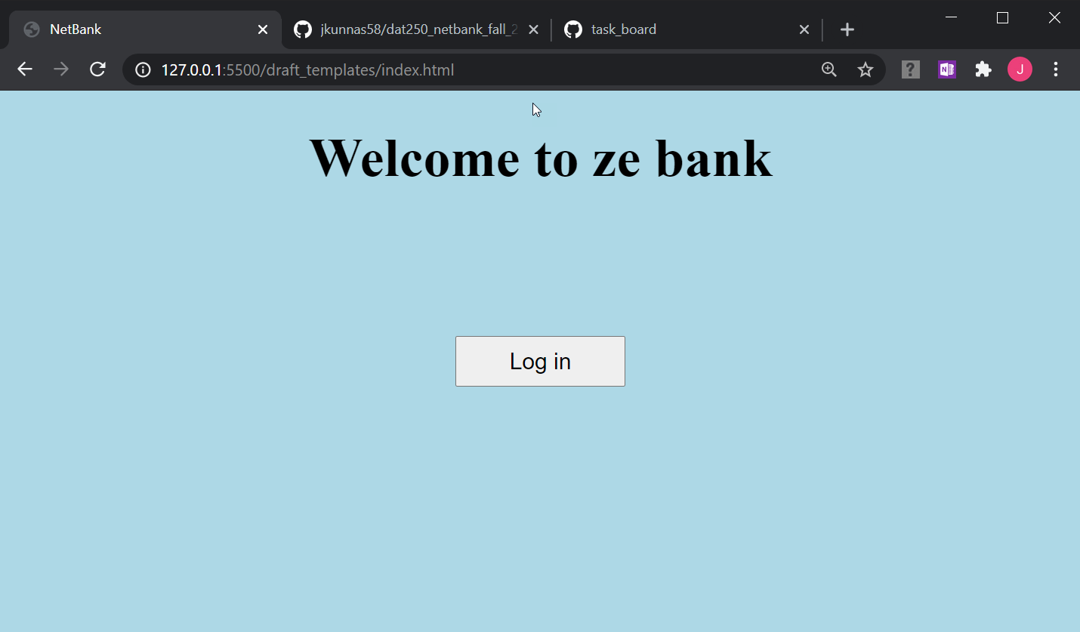
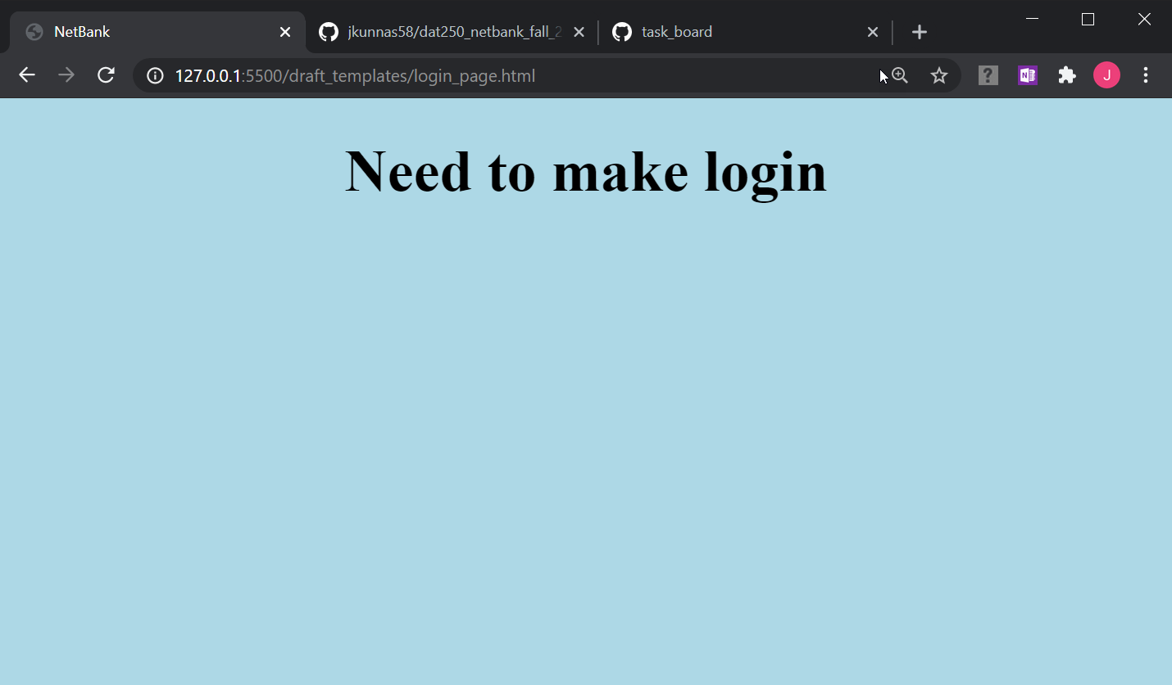
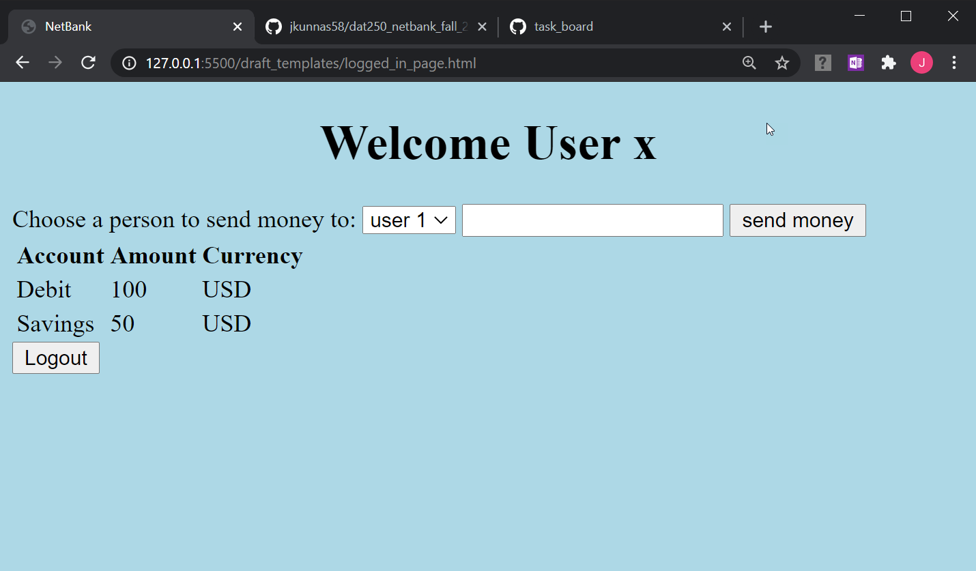
HTML drafts

Slide 4
database

