Slide 1
Project Report Make A Secure Website
Group 9
Minde Hansen
Stig Helle
Anders Mikalsen
Jari Kunnas

Slide 2
Contents
Overview
Files and folders
HTML drafts
Database
Site map
Threat model
Securing the website
Reflections concerning security
Deployment to Heroku

Slide 3
Overview
We chose the task of creating an online banking application
Communcation and meetings were done using Discord
GitHub was used to create seperate branches and collaborate on the master branch for the code and other files in the project
The finished website was hosted on Heroku

Slide 4
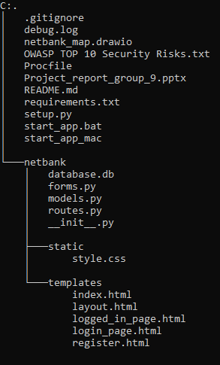
Files and Folders

Slide 5
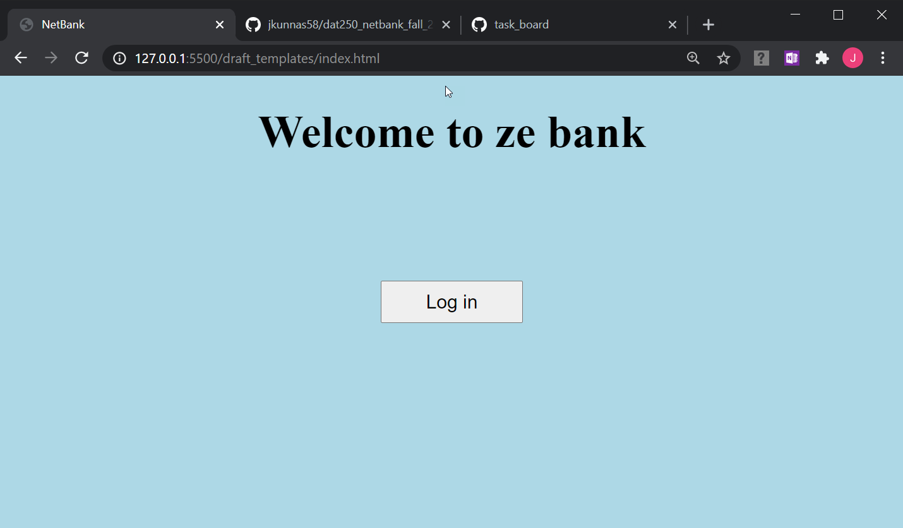
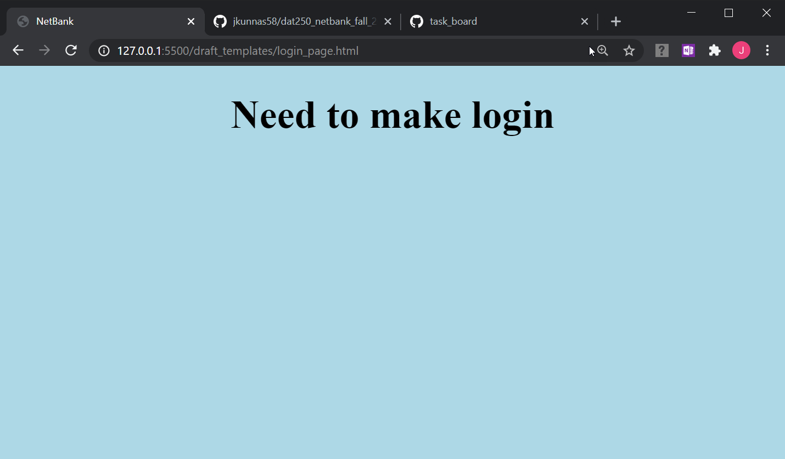
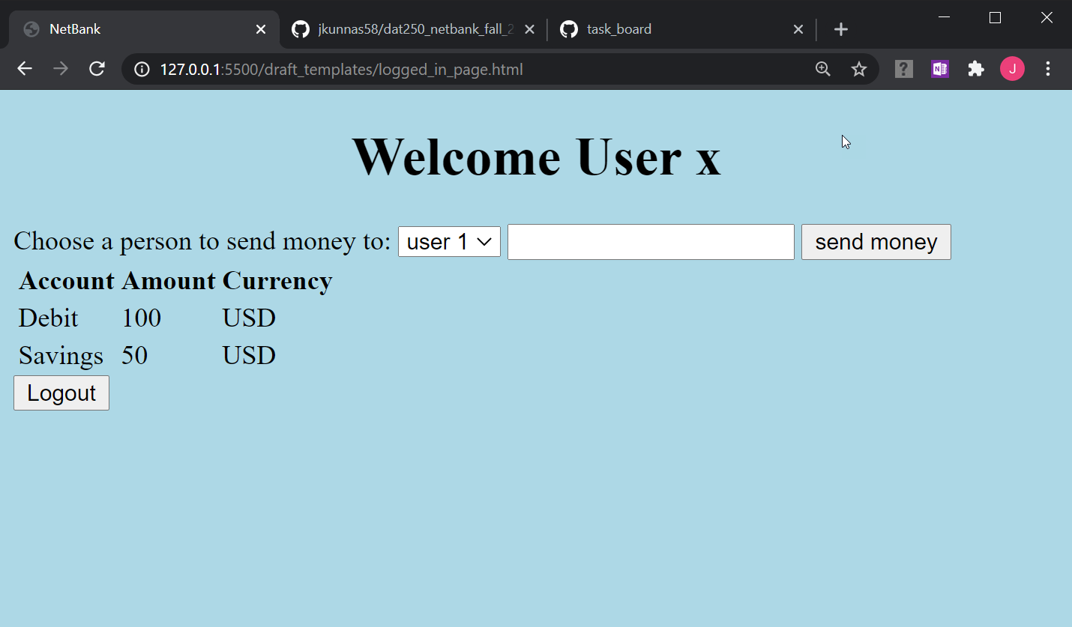
HTML drafts

Slide 6
Database

Slide 7
Site map
# This is listed in the project description as something that should be included

Slide 8
Threatmodel
# This is listed in the project description as something that should be included

Slide 9
Securing the website
In addition to the web application having the desired funcionality, the goal was to secure the web application against as many of the OWASP Top Ten Application Security Risks as possible

Slide 10
OWASP A1 - Injection

Slide 11
OWASP A2 - Broken Authentication

Slide 12
OWASP A3 - Sensitive Data Exposure

Slide 13
OWASP A4 - XML External Entities (XXE)

Slide 14
OWASP A5 - Broken Access Control

Slide 15
OWASP A6 - Security Misconfiguration

Slide 16
OWASP A7 - Cross Site Scripting (XSS)

Slide 17
OWASP A8 - Insecure Deserialization

Slide 18
OWASP A9 - Using Components with Known Vulnerabilities

Slide 19
OWASP A10 - Insufficient Logging & Monitoring

Slide 20
Other security threats?

Slide 21
Reflections concerning security
blablabla

Slide 22
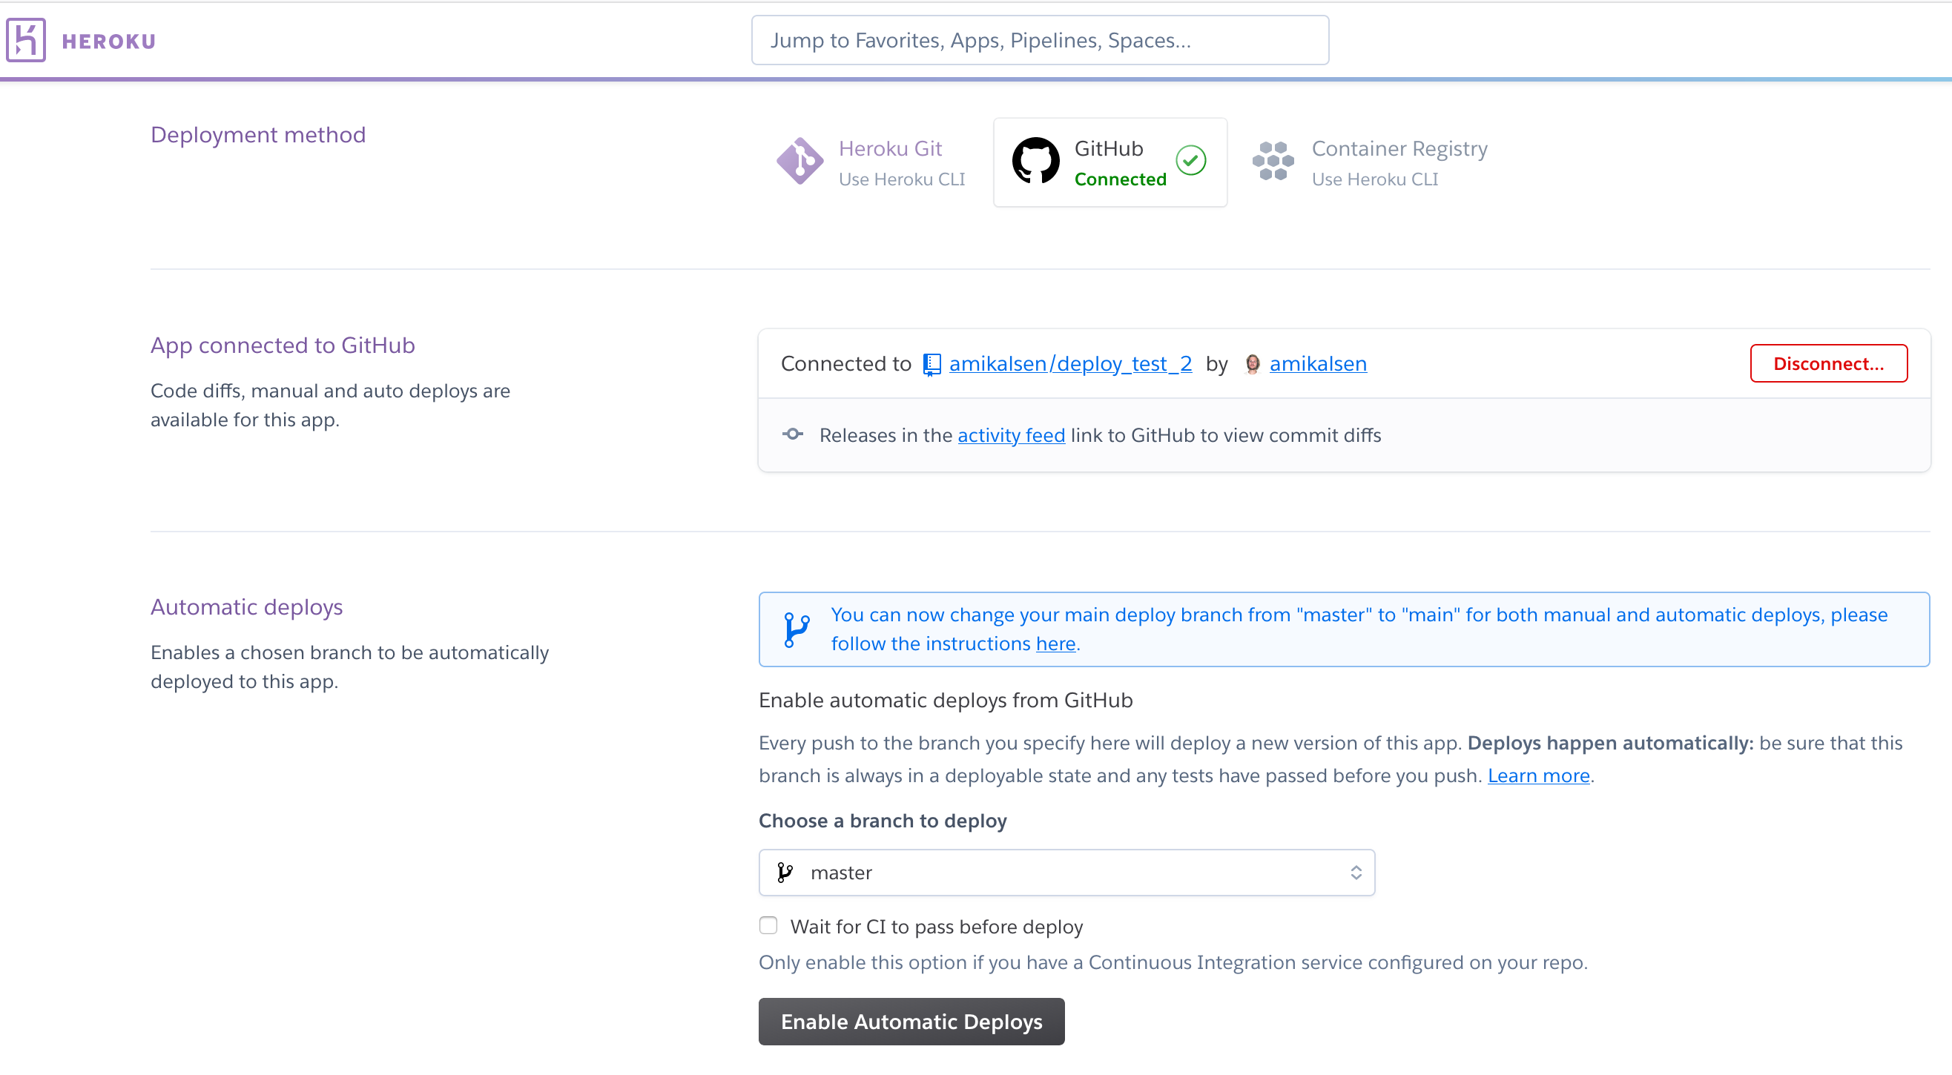
Deployment to Heroku
Testing deployment using both Heroku CLI and connecting to GitHub on Heroku.com

