Slide 1
Project Report Make A Secure Website
Group 9
Minde Hansen
Stig Helle
Anders Mikalsen
Jari Kunnas

Slide 2
Contents
Overview
Files and folders
HTML drafts
Database
Site map
Threat model
Securing the website
Security testing of our application
Reflections concerning security
Deployment to Heroku

Slide 3
Overview
We chose the task of creating an online banking application
Communcation and meetings were done using Discord
GitHub was used to create seperate branches and collaborate on the master branch for the code and other files in the project
https://github.com/jkunnas58/dat250_netbank_fall_2020
The finished website was hosted on Heroku
https://dat250-netbank.herokuapp.com

Slide 4
Functionality of Netbank
Register user with 100-1000 dollars
Log in to personalized site.
View how much money you have in your account
View account number
Select account number to send to
Select amount to send
Verify sending by entering username and password again
Logout

Slide 5
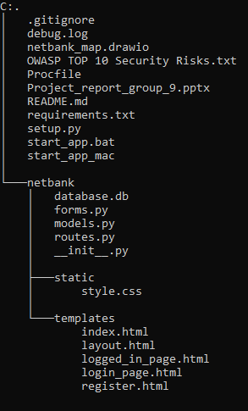
Files and Folders
Application can be run locally by running the “start_app.bat” file on Windows systems or use the commands in the “start_app_mac” on IOS.

Slide 6
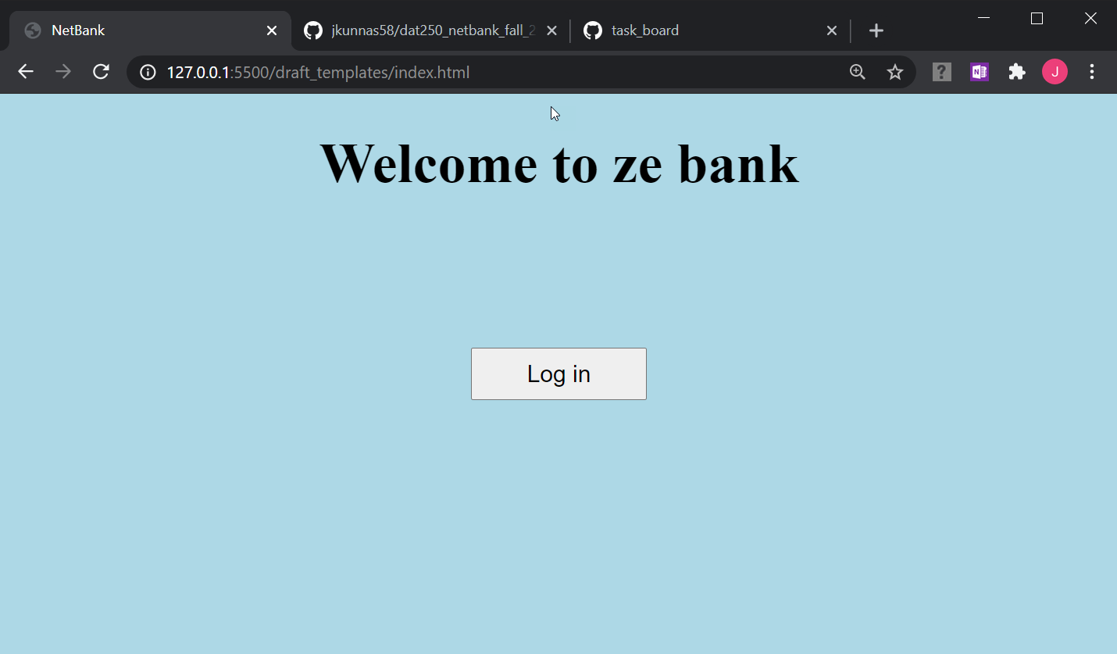
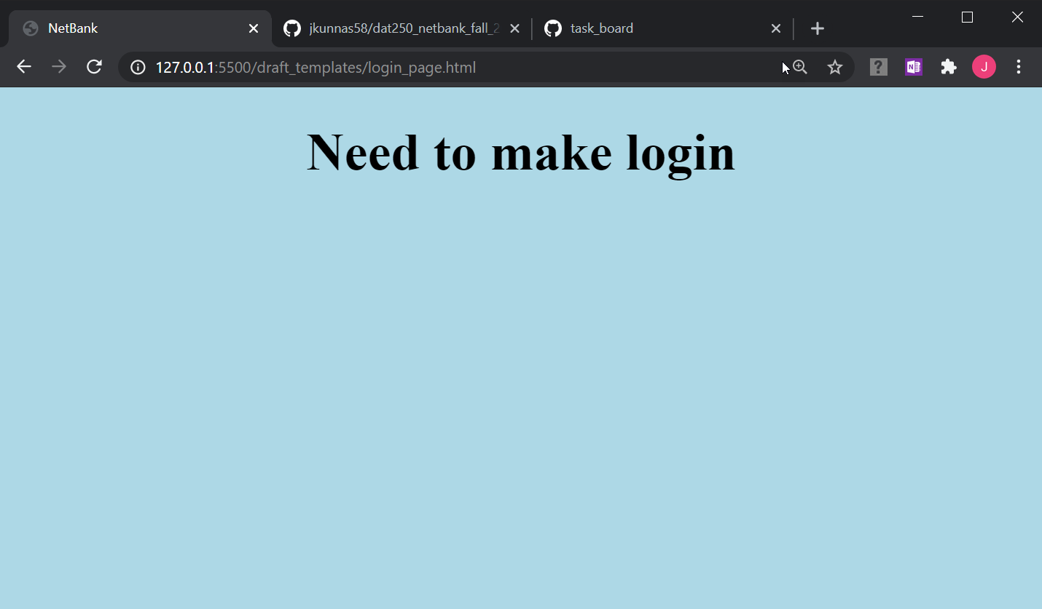
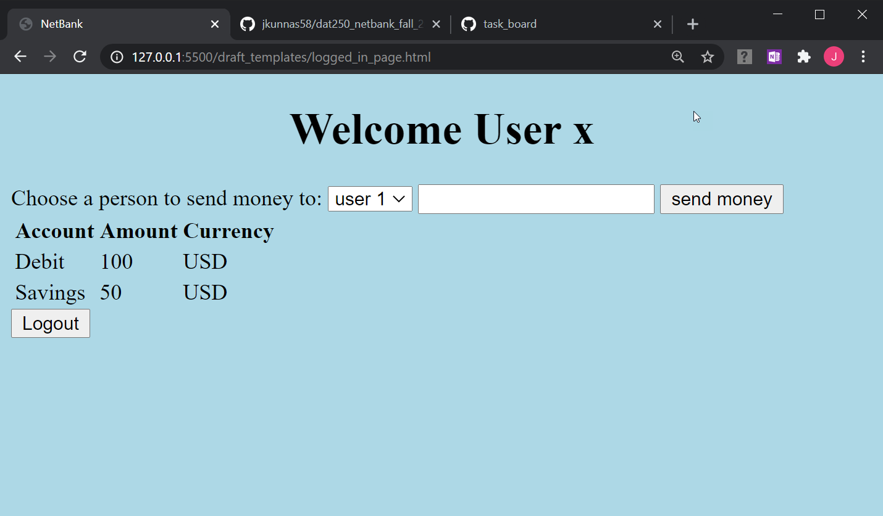
HTML drafts
First HTML drafts had 3 pages. A register user page was made later when that functionality was needed.

Slide 7
Database
The database used is SQLite and handled via the SQLAlchemy python module.
“database.db” is stored under the netbank folder, added to the project in the __init__.py and initiated in the routes.py script.
For production the SQLite database was swapped with PostgreSQL because Heroku is not persistent for SQLite, but is for PostgreSQL
This was performed following the tutorial from Magnus Book

Slide 8
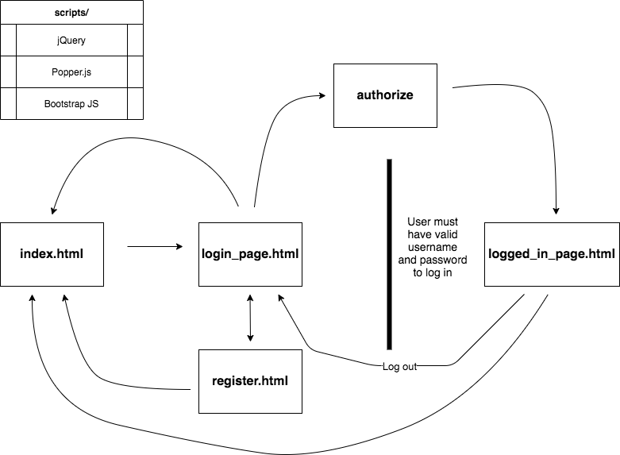
Site map

Slide 9
Threat model
A threat model, is defined as ’’a process that reviews the security of any connected system, identifies problem areas, and determines the risk associated with each area.’’
For our webpage, we did an initial threat model, and then continuously improved the model as new potential issues came up while developing new features.

Slide 10
Securing the website
In addition to the web application having the desired funcionality, the goal was to secure the web application against as many of the OWASP Top Ten Application Security Risks as possible
The next slides cover the topics and how our page is protected or not against the top ten and other potential information and software security risks

Slide 11
OWASP A1 - Injection
SQLAlchemy was selected as a ORM for this project. The benefit of this is that you don’t need to pass raw sql statements to the database to update and register users. SQLAlchemy will sanitize the inputs if used correctly.
The WTForms package does not necessarily sanitize all the inputs, but the way it is set up it will limit some possibilities of what can be entered and sent to the SQLAlchemy methods.
This project is set up to get/set user objects from the database, update those and then commit those objects to the database. This should prevent sql injection as an option to compromise this website.

Slide 12
OWASP A2 - Broken Authentication
Passwords are hashed in the database using the bcrypt python module.
Passwords have a minimum 8 character length and demand characters(lower and upper case), special symbol and numbers.
A user can only access the login page 5 times in 5 minutes. If they try more than 5 times, they are locked out for the remaining 5 minutes. This stops brute force attacks at the login page.
The user will be logged out if inactive for 2 minutes
There is no notification that will let you know if you have entered a correct username, but a wrong password. This will limit the chance of brute force attacks.
!! The website doesn't have multifactor authentication implemented. This would also decrease the risk of Broken Authentication, for this project it was deemed an extra feature we did not prioritize spending time learning how to implement!!
We used the python safe package(https://github.com/lepture/safe) that checks for password strength=STRONG, minimum length=8 and mixed number, alpha and (not (marks or alpha)) :
How it works
Safe will check if the password has a simple pattern, for instance:
password is in the order on your QWERT keyboards.
password is simple alphabet step by step, such as: abcd, 1357
Safe will check if the password is a common used password. Many thanks to Mark Burnett for the great work on 10000 Top Passwords.
Safe will check if the password has mixed number, alphabet, marks.
This verification might flag some sql injection checks as unsafe, but the inputs still go through WTForms, bcrypt hashing and flask-sqlalchemy database writing so should be sql injection safe.

Slide 13
OWASP A3 - Sensitive Data Exposure
Heroku has a paid option to allow for TLS on the hosted sites there. We opted not to pay for this service, but are aware of it and know it will mitigate the risk of hijacking a session or sniffing.
We don’t share usernames of other users to the logged in user. They need to enter the account number (we use the user primary key as the identifier on where to send the money)
We use bcrypt to hash the passwords in the database. We have limited amount of sensitive data in the database so did not see the need of encrypting the other entries, but username and account/money for a user might be an idea to encrypt.
Additional steps that could be taken to further secure against sensitive data exposure is HTTP Strict Transport Security (HSTS).

Slide 14
OWASP A4 - XML External Entities (XXE)
N/A, we don’t use any XML or have any option to insert any XML in our website. Should be protected from this security risk

Slide 15
OWASP A5 - Broken Access Control
SQLinjection is not possible for logged in users either.
Displayed information is only from the current user.

Slide 16
OWASP A6 - Security Misconfiguration
Our application is quite minimalistic, with no unnecessary features or default accounts/passwords. This limits the chance of security misconfiguration.

Slide 17
OWASP A7 - Cross Site Scripting (XSS)
In Flask, Jinja2 is automatically configured to escape all values unless explicitly told otherwise. This should in general rule out all XSS issues caused in templates. However, there are still other areas where one needs to be vigilant.
Additional steps that could be taken to further secure against XSS is HTTP Strict Transport Security (HSTS).

Slide 18
OWASP A8 - Insecure Deserialization
When an object is converted into a byte stream is called serialization. When the byte stream is converted into an object is called deserialization.
JSON (JavaScript Object Notation) handles deserialization in Flask.
The best way to avoid insecure deserialization is to avoid deserializing untrusted data. If you cannot verify and validate the data, it should not be deserialized.

Slide 19
OWASP A9 - Using Components with Known Vulnerabilities
To our knowledge the components we are using, don’t have known vulnerabilities that we have misused.
The Flask framework, Flask packages, SQLAlchemy, WTForms and safe that we have chosen is to aid in security and are commonly used for that purpose. We are not aware of any vulnerabilities with those packages if they are used properly.

Slide 20
OWASP A10 - Insufficient Logging & Monitoring
We don’t do any explicit logging and monitoring in our application.
Heroku, where the page is deployed, has a range of runtime logs that can be used, such as app logs, system logs, API logs and add-on logs. These are accessed through commands in the CLI.
For paid version of Heroku hosted sites (hobby or professional dynos), there are extended metrics available.
Also, having a transactions table that stores every movement of money would be a proper thing to have in a real bank.

Slide 21
Other security threats?
Cross-Site Request Forgery (CSRF): For registration and login, we use WTForms. Flask WTForms provides among other things CSRF protection. CSRF was on the OWASP top ten in 2013, but was not included in the 2017 version.

Slide 22
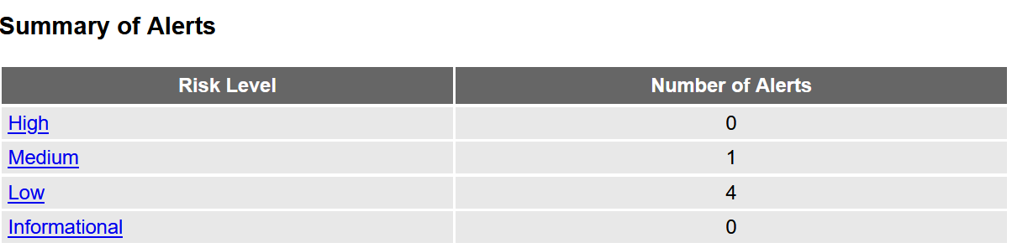
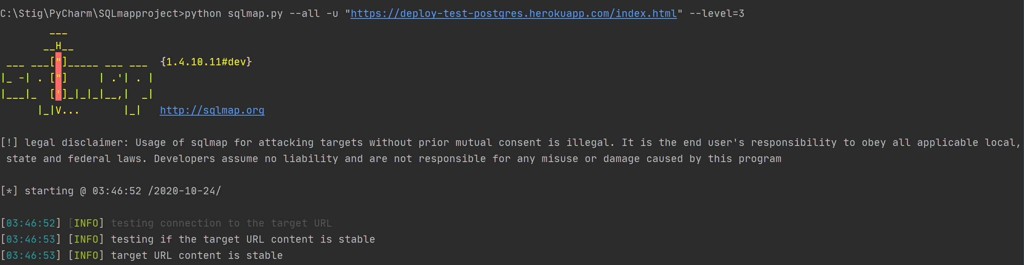
Security testing of our application
To test security, we tried to attack our site in various ways:
ZAP (Zed Attack Proxy) testing tool
SQLmap

Slide 23
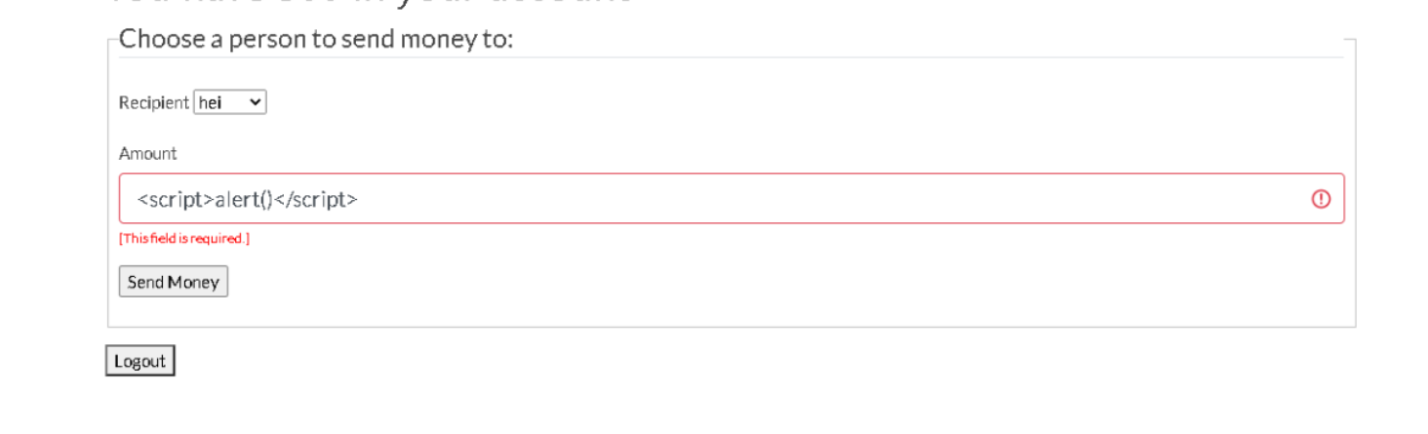
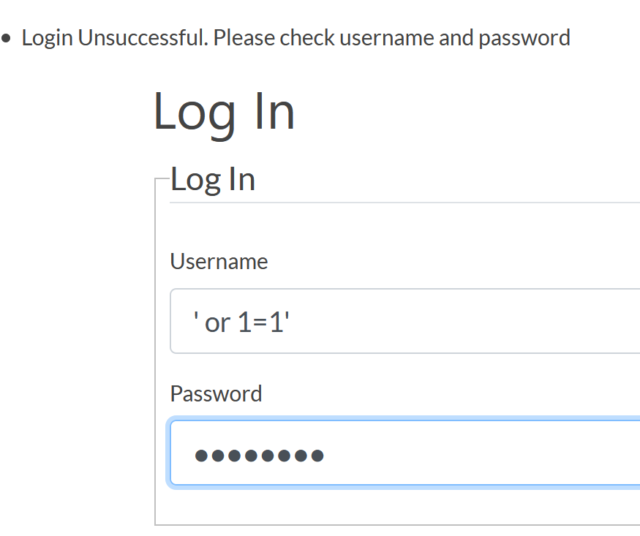
Security testing of our application
Script injection test (example of test)
SQL injection
Example of test

Slide 24
Reflections concerning security
We ran various security tests that all resulted positive as in being secure.
We have also gone through all the steps and functionality we have in our page to see if there are any weakness.
We have used well known packages and modules that protects against the most common security challenges. They were chosen from the start so we could follow the "build security in" thinking.
We made sure we started the coding and development with the security in mind for every extra feature that was added.

Slide 25
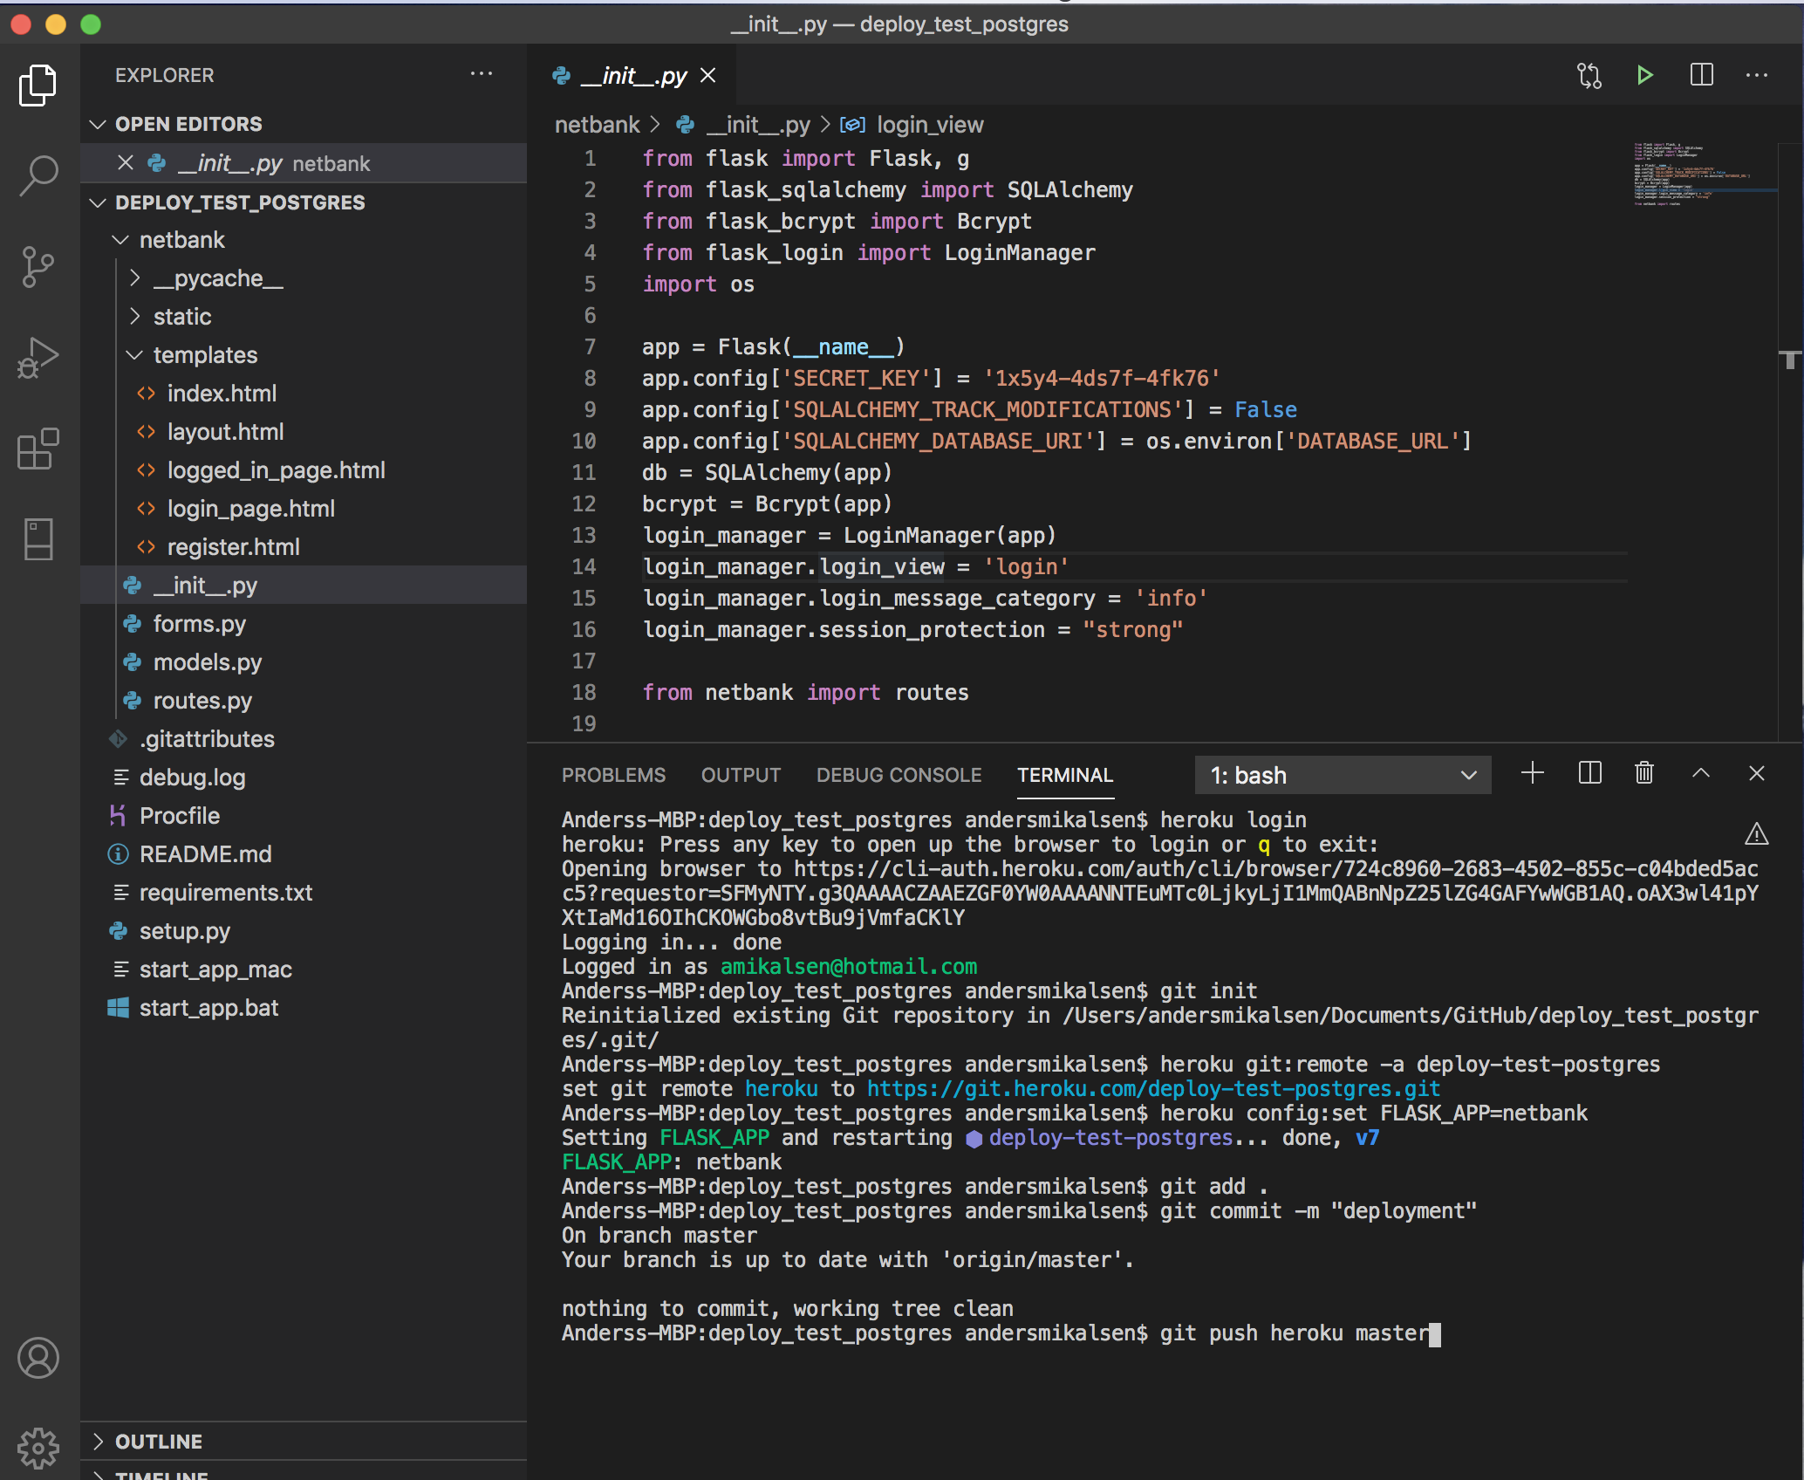
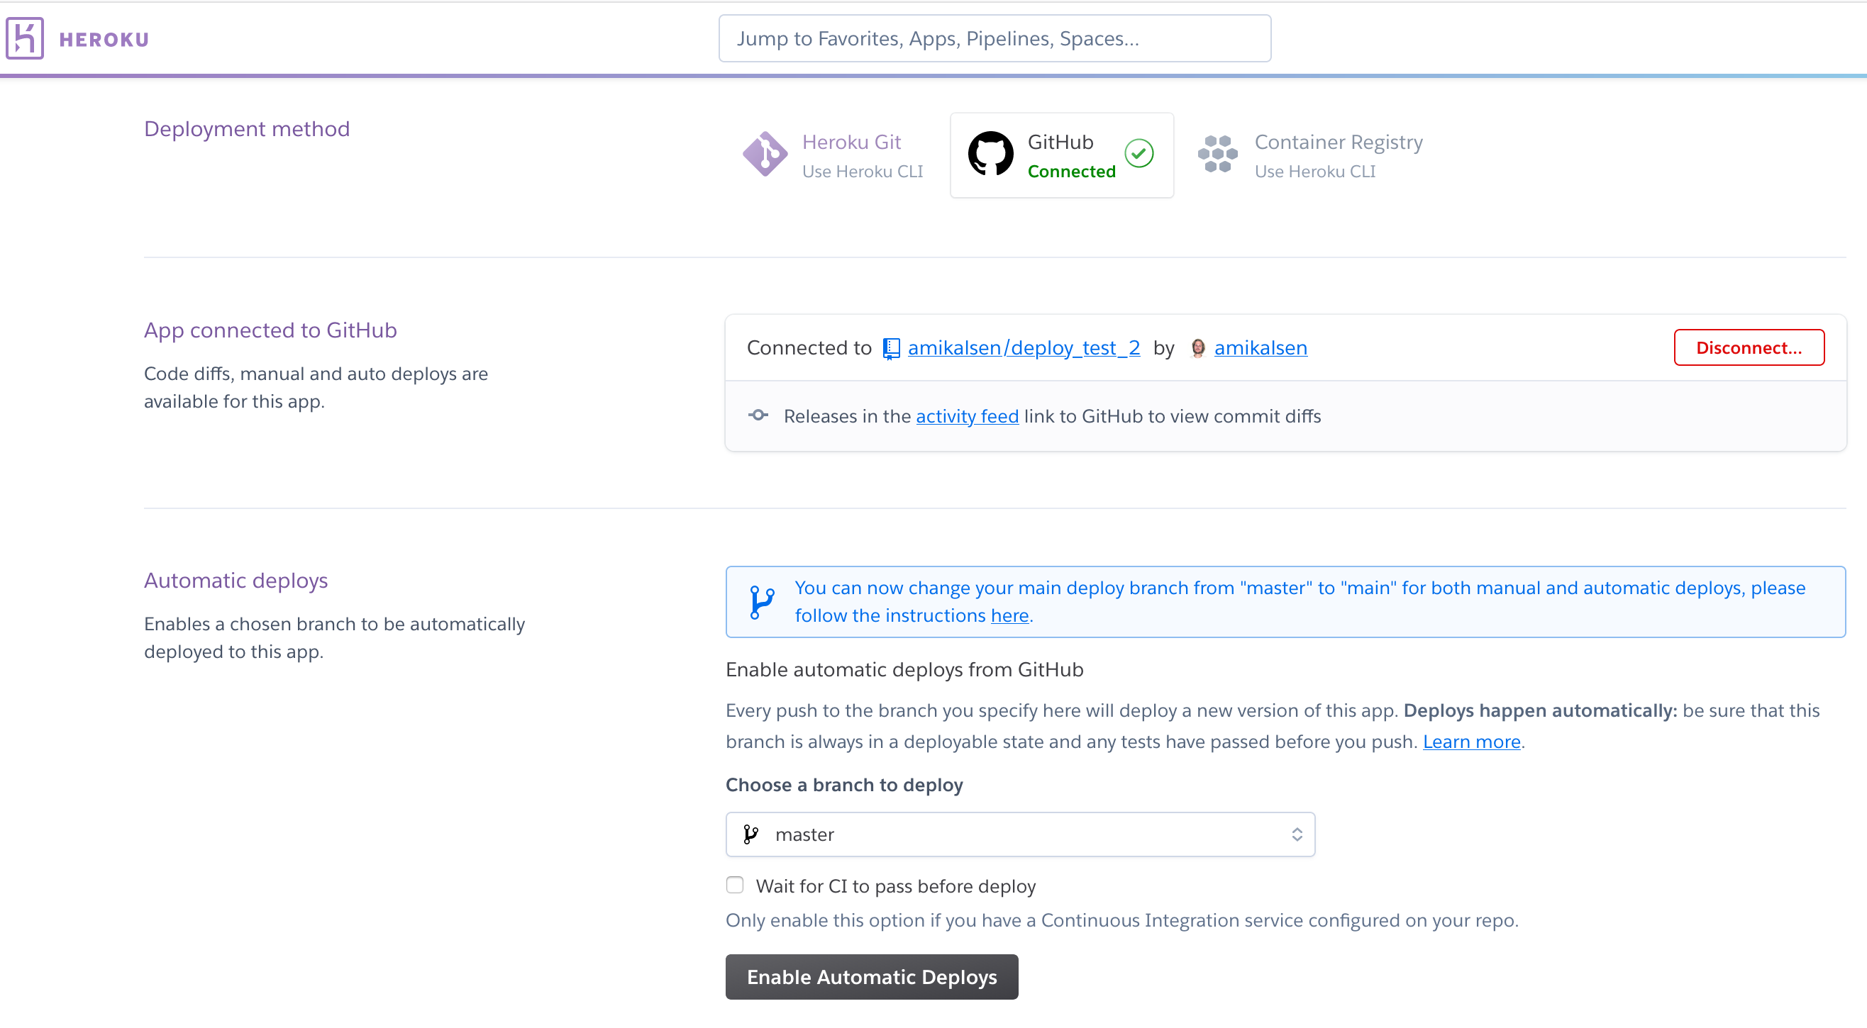
Deployment to Heroku
Testing deployment using both Heroku CLI and connecting to GitHub on Heroku.com. Final deployment was done using CLI.

