Slide 1
Low-Risk Persistent Identification: the “Entity” (N2T) Resolver
10 October 2006
John Kunze, California Digital Library, University of California

Slide 2
NT2 “Entity” – overview
Establish a consortium and a small web server.
Each member publishes URLs under n2t.net:
http://n2t.net/12345/foo/bar.zaf
…which redirects to the member server URL.
Why? It solves the same persistent identifier problem as URN, DOI, and Handle systems, but more fully, and at lower cost and risk.

Slide 3
Persistent identification
Persistent identifiers? We have them.
But still need persistent actionable ids
Actionable “with widely available tools”
Which really means “with URLs”
URNs, ARKs, Handles, DOIs, etc. become actionable (practically speaking) when embedded in URLs
All these ids have similar maintenance costs, and they all break for the usual reasons

Slide 4
The usual reasons
Whatever the string, what matters is the thing
If the thing’s unavailable, the id’s broken
Broken, for URLs, means either
The hostname is broken
  Server down, gone, or renamed *
  Domain name lost, provider out of business
Or the pathname to the thing is broken
  Thing down, gone, or renamed *
* No global fix for these, only the provider can fix.

Slide 5
Hostname instability
Domain name lost, provider out of business
We can help this case
Smaller organizations most vulnerable
The comfort of not seeing your hostname
The comfort of seeing your hostname
Traditional solutions: PURL, URN, Handle, DOI
Solutions tied to special-purpose technology, sometimes complex and proprietary

Slide 6
N2T (Name-to-Thing)
N2T is two things at once
A consortium of cultural memory organizations
… and …
A small, ordinary web server, mirrored in several instances globally for reliability
Basic idea: protect 200 organizations’ URLs from hostname instability with 200 rewrite rules
How: simple HTTP redirects, one per organization

Slide 7
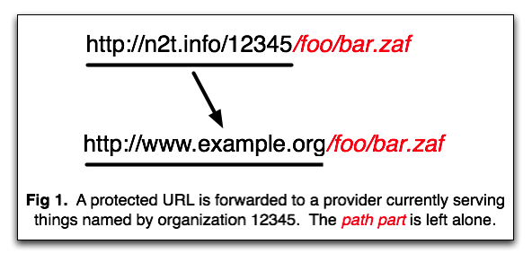
N2T – user point of view
Each consortium member organization gets a unique number, such as, 12345.

Slide 8
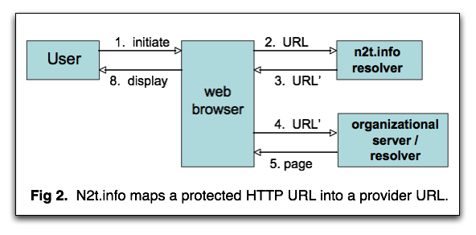
N2T – system point of view
Technically, resolution (access to a thing given its name) is two simple steps.

Slide 9
N2T – consortium point of view
“Consortium-lite”
  Members have no fees or responsibilities
  One domain name for whole consortium
    Rent is $30/year, runs on 4 total web servers
Volunteer member orgs run the servers
  1 primary + 3 mirrors
Interested bodies: CENDI, DLF, DCC
Interested institutions: CDL, NYU, NLA, …

Slide 10
N2T – global point of view
Regional (eg, Europe, Asia, North America) clusters of mirrored resolver instances, with round-robin failover for redundancy, fault-tolerance, and load-sharing
No browser modifications required
resolver
instance
web
browser
resolver
instance
resolver
instance
User
resolver
instance

Slide 11
Namespace Splitting Problem
URL
user
URN/Handle/DOI
resolver
URL’
B
web
browser
URL’
6 7 8 9 10
1 4
page
1
2
3
4
5
2 3 5
URL’’
URL’’
11 12 13 14 15
2 3 5
page
C
A
Org’n A’s namespace splits when B and C inherit its objects.
Under the URN/Handle/DOI model, B must still forward to C.

Slide 12
Global resolver updating
Per-object resolver needs bulk updates
Periodic harvest (e.g., daily) of table mappings
From well-known provider-side web server files, e.g., tools and conventions similar to Google sitemaps
harvested updates
global
resolver
university
library
User
web
browser
national
library
national
archive
to/from final
web server
. . .

Slide 13
Prototype resolver
Sample identifiers at n2t.net – these work now
    http://n2t.net/12345/libraries/visitor.html
    http://n2t.net/13030/inside
    http://n2t.net/urn:nbn:se:uu:diva-3324
    http://n2t.net/ark:/13030/tf5p30086k
Incidentally, it can also redirect all URNs, DOIs, and Handles, e.g.,
    http://n2t.net/doi:10.1111/j.0307-6946.2004.00571.x

Slide 14
The n2t.net persistent identifier resolver
Advantages
Big reduction in architectural complexity
No browser modification required
Identifier scheme-agnostic
No proprietary, special-purpose infrastructure to carry forward as a liability to persistence
John.Kunze@ucop.edu
California Digital Library (CDL)

