Slide 1

How FAIR is your persistent identifier infrastructure?
Twitter thread 10 persistent myths about persistent identifiers
Persistent identifier? A URL that won’t give “Page Not Found.”
Meanwhile:
“Cool URIs Don’t Change” -- Tim Berners-Lee, 1998
Notes:
You may be familiar with, or even be tired of, the FAIR acronym, standing for Findable Accessible Interoperable and Reusable. This talk touches on the A=Accessible part, as it applies not to content, but very broadly to identifiers we use to link to content persistently. Why do we care? Because as early as 1997 a study claimed that the average life of a URL was only 44 days, the time when a typical URL would return the dreaded 404 Not Found error.
The web was then new and people loved it, so a kind of panic took hold in the web community. In the rush to find a so-called persistent identifier, ten silly notions took root that are still mis-guiding decision makers today.
A list of them was posted as a twitter thread in 2018, and they apply to all persistent identifiers, whether ARKs, DOIs, Handles, PURLs, or URNs.
Meanwhile not everyone remembers that Tim B-L didn’t bother with persistent identifiers. He was kind of "Bah! Humbug!", and wrote just: "Cool URIs don't change.”

Slide 2

In the beginning
Notes:
Long ago, in 1990, there was no free, instant access to the vast body
of content we take for granted today.
Sam Agnew @ flickr

Slide 3
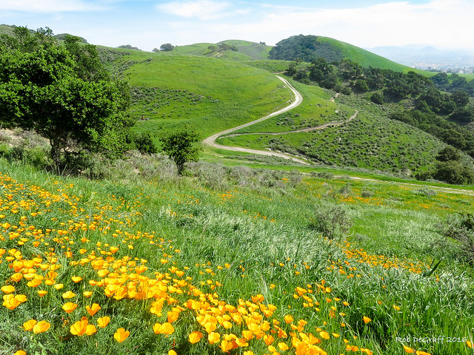
Then came the web
Notes:
But by the late '90s the web was rapidly becoming what we know today.
It wasn't just about access, but also about ease of online publishing.
Before the web, publishing was usually a formal process, with explicit contracts, payments, permissions, and rights transfers. So the web was hugely liberating for people who just wanted to put stuff out there.
But web links breaking in large numbers led many to conclude that URLs were inherently unreliable – a kind of nonsense – like banning English because there’s so much bad writing.
jcw1967 @ flickr

Slide 4
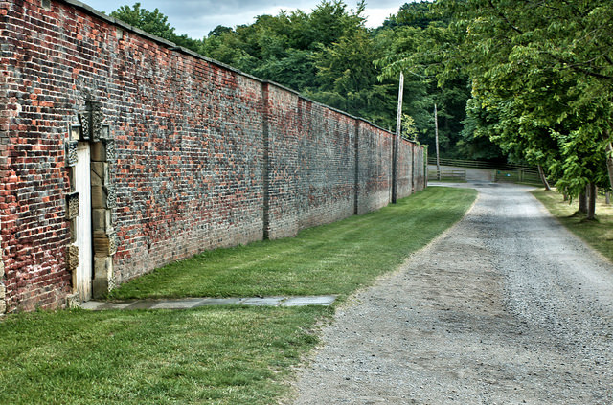
Then came the link resolvers
purl.org, hdl.handle.net, dx.doi.org, n2t.net
Notes:
In the rush for relief, many put their faith in purely technical solutions called "link resolvers".
The idea was to route all access through an identifier scheme’s own resolver, which would take care of web redirection.
But these were choke points. They were antithetical to the emerging spirit of sharing – the A in FAIR. They were generally not community-owned and came with fees. You pay your fee and think you’ve outsourced persistence, but you’re still on the hook for the hard work, which is updating a redirection table.
The one trick they could do – redirection – has always been technically trivial and baked into the earliest web servers. In fact that trick is given away at much larger scale by hundreds of services that shorten URLs, … for free!
What prevents our community from just forming a group to rent a hostname persistently, park a simple server there, and configure it to specialize in redirection?
jcw1967 @ flickr

Slide 5
An open alternative: ARK identifiers
ARKs are DWeb-ready (“decentralized web”)
500+ institutions, 3.2 billion ARKs in the world
A labelled URL with a globally unique identity inside
http://n2t.net/ark:/12345/fk1234
makes ARK actionable
core globally unique identity
Notes:
Well, that's what we did at the California Digital Library when we adopted ARK identifiers 17 years ago. Instead of succumbing to mythology, ARKs were built in the spirit of the free and open internet. This also aligns with the new decentralized web, or DWeb, movement that the web and internet founders are backing. Yes, redirection is important, but no one resolver need own it.
[] How can you tell if you have an ARK? By this internal label.
[] This Assigning Authority number identifies the organization that assigned the ARK.
[] The hostname makes it actionable.
[] The part after that is the core, globally unique identity, which doesn’t depend on the host, or even on HTTP.

Slide 6
The Covenant of the ARK
The ARK scheme
will not charge fees to create or use ARKs
will not limit the number of ARKs you assign
will not limit the kind of content you identify
will not require metadata, nor even persistence
will not mandate use of any particular resolver
Notes:
ARKs break the siloed, paywalled paradigm followed by most persistent identifier schemes. You don’t pay to create URLs, and you don’t pay to create ARKs. You can run your own resolver, and many do so. Or you can hire a vendor to do it.

Slide 7
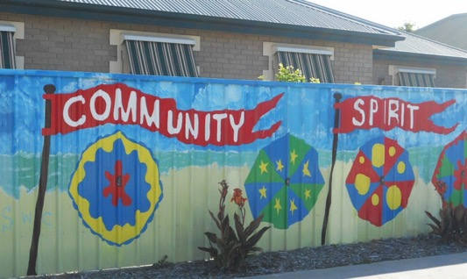
Community owned ARK infrastructure
“ARKs in the Open” project
Collaboration: CDL & DuraSpace
Support from 31 organizations
Working groups in 3 areas:
outreach, sustainability, technical
First draft ARKs FAQ!
Join us!
ARKsInTheOpen.org
Notes:
What about community? For the past year, the CDL and DuraSpace have been collaborating to achieve something that's been in discussion for over a decade. It’s called "ARKs in the Open”, and its goal is to build an open, international community to sustain ARKs. With three working groups launched, we have support from 31 organizations on 4 continents. We’ve produced a first ever ARKs FAQ, a survey is close going out, and standardization is being pursued. And of course we welcome your participation.
Do we have time for questions?
Community spirit
Image credit: https://www.flickr.com/photos/mikecogh/5288007926 by Michael Cochlan

