Slide 1
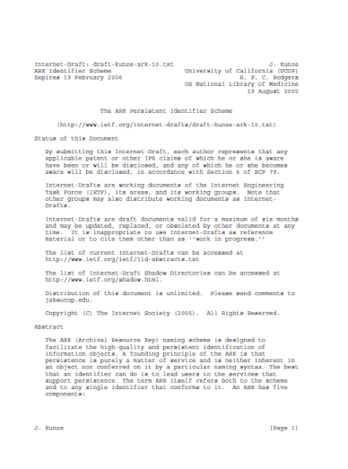


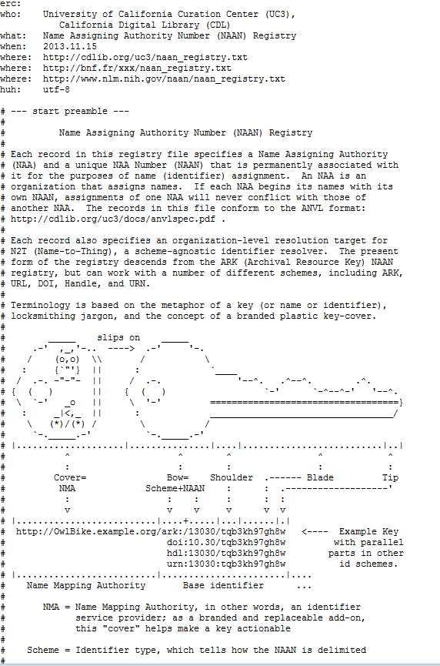
Reminder: what are ARKs
A maintaining institution | A specification
A user registry | A discussion list http://groups.google.com/group/arks-forum
http://tools.ietf.org/pdf/draft-kunze-ark-18.pdf
http://www.cdlib.org/uc3/naan_registry.txt

Slide 2



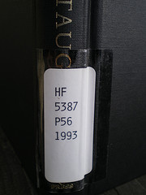
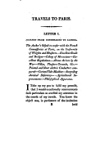
Reminder, 2: Ark anatomy
RESOLVE IDENTIFIERS
RESOLVE IDENTIFIERS
ASSIGN IDENTIFIERS
http://www.flickr.com/photos/jenwaller/2207918246/
>
>
>
>
>
delivery
service
the world
the naming
authority
the resource
page
variant
http://gallica.bnf.fr/ark:/12148/bpt6k103039f/f26.thumbnail
http://gallica.bnf.fr/
ark:/
12148/
bpt6k103039f
/f26
.thumbnail
Name mapping authority
Scheme
Name assigning authority number
(NAAN)
Name
Qualifiers

