Slide 1


Visit us, follow us, and subscribe to our newsletter!
Web: arks.org
Twitter: @arks_org
Email forums: arks-forum@googlegroups.com
arks-forum-fr@framalistes.org 🇫🇷
Notes:
for arks.org/wp-admin, should be 400 x 100 pixels

Slide 2

Notes:
min size for arks.org icon: 512 x 512 px

Slide 3
Notes:
min size for arks.org icon: 512 x 512 px

Slide 4
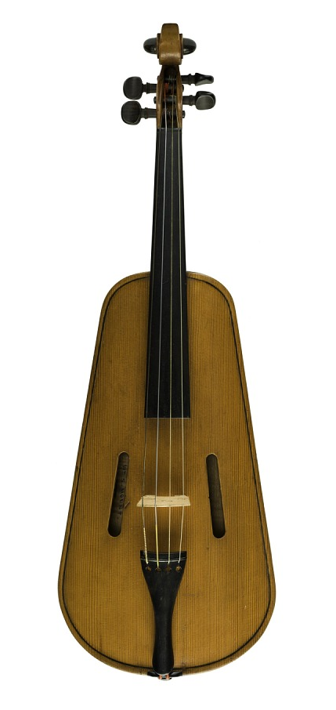
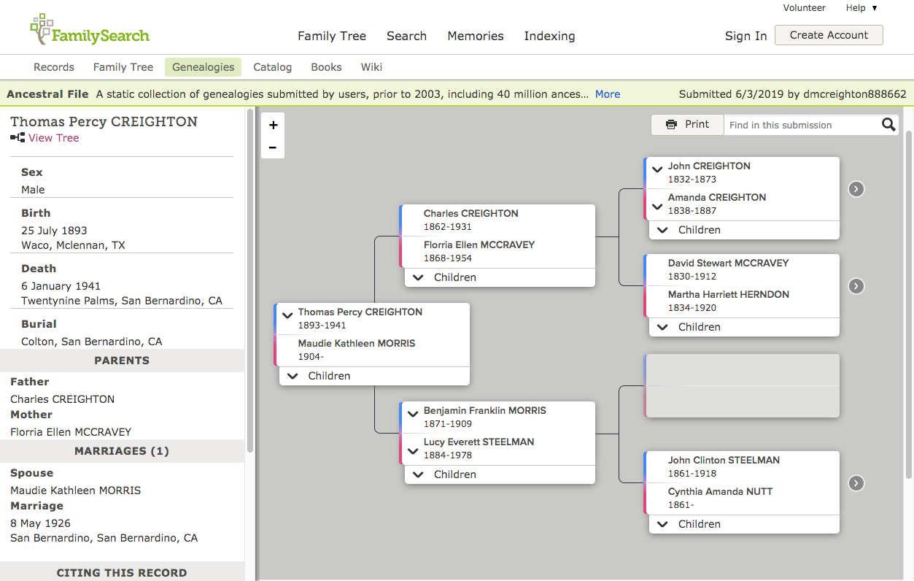

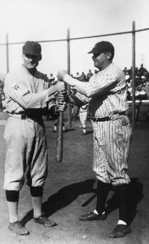
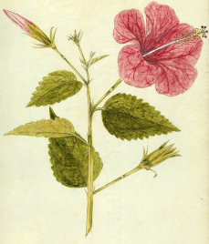
Notes:
n2t.net/ark:/13030/qt40f9d3h0 Scientific paper (eschol)
violin
genealogical record
scanned book (IA)
historic photo (calisphere)
plant specimen

Slide 5
Notes:
min size for arks.org icon: 512 x 512 px

Slide 6

A
R
K
Alliance

Slide 7
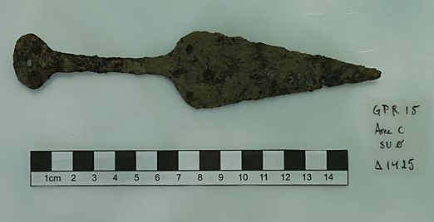
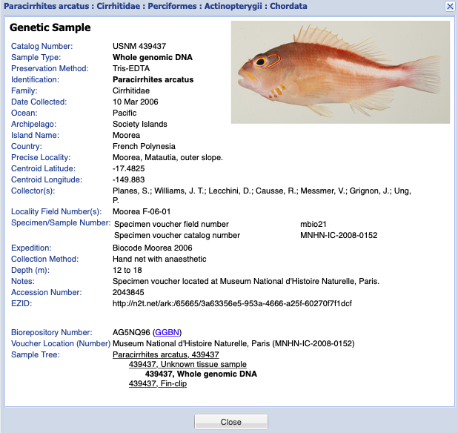
Eric Kansa, Open Context
Iron blade from the time of the Roman Republic.
Smithsonian NMNH Biorepository sample.
Notes:
for arks.org/wp-admin, should be 400 x 100 pixels

Slide 8
Notes:
for arks.org/wp-admin, should be 400 x 100 pixels

Slide 9
ARK Alliance
Notes:
for arks.org/wp-admin, should be 400 x 100 pixels

Slide 10
Notes:
min size for arks.org icon: 512 x 512 px

Slide 11
A
R
K
Alliance

Slide 12
A
R
K
Alliance

Slide 13
ARK Alliance

