Slide 1
NFL Draft Predictions
By
Jacob Kurstedt

Slide 2
Problems
Predicting whether a player would be a Pro Bowl Selection in the NFL based off NFL combine tests
Predicting whether a player would be drafted or not

Slide 3
Actions
Coaches and GMs should look for defensive players who have good three cone drill and shuttle run times when thinking about who to draft
Players should focus on improving their three cone and shuttle run times to improve draft rank .

Slide 4
Data Wrangling
Used only defensive players in the draft combine
Dropped columns that had offensive stats
Filtered out all Offensive and Special Teams Players
Filled in blanks with the mean of each combine test

Slide 5
Exploratory Data Analysis
Explored undrafted player combine tests compared to the drafted players tests
Undrafted player had quiet similar scores
40-yard dash and Broad Jump had some difference
This made sense, since being faster and more explosive is very beneficial for a player

Slide 6
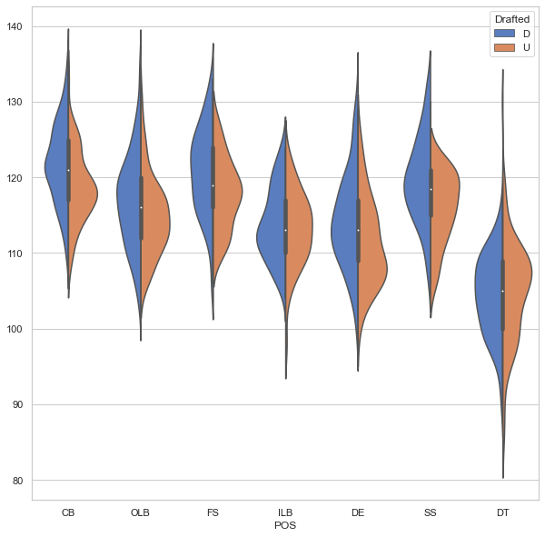
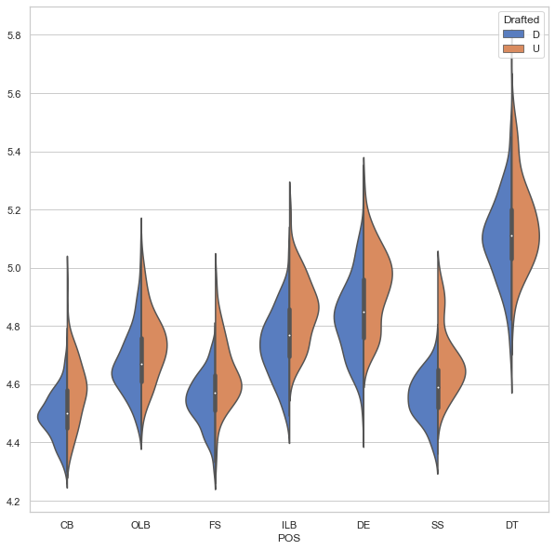
Exploratory Data Analysis
Broad Jump
40 Yard Dash

Slide 7
Pro bowl Selection
Predicting if a player would be a Pro Bowler based off their combine stats did not go so well
Trained many different models some underfit and some overfit
I was not satisfied with my findings
Model | Accuracy Score
Logistic Regression | 0.09
Logistic Regression w/ PCA | 0.92
Decision Tree | 0.52
Random Forest | 0.50
Gradient Boosting | 0.87
Gradient Boosting w/ PCA | 0.92

Slide 8
What went wrong? (Pro Bowl Selection)
The main reason is that there are so many other factors that play into being selected to the pro bowl
Popularity
Team they play for
NFL stats
In the future predicting a player's stats in the NFL based off the combine tests could lead to better results

Slide 9
Getting Drafted
Predicting a player getting drafted based of the combine scores went very well
Most models did a good job at predicting a player being drafted.
Model | Accuracy Score
Logistic Regression | 0.70
Logistic Regression w/ PCA | 0.69
Decision Tree | 0.52
Random Forest | 0.52
Gradient Boosting | 0.68
Gradient boosting w/ PCA | 0.70

Slide 10
Model Selection Getting Drafted
The best model to use was Gradient Boosting which produced a score of 0.71.
Feature Importance in order:
Three Cone Drill
Shuttle Run
Broad Jump
Vertical Leap
Bench Press
40-yard dash
Weight
Height

Slide 11
Feature Importance
When comparing the drafted and undrafted players on the Three cone and Shuttle run, they seemed to have similar scores
Shocking to see that the they were the top two most important features
Interesting that 40-yard dash, weight, and height were the bottom 3

Slide 12
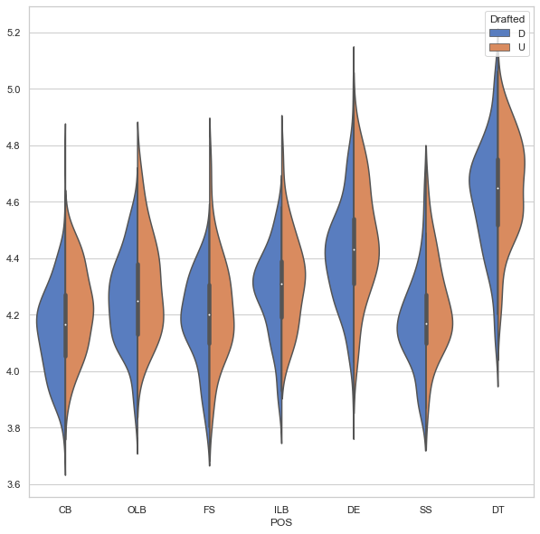
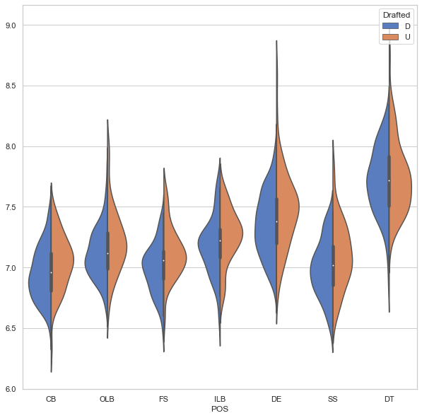
Exploratory Data Analysis
Shuttle Run
Three Cone Drill

Slide 13
Conclusion
The reasoning that Three Cone and Shuttle run were the most important features
Tests change of direction
Tests quickness
Tests explosiveness
For a defensive player these are very important
Shows they can get off the ball fast
Ability to cover
Ability to pass rush
Weight and height aren’t as important because if a player doesn’t have the skills their weight and height go to waste
40-yard dash wasn’t as important because playing defense you need to be quick side to side and not just quick running forward.

Slide 14
Moving Forward
Bring in data from the past 20 years
Preform same models on offensive players
Use College conferences to see number of players drafted in each
Use more graph visualization
Preform PCA on random forest and Gradient Boosting models

