Slide 1
NFL Draft Predictions
By
Jacob Kurstedt

Slide 2
Problems
Predicting whether a player would be good in the NFL based off NFL combine tests
Predicting whether a player would be drafted or not

Slide 3
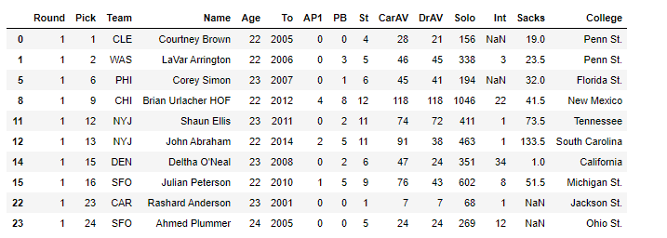
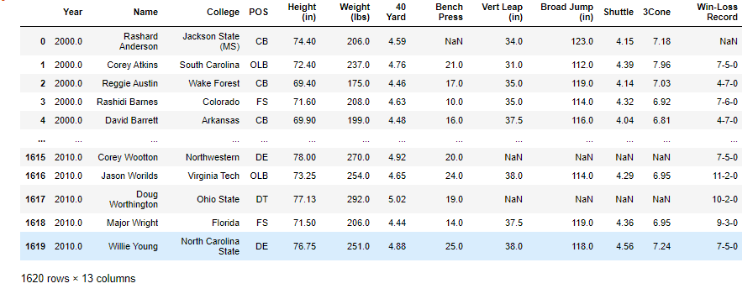
The Data

Slide 4
Data Wrangling
Renamed Columns to be more clear
Dropped unnecessary Rows
Filtered out all Offensive players
Filled in blanks with the mean of each combine test
Merged all my data into one table

Slide 5
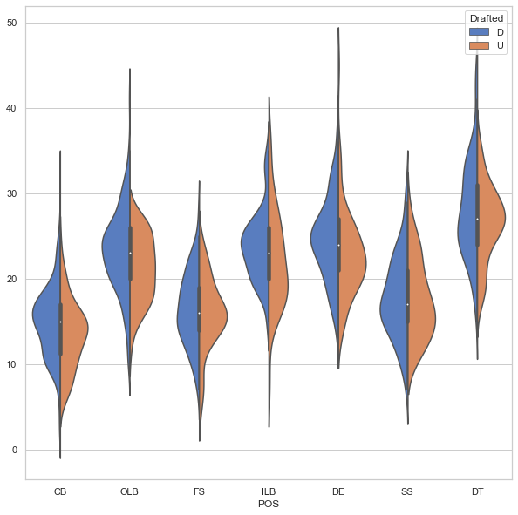
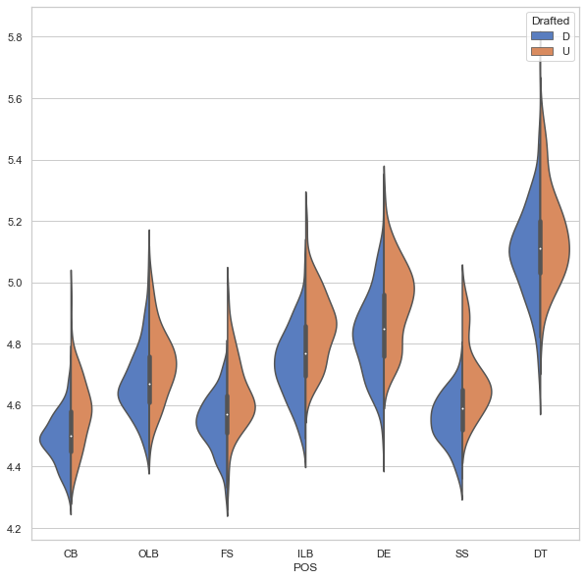
Exploratory Data Analysis
Bench Press
40 Yard Dash

Slide 6
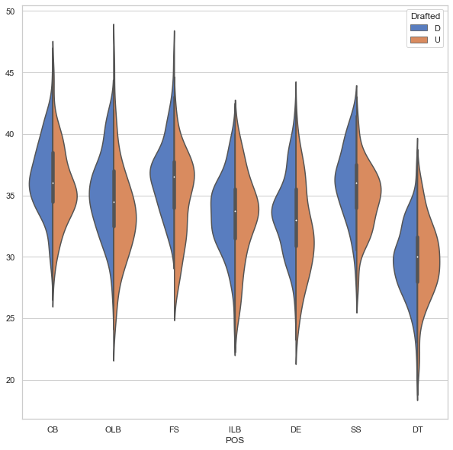
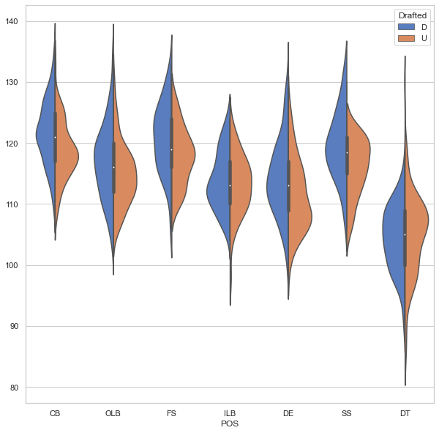
Exploratory Data Analysis
Vertical Leap
Broad Jump

Slide 7
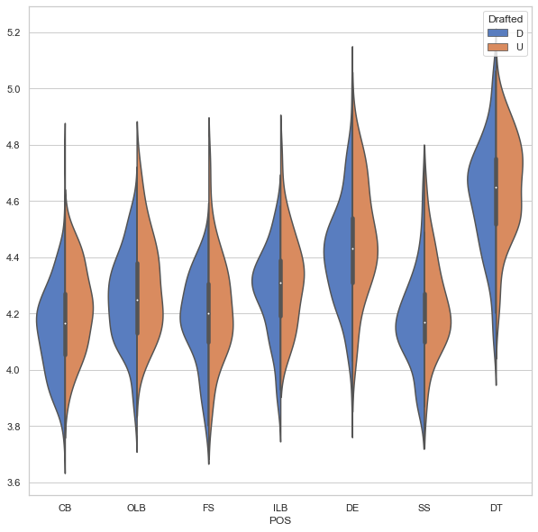
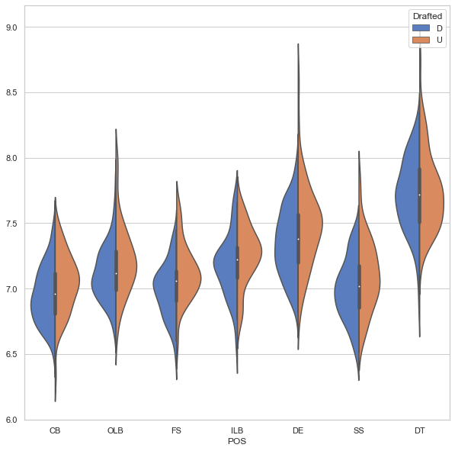
Exploratory Data Analysis
Shuttle Run
Three Cone Drill

Slide 8
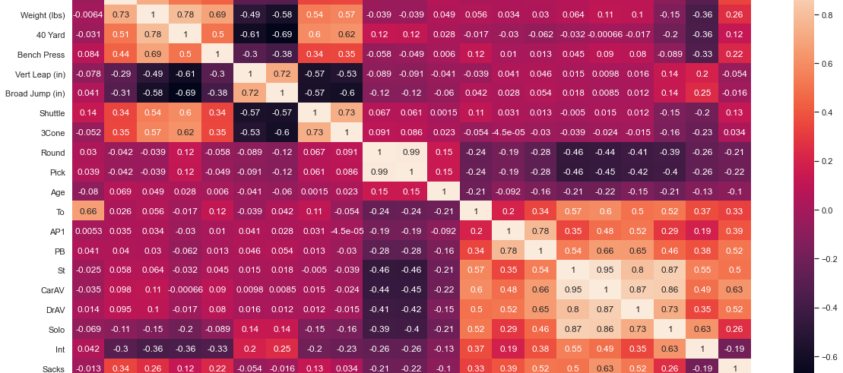
Exploratory Data Analysis

Slide 9
Preprocessing (Predicting Potential)
Created a variable Pro bowl select to use as my y variable to see players picked to go to the pro bowl
X variable all the draft combine tests
Logistic Regression balanced accuracy = 0.09
Logistic Regression with PCA balanced accuracy = 0.92
Decision Tree balanced accuracy = 0.52
Random Forest balanced accuracy = 0.50
Gradient Boosting balanced accuracy = 0.87
Gradient Boosting with PCA balanced accuracy = 0.92

Slide 10
Preprocessing (Predicting Drafted)
y variable was the column I created call Drafted
X variable all the draft combine tests
Logistic Regression balanced accuracy = 0.70
Logistic Regression with PCA balanced accuracy = 0.69
Decision Tree balanced accuracy = 0.52
Random Forest balanced accuracy = 0.52
Gradient Boosting balanced accuracy = 0.68
Gradient Boosting with PCA balanced accuracy = 0.7

Slide 11
Model Selection
Gradient Boosting was the best model
Parameters
Learning_rate = 0.05
Loss = ‘exponential’
Min_samples_split=5
Score was 0.71

Slide 12
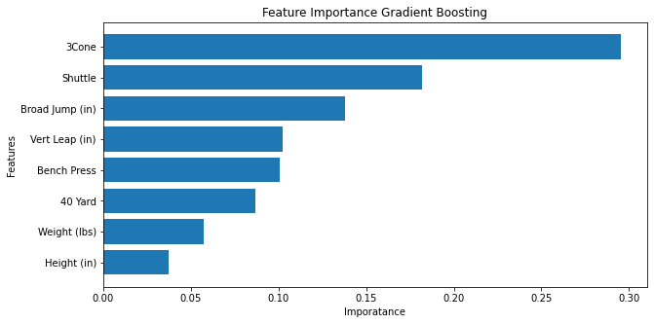
Model Selection Feature Importance

Slide 13
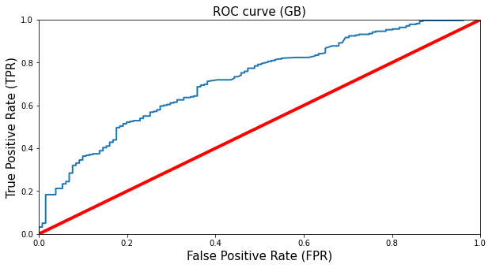
Model Selection ROC Curve

Slide 14
Conclusion
Gradient Boosting was the best model to choose
Three cone Drill and shuttle run were the two most important features
Height and weight seem to not be important at all

Slide 15
Moving Forward
Bring in data from the past 20 years
Preform same models on offensive players
Use College conferences to see amount of players drafted in each
Use more graph visualization
Preform PCA on random forest and Gradient Boositng models

