Slide 1


Angular for CF Developers
Josh Kutz-Flamenbaum
M.S. Information Systems Bumble and Bumble. Senior Software Architect jkutzflamenbaum@gmail.com / @jkutzfla https://github.com/jkutzfla/cf2018demo
Adobe ColdFusion Summit 2018
+
Notes:
BENEFITS of ANGULAR:
Better user experience
More organized code, fewer errors
Higher software quality
State of the art
Agility; better able to deliver your customer’s requests
Fun
This talk is about Angular, both AngularJS and the newest version, and why it is such a great platform for building interactive web apps and how to connect it to Adobe ColdFusion.
I’ve been working in software/web development for 23 years, I have worked for tons of different companies including education, start-ups, etc… I have a MSIS from NYU and I really think Angular is the Bees Knees!
As I’ll show, moving to a JavaScript based platform for software dev has a lot of benefits.
Chiefly, you are working right within the browser that the user is running.
So you are able to control the browser view and actions a lot easier than ever before.
This lets you build more advanced front-end applications that contain lots of data, business logic and interactivity.
The Angular framework gives you high level functionality, conventions and guidance on how to organize your code. This system of organization keeps your code agile, helps to isolate errors and find and eliminate them when they occur.

Slide 2
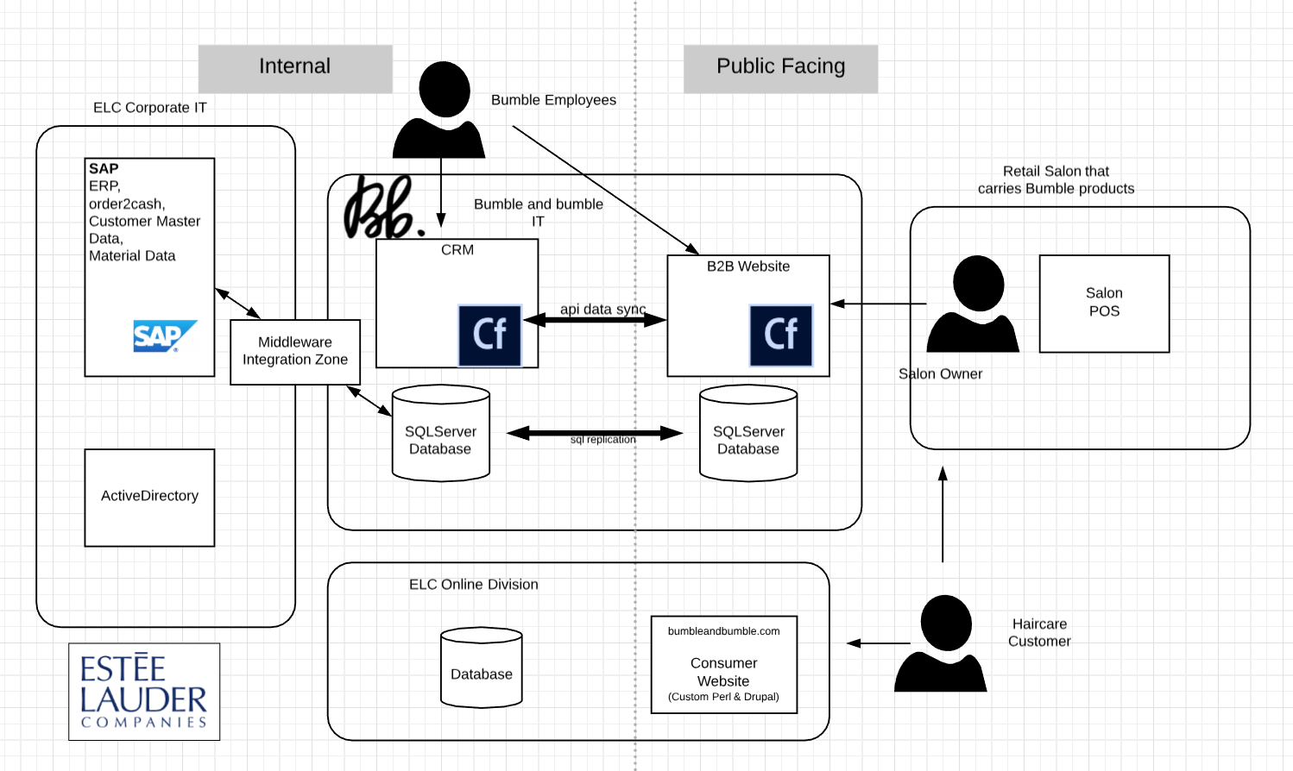
Bumble Technology Landscape
Notes:
I’ve been working at bumble for the past 10 years. When I started there was an entire software team, I was hired as the sr. software architect within that team. Over the past 10 years, most of the tech development has moved to Estee corporate and I am now the only person writing code, and making tech decisions. What’s more, I work full time for Bb which is housed in NYC but I live in PGH with my family and puppy. So I’m mostly working remotely. I inherited lots of legacy stuff and have found esp in the past few years that the site needs to maximize responsiveness as I get requests for changes with varying (but never long enough) time frames.
ColdFusion has provided a rapid application development framework and Angular really helps to add front-end functionality to the CF backend.
The business is always changing and I need software development tools that help me focus on delivering new functionality without getting stuck in the details and lower layers.
Lots of changes in the ecommerce / retail space. B2B customers want e-com like functionality,
Omnichannel
Digital Transformation within the enterprise.
Technology apps need to work correctly and intuitively since job functions are getting mixed around.

Slide 3
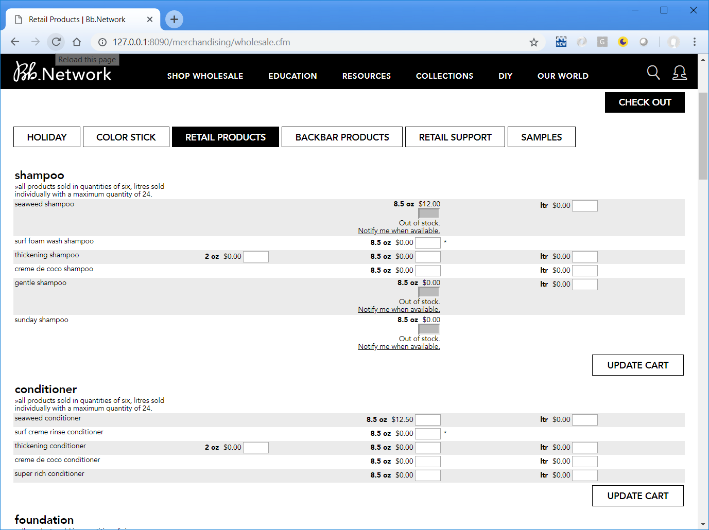
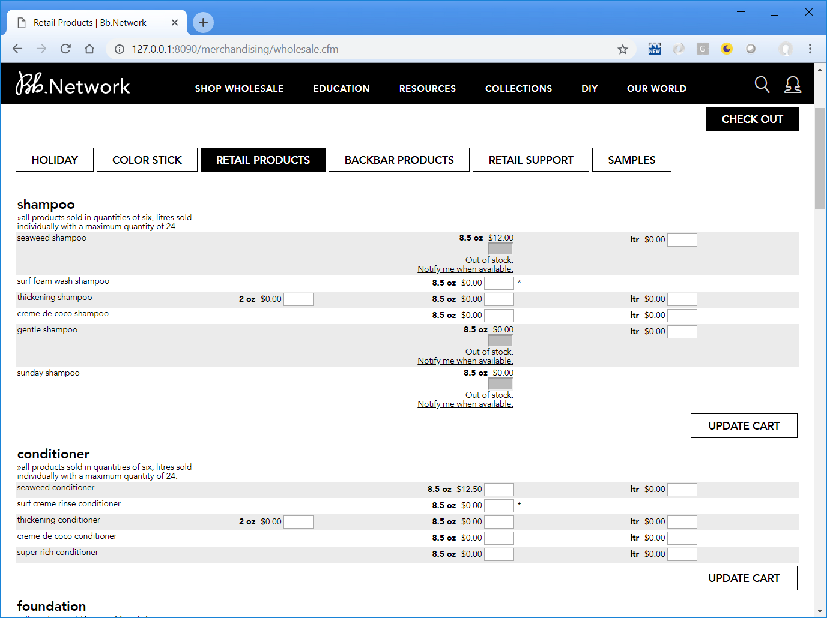
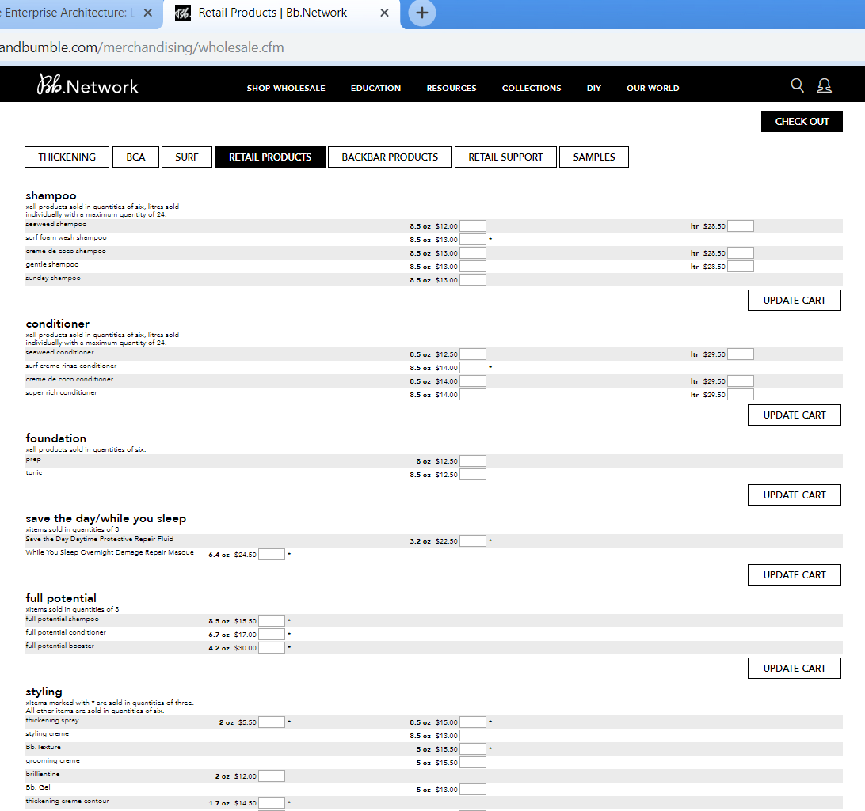
B2B website
Notes:
B2B Order form, for re-ordering.
Customers like the ability to enter multiple products at once.
A few years ago, the business needed to add out-of-stock information and notification.

Slide 4
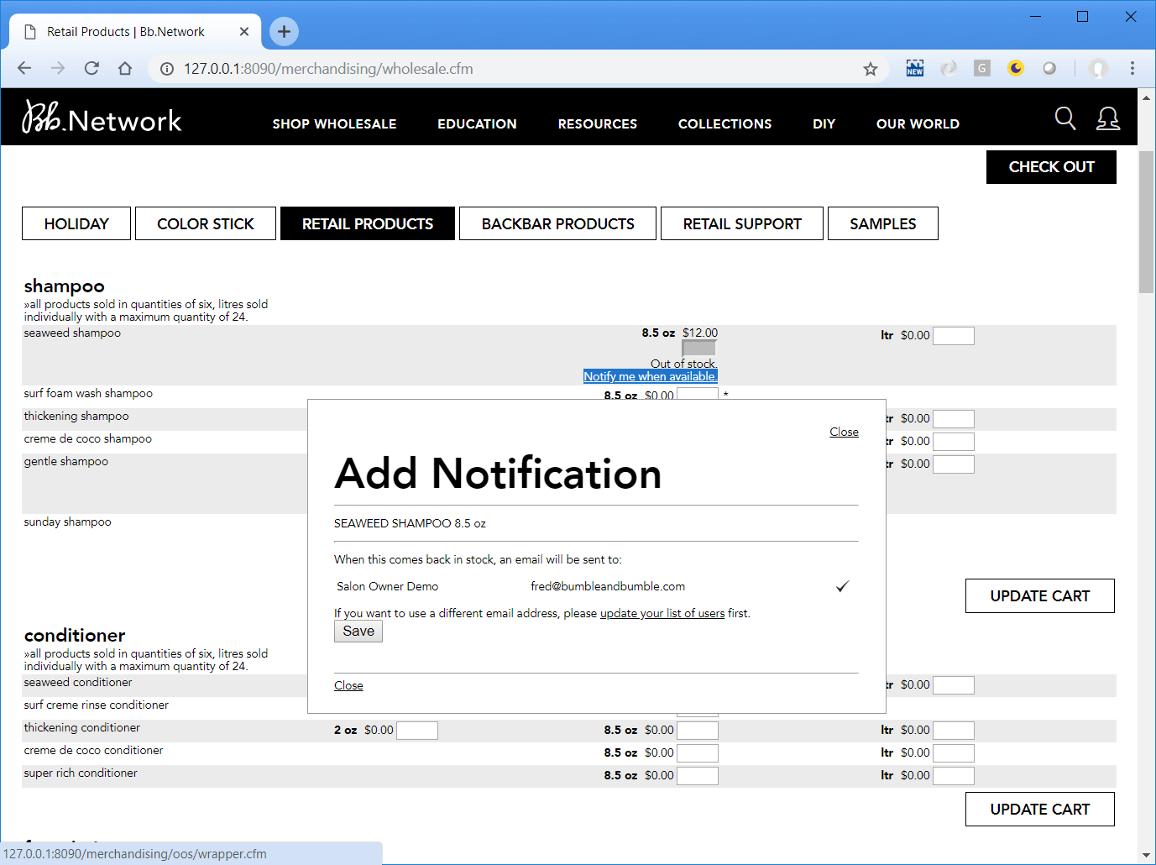
B2B website Popup
Notes:
B2B Order form, for re-ordering.
Customers like the ability to enter multiple products at once.
A few years ago, the business needed to add out-of-stock information and notification.

Slide 5
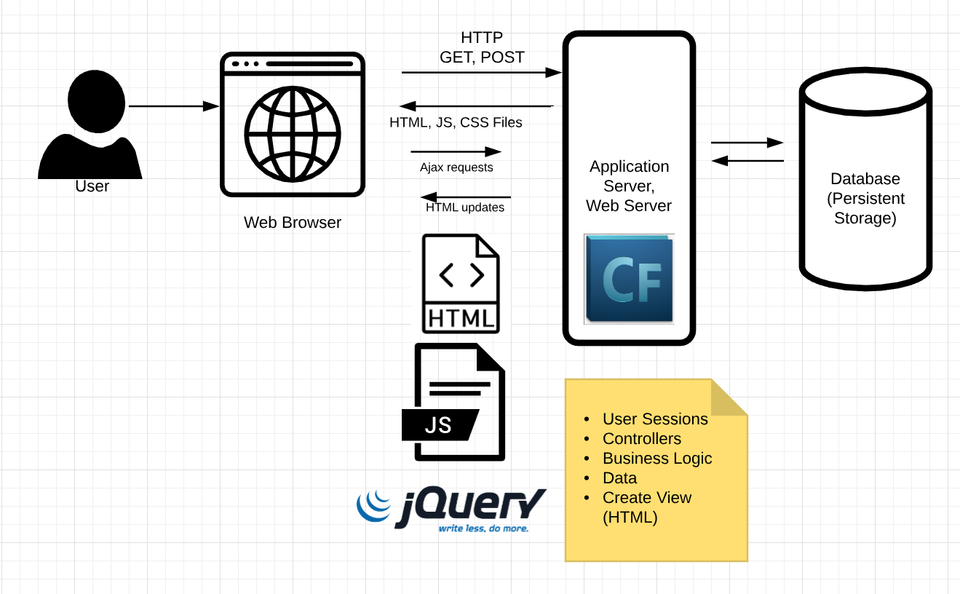
Traditional Web Dev
Old way of creating front-end functionality is limiting and frustrating.
Issues:
jQuery nested event handlers for each new interaction
Tightly coupled to the presentation layer: css styles and ids
The .cfm page called via Ajax does both data actions and HTML rendering
Notes:
Full page load,
Then augmented with jQuery event handlers.
3 main shortcomings:
Nested callbacks for each new interaction
Hyperlink takes the user away and loses state
Tightly coupled to the view
End result: hard to imagine adding more features or accommodating new business requests
.CFM files do double duty:
Controller/action code that manipulates data
PLUS
Returning HTML to present to the user

Slide 6
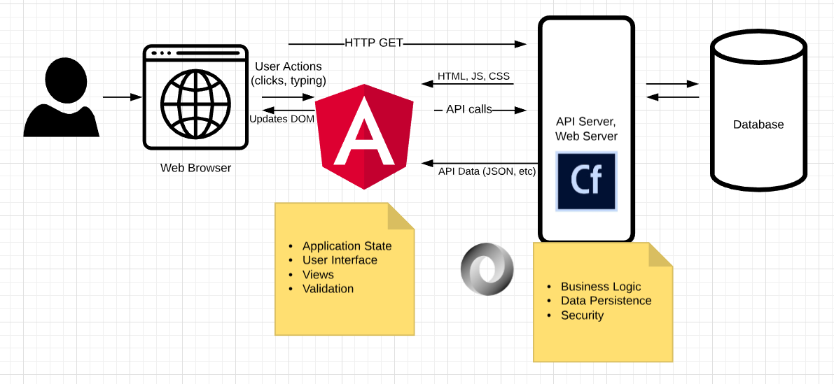
New Architecture
JavaScript is the world’s most popular language: https://insights.stackoverflow.com/survey/2018#technology
https://octoverse.github.com/
Notes:
Adopt a browser-centric, front-end application
ColdFusion becomes an API engine
Realize that the javascript interactions are application state.
JavaScript – the most popular language
https://insights.stackoverflow.com/survey/2018#technology
https://octoverse.github.com/

Slide 7
Technical Features & Advantages of Angular
Web component architecture
Two-way Data Binding & forms
Dependency Injection
Asynchronous HTTP Support
TypeScript in Angular 6
Also animation support but I ran out of time for this.
Notes:
Be here by 5:00

Slide 8
How to do it– connect to Adobe ColdFusion
Demo – a shopping cart of products
Demo code is also available: https://github.com/jkutzfla/cf2018demo
Same functionality in both AngularJS and Angular v6
Use Browser DevTools (F12) to show the api data
Notes:
Need to be here by 10:00, so you see how it worked out for me, the features and advantages. I think it will work great for you to. I want to take the time now to walk through a mock case.
Show both sites.
Make sure to create multiple carts.

Slide 9
Technical Features
Web Component Architecture
Two-way Data Binding & forms
Dependency Injection
Asynchronous HTTP Support
TypeScript in Angular 6

Slide 10
Introducing Web Components
A new* way to assemble a web application from discrete pieces
<html>
<body>
<h1>Title</h1>
<my-component my-parameter="Josh"></my-component>
</body>
</html>
Angular was created to “make HTML what it always wanted to be” -- Misko Hevery
* AngularJS 1.5.0 released February 2016 W3C standard
Notes:
Angular (and many current front-end frameworks) provide a way to organize your code into pieces and glue them together.
Angular was created to “make HTML what it always wanted to be” -- Misko Hevery
Web Component W3C standard:

Slide 11
Web Component Template Language
<!-- Angular.js Template Language: -->
<div ng-init="$ctrl.showContentFlag = false">
<button ng-click="$ctrl.showContentFlag = ! $ctrl.showContentFlag">
Click to toggle</button>
<div ng-if="$ctrl.showContentFlag">Content appears when true. </div>
</div>

Slide 12
Web Component Controller Syntax
// my-component.component.js
// add this to angular.module('app')
.component('myComponent', {
...
controller: function() {
this.showContentFlag = false; this.data = ['Model','Data','Here'];
this.doSomething = function() {
}
}
});
Lifecycle hooks:
$onInit()
$onChanges(changeObj)
$doCheck()
$onDestroy()
$postLink()
Notes:
Web Components give you a template and a controller for each part of your application.
Allow you to control the view and the interactions
Your model is the javascript variables exposed from the Controller.
The standard lifecycle hook methods give you control

Slide 13
Web Component Bindings Syntax
bindings: {
variableIn: '<',
twoWayData: '=',
actionOut: '&',
stringIn: '@'
}
These will be used to connect the components within your application. Send data “down”, receive actions “up”.
Notes:
Bindings are used to connect the components within your application.
Data down, actions Up

Slide 14
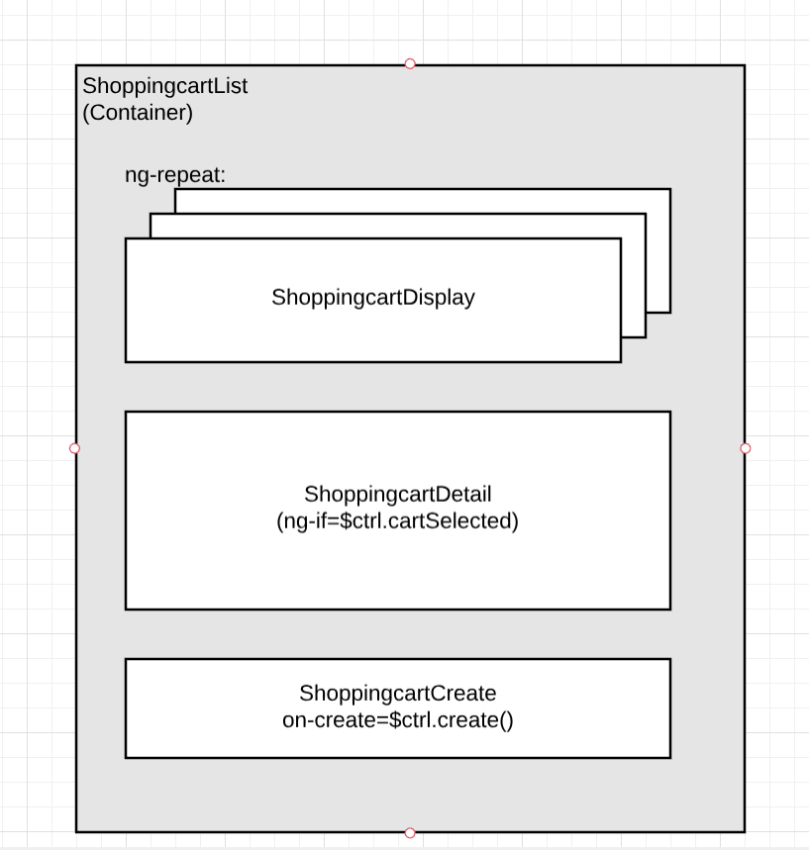
Web Component Architecture
Think of the application as a Tree of Components
Smart container pass data “down” to dumb presentation/view components
Events/Actions are passed “up” to the container
Container manages state and service calls
Benefits are: * Better code organization * Reuse * Explicit lifecycle hooks
Notes:
An Application is a Tree of Components

Slide 15
Define ShoppingcartListComponent
// shoppingcart-list.component.js // The App container
angular.module('app').component('shoppingcartList', {
bindings: {},
templateUrl: 'containers/shoppingcart-list/shoppingcart-list.html’,
controller: ['Shoppingcart', 'Product', function(Shoppingcart, Product) {
//functionality goes here
}]
});
<!-- index.html -->
<html><head><!-- include angular.min.js, app.js here -->
<script src="…path_to/shoppingcart-list.component.js"></script></head>
<body ng-app="app">
<shoppingcart-list>Loading...</shoppingcart-list>
</body>
</html>

Slide 16
ShoppingcartList Component - onInit()
$onInit() – explicit lifecycle method on the controller
Get data from a service and store it
// inside shoppingcart-list.component.js controller
// this.cartlist is a variable on the controller.
// In the template it will be accessible as $ctrl.cartlist.
this.cartlist = [];
this.$onInit = function() {
this.isLoading = true;
var self = this;
//Shoppingcart was injected
Shoppingcart.getList().then( function() {
self.cartlist = Shoppingcart.cartlist;
Product.getList().then(function() {
self.isLoading = false;
});
});
}

Slide 17
ShoppingcartList Passes Data Down
<!-- File: shoppingcart-list.html
shoppingcart-list loops the carts and passes each to the display component: -->
<ul>
<li ng-repeat="c in $ctrl.cartlist" style="display: block;">
<shoppingcart-display cart="c"></shoppingcart-display>
</li>
</ul>
// shoppingcart-display.component.js angular.module('app').component('shoppingcartDisplay', {
bindings: {
cart: '<' //input
},
templateUrl: 'components/shoppingcart-display/shoppingcart-display.html',
controller: function() {}
});
<!– File: shoppingcart-display.html -->
<span>Id: {{$ctrl.cart.id}} - name: {{$ctrl.cart.name}}</span>
Notes:
This allows for code organization where components that just need to display the cart go in their own file.

Slide 18
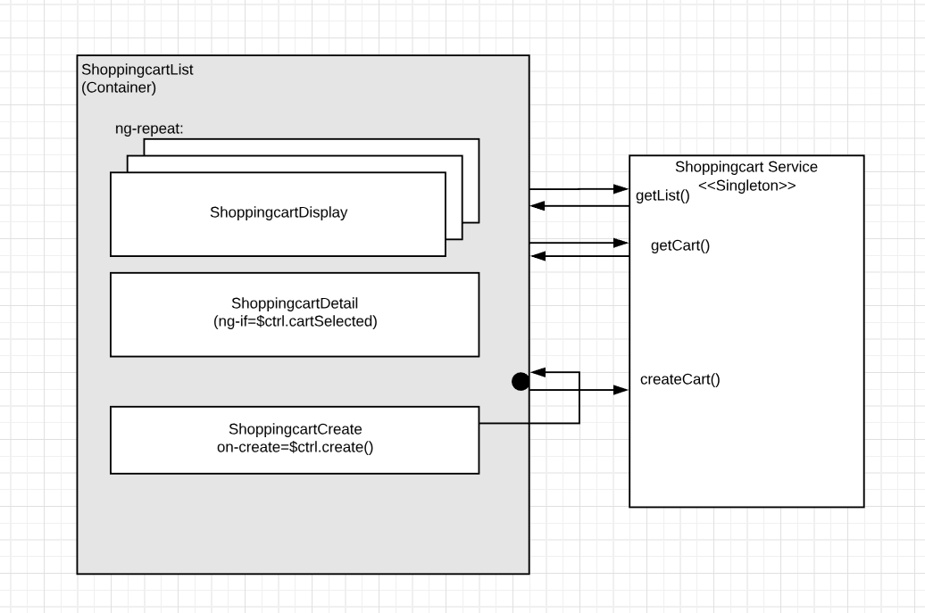
Data down, Actions up
The ShoppingcartCreate
create() action
is passed “up” to the ShoppingcartList
Notes:
Walk through the ShoppingcartCreate.create() action that is passed up to the List container.
Explain that the black dot is a function on the ShoppingcartList component.
You never have to worry about scope, just find the component’s controller.

Slide 19
ShoppingcartCreate passes the ‘onCreate’ Action up
// shoppingcart-create.component.js binding to pass an event up
angular.module('app').component('shoppingcartCreate', {
bindings: {
onCreate: '&' },
// when the create button is clicked:
this.create = function() {
console.log('create() in shoppingcart-create');
this.isLoading = true;
var self = this;
this.onCreate({name: this.name}).then(function() {
self.isLoading = false;
self.name = "";
});
}

Slide 20
onCreate Event is bound by the ShoppingcartList container
// Back in shoppingcart-list.component
//
// we have bound to this method:
// <shoppingcart-create on-create="$ctrl.createCart(name)">
this.createCart = function(name) {
console.log('in create, name=', name);
this.isLoading = true;
var self = this;
return Shoppingcart.create(name).then( function() {
self.cartlist = Shoppingcart.cartlist;
self.isLoading = false;
});
}

Slide 21
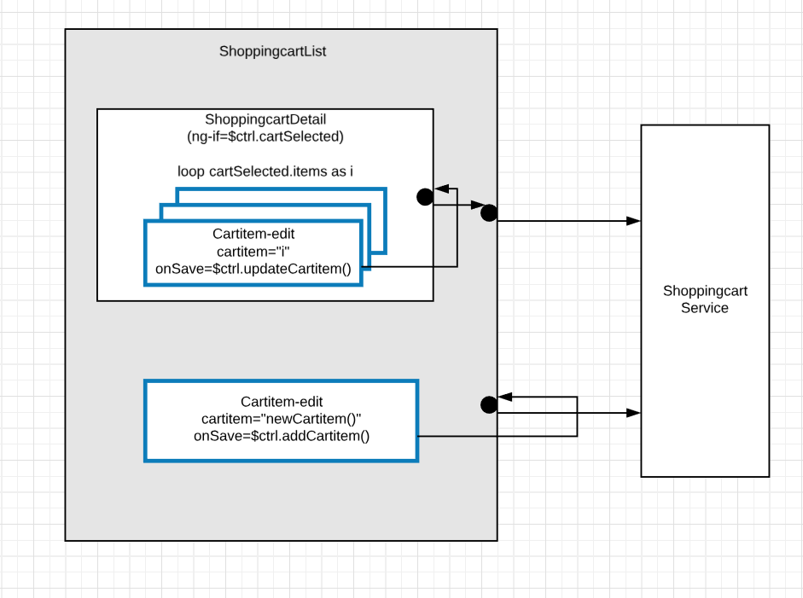
Component Reuse Achieved!
cartitem-edit component is used twice:
add a new item
edit existing item
The same component is bound to two different container methods
Benefit: the populateProduct() and cartWorkingTotal() logic inside cartitem-edit is not duplicated.
Notes:
Same binding rules as the CartCreate component, but the CartItemEdit component is used in two different cases.
The same component is bound to two different actions.
I really feel like this opens the possibility to build whole apps from elements.
It will make the ui consistent
Creating your custom elements is like meta-programming! Building blocks (legos)
Because it gives you view, controller, lifecycle & event listening.

Slide 22
AngularJS Web Components & ColdFusion
Can call them within a .cfm
4 steps:
Include angular
Include your javascript source code
Set the ng-app (must match your angular.module name)
Call the web component
In a pinch, you can also pass JSON as an input
<!--- e.g. in Bumble wholesale.cfm --->
<cfset upc=“123”>
<oos-notice upc=“#upc#”></oos-notice>
Notes:
To me, this is like a <cfinclude > on Steroids!

Slide 23

Demo of JSON sent from CF to ng
/www/samples/in_a_pinch.cfm
(JSON will be discussed more in the http section)

Slide 24
Technical Features
Web component architecture
Two-way Data Binding & forms
Dependency injection
Asynchronous HTTP Support
TypeScript
Notes:
Explain each of these, maybe with visual, not code.

Slide 25
Two-way Data Binding
<!-- cartitem-edit.html -->
<br>Working total: {{$ctrl.getCartTotal() | currency}}
<form>
<select … ></select>
<input type="number" placeholder="Quantity"
ng-model="$ctrl.item.quantity">
<input type="number" placeholder="Price"
ng-model="$ctrl.item.priceDollar">
</form>
<div>
<button class="btn btn-large" ng-click="$ctrl.addItem()">addItem</button>
</div>
Notes:
Ng-model powers the two-way data binding.
As the user changes the value, it is instantly sent back to the JavaScript variable.
Which is read in the controller method getCartTotal()
This can provide instant user feedback.
In the Demo:
When adding items to cart.
And when creating a new cart, to ensure the name is set

Slide 26
Ng-model with Form Validation
<form #promocodeForm="ngForm">
<div class="form-group">
<label for="message">Message:</label>
<input type="text" class="form-control" id="message"
required
[(ngModel)]="promocode.message" name="message"
#message="ngModel">
<div [hidden]="message.valid || message.pristine" class="alert alert-danger">
Message is required
</div>
</div>
<div>
<button (click)="save()" class="btn btn-success"
[disabled]="!promocodeForm.form.valid || isSaving">
Save</button>
<span *ngIf="isSaving">Saving...</span>
</div>
</form>
See promocode-edit.component.html in ngNetwebAdmin

Slide 27
Technical Features
Web component architecture
Two-way Data Binding & forms
Dependency Injection
Asynchronous HTTP Support
TypeScript in Angular 6

Slide 28
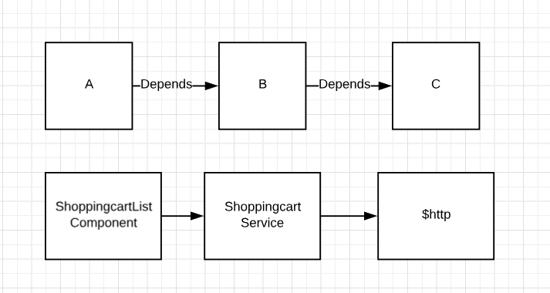
Dependency Injection
Software is assembled from small pieces to large
One piece depends on others
But sometimes the connections can be hard to manage
Instead of direct dependencies, use DI libraries (avoid calling ‘new’ yourself)
Why? More modular code, testability, avoid spaghetti code and avoid Global scope
https://martinfowler.com/articles/injection.html https://wirebox.ortusbooks.com/getting-started/overview add di/1
Notes:
Double check this in head first Design Patterns
We see this in our app already with the ShoppingcartService that SC-list depends on, and which depends on $http

Slide 29
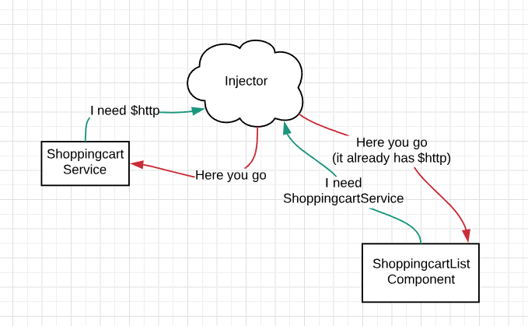
Dependency Injection in the Demo
Notes:
My definition: A Service is something that can be called directly from client code, and it knows how to get it’s own dependencies.
Facilitates service composition.
Supports the scenario down the road when a Promo service needs to know about Users, Products and Carts.

Slide 30
DI Eliminates complex object creation
You should not call ‘new’ yourself.
Why? If the services are constructed for you, they can be swapped out behind the scenes if you want to write tests for your http services.
And it becomes easier to combine discrete services if you are not worried how to create them
Avoid:
ShoppingcartListComponent:
New ShoppingcartService();
New ProductService();
ShoppingcartService:
New $http();
X
X
X
Notes:
This pattern is also part of MVC – you write the controllers but you never call the methods yourself.
This might be a code smell

Slide 31
Dependency Injection examples from Demo
Declare the dependency when creating the service or component
Use the injected object (as a Singleton)
// shoppingcart.service.js
// create the Shoppingcart service
angular.module('app’)
.factory('Shoppingcart’, ['$http', function($http) {
//later:
$http.get(url);
}
// in shoppingcart-list.component.js:
// inject the Shoppingcart service
controller: ['Shoppingcart', function(Shoppingcart) { this.$onInit = function() {
//Shoppingcart was injected
Shoppingcart.getList();
}
N.B. This syntax will fail if code is minified. See ng-annotate to support minification.
Notes:
Same module?
The services include in AngularJS start with a $.
$http, $location, $window.
Basically anything outside of the view and controller data should be accessed as a service.

Slide 32
DI – real world example
// example from Bumble University Registration System angular.module('core')
.factory('Attendee', ['BbUClass','AttendeeExperienceRequired', 'ContactEduhistoryCheck', 'Account',
function (BbUClass, AttendeeExperienceRequired, ContactEduhistoryCheck, Account) {
// later in the Attendee service,
// validity requires checking multiple domain objects:
// the BbUClass, the EduHistory, the Account contact info
if (this.contactType != 'tbd' && ContactEduhistoryCheck.isCheckNeeded()) {
if (this.contactId != '') {
var contact = Account.findContact(this.contactId);
var check_edu = ContactEduhistoryCheck.check(contact);
if (!check_edu) {
this.errorMessages.push('Bb.U Prereqs are not satisfied.')
}
}
}
Notes:
Real world gets complicated.
DI is there to help.

Slide 33
ngModule
// app.js
// step 1: define your module and specify required modules
angular.module('app', ['shared']);
// step 2-n, add stuff to the module
angular.module('app').component('name', {});
Like the DI system, angular modules allow for code to be divided into independent files and re-combined.
The only global object is ‘angular’!
Everything is added to the angular.module(‘modulename’)
.component() .factory() .directive() .pipe()
Notes:
No global scope is a good thing
Just need a <script> tag on each file, the order does not matter. Because modules delay execution.
https://docs.angularjs.org/guide/module

Slide 34
Technical Features
Web component architecture
Two-way Data Binding & forms
Dependency Injection
Asynchronous HTTP Support
TypeScript in Angular 6

Slide 35
Asynchronous = “Out of time”
In a Web Browser, all resources are loaded across the network
This action cannot block the main application thread or the application would freeze; terrible UX
So the network requests occur in a separate thread, asynchronously, and the programmer does not know when they will complete.
But programming logic must be written in an imperative manner: if this, then that.
So Promises are added to AngularJS to give you control
JavaScript Promises are closures and will affect scope, see:
http://javascriptissexy.com/understand-javascript-closures-with-ease/
Notes:
What is a closure? A closure is an inner function that has access to the outer (enclosing) function’s variables—scope chain. The closure has three scope chains: it has access to its own scope (variables defined between its curly brackets), it has access to the outer function’s variables, and it has access to the global variables. http://javascriptissexy.com/understand-javascript-closures-with-ease/

Slide 36
AngularJS Promise API:
// angularJS Promise API:
function then(successCallback, [errorCallback], [notifyCallback])
function catch(errorCallback)
function finally(callback, notifyCallback)
//used like:
var self = this;
$http.get('url').then(function(response) {
console.log('received response', response);
self.userid = response.data.userid;
})
.catch( function(error) {
console.log('received error: ', error);
})
.finally( function() {
console.log('finally runs regardless');
});
Notes:
Inside the then(), that is where your code will run.
It is a function call that over-writes the ‘this’ keyword, so need to save this elsewhere, convention is to save it in var self;
But you don’t need to include the catch and finally on each call.
Just handle failures in a Interceptor

Slide 37
Services return the Promise
// in shoppingcart.service.js
// will return a promise from the $http.get()
getList: function() {
var url = "/api/cart/list";
//$http was injected:
return $http.get(url).then(function (response) {
// store the result in the object:
service.cartlist = response.data;
});
},

Slide 38
Chaining Promises
By returning the Promise object, you can chain .then() after .then() and write code that will only run after the required network requests are done.
// onInit in shoppingcart-list.js
this.$onInit = function() {
this.isLoading = true;
var self = this;
//Shoppingcart object was injected
Shoppingcart.getList().then( function() {
// inside the promise returned by Shoppingcart.getList()
self.cartlist = Shoppingcart.cartlist;
Product.getList().then(function() {
// inside the promise from Product.getList(), now template is ok to render:
self.isLoading = false;
});
});
}

Slide 39
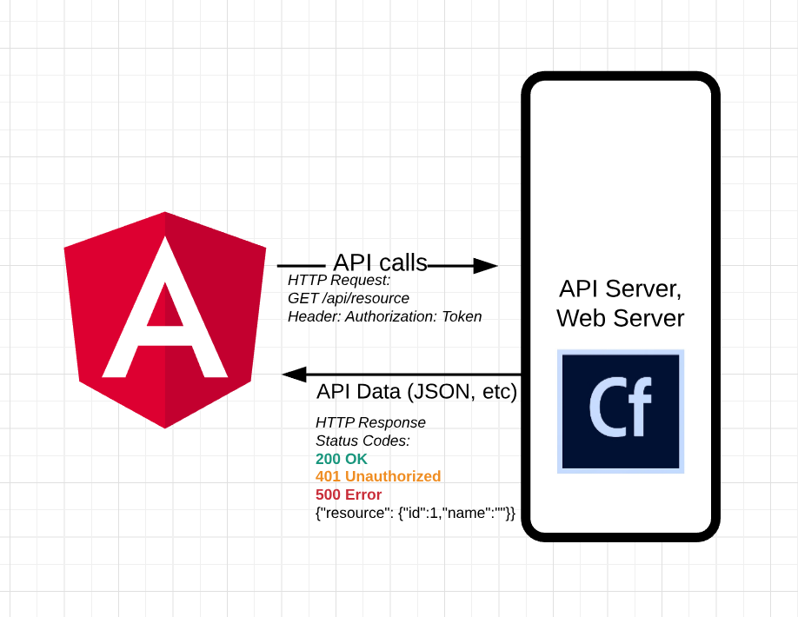
API Authentication
Use HTTP Interceptors within the Angular app:
Add the api auth token to outgoing requests
Check incoming responses for auth errors and forward to login
This is a design choice, it could also be handled by an API Service class in Angular that all calls are sent thru.

Slide 40
ColdFusion receive JSON
// in a .cfm:
// how to get the HTTP body from Angular:
dataIn = deserializeJSON(getHTTPRequestData().content);
// FW/1 config:
variables.framework = {
decodeRequestBody = true, // will convert the JSON from the HTTP body
preflightOptions=true // respond to OPTIONS request

Slide 41
ColdFusion send JSON
<!--- in a .cfm, build up one object and output --->
id = regSrv.getRegistrationId();
data = {"id"=id};
<cfheader name="Content-Type" value="application/json">
<cfoutput>
#serializeJSON(data)#
</cfoutput>
Also: <cffunction access=“remote” returnFormat=“json”>
/**
* FW/1 API for Josh Kutz-Flamenbaum Angular Demo
*/
component accessors="true" {
property framework;
property CartService;
function list(struct rc) {
var carts = variables.CartService.list();
variables.framework.renderData().data(carts).type("json");
}

Slide 42
ColdFusion JSON Serialization
CF11 – will preserve the case of the struct key
Set this.serialize in Application.cfc
Otherwise always set with {“keyName”=value}
CF2016 update 2 – able to enforce data types with setMetadata()
Timezones?
When in doubt, write some tests
// Application.cfc - CF2018 Demo
component {
this.name = "CF2018Demo";
// the default is false, meaning that struct keys are force to UPPPERCASE.
this.serialization.preserveCaseForStructKey = true;
}
https://helpx.adobe.com/coldfusion/cfml-reference/coldfusion-functions/functions-s/serializejson.html
https://cfdocs.org/serializejson

Slide 43
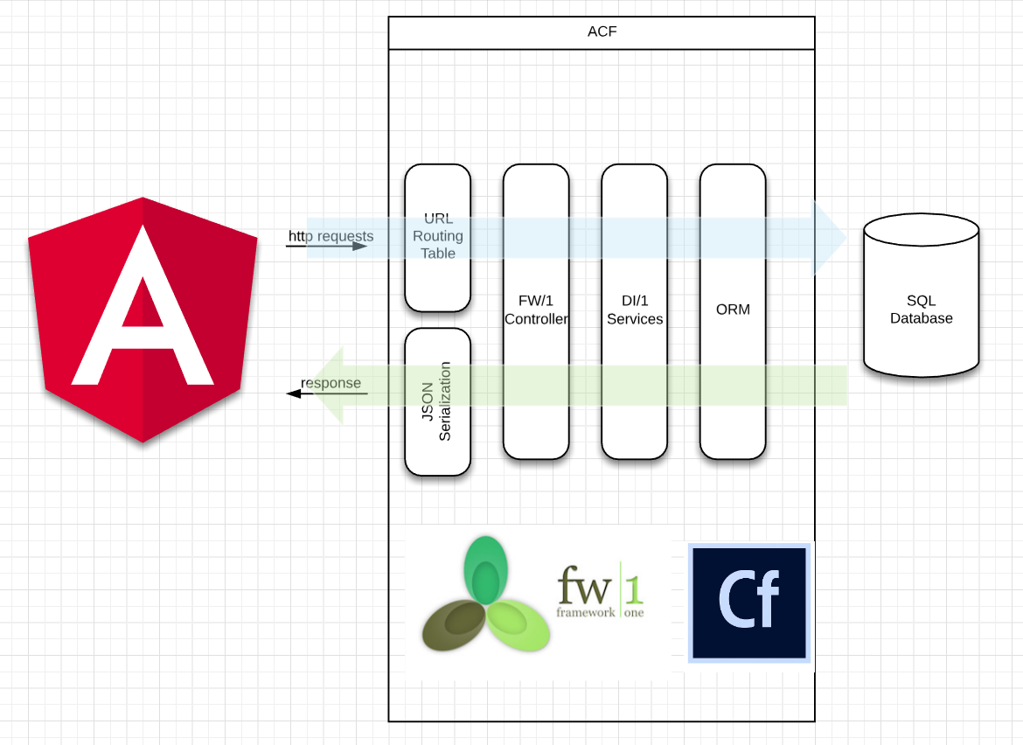
ColdFusion API Architecture
Notes:
Layers keep the code clean, each layer has its own concerns.
DI for the services means that each one can be used in isolation.
So if, down the road, I need a new feature like CustomerPromotions that uses Carts, Products and Users, I can create a new service that injects each and build on top. See file: /api/model/services/CustomerPromotionService.cfc

Slide 44
AngularJS vs Angular 6
AngularJS
Angular #itsjustangular
Version 1.7 July 2018 LTS
3 years of security and browser compatibility fixes
Version 6 May 2018 6 months active support 12 months LTS (LTS starts November 2018)
Version 7 expected Fall 2018
Version 8 expected Spring 2019
Source: https://docs.angularjs.org/misc/version-support-status#
Source: https://angular.io/guide/releases
Notes:
Be here at 30:00 - 35:00
I see AngularJS as good for adding bits to existing sites,
Angular v6 good for new full size applications

Slide 45
Technical Features
Web component architecture
Two-way Data Binding & forms
Dependency Injection
Asynchronous HTTP Support
TypeScript in Angular 6

Slide 46
Angular version 6
TypeScript
Benefits: type safety on code, libraries & JSON
JSON data casted to a TS Interface in one line!
Static checks while transpiling to js
Developer Productivity benefits: Intellisense in typescript-aware editor
Very useful to see your controller variables while in HTML view.
JavaScript ES6
Benefits:
import/export is simple compared to ES5 add ons (CommonJS, RequireJS)
Decorators are a clean way to add meta info to source code.
New language syntax: ‘let’ and ‘const’ variables
Fat arrow => makes closure code easier because ‘this’ is left alone
Requires polyfills
Observables
Benefits: react to browser events with more control
ng CLI – scaffold code & build/optimization tool
* ECMAScript 5 (2009) compared to ES6 ECMAScript 2015
Notes:
ECMAScript 5 (2009) compared to ES6 ECMAScript 2015

Slide 47
Web Component Architecture stays the same in Angular 6

Slide 48
Same Web Component Concepts, New Syntax
// shoppingcart-detail.component.ts
import { Component, OnInit, Input, Output, EventEmitter } from '@angular/core';
import { Shoppingcart, ShoppingcartItem } from '../../core/shoppingcart.interface';
@Component({
selector: 'app-shoppingcart-detail',
templateUrl: './shoppingcart-detail.component.html' })
export class ShoppingcartDetailComponent implements OnInit {
@Input() cart: Shoppingcart;
@Output() updatedItem = new EventEmitter<ShoppingcartItem>();
selectedCartitem = 0;
constructor() { }
updateItem(item: ShoppingcartItem) {
console.log('updateItem() in sc-detail.comp');
this.updatedItem.emit(item);
} }
Notes:
@Input()
@Output() – uses Observable

Slide 49
Angular 6 Template Syntax
<!-- shoppingcart-detail.component.html -->
<h3>Cart: {{cart.name}} ({{cart.id}})</h3>
<div *ngIf="!cart.items || cart.items.length == 0">No items</div>
<ul>
<li *ngFor="let i of cart.items">
{{i.productName}} {{i.quantity}} @ {{i.priceDollar | currency}}
<span *ngIf="i.id == selectedCartitem">
<button (click)="selectedCartitem=0">Close</button>
</span>
<span *ngIf="i.id != selectedCartitem">
<button (click)="selectedCartitem=i.id">Edit</button>
</span>
<div *ngIf="selectedCartitem==i.id">
<app-cartitem-edit [cart]="cart" [cartitem]="i" (savedShoppingcartItem)="updateItem($event)"></app-cartitem-edit>
</div>
</li>
No $ctrl. anymore
Notes:
*ngIf
*ngFor
{{ }} is the same
| pipes are the same
[cart] – data down
(savedShoppingcartItem) – is an action up

Slide 50
DI Angular 6
import { Component, OnInit } from '@angular/core';
import { ProductService } from '../../core/product.service';
import { ShoppingcartService } from '../../core/shoppingcart.service';
import { Shoppingcart, ShoppingcartItem } from '../../core/shoppingcart.interface'; @Component({
selector: 'app-shoppingcart-list',
templateUrl: './shoppingcart-list.component.html’ })
export class ShoppingcartListComponent implements OnInit {
isLoading: boolean;
cartList: Shoppingcart[];
cartSelected: Shoppingcart; constructor(
private productService: ProductService,
private shoppingCartService: ShoppingcartService) { }
ngOnInit() {
this.isLoading = true;
this.cartList = [];
this.getProducts();
this.getCarts();
}
Notes:
Here’s how you inject your dependencies.

Slide 51
Angular 6 Create Service
// @Injectable decorator creates a Service.
// providedIn: 'root' ensures Singleton.
@Injectable({ providedIn: 'root' })
export class ShoppingcartService {
private apiUrl = '/api/cart';
constructor(
private http: HttpClient ) {}
// service methods here
}
Notes:
Declare something Injectable

Slide 52
Observables replace Promises
// in shoppingcart.service.ts
// create an Observable of an array of Shoppingcart
// to be subscribe()'ed in a component.
getCartlist(): Observable<Shoppingcart[]> {
const apiUrl = this.apiUrl + '/list';
return this.http.get<Shoppingcart[]>(apiUrl);
}
// shoppingcart-list.component.ts
// called from ngOnInit or to update the list of carts.
getCarts(): void {
// subscribe to the Observable,
// save the data in the component and flip the isLoading flag.
this.shoppingCartService.getCartlist()
.subscribe(carts => {
this.cartList = carts;
this.isLoading = false;});
The intro to Reactive Programming by André Staltz: https://gist.github.com/staltz/868e7e9bc2a7b8c1f754
Notes:
Reactive Programming is a big new topic.
But re-iterate that they are still designed to be within the Services that you get from DI.
A Promise is an Observable that returns one thing
http://rxmarbles.com/

Slide 53
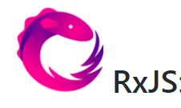

forkJoin Multiple Observables
ngOnInit() {
this.isLoading = true;
this.cartList = [];
const products = this.productService.getProductsCached();
const carts = this.shoppingCartService.getCartlist();
// when starting up, dont show the page until
// all required network resources are loaded.
// forkJoin is the Promise.all for rxjs.
forkJoin( [products, carts] ).subscribe( results => {
// results[0] is products,
// results[1] is carts.
this.cartList = results[1];
this.isLoading = false;
});
Like chaining the Promise.then()’s in AngularJS, this uses a Boolean flag to delay the page render until both the Product and Shoppingcart services have returned. This example loads in parallel.

Slide 54
TypeScript your JSON
{ "cart": {
"totalDollar": 145.94,
"dateModified": "September, 25 2018 05:23:55",
"totalPoint": 0,
"items": [
{
"priceDollar": 14.99,
"quantity": 3,
"dateModified": "September, 24 2018 18:06:50",
"pricePoint": 0,
"id": 28,
"productName": "Drug Store Conditioner",
"dateCreated": "September, 24 2018 18:06:50"
},
{
"priceDollar": 28.00,
"quantity": 2,
"dateModified": "September, 25 2018 05:23:32",
"pricePoint": 0,
"id": 30,
"productName": "Prestige Conditioner",
"dateCreated": "September, 25 2018 05:23:32"
},
{
"priceDollar": 14.99,
"quantity": 3,
"dateModified": "September, 25 2018 05:23:55",
"pricePoint": 0,
"id": 31,
"productName": "Drug Store Shampoo",
"dateCreated": "September, 25 2018 05:23:55"
}
],
"id": 14,
"dateCreated": "September, 24 2018 16:47:15",
"name": "12123213"
}
}
Turn this:

Slide 55
TypeScript your JSON
export interface Shoppingcart {
id: number;
name: String;
totalDollar?: number;
totalPoint?: number;
items?: ShoppingcartItem[];
dateCreated: Date;
dateModified: Date;
}
export interface ShoppingcartItem {
id: number;
quantity: number;
priceDollar: number;
pricePoint?: number;
productName: string;
productId?: number;
dateCreated: Date;
dateModified: Date;
}
Into this:
Notes:
Type safety and Object mapping for JSON.
Opens potential to work with big amounts of JSON data.

Slide 56
TypeScript your JSON
// in shoppingcart.service.ts
// do HTTP GET /api/cart/{cartId}
getCart(cartid: Number): Observable<Shoppingcart> {
return this.http.get<any>(this.apiUrl + '/' + cartid)
.pipe(
map(response => response.cart as Shoppingcart),
tap( … )
);
}
By doing this:
Notes:
Don’t forget the map() !!!!!

Slide 57
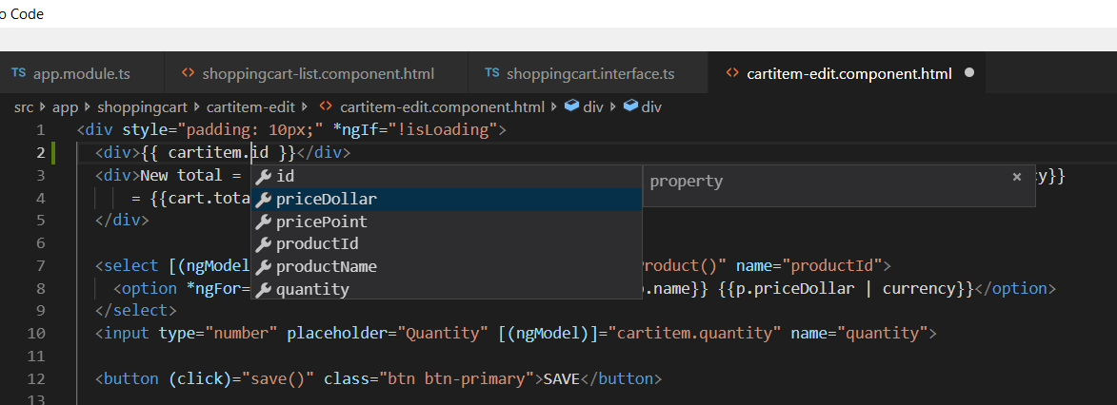
Intellisense (in a template)
VS Code w/ Angular Language Service Extension & TypeScript support
Notes:
Is this incredible or what?
The level of engagement feels like playing a video game!
Is there any other language and IDE that can compare? Serious question?

Slide 58
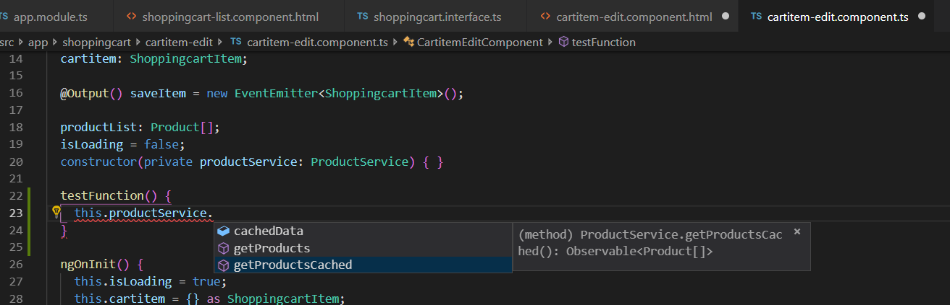
Intellisense (in .ts files)
N.B. VS Code + CFML Extension by KamasamaK + CFLint.jar will intellisense var scope bugs in a <cfcomponent>!

Slide 59
Conclusion
By adopting Angular, you will gain:
Best of both worlds:
Pure js frontend
Pure cf backend
Usability, Agility, Quality
Code Reuse
Performance
Developer Productivity & Engagement

Slide 60
Q & A
Do you think you will try Angular?
Version 1.7 or 6?
Submit your survey in the app to enter the $25 raffle. (You must be registered for this session)

Slide 61
P.S.
Don’t forget:
Error reporting
Need a reporting endpoint and an Exception Override
Not perfect
Browser compatibility
Need Polyfills for some js functionality (find, map, …)
There will be some duplication between app and API
Validation
SEO & first time page render
Security
Case-insensitivity

Slide 62
Exception Override
Catch errors and forward to a logger endpoint
// File misc/exceptionOverride.js
var mod = angular.module('exceptionOverride', []);
mod.config(function ($provide) {
$provide.decorator("$exceptionHandler",
['$delegate', '$injector', function ($delegate, $injector) {
return function (exception, cause) {
var $http = $injector.get("$http");
var $log = $injector.get("$log");
var registration = $injector.get("Registration");
registration.account.contacts = ['Snipped']; //dont need these filling the error log.
console.log("Registration", registration);
//also, exception.message, .fileName, .lineNumber
var data = { exception: exception.toString(), message : exception.msg,
stack: (exception.stack) ? exception.stack : 'No Stacktrace Found’, … };
//want to only log non-http errors.
var exception_text = exception.toString();
if (exception_text.indexOf("$http") == -1) {
$http.post('error.cfm', data);
}
console.log('Angular Exception Caught', exception_text);
$log.warn(exception, cause);
}
}]);
});

Slide 63
Resources
AngularJS docs
https://docs.angularjs.org/tutorial
https://docs.angularjs.org/guide
Angular docs - https://angular.io/docs
Ng-book - https://www.ng-book.com/
UpgradingAngularJS.com
Paid Course on migration from AngularJS to modern
Videos that show all the steps
John Papa style guide
https://github.com/johnpapa/angular-styleguide

Slide 64
Cheatsheet
 | CF | AngularJS | Angular
String output | #variable# | {{ variable}} | {{ variable }}
Combine files | <cfinclude> | <webComponent my-param=“”> | <webComponent [param]=“”>
Iterator | <cfloop> | <li ng-repeat=“c in $ctrl.cartlist”> | <li *ngFor=“let cart of cartlist”>
Dump | <cfdump var=“#variable#”> | {{ variable | json}} | {{ variable | json }}
DI | component accessors=“true” { Property MyService; | Angular.module(‘app’) .factory(‘MyService’) | @Injectable() export class MyService {}
Code packages | mappings | Angular.module(‘app’) | @NgModule()

Slide 65
Debugging
{{ var | json }}
Chrome Devtools (F12) is your friend.
AngularJS: angular.element(document.body).injector();
Angular v6 – Augury Extension - $$el.componentInstance
Dev vs. Prod
CommandBox server log –follow
Rewrites too

Slide 66
Angular v6 How-to
New development workflow: ng-cli & a build process
Watch out for virus scanning software, vpn security, etc.
Will need to learn npm – the Node Package Manager
Set a proxy to CF server in your package.json
"scripts": {
"start": "ng serve --proxy-config proxy.config.json --progress --open",
{
"/api": {
"target": "http://127.0.0.1:8070/api/",
"secure":false,
"pathRewrite": {
"^/api" : ""
},
"logLevel":"debug"
}
}
Notes:
Angular 6 is more suited to full web apps, not included on a cf page.

Slide 67
Gotchas
Case-sensitive
&& instead of AND
Arrays start at 0! (Array syntax in general, push vs append, .length vs .len())
Structure key syntax uses :, not =
HTML comments use two dashes, CFML uses three

Slide 68
ngRouter
Use the URL to maintain application state

Slide 69
Observables: Everything is a stream
RxJS
Hot vs Cold
HTTP requests are a cold stream that emits one value
Nothing happens without the .subscribe()
Rxmarbles.com

Slide 70
Testing
See the *.spec.ts files in the Angular 6 Demo
AngularJS:
// test the service against known JSON:
describe("http data test", function() {
it("matches known json", inject(function($injector) {
var $httpBackend = $injector.get('$httpBackend');
var acc = $injector.get('Account');
$httpBackend.when('GET', 'json.cfm?method=getAccount&id=125489')
.respond({account:{}, points:{educ:100}, contacts:{}, cards:{}, comps:[]});
var p = acc.get('125489');
$httpBackend.flush();
expect(acc.isLoaded).toBe(true);
expect(acc.points.educ).toBe(100);
}))
});

Slide 71
Future Directions
Angular Universal (on the server) & Performance Improvements
Redux State Machine
Angular Material Component Library
NativeScript
WebSocket
Service Workers

