Slide 1
Situational Awareness for the Twitter Age Conflict-related Incident Detection System: a proof-of-concept Text Mining, Group 16: Olivier Hofman Julian Kuypers Manuel Demetriades Artur Varanda

Slide 2

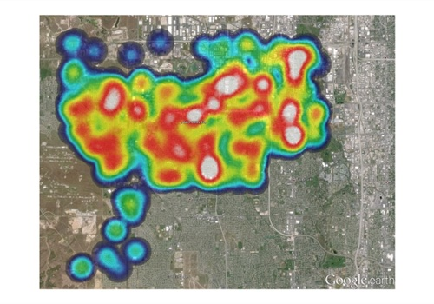
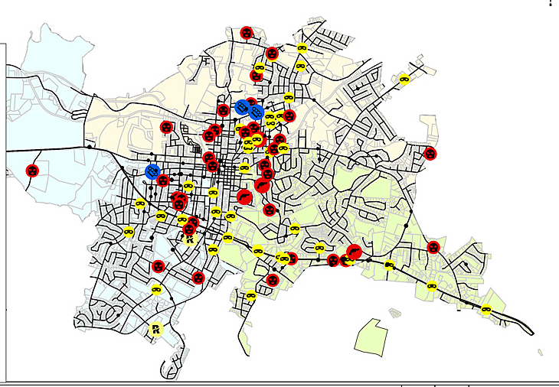


I. Intro | II. The Problem | III. The Tool | IV. The Solution | V. End
Objective:
Create a proof-of-concept for “Conflict-related Incident Detection System”
►

Slide 3
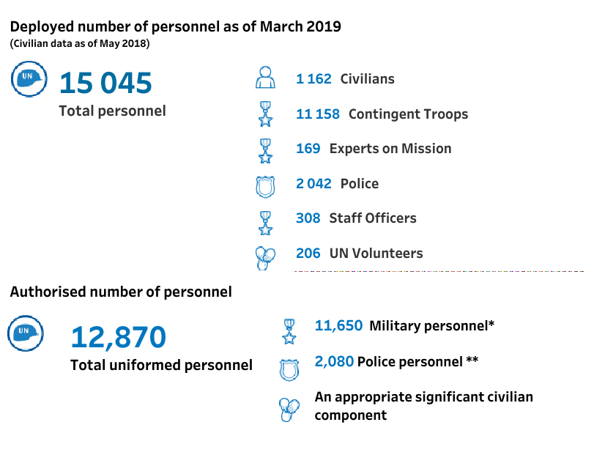
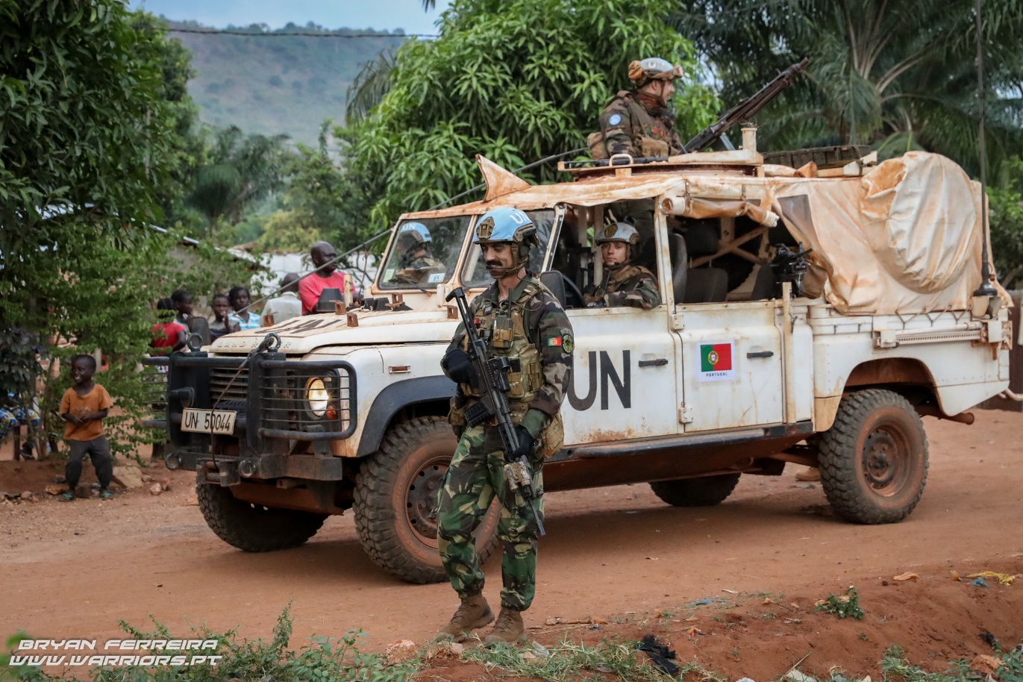


I. Intro | II. The Problem | III. The Tool | IV. The Solution | V. End
<200 Portuguese troops
(“Quick-reaction force”)
Little to none UN intelligence capabilities
Situational Awareness in the Twitter Age
Notes:
Rupert Smith (via TIA): características da Guerra entre as Pessoas

Slide 4

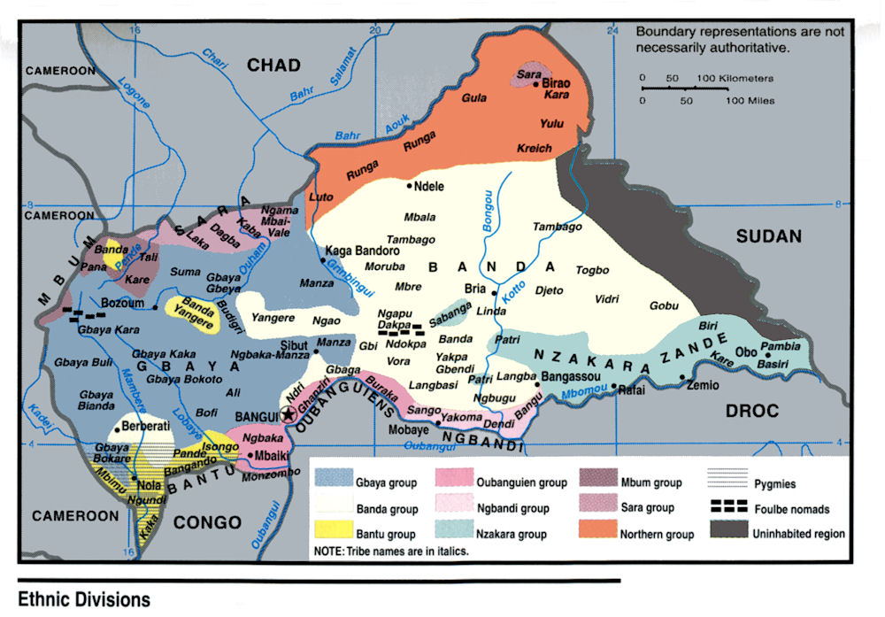
I. Intro | II. The Problem | III. The Tool | IV. The Solution | V. End
5 million people, >6 major ethnic groups
How do we maintain situational awareness in such a situation with limited resources?
Open Source Intelligence
>700 000 internally displaced persons, >5000 dead since 2012
Multiple factions in conflict
Notes:
Rupert Smith (via TIA): características da Guerra entre as Pessoas

Slide 5
I. Intro | II. The Problem | III. The Tool | IV. The Solution | V. End
Incident Detection Application Flow:
Scrape
RSS Feed
Twitter
Preprocessing
Normalize
Tokenize
Trigger
NATO mission verbs
Event detection
Stem
P.O.S tagging
Notes:
“How can one improve his Ortsinn?” Detour: componentes of GIS

Slide 6
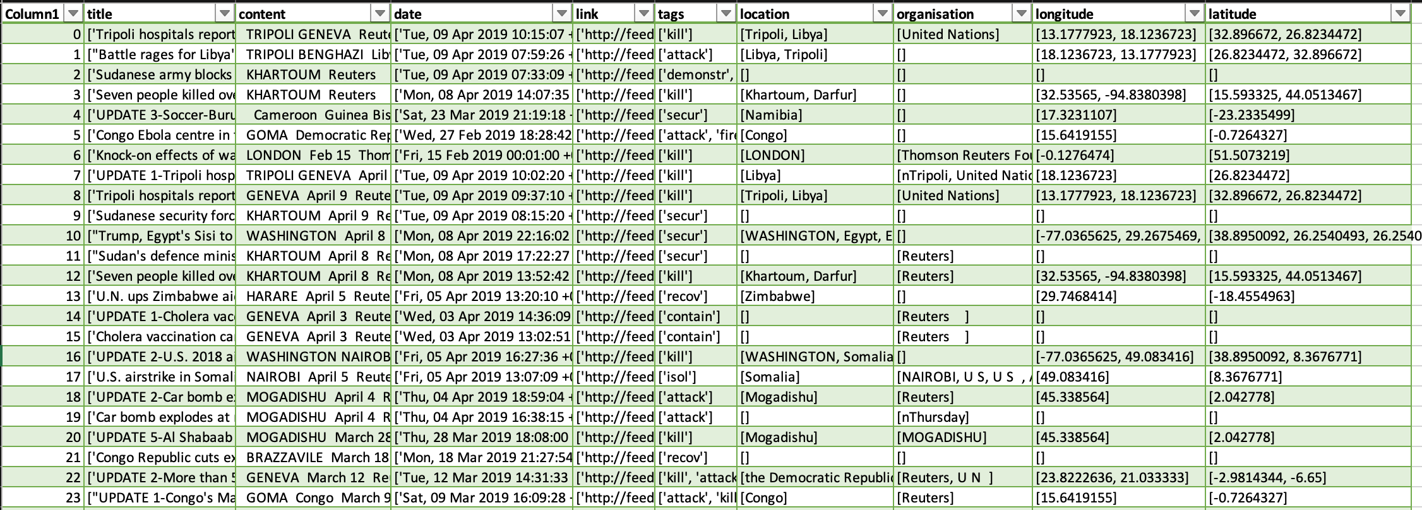
Output:
I. Intro | II. The Problem | III. The Tool | IV. The Solution | V. End
Notes:
“How can one improve his Ortsinn?” Detour: componentes of GIS

Slide 7
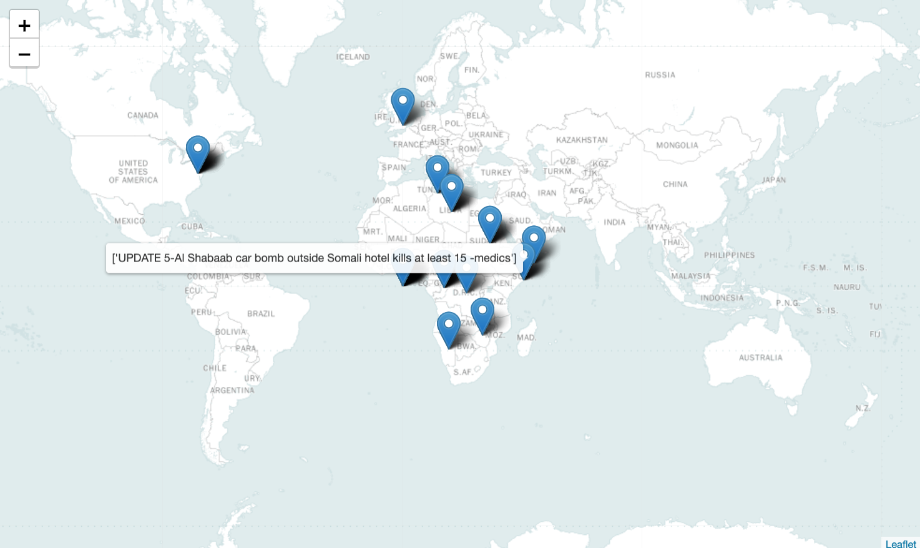
Output Map:
I. Intro | II. The Problem | III. The Tool | IV. The Solution | V. End
Notes:
“How can one improve his Ortsinn?” Detour: componentes of GIS

Slide 8

Thank you!
Discussion
Address: Campus de Campolide, 1070-312 Lisboa, Portugal
Tel: +351 213 828 610 | Fax: +351 213 828 611

