Slide 1

Principle of Least Privilege: Security breach at Premium House Lights Inc on 19/Feb/2022
By James Kuzhilaparambil
Notes:
Good Day Friends, My name is James Kuzhilaparambil, transitioning my career from a pharmaceutical background with 5 years of experience. I graduated with diploma in software engineering before I got introduced to cybersecurity at Lighthouse Labs Immersive Bootcamp which gave me the opportunity to learn best practices implemented in the different domains of cybersecurity industry.
The focus of my presentation is identifying vulnerabilities, finding mitigations, and suggesting recommendations based on the *Least Privilege Principle *, supported by NIST and MITRE ATT&CK frameworks for the security breach incident at Premium House Lights Inc. on 19/Feb/2022

Slide 2
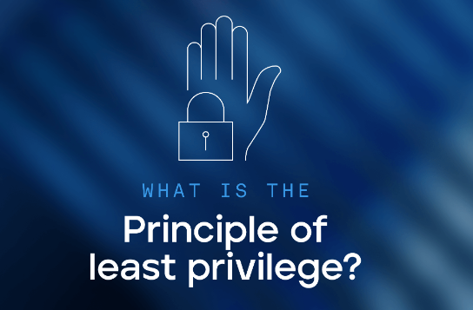
- Definition: Grant users only the access necessary for their role.
- Goal: Minimize the risk of unauthorized access and data exposure.
- Impact: Reduces insider threats, limits damage from breaches.
Notes:
So what is the Principle of least privilege ?
This principle ensures that each user has the minimum level of access required to perform their job functions. By limiting access, organizations can reduce the risk of unauthorized actions and potential security breaches.
The primary objective is to protect sensitive information by restricting access to only those who need it. This helps prevent accidental or malicious data leaks and ensures that critical systems and data are only accessible to authorized personnel.
Implementing this principle can significantly reduce the risk of insider threats, as employees and systems have limited access to sensitive information. In the event of a security breach, the damage is contained because the attacker’s access is restricted to only what the compromised account is permitted to access reducing the overall attack surface.

Slide 3

Key Vulnerabilities Identified
- Overly Broad User Access
- Insufficient Role Definitions
- Lack of Monitoring for Privileged Accounts
- Database Access
- Insecure File Uploads
Notes:
These were the Key Vulnerabilities Identified
- Employees had excessive permissions beyond their job needs.
The account used by the attacker, www.data, likely had excessive permissions, allowing actions like executing critical commands, modifying system settings or accessing sensitive data without proper constraints and perform actions that should have been restricted.
- Undefined roles that led to inconsistent access.
- There was no oversight of actions at high-privileged accounts.
The attacker gained root user access to the system through exposed vulnerabilities , gained access to database and later attacker made a backup of the database with root user privileges.
- database access was over-permissioned leading to root-level control by unauthorized users.
Attacker connected to the MySQL database, conducted searches, and managed to extract sensitive data after manipulating session information, copied & deleted database tables and parameters.
- Broad access permissions for file uploads enabled script execution.
Attacker uploaded `shell.php` via the `uploads` directory, enabling remote command execution.

Slide 4

Implementing Least Privilege at Premium House Lights Inc.
- RBAC Implementation
- Permission Audits
- Privileged Access Monitoring
- File Upload Controls
Notes:
Here is a outline of practical steps to implement the ** Least Privilege Principle** based on MITRE and NIST frameworks at Premium House Lights
- Define user roles & restrict access to only necessary data & systems.
- Conduct regular audits to ensure compliance with least privilege principle. Use automated tools to monitor and report on privilege escalations or anomalies in access patterns.
- Use Strong Authentication like Multifactor authentication for accessing sensitive and critical systems, particularly those in the production VLAN (e.g., web and database servers) reducing the potential for privilege escalation or lateral movement.
- Limit Administrative Privileges by restricting administrative roles to a few trusted personnel and monitor their actions closely.
- Log, monitor, and alert on privileged user activities as well as continuous monitoring, aligning with industry best practices.
- Restrict file upload capabilities and validate the file types.
Conduct a robust Training and Awareness program to foster a security-conscious culture across the organization.

Slide 5

Conclusion & Next Steps
- RBAC
- MFA
- Regular Access Audits
- Monitoring
Notes:
- To summarize Implementing **Least Privilege Principle** is critical for securing Premium House Lights.
I want to emphasize the importance of taking immediate action to reduce risk through Role-Based Access Control (RBAC), Multi-Factor Authentication (MFA), Regular Access Audits and continuous monitoring. Implementing these practices can significantly enhance organizational security posture.
Adopting these practices not only addresses immediate security gaps but also lays the foundation for the long-term security. By proactively managing access, authenticating users, and monitoring activities, you create a robust defense against evolving threats.
I encourage you to start implementing these measures today to protect Premium House Lights and ensure its resilience in the face of cyber threats.
-( **Call to Action**:) ) So start securing sensitive systems today by adopting these recommendations.

Slide 6

Notes:
I appreciate you all for taking the time to watch and listen to my presentation and for your undivided attention. I hope you found the information valuable and insightful. Thank you once again, and have a great day!

