Slide 1
UMBC TEXTBOOK MARKETPLACE
(THE A-TEAM)
TUC NGUYEN - AMRA MO - JUN KWON - HAO WU
AMIR BESHIR - SOPHIA SHIN

Slide 2
USER INTERFACE DESIGN

Slide 3
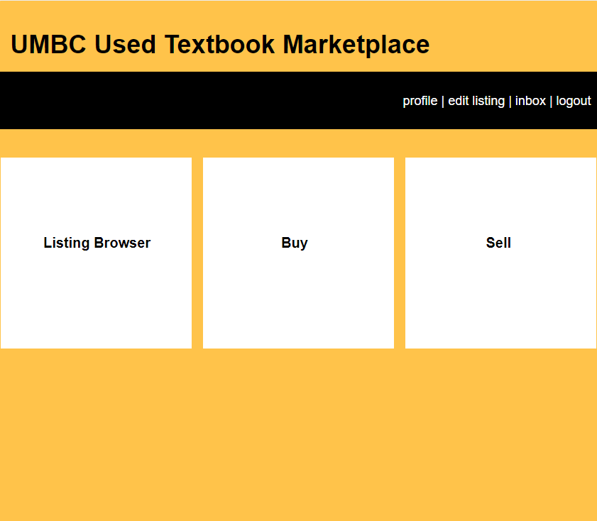

Slide 4
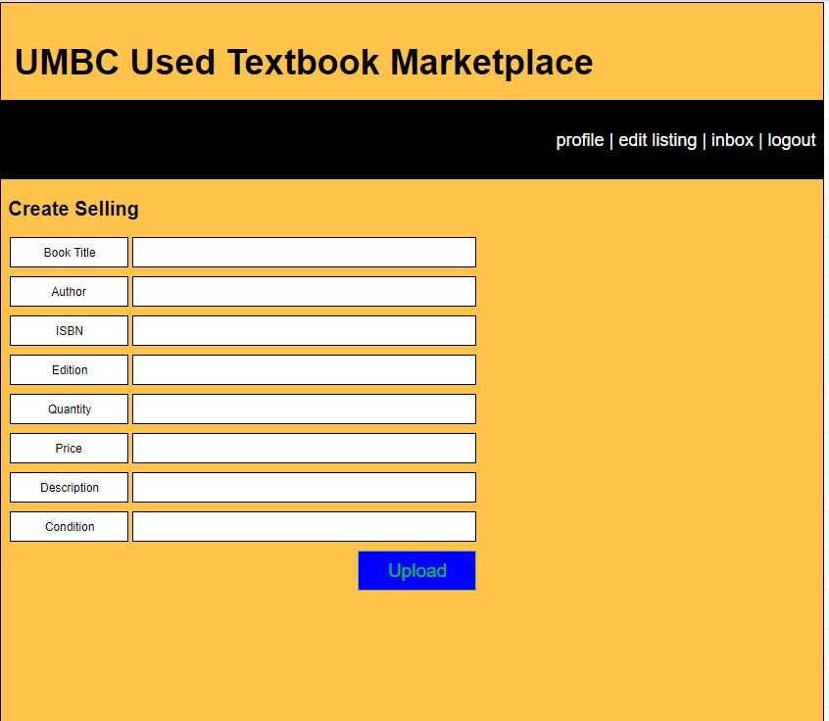

Slide 5
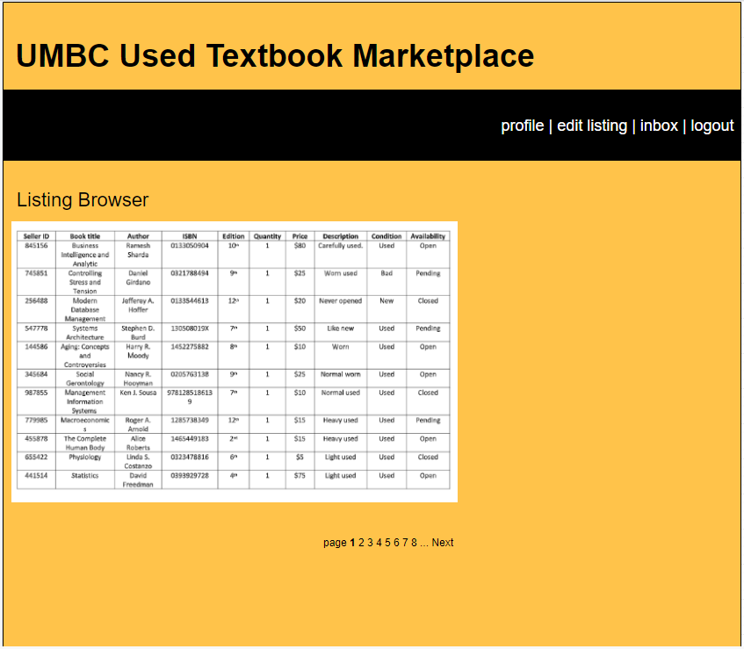

Slide 6
INTERFACE STANDARDS
Users to choose a list of options they want to complete (Listing Browser, Create Sell Listing, Create Buy Listing) in the form of a button.
User should be allowed to see a compiled list of books available or pending.
All information is stored within the database.
Create Sell Listing page will provide a fillable form for users to input their information to upload their book information to the database in order to be viewable by users on the Listing Browser Page.
Each HTML page should not be complex and be relatively easy to navigate.

Slide 7
SYSTEM IMPLEMENTATION
Hardware and Software
Local PC or cloud computing
Windows or Linux
Quality Control
Bugs and / or vulnerabilities
Users’ sensitive information
Maintenance
Little issue, unless we expand

Slide 8
DEMO
http://htmlpreview.github.io/?https://github.com/jkwon41/D5_IS436/blob/master/interface.html

Slide 9
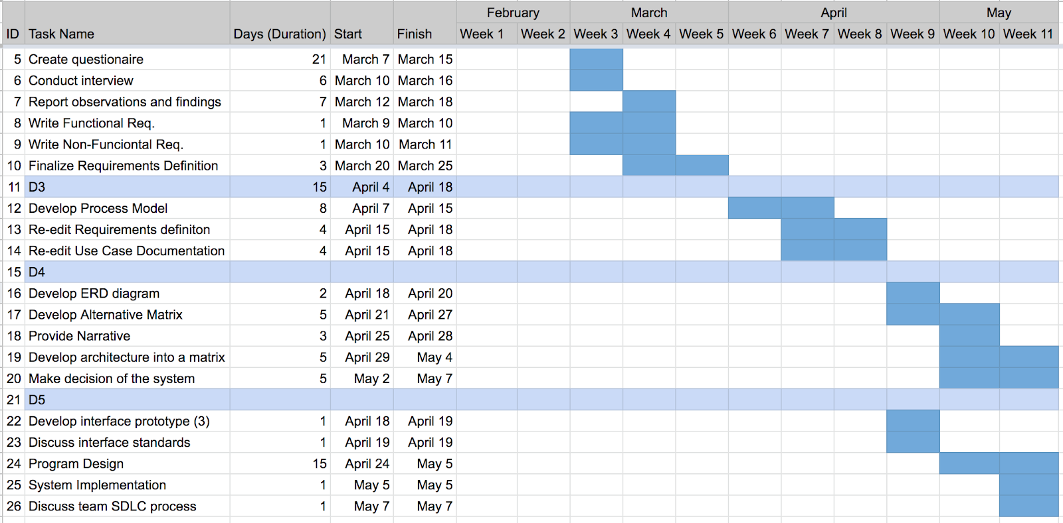
PROJECT WORK PLAN

Slide 10
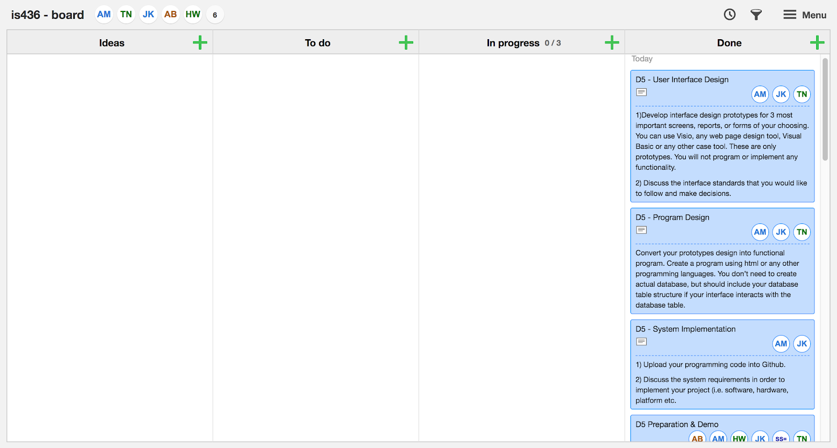
KANBAN BOARD

