Slide 1
Umbc Textbook marketplace
Tuc Nguyen - Amra Mo - Jun Kwon - Hao Wu
Amir Beshir - Sophia Shin
(D3)

Slide 2
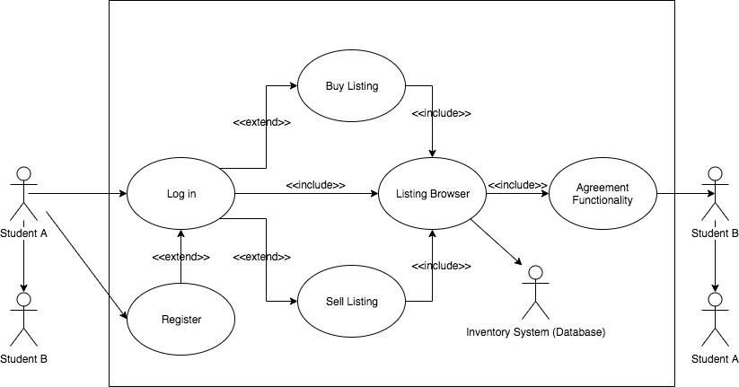
Use Case Diagram

Slide 3
Data Flow Diagram

Slide 4
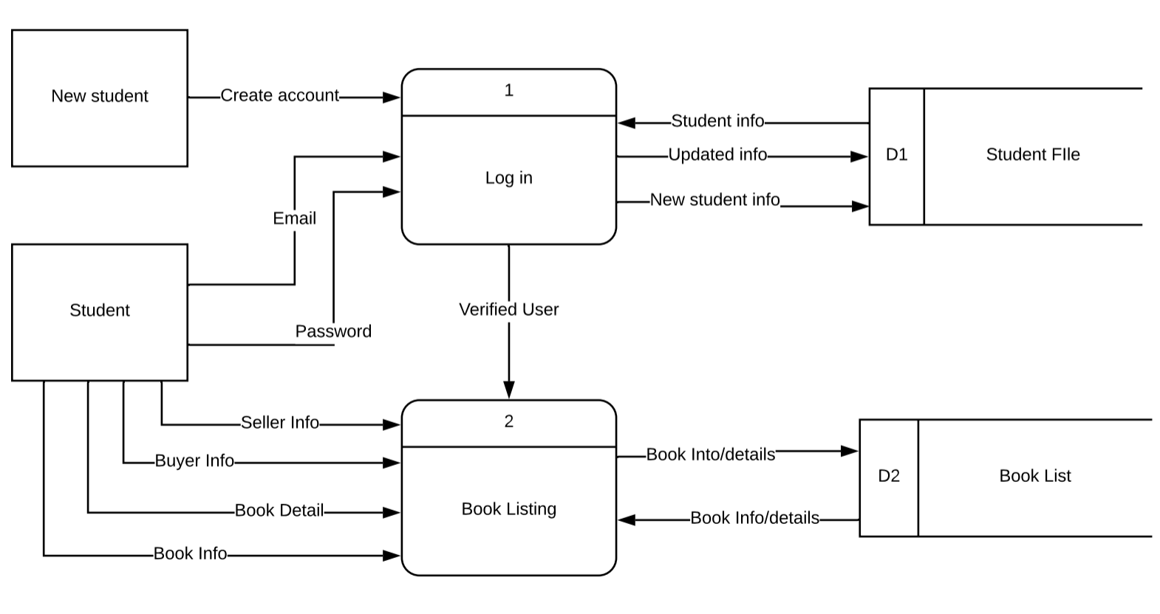
Level 0 Diagram

Slide 5
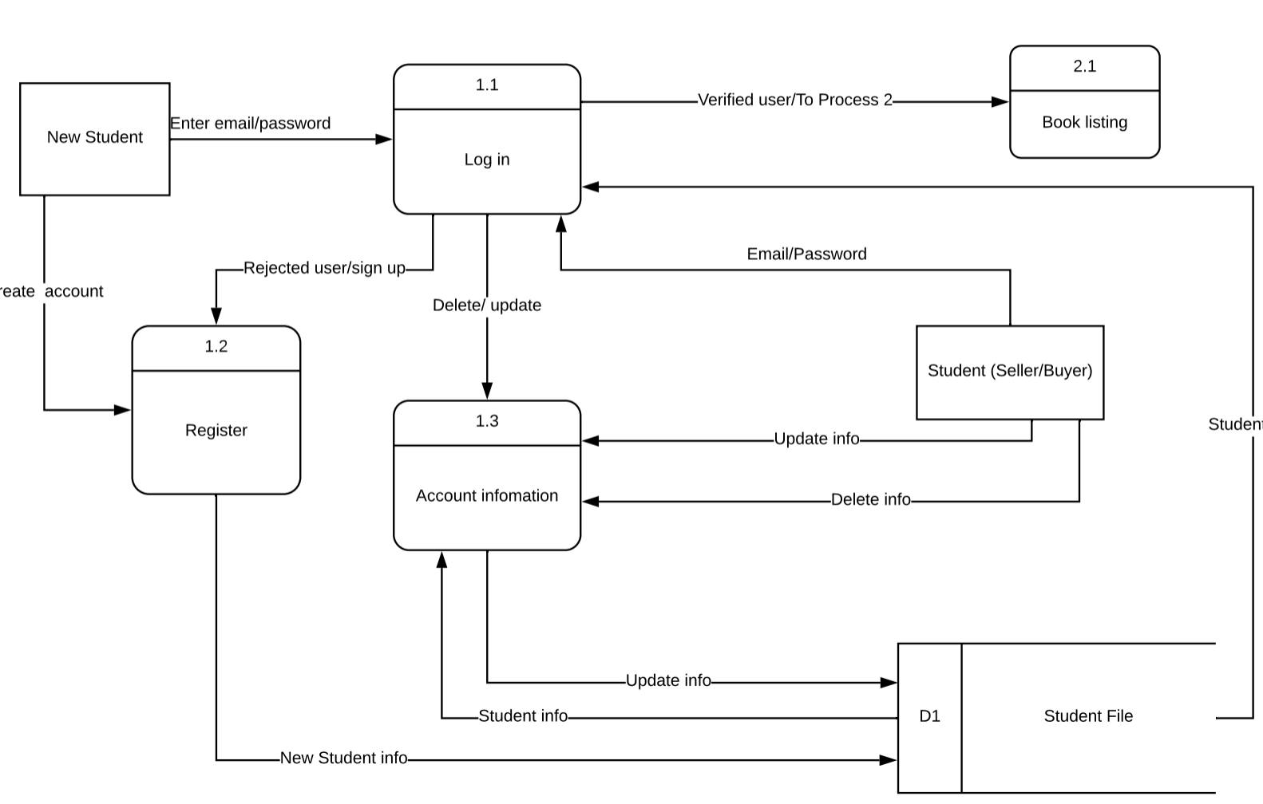
Level 1 Process 1

Slide 6
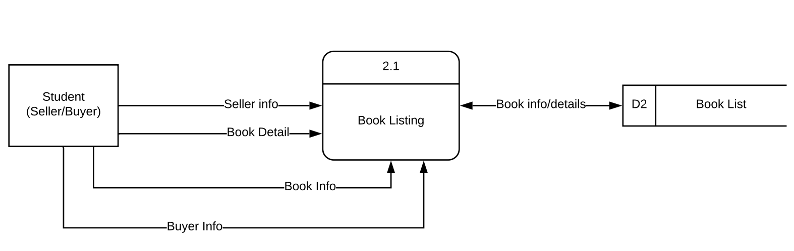
Level 1 Process 2

Slide 7
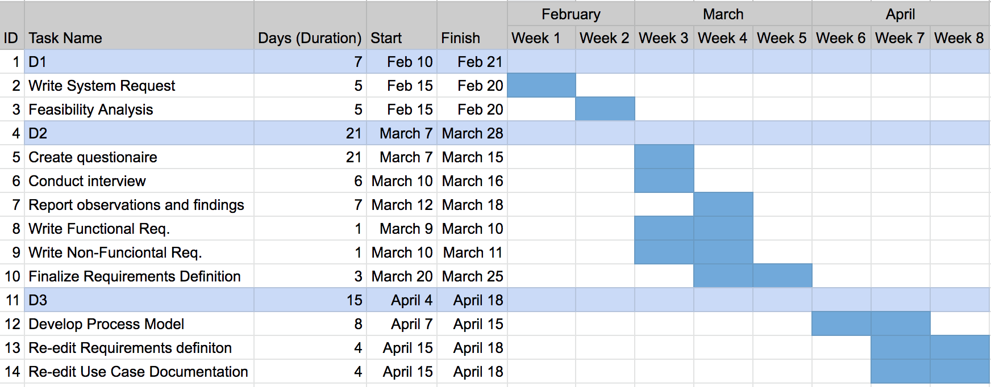
Project Work Plan

Slide 8
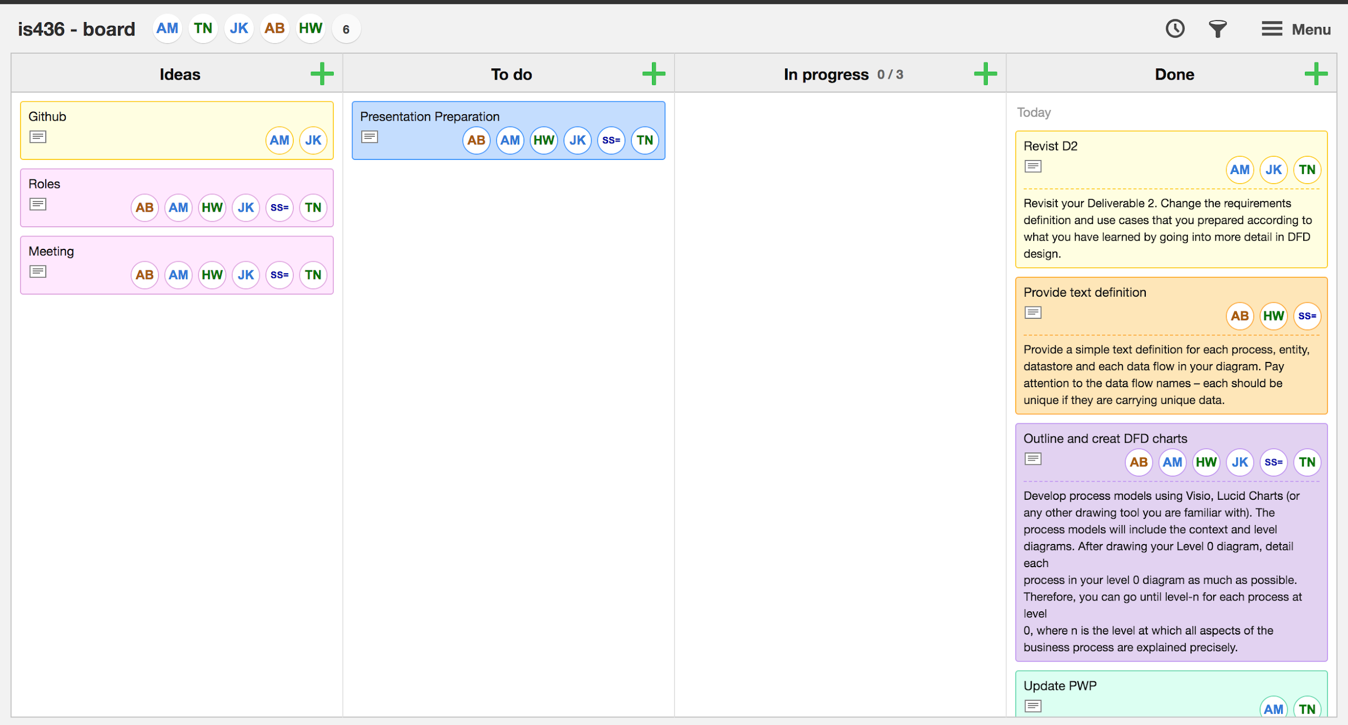
Kanban Board

