Slide 1
UMBC Textbook Marketplace (the a-Team) D2
Tuc Nguyen - Amra Mo - Jun Kwon - Hao Wu
Amir Beshir - Sophia Shin

Slide 2
Questionaires
Notes:
Everyone speaks about their interview and of the most important aspects of it

Slide 3
Requirements definition

Slide 4
Functional Requirements
Process-Oriented:
User must be able to:
Sell and buy.
Create and delete new accounts on our page.
Able to browse textbook listings.
Add, remove, and change any information.
Make and reject offers made by other users.
User may select new or used items
Information-Oriented:
Add new users
Update user info
Add new or user book/items
Update new book/items
Payment
Authentication
Search
Request books/items
Notes:
Hao

Slide 5
Non functional requirements
Operational:
To start building the application to run on most web browsers, we need to choose a web framework that is tested to run successfully on Chrome, Firefox, Safari, Edge, and other important browsers. Use popular tools such as Jquery and other frameworks that are proven to work.
Notes:
amir

Slide 6
Non functional requirements
Performance:
To maximize the performance of the application we need to choose a web server that is fast and can handle many user connections. Nginx and the Apache load balancers are good choices to use to distribute user traffic to different application servers.
The system should be available for user 24 hours per day, 365 days per year. It should also be able to support simultaneous users at all other times.
Notes:
amir

Slide 7
Non functional requirements
Security:
System administrators will be allowed permissions to maintain the system. Developers should be authorized to access the system source code to provide new features and fix bugs associated with the system.
Student users will only have permissions to view and edit their own book listings and system account information. Interpersonal politics affects the performance of the entire project. Buyer and seller protection and information security should be a priority for any ecommerce site.
Notes:
sophia

Slide 8
Non functional requirements
Cultural and political:
Our primary tools will be from academic partners in the industry such as Dell, Cisco, IBM, etc. We could choose to use cloud services such as Amazon Web Services, Microsoft Azure, or Google Compute Cloud instead of buying our own hardware for the servers.
Find partnerships in order to reduce costs in the future. In order to reduce costs now, make minimal mistakes in the programming, have effective project management practices, and use minimum viable product releases.
System should distinguish between US currency and currency from other nations. Student’s personal information is protected in compliance with the Data Protection Act
Notes:
tuc

Slide 9
System Description/Requirements:
Subsystems could include a database system, a load balancing system, a network logging and metrics system, and a dedicated security system.
Running the system on a Linux based platform such as Ubuntu LTS or CentOS would allow us to have a solid and free operating system that has security updates and supports our enterprise requirements.
We need to build the system around the requirements. Use encryption, user rights restrictions, and connection blocking, and separation of duties for security. Use load balancers and commonly used frameworks in order to maximize usability across phone OSs and browsers. Cloud computing and open source software can reduce cost across the application.
Notes:
jun

Slide 10
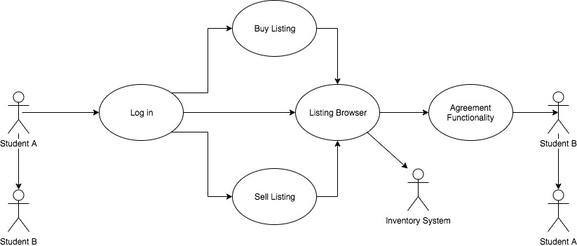
System Level Use Case Diagram
Notes:
Amra

Slide 11
Subsystem descriptions
System Access Subsystem: Handles login, validates student ID
Display Main Screen: Handles a window that shows option for the user to pick amongst
Buy Listing
Sell Listing
Listing Browser
Book Info Subsystem: Provides information about books on record / Inventory System
Manage Student Info Subsystem: Who is selling or buying books
Database Subsystem:
Contains data needed to store for application
Retrieves, updates, and delete functions for data stored
Information about books (Title, Catalog #, Author, Year, Edition, etc.)
Notes:
Amra

Slide 12
Questions?

