Slide 1

Catastrophe Insurance Technology
Presented by: Spilled Milk
Andrew Atkins|Michael Campbell|Benji Vazquez|James WOod

Slide 2
HELP Consultation Overview
Purpose:
Analyze historical hurricane data to assess property portfolio exposure
Provide actionable insights and strategies for improving portfolio resilience and ensuring premium adequacy over time
Datasets Used:
Historical Hurricane 1
Historical Hurricane 2
Exposures
For more detailed information:
Further analysis is conducted in supplementary files

Slide 3
Findings Management Request App Interactive Map

Slide 4
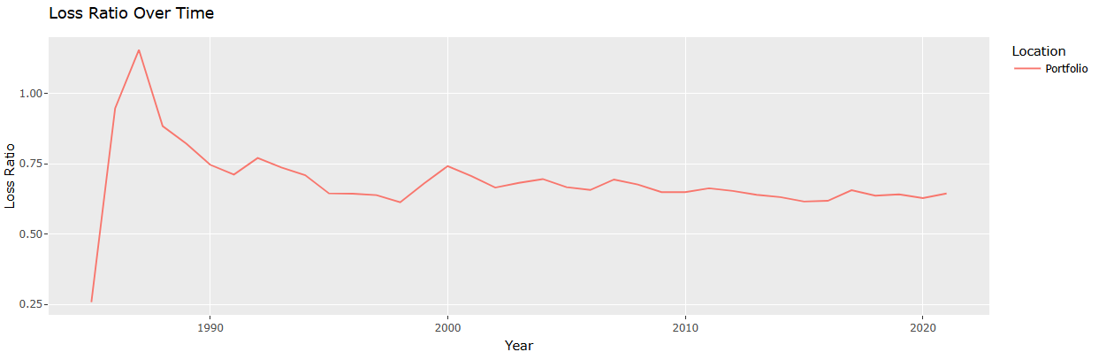
Loss Ratio Trends

Slide 5
Loss Ratio Trends
Insights
Key Assumptions
Improving Loss Ratios:
Suggest improved risk management, lower claims, or adjusted premium pricing to maintain profitability
Deteriorating Loss Ratios:
May indicate rising claim costs or underpriced premiums relative to the risk
Suggestions:
Adjust premium rates based on historical loss data and forecasted climate trends
Loss Ratio Calculation:
(Loss Ratio) = (Losses / Premium)
Assumes stable coverage terms
Uses cumulative data to reflect profitability trends

Slide 6
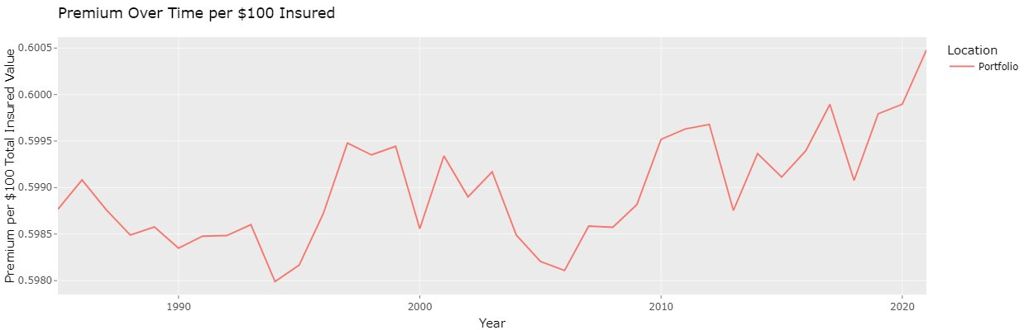
Premium vs. Insured Value Trends

Slide 7
Premium vs. Insured Value Trends
Insights
Key Assumptions
Stabilization or Fluctuation in Rates:
Consistent premiums per unit of insured value suggest stable pricing
Adjustments Reflect Broader Market Factors:
Increase could be driven by inflation, industry-standard adjustments, or evolving risk assessment strategy
Suggestions:
Implement annual review of premium rates
Adjust for trends in prior year's loss experience
Assume reported Total Insured Value and premium amounts consistently represent same types of policies and coverage limits over time

Slide 8
Changes in Wind Speed

Slide 9
Changes in Wind Speed
Insights
Key Assumptions
Upward Trend in Maximum Wind Speeds:
Regression line indicates a trend toward more intense storms
Suggestions:
Gather additional data on building materials, construction quality, resilience to high winds
Offer lower premiums for more resilient buildings, charge higher rates for those at greater risk
Consistent measurement standards over time
Increase in storm intensity is continuous/unaffected by phenomena such as El Niño and La Niña
Unique Hurricane Naming and Timing: Assumes that no two hurricanes exist with the same name and at the same time.

Slide 10
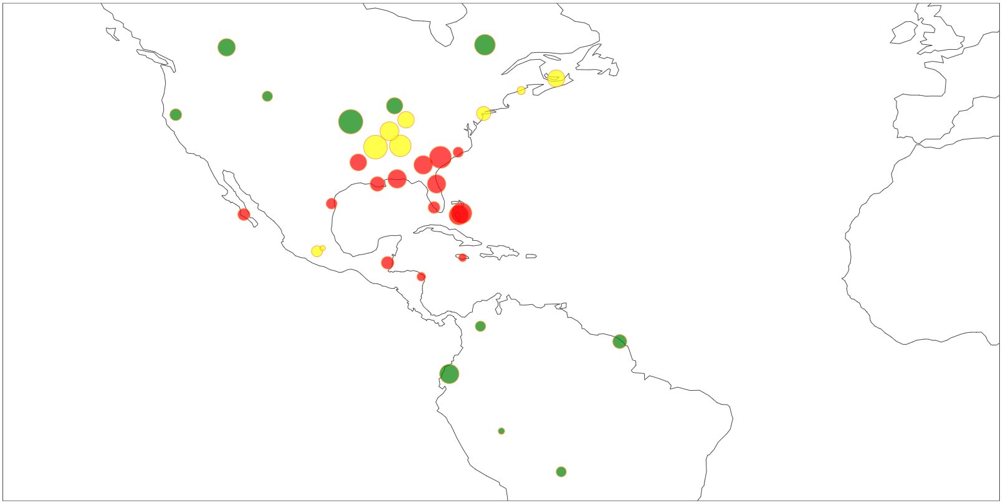
Maximum Loss Risk Assessment

Slide 11
Maximum Loss Risk Assessment
Insights
Key Assumptions
Frequency of Hurricane Interactions:
There is not a strong correlation between the maximum loss risk and the premium per $100 total insured value
Inland Locations:
These locations may be less vulnerable, allowing HELP to maintain a balanced portfolio
Suggestions:
The rates of the following locations are not well correlated with the catastrophe risk posed to them:
6, 12, 13, 18, 23
Risk Thresholds:
Based on number of interactions with historical hurricanes
Green = zero interactions
Yellow ≤ 16 interactions
Red > 16 interactions
Marker sizes are scaled by logarithm of Total Insured Value (TIV)

Slide 12
Future Work
Explore Diversification Opportunities
Consider assessing the feasibility of expanding into regions with different risk profiles to reduce concentration risk in high-exposure areas, thus enhancing overall portfolio resilience.
Conduct Comparative Analysis with Industry Benchmarks
Compare HELP’s loss ratios, premiums, and TIV changes with industry averages to gauge performance and highlight areas for competitive improvement.

