Slide 1
DIY or Buy?

Slide 2
Performance and Pricing

Slide 3
Macbook Pro (2017)
Vs
My Mockup Build
CPU: 3.6 GHz, 2 Core
Storage: 128GB SSD
RAM: 8GB
GPU: N/A
Price: $1299
https://www.apple.com/macbook-pro/specs/
CPU: 4.0 GHz, 8 Core
Storage: 240GB SSD
RAM: 8GB
GPU: 4GB
Price: $715.05
https://pcpartpicker.com/user/j_guntak/saved/2KdNGX

Slide 4
Flexibility

Slide 5
Andrea Eldridge - CEO of Nerds on Call
· Parts fused to laptop motherboard
· RAM/GPU/HDD swaps
· Outdated WiFi protocol
· Spatial limitations
· Interchangeable parts

Slide 6
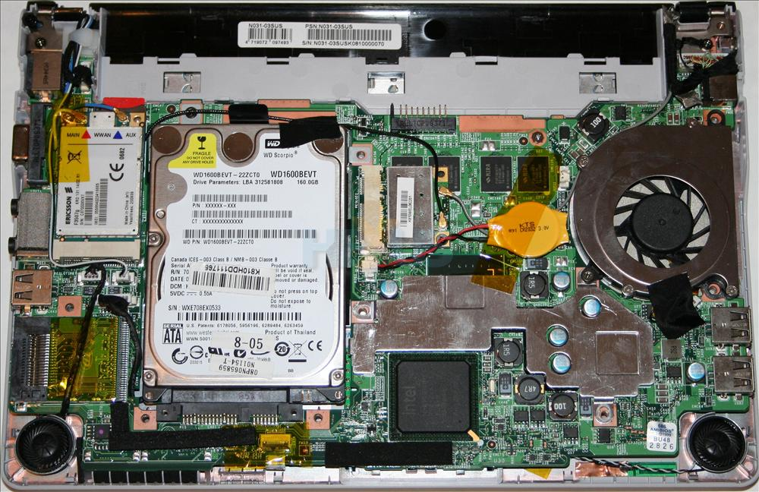

Slide 7
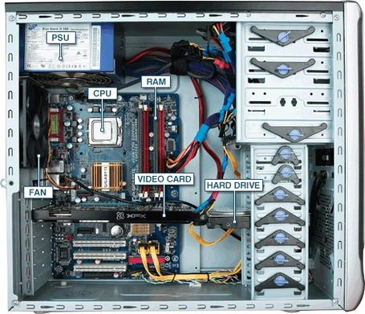

Slide 8
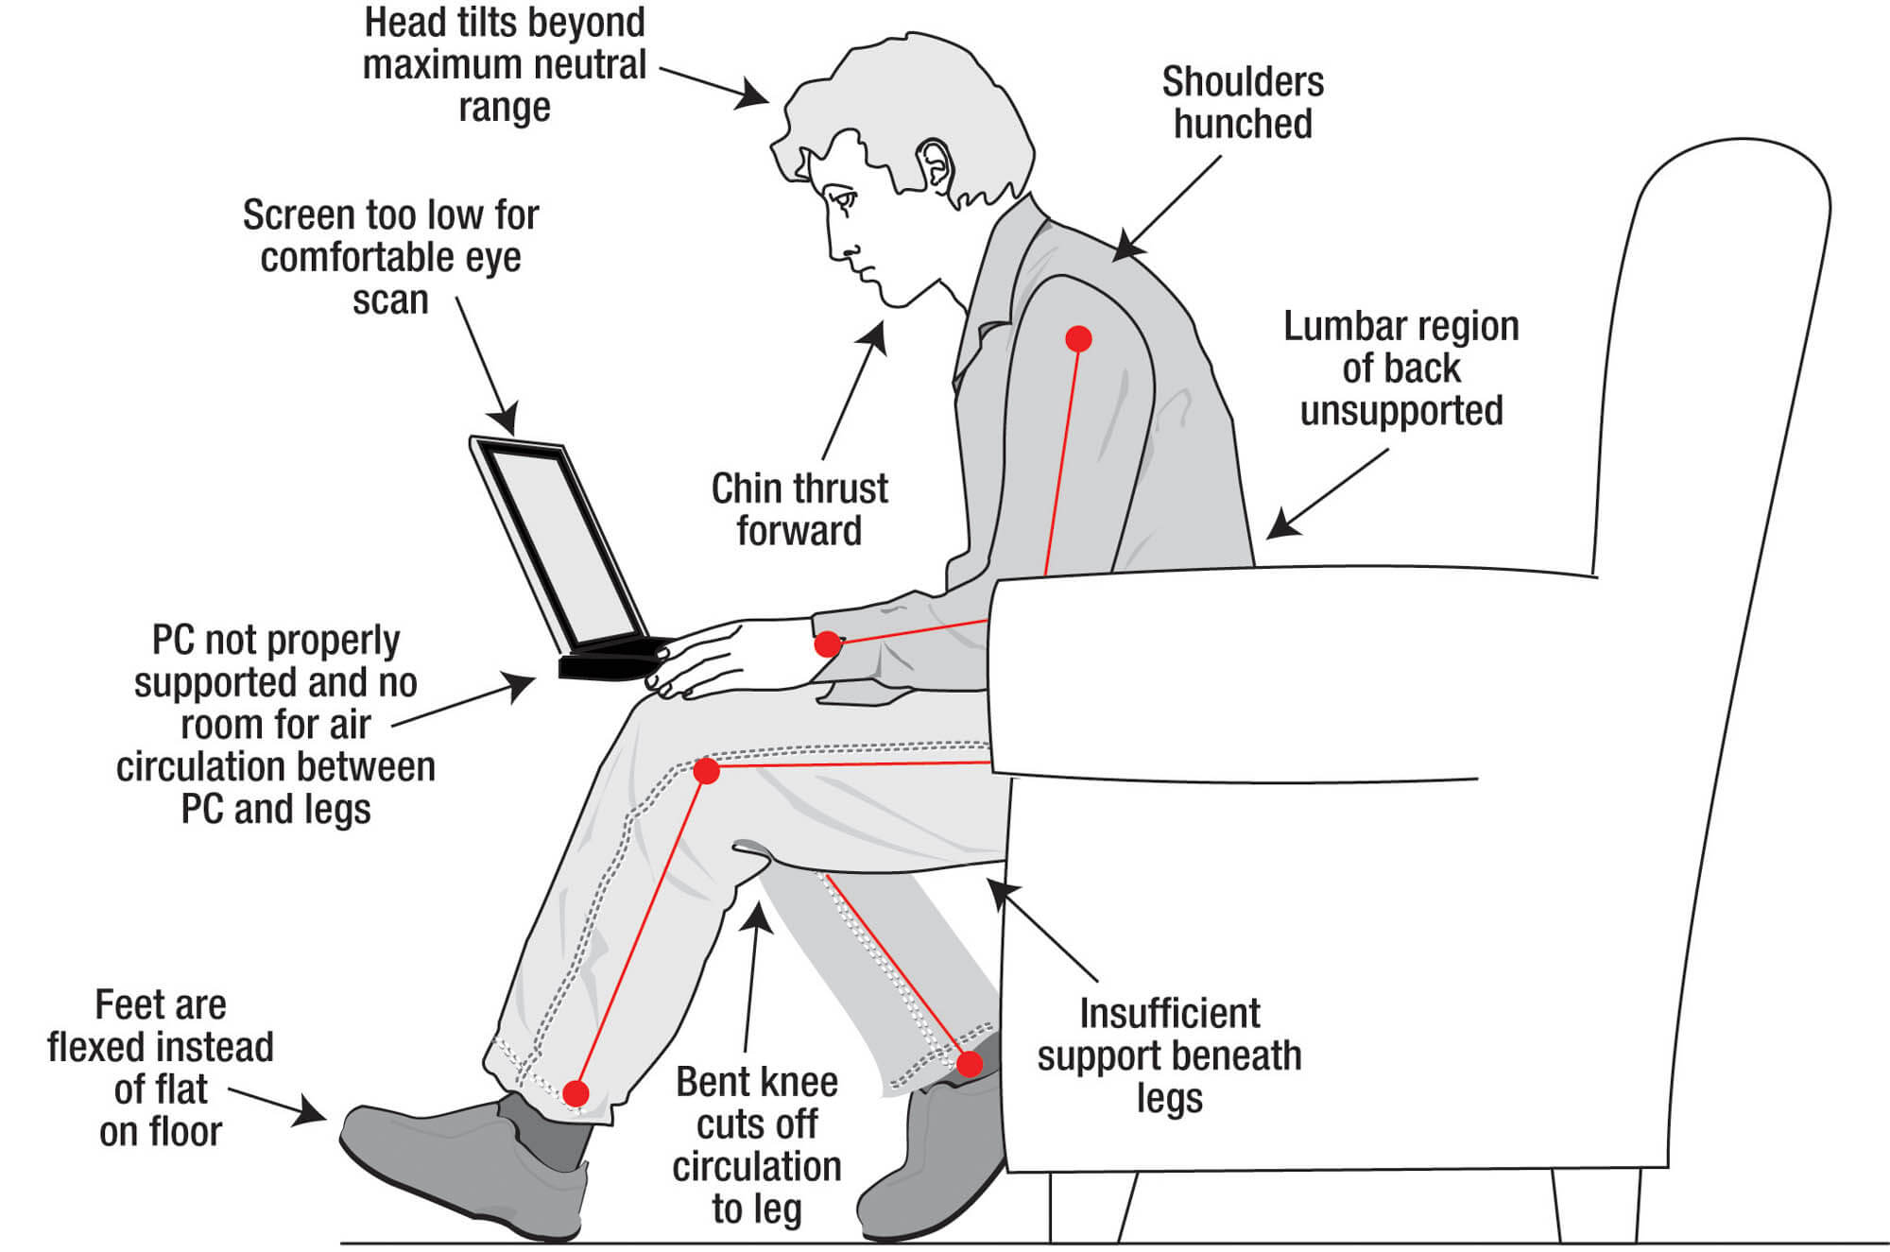

Slide 9
Better Options

Slide 10
Tablets
Generally cheaper
Longer battery
More portable
Can perform similarly to laptop

Slide 11
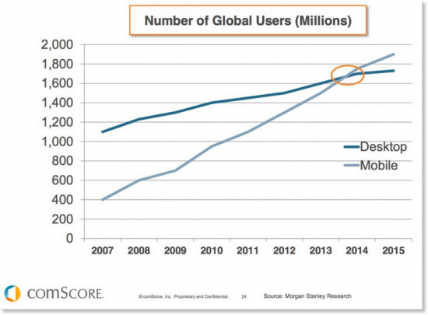

Slide 12
