Slide 1
Are Younger people more involved in fatal accidents?
Kyle Morris
DSC 530
Summer 2019
Bellevue Univers

Slide 2
Are younger occupants more likely to become fatalities in a crash?
Our data comes from the 2017 dataset on fatalities from the NHTSA (National Highway Traffic Safety Administration.
We exported the dataset from that year containing only the values we were interested in and a few other identifiers.
The dataset contained 74,721 rows and 20 columns.

Slide 3
Selection of variables
Variables Chosen
What does that mean?
Age
Numfatal
Dayofweek
Holiday
Sex
The age of the occupant.
The number of fatalities in a given wreck involving that occupant.
The day of the week the accident occurred. 1 = Sunday, 7 = Saturday
Is it a Holiday? 0 = no, 1-10 is a specific holiday.
Male = 1, Female = 2.

Slide 4
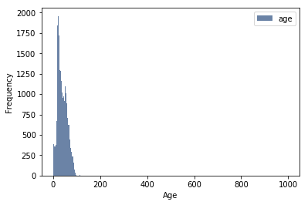
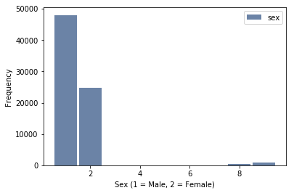
Histogram of variables

Slide 5
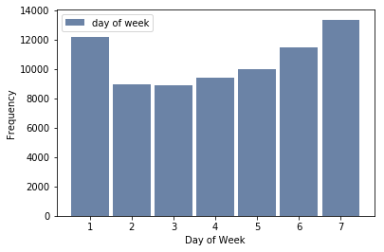
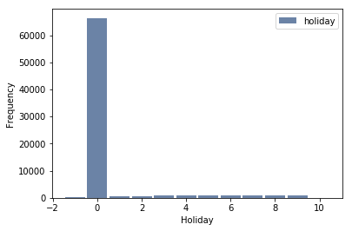
Histogram of variables

Slide 6
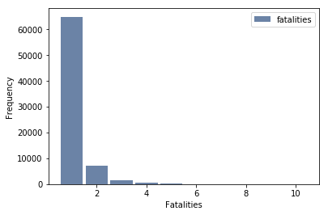
Histogram of variables
Age, sex, and Holidays are the only ones with any outliers and there aren't very many. In this case, we have enough data points that these few records I will take out and we'll deal with only complete datasets.
These outliers are the coded answers:
Age 998 or 999 is unknown, not recorded.
Sex 8 or 9 are the same for sex.

Slide 7
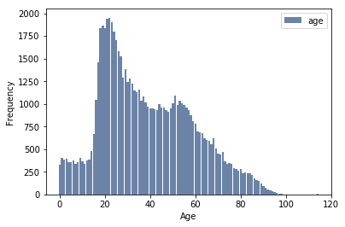
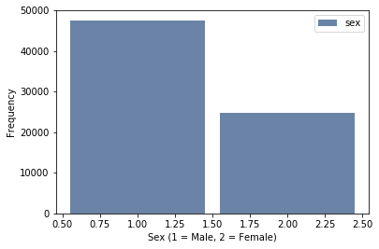
Histogram of variables – after cleanup

Slide 8
Vital Statistics
Age | Sex | numfatal
Mean: 38.508140 | Mean: 1.341367852 | Mean: 1.179509898
Mode: 22 | Mode: 1 | Mode: 1
Variance: 409.947731 | Variance: 0.224838954 | Variance: 0.318493605
Standard Deviation: 20.24716601 | Standard Deviation: 0.474171861 | Standard Deviation: 0.564352377
Holiday | Dayofweek
Mean: 0.53639761 | Mean: 4.13090128
Mode: 0 | Mode: 7
Variance: 3.17265655 | Variance: 4.43159019
Standard Deviation: 1.78119526 | Standard Deviation: 2.10513424

Slide 9
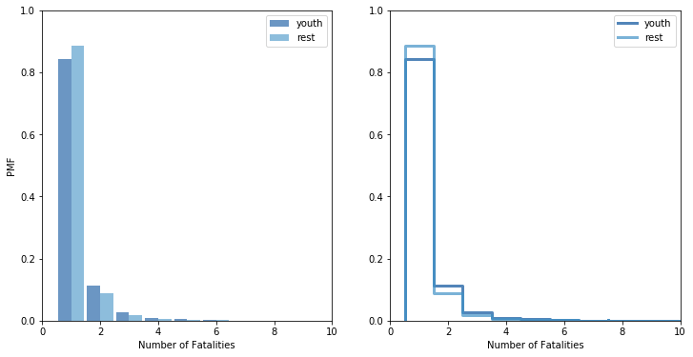
Number of fatalities involving <25 versus everything else
Based on our PMFs here, it does seem like younger occupants are less likely to be involved in single-fatality crashes, but for more than one fatality younger people are more likely to be involved.

Slide 10
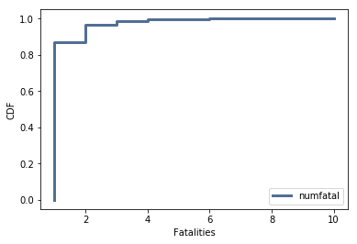
CDF: Probability of number of fatalities
As we can see here, fatalities are quite likely to be single fatalities as opposed to multiple fatalities. However, from our PDF earlier, it does look like younger people are more likely to be involved in multiple fatality crashes.

Slide 11
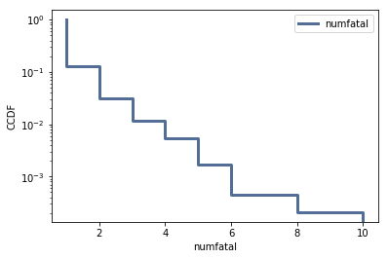
What distribution models our data?
In this situation, I think the exponential distribution is most likely going to be useful for our dataset. We will plot it as follows:
thinkplot.Cdf(fatalCDF, complement = True)
thinkplot.Show(xlabel = "numfatal", ylabel = 'CCDF', yscale = 'log’)
The slope is mostly a straight line, adjusting for the stepwise function it's fairly linear for most of it. The other CDF shape that resembles our data is the Pareto Distribution. Graphing the CDF on a log scale on both the x and y axis for a Pareto distribution results in a straight line.

Slide 12
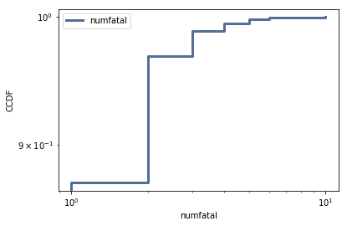
What distribution models our data?
Doesn't particularly look like a straight line. I think the exponential distribution is the best model fit we are going to find.

Slide 13
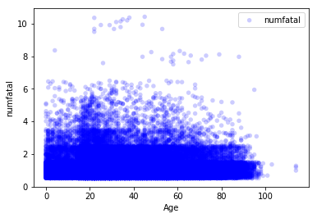
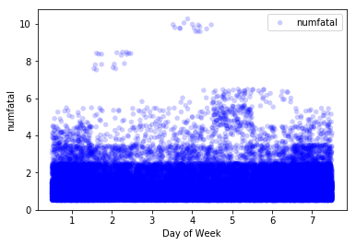
Correlation and Causation
Based on the scatter plot, there does seem to be a concentration around age 20 where the number of fatality increases. The most fatalities recorded occur between 60 and 20 years old.
There is an uptick on Thursday, of all days. Generally, Friday Saturday and Sunday see the expected uptick but the Thursday is interesting.

Slide 14
Correlation and Causation
Stats
Analysis
Covariance for Age and Numfatal: -0.6416246963944783
Pearson's Coefficient for Age and Numfatal: -0.05615293770164982
Covariance for Dayofweek and Numfatal: -0.0009035870749078954
Pearson's Coefficient for Dayofweek and Numfatal: -0.0007605816922902859
As age increase, the number of fatalities decrease. The covariance shows this relationship. However, the Pearson's coefficient shows that this connection has a mild effect.
For Dayofweek, there doesn't seem to be much of a connection based on the Pearson's cofficient and covariance.

Slide 15
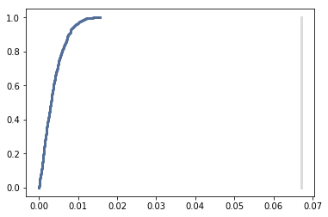
Diffmeanspermute
A difference in the means of numfatal between our youth set and the rest of our dataset would look to answer our hypothesis. We'll use the DiffMeanPermutation example from our text.
The p-value is 0.
The observed difference in means never intersects: p is less than .001 and so we can conclude that the difference in number of fatalities is statistically significant.

Slide 16
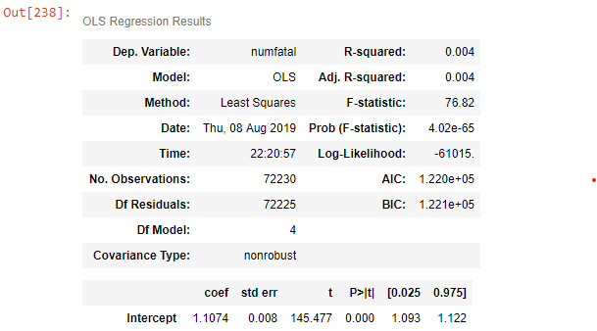
Regression Analysis
Single Exploratory Variable
Multiple Exploratory Variables
Results for numfatal ~ isYoung
Intercept: 1.1575600419830092
Slope: 0.06706874942108798
Slope p-value: 7.551945523857323e-51
R^2 Value: 0.003109534787788193
R^2 p-value: 7.551945525706778e-51

Slide 17
Multiple Regression Analysis
Day of Week looks to be the only variable that doesn't have some significance that we can find. We ran numfatal versus the other variables, and used isYoung instead of age - this lets us show that youth has some significance attached to it.

