Slide 1


Workers Compensation Analysis NYC
Final Project Jayne Horton

Slide 2
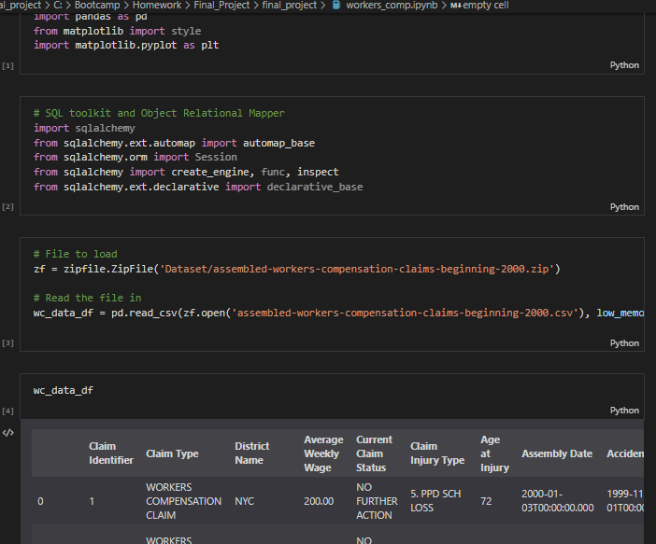
Source File Kaggle - https://www.kaggle.com/new-york-state/nys-assembled-workers'-compensation-claims?select=assembled-workers-compensation-claims-beginning-2000.csv
ETL
Reviewing csv file
Significant work to explore data types and convert to dates, floats etc
Data file was significantly large, required .gitattributes file to track and commit
Reduced dataframe to 2015-2020

Slide 3
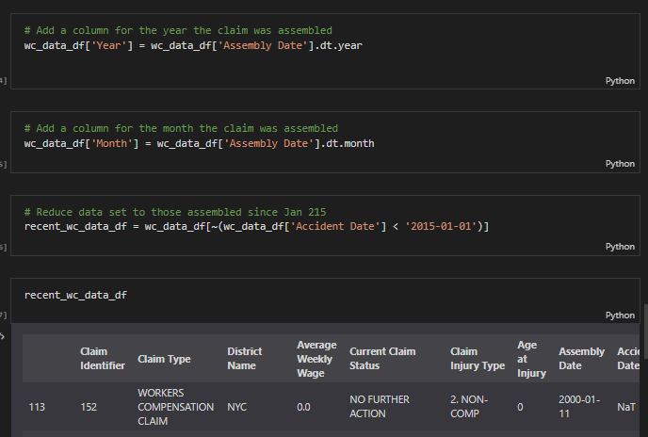
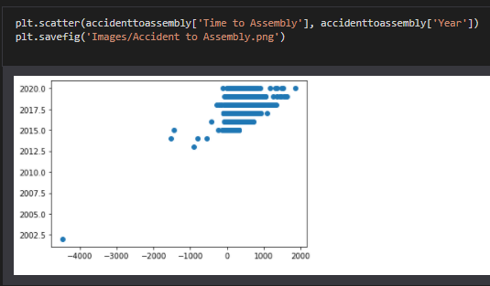
Data exploration

Slide 4
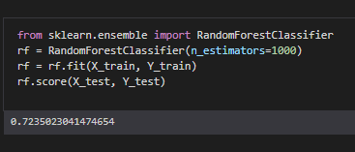
Machine learning
Required the creation of a new Pandas dataframe
Random Forest Classifier from Scikit-Learn
Data points are categorical
Various different estimators made little difference to the resulting 0.72
SQLite database
Ran into trouble trying to create the database and flask app.

Slide 5






Applications used

