Slide 1
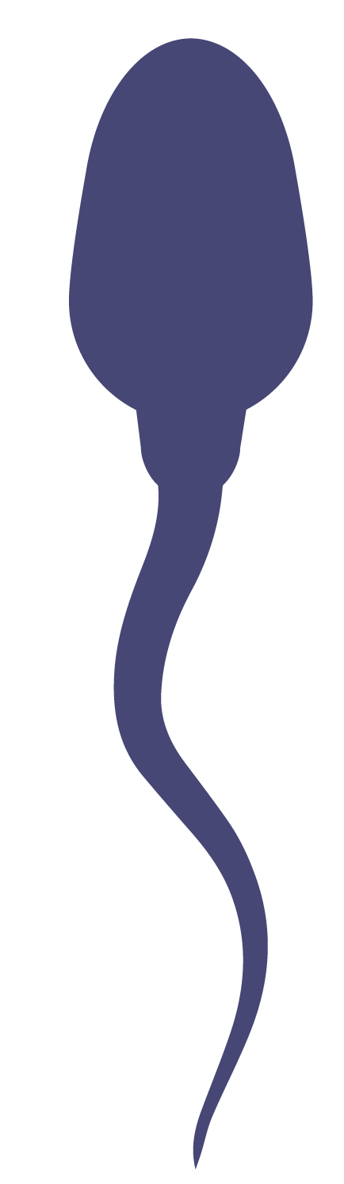
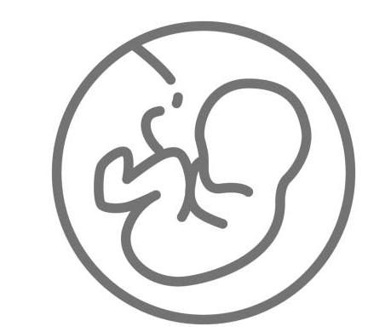


Variant present in gamete
Variant absent in gamete
Variation present in every cell in the body, including those of the germline
Variation can occur during fetal development or any time after birth in any cell of the body, except those of the germline
Variants can be passed on to offspring
Variants are not passed on to offspring
Germline Variants
Somatic Variants

