Slide 2



Portsmouth R User Group - dplyr Workshop
Jamie Lendrum (jalendrum@dstl.gov.uk)
Defence Science & Technology Laboratory (Dstl)
5th March 2019

Slide 3
Housekeeping
Please ask questions
Don’t worry if you can’t remember everything
What’s your experience with R / tidyverse / dplyr?

Slide 4
Getting acquainted: Things to note
RStudio is the recommended way to use R
The assignment operator: <-
The Environment pane
Variable names can include full-stops/spaces (nooo!)
my_variable, my.variable, MyVariable, myVariable, `my variable`
Case sensitivity – will be 50% of your initial errors
Using the console (use of up/down arrow)
Use a script to save your useful code
Running code from the script window (Ctrl + Enter)
Accessing help, e.g. ?sum

Slide 5

Import data
Use the function read_excel (from the readxl package) to load in a sheet from a excel spreadsheet
Save the data to the name gdp

Slide 6

Data Manipulation
Sorting
dplyr::arrange
Subsetting
dplyr::select
dplyr::slice
dplyr::filter
Add/replace columns
dplyr::mutate
Piping
magrittr::`%>%`
Pivoting
dplyr::count
dplyr::group_by
dplyr::summarise

Slide 7
Loading tidyverse packages
This loads all useful packages at once, i.e.
library(readr)
library(dplyr)
library(ggplot2)
library(magrittr)
library(tidyr)
…..

Slide 8

The arrange() function
This sorts the data based on a particular column(s)
Sort by more than one column
Sort in descending order

Slide 9

The select() function
Select (or drop) particular columns
Select by name or position
Can select more than one column or give a range using the colon
Can drop columns using a negative sign in front of the column

Slide 10

The slice() function
Select particular rows by row number
Note that c(1, 3, 5) creates a vector, as does 1:12
1:4 is equivalent to c(1, 2, 3, 4)

Slide 11

The filter() function
Similar to Excel autofilter
Filter on condition using
==, ! (NOT), <=, >=, <, >, %in%, between
Use multiple conditions with | (OR), & (AND)

Slide 12
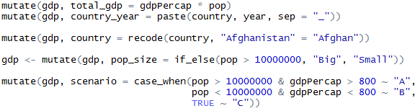
The mutate() function
Add or replace columns
Useful helper functions
paste(), paste0(), round(), recode(), if_else(), case_when()

Slide 13
Exercise: applying multiple functions
Using everything you’ve learned, take the gdp dataset and…
Filter on years after 1990, then use this to …
Sort by population (in descending order), then …
Select only the first 3 columns

Slide 14


The %>% (pipe) operator
Shortcut for %>%: Ctrl + Shift + M
Only use the pipe if you’re applying more than one function

Slide 15


group_by() and summarise()
summarise() calculates summary statistics of the dataset, e.g. mean, sd, sum
group_by() plants an invisible flag in the dataset to indicate follow on functions should operate on groups

Slide 16



Counting/summing across groups
A common task is to find out how many rows each group has, or to sum a column for each group

Slide 17

The count() function
Counts how many rows contain each value
If more than one column provided, it counts the number of unique combinations
Mainly for categorical data (but can be used with numerical data)
The wt argument weights by another variable

Slide 18



Exercise: Put it all together!
In which year does each country reach its maximum GDP per cap?
Provide a table with the country, year of maximum GDP per cap, and the associated GDP per cap figure

Slide 19
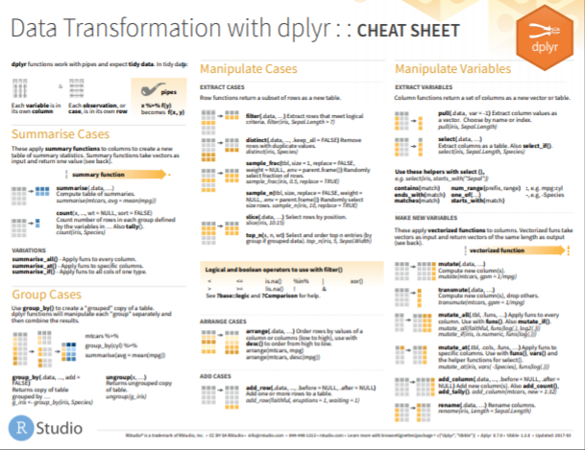

Slide 20
How can I learn more?
R User Groups (e.g. Portsmouth)
R-Bloggers
DataCamp
#rstats on Twitter
YouTube videos
R for Data Science: https://r4ds.had.co.nz/
What they forgot to teach you about R: https://whattheyforgot.org/

Slide 21
Data Science Opportunities at Dstl
Data Science continues to be an area of growth within Dstl
Dstl Job opportunities can be found on Civil Service Jobs
https://www.civilservicejobs.service.gov.uk/csr/index.cgi
New opportunities are added all the time
Dstl Data Science related current opportunities include:
Data Analyst Apprenticeship closing date 17/03/19
Team Leaders closing date 22/03/19

