Slide 1
Apache Sqoop
By: Jeff Lanning

Slide 2
Introduction
Sqoop is a project built on top of Hadoop
Supports moving data between Hadoop and RDMS
Two main features
Importing
Exporting
Other tools
Sqoop-list-databases
List available database schemas
Sqoop-list-tables
List available tables within a schema
Sqoop-eval
Simple and primitive SQL execution engine

Slide 3
Importing
Importing
Load RDBMS data into Hadoop, HBase, and Hive
Take database table as input
Reads table row-by-row into HDFS
Performed in parallel
Produce list of files as output in Hadoop
Generates java class that represents one row of imported table
Used in import process
Serialize/Deserialize data
Can parse the delimited form of the record
Example
Sqoop import –-connect jdbc:mysql://localhost/db –username root –password pass –table tableName –hbase-table hbase_tableName

Slide 4
Import Parameters
--connect <jdbc-uri>
Database of the server to connect to
--connect jdbc:mysql://host:port/databasename
--connection-manager <class-name>
Connection manager class name
--driver <class-name>
JDBC driver classname
--hadoop-home <directory>
Overrides $HADOOP_HOME env. variable

Slide 5
Input Parameters (2)
--username <username>
Username for database
--password <password>
-P
User enters password from command line
--help
--verbose
Additional information about query execution
--query
Specify your own query instead of selecting all rows/columns

Slide 6
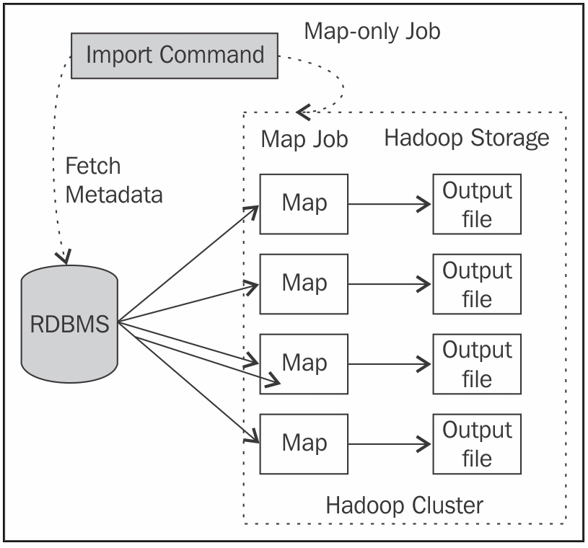
Import Architecture Diagram

Slide 7
Import Examples
$ sqoop import --connect jdbc:mysql://db.foo.com/corp --table EMPLOYEES \ --columns "employee_id,first_name,last_name,job_title“ --m 8
$ sqoop import --connect jdbc:mysql://db.foo.com/corp --table EMPLOYEES \ --fields-terminated-by '\t' --lines-terminated-by '\n –direct
$ sqoop import --connect jdbc:mysql://db.foo.com/corp --table EMPLOYEES \ --where "start_date > '2013-01-01'“
sqoop import --connect jdbc:mysql://db.foo.com/corp --table EMPLOYEES \ --split-by dept_id
$ sqoop import --connect jdbc:mysql://db.foo.com/somedb --table sometable \ --where "id > 100000" --target-dir /incremental_dataset –append
$ sqoop import --connect jdbc:mysql://db.foo.com/corp \ --table EMPLOYEES –validate
$ sqoop merge --new-data newer --onto older --target-dir merged \ --jar-file datatypes.jar --class-name Foo --merge-key id

Slide 8
Sqoop - Export
Export
Moves HDFS data back to RDBMS table
Output table must exist in RDBMS before executing export job!
Since import process is done parallel, the output files can be a set of files.
Reads delimited output files line-by-line
Parses data into records
Translates into INSERT
Inserts the data into the export table
Primary key (if exists) must be unique in the file
Primary key constraints
Export process runs MapReduce job in parallel

Slide 9
Export Parameters
--direct
Used to quickly perform the export for MySQL.
--export-dir <directory>
HDFS input files location
--table <tablename>
Specifies the output RDBMS table name
--num-mappers <num> or -m
Number of mapping tasks

Slide 10
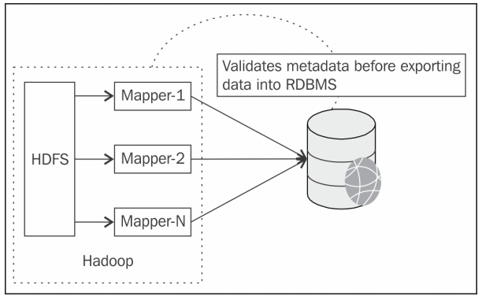
Export Architecture Diagram

Slide 11
Export Process
Validates metadata before exporting it into RDBMS
Executes MapReduce job to transport data
Example
sqoop export –connect jdbc:mysql://localhost:8088/db --table tableName --username root --password pass –export-dir /usr/local/tableName

Slide 12
Demo
Setup
Install Hadoop, Hbase, Hive, Sqoop
Apache BigTop 0.50
bigtop.apache.org
Packaging and interoperability between Hadoop related projects.
Install MySQL
Open source RDBMS system used to create relation database tables and import into Sqoop
Download JDBC drivers and copy to the sqoop lib folder
http://www.mysql.com/downloads/connector/j/
(e.g. /usr/lib/sqoop/lib)

Slide 13
Demo (2)
Create a database in MySQL
Login to MySQL
mysql –u root –P mysql
Create table
Create database
create database sqoop_demo;
CREATE TABLE orders(id INT, name VARCHAR(30));
show tables;
Insert values into the table
INSERT INTO orders(id,name) VALUES(1,”orderA”);
INSERT INTO orders(id,name) VALUES(2,”orderB”);
INSERT INTO orders(id,name) VALUES(3,”orderC”);

Slide 14
Demo (3)
Import orders table into HDFS using Sqoop
sqoop import --connect jdbc:mysql://localhost/sqoop_demo --table orders --username root --target-dir /usr/local/orders –m 1
Files are created in HDFS with the data from the table.
To read the files enter the command:
hadoop fs –ls /usr/local/orders
Example output:
Found 3 items
-rw-r–r– 1 local supergroup 0 2013-10-28 13:23 /usr/local/orders/_SUCCESS
drwxr-xr-x – local supergroup 0 2013-10-28 13:23 /usr/local/orders/_logs
-rw-r–r– 1 local supergroup 60 2013-10-28 13:23 /usr/local/orders/part-m-00000

Slide 15
Demo (4)
Read the ‘part-m-00000’ file to view the results in Hadoop
hadoop fs –cat /usr/local/orders/part-m-*
Output:
1. orderA
2. orderB
3. orderC
5. Export data from HDFS into RDBMS (MySQL)
Mysql> CREATE table orders_exported(id INT, name VARCHAR(30));
sqoop export --connect jdbc:mysql://localhost/sqoop_demo --table orders orders_exported --export-dir /usr/local/orders –username root –P –m 1

Slide 16
Demo (5)
Read data from RDBMS
Mysql> select * from orders_exported;
+——+———–+
| id | name |
+——+———–+
| 1 | orderA |
| 2 | orderB |
| 3 | orderC |
+——+———–+

Slide 17
Questions?

