Slide 1
Cross-Platform Budgeting Application
Karunakar Reddy Kaitha, Jordan Lee and John Lim
MSSE 692: Software Engineering Practicum I Week 8 Final Presentation

Slide 2
Presentation Agenda
Problem Overview
Our Solution
System Architecture
Technology Stack
Live System Demo
Challenges & Lessons Learned
Results & Impact
Future Improvements

Slide 3
Problem Overview
Many individuals struggle with tracking personal finances consistently.
Common problems include:
No centralized budget tracking
Poor visibility of monthly spending
Manual tracking methods (spreadsheets)
Lack of simple cross-device tools
Users need a simple, accessible budgeting system.

Slide 4
Our Solution
We developed a Cross-Platform Budgeting Application that allows users to:
Create and manage budgets
Track expenses
View spending summaries
Access the system from mobile or web
Key characteristics:
Cloud-hosted
Responsive UI
Secure authentication
Real-time financial tracking

Slide 5
Key Features
Core system features include:
User Account Management
Secure login and authentication
Budget Management
Create monthly budgets
Modify budget limits
Expense Tracking
Add expenses
Categorize spending
Dashboard Summary
Overview of financial activity
Budget vs actual spending

Slide 6
System Architecture
Architecture components:
Frontend
React web interface
Responsive design for mobile
Backend
FastAPI REST API
Database
PostgreSQL
Cloud Hosting
Vercel (frontend)
Render (backend)

Slide 7
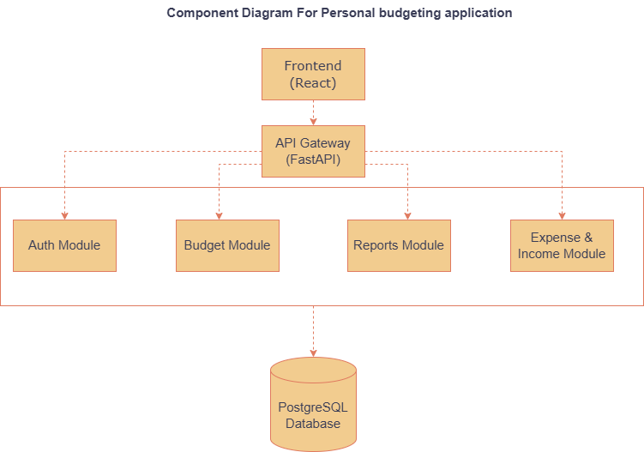
Architecture Diagram
The application follows a layered architecture that separates the user interface, application logic, and data storage. The React frontend handles user interactions and sends requests to the FastAPI backend through REST APIs. The backend processes business logic such as authentication, budgeting operations, and expense calculations, then communicates with the PostgreSQL database to store and retrieve data. This separation of concerns improves scalability, maintainability, and security by ensuring each layer has a clearly defined responsibility.

Slide 8
Technology Stack
Frontend
React
JavaScript
HTML / CSS
Backend
Python
FastAPI
Database
PostgreSQL
Infrastructure
Render
Vercel
Testing Tools
pytest
Jest

Slide 9
Development Process
Our development followed a structured iterative process:
Week 2 | Requirements
Week 3 | Architecture Design
Week 4 | Detailed Design
Week 5-6 | Implementation & Integration
Week 7 | Quality Assurance & Documentation
Week 8 | Final Delivery & Presentation

Slide 10
Demo Overview
Now we will demonstrate the system workflow.
Demo will show:
User login
Create a monthly budget
Add expenses
View dashboard summary

Slide 11
Demo Step 1
User Authentication
User logs into system securely.
JWT Authentication
Our application uses JSON Web Token (JWT) authentication to securely verify user identity after login. When a user logs in, the backend generates a JWT token that is sent to the frontend. This token is included in future API requests to authenticate the user without repeatedly sending login credentials. JWT enables secure, stateless authentication between the React frontend and FastAPI backend.
Secure Password Handling
User passwords are never stored in plain text. Instead, passwords are securely hashed using a cryptographic hashing algorithm (bcrypt) before being saved in the database. During login, the entered password is hashed and compared to the stored hash. This ensures that even if the database were compromised, actual user passwords would remain protected.

Slide 12
Demo Step 2
Budget Creation
User creates a monthly budget.
Fields include:
Budget amount
Time period
Category limits

Slide 13
Demo Step 3
Expense Tracking
User records expenses including:
Expense description
Amount
Category
System updates totals automatically.

Slide 14
Demo Step 4
Dashboard Summary
User can view:
Total expenses
Remaining budget
Category spending
This provides quick financial insight.

Slide 15
Challenges & Lessons Learned
Some challenges encountered:
Integration Complexity Frontend and backend synchronization required careful API design.
State Management Ensuring UI reflected updated financial data.
Testing Financial Logic Budget calculations required strong test coverage to ensure accuracy.
Lessons learned:
Start integration earlier
Write tests alongside implementation
Maintain clear documentation.

Slide 16
Results & Impact
Our system successfully delivers:
Functional budgeting system
Cross-platform accessibility
Secure authentication
Reliable financial calculations
Quality assurance results:
75%+ test coverage
All critical bugs resolved
Fully deployable MVP

Slide 17
Future Improvements
Potential future enhancements include:
Data visualization charts
Budget forecasting
Multi-user household budgets
Financial insights and alerts

Slide 18
Conclusion
The Cross-Platform Budgeting Application demonstrates:
Full-stack system development
Team collaboration
Testing and quality assurance
Professional documentation
This project reflects the integration of knowledge from across the MSSE program.
Thank you.

Slide 19
Thank You

