Slide 1
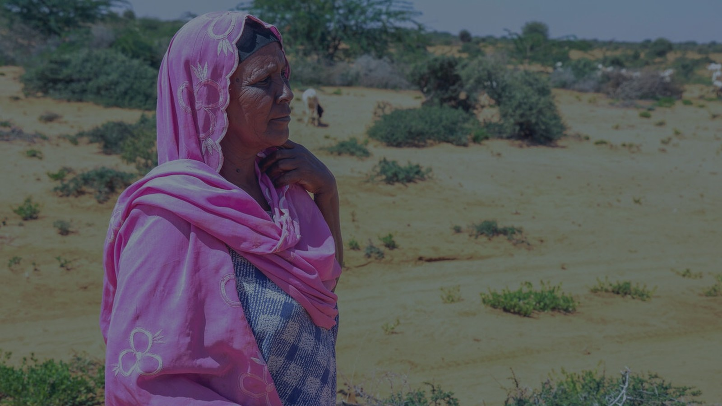

A shared framework for coordinated evidence generation, 2026–2030
Overview for the validation meeting
October 2026

Slide 2
What we are here to do
1
Review agenda
Recap the agenda through the slides to get the conversation going.
2
Overall sentiments
Identify what should be added and what needs expansion.
3
Discuss the first round of comments
Work through specific comments and resolve them together.
4
Wrap up for Berlin
Agree way forward and to see if a working version to present at the Global Dialogue Platform as a living document, for a second round of feedback.
2

Slide 3
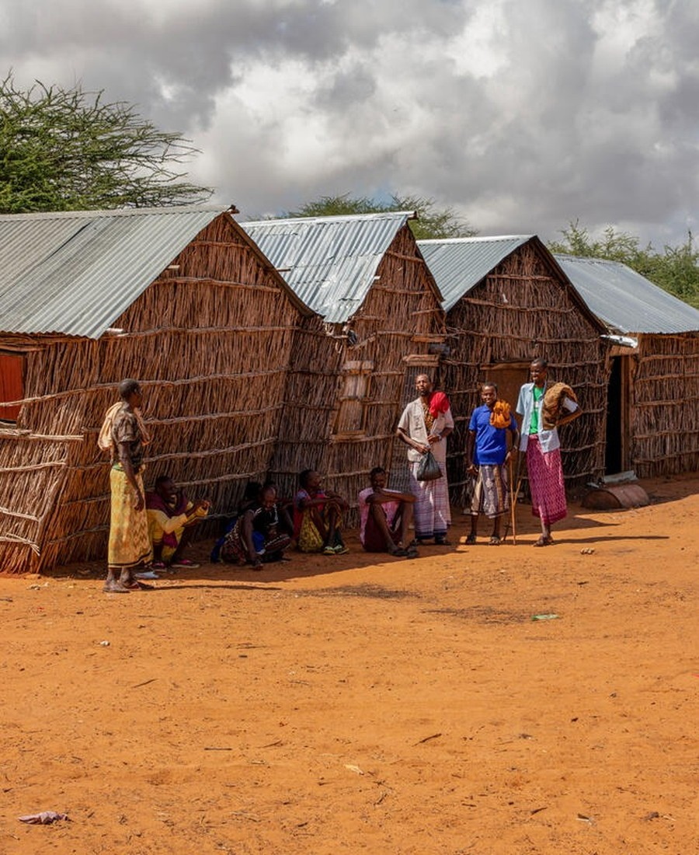
How we started and where we are?
FAO workshop, Rome April 2026
“Leveraging Evidence for Effective Anticipatory Action” — 50+ speakers, 150+ participants.
WFP Global Impact Evaluation Forum Geneva, Sep 2026
Refined priorities; the OCHA-WFP AA evidence window focusing on Impact Evaluations can be situated within the agenda.
ISDC roundtable & partner consultations Berlin, Sep 2026
Evidence in fragile settings; bilateral inputs from partners.
Living document Ongoing
Continues to evolve through contributions from participating stakeholders.
13

Slide 4
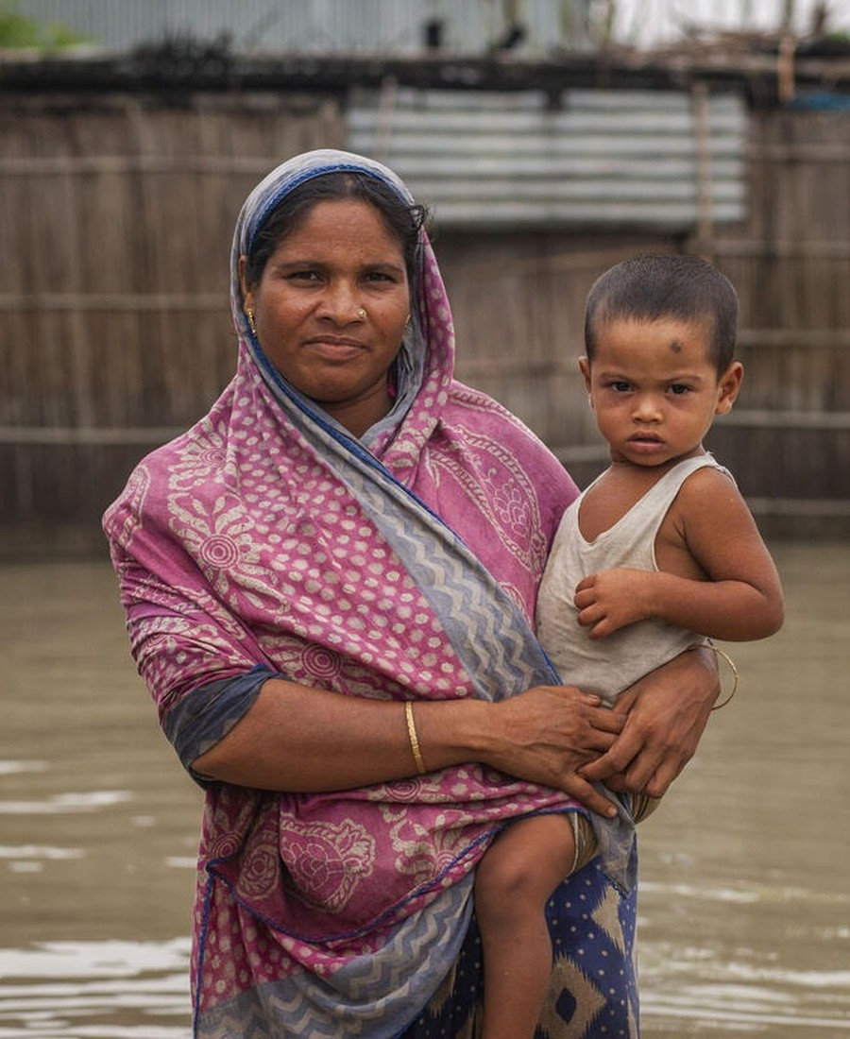
The case for acting early is made;
the frontier has moved
A strong base to build on
A decade of rigorous studies across geographies and hazards shows that reaching people before a shock protects food security, reduces harmful coping and preserves assets.
The question has changed
The frontier is now making anticipatory action work better: which design features matter, how short-term protection lasts, and how costs compare.
No single study can answer it
These are comparative questions. Answering them means moving from individual studies to a shared effort — especially as funding tightens.
3

Slide 5
A shared framework: not a platform or a fund
An overarching structure under which the efforts of individual institutions are systematised, so each contribution is magnified by being comparable with and cumulative to the work of others. Partners keep designing, funding and implementing their own studies; the agenda aligns them.
FOCUSED SCOPE
WHO IT IS FOR
WHAT IT ADDS
Evidence on the impact, effectiveness and cost-effectiveness of anticipatory action for the people it aims to protect.
Open to any organisation that generates, finances or uses AA evidence — UN agencies, Red Cross / Red Crescent, NGOs, researchers, banks, donors and governments.
Early visibility of others' studies, shared baselines, stronger joint resource mobilisation, and findings that carry more weight because they are comparable.
4

Slide 6
Agenda key objectives
Roadmap for evidence building
Shared reference for progress & expectations
An overarching framework that builds on and complements existing work rather than duplicating it.
A common view of what is known, what remains open, and what AA can and cannot realistically achieve.
A bridge from evidence to action
A lever for mobilising resources
Putting both existing and new findings to work in programme design, financing and policy.
Partners pool effort and use each other's commitments to attract funding — without necessarily pooling budgets.
5

Slide 7
Four priority gaps identified in the Agenda (so far)
An initial, evolving set. a starting point to be refined with the community, not a fixed scope.
GAP 1
GAP 2
Conditions under which AA works best
Linkages with long-term outcomes & resilience
Timing and sequencing, cash vs in-kind and multi-sectoral packages, which design features drive outcomes.
Whether gains last through the season and across repeated shocks, and how they connect to resilience.
GAP 3
GAP 4
Cost-effectiveness & value for money
Coverage
A common method for avoided losses, added benefits, and the full costs of readiness and delivery.
Deliberately diversifying the evidence base — multi-hazard settings, under-represented regions and livelihoods.
6

Slide 8
Agenda proposition on how studies are chosen and conducted
Decision-relevant. Each study starts from the decision it must inform, not from the method.
Build on what exists. Existing evidence is used and put to work before new studies are commissioned.
Transparent, tiered rigour. Most rigorous methods where feasible, robust alternatives elsewhere — stated openly, not pooled as equivalent.
Comparable by design. Common measurement module applied where feasible; key context documented so findings travel.
Proportionate & ethical. Data collection limited to what is needed; communities treated as partners, not only respondents.
7

Slide 9
Seven actions, aligned to the gaps
1
Critical mass of evidence
≥10 rigorous studies by 2030, selected as a portfolio.
5
Open data
Anonymised portfolio data shared under agreed protocols.
2
Common measurement module
A small shared set of core indicators and a common costing approach.
6
From evidence to action
Findings timed and packaged as briefs for the decisions they inform.
3
Living inventory of studies
A public map of completed and ongoing evaluations, building on the Anticipation Hub.
7
Stakeholder engagement
Governments, donors and communities engaged in shaping and using the evidence.
4
Evaluation-ready studies
Joint evaluations with shared baselines, prepared ahead of activations.
8

Slide 10
Light governance and Open financing mechanism
Participating stakeholders and core group
AA MEAL Working Group/AA Task Force
Define priorities, contribute studies and data, endorse the agenda by consensus.
Specialists who carry substantive work between meetings — priorities, the module, portfolio review, synthesis.
Informal secretariat: facilitates the process, maintains the agenda and the inventory.
Leads advocacy and links to programming; turns findings into messages for donors and governments.
FINANCING: POSSIBILITY A
FINANCING: POSSIBILITY B
Individual studies
Shared functions
Financed by partners: singly, or jointly where interests align. Partners leverage each other's commitments to attract further funding.
Modest joint resources for the common measurement module, the inventory of studies, and the synthesis of results.
9

Slide 11
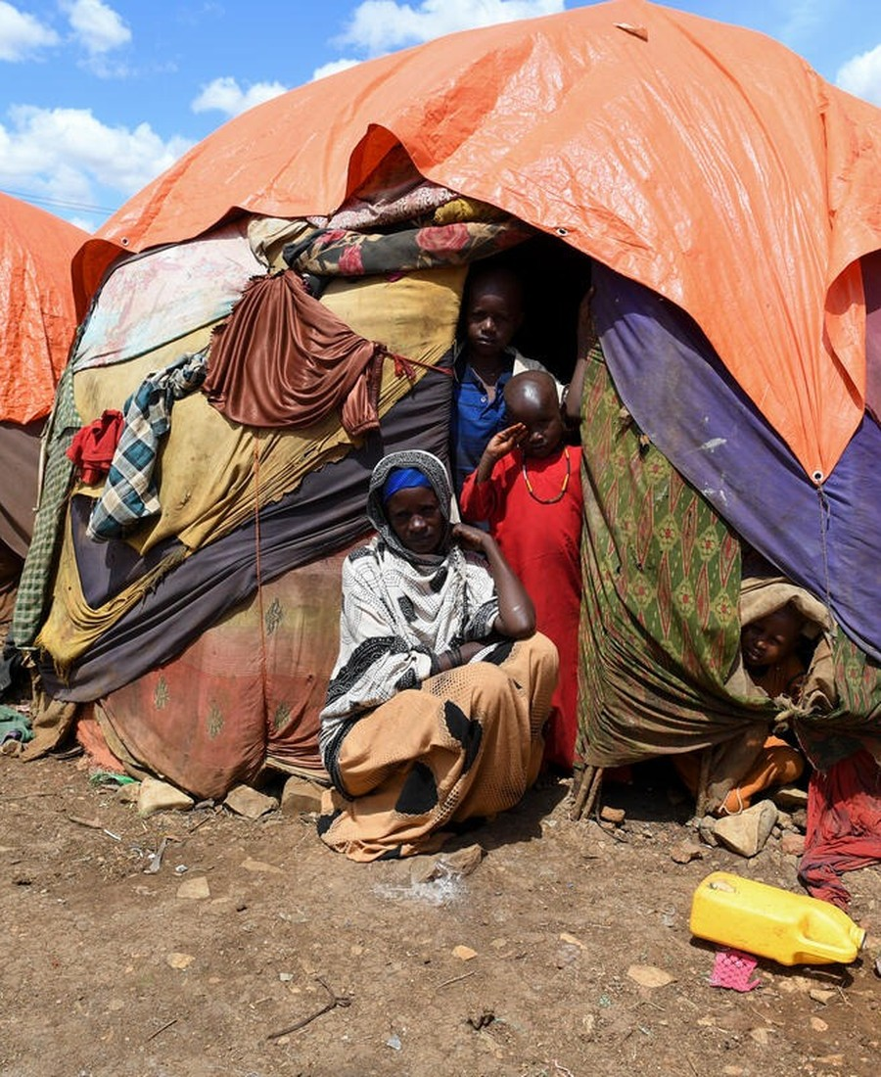
Measuring success of the agenda
1
Organizations that have formally endorsed the agenda
2
Studies in the portfolio, including joint evaluations with shared baselines
3
Share of AA evaluations applying the common measurement module
4
Pooled analyses completed across countries and hazards
5
Documented cases where this evidence informed a programmes, scaling or financing decision
12

Slide 12
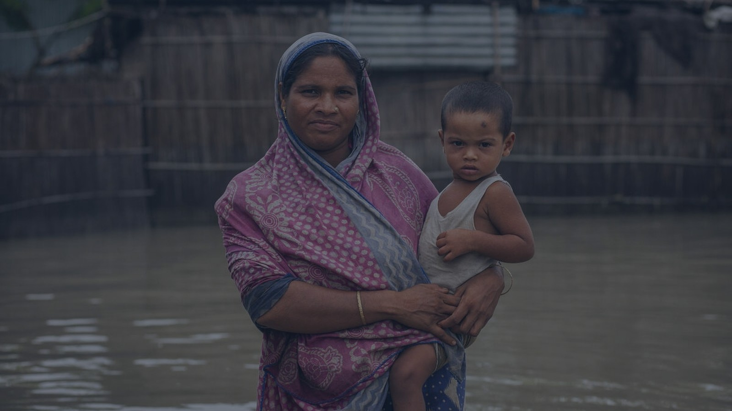
FIRST ROUND OF FEEDBACK
What partners told us
46 comments from ~10 organizations: World Vision, German Red Cross, REAP, Tufts / RCRC Climate Centre, DG ECHO, OCHA and others. Eight themes.
Please note we have received several comments into the document since this morning which are not included in the comments discussed in the slides.
15

Slide 13
Scope & framing: what evidence, and for whom?
Clarify whether the agenda is about what works in AA (and what doesn't) or the case for AA vs response. GRC
Clarify whether we are still about “make the case” of if AA works while the questions have moved to “making AA work better”. GRC
Broaden scope to the country / national-policy perspective, not only how organizations coordinate. REAP
Title risks confusion with “learning” as training; keep JLAA and gloss “learning” as evidence. GRC
Be explicit on whether scope reaches beyond the humanitarian sector (development, climate). Tufts / Climate Centre
17

Slide 14
Gap 1 (Optimal conditions) and Gap 2 (Long-term outcomes)
Add an explicit targeting question: who benefits most, and the right targeting approach for AA. CRS / GRC (x2)
Add delivery channel as a design feature (UN, government social protection, local & faith-based). World Vision
Clarify “trigger timing”; include return period / event severity. Is AA better for frequent or rare events? DG ECHO
Questions may be too broad to answer well: design features differ by hazard and country. Tufts / Climate Centre
Make children explicit in Gap 2: nutrition, continuity of education, protection risks (child labor, early marriage). World Vision
Capture developmental outcomes: poverty, productivity, protection of private investment to attract development / private funding. DG ECHO
Welcomed as a genuine addition the Window does not cover. Tufts / Climate Centre
Make expected long-term effects proportionate to dose: 1–2 months of assistance cannot yield lasting outcomes. (reviewer)
18

Slide 15
Cost-effectiveness, coverage and equity
Define and distinguish cost-effectiveness vs cost-benefit analysis and set a standard method before studies are pooled. CRS / GRC
Specify perspective of analysis: opportunity cost: what else would that actor fund? Tufts / Climate Centre (x2)
Compare against longer-term investments, not only emergency response; cite the recent OCHA fiscal-savings study. DG ECHO
Include readiness costs and “no-regret” value, and un-triggered frameworks (52% never activated, CARE 2026). World Vision
Consider merging cost-benefit into each study rather than a stand-alone gap. (reviewer)
Apply common disaggregation by sex, age and disability across all studies: x3 World Vision, REAP
Treat fragile and conflict-affected settings as a knowledge gap, not only an evaluation obstacle (one experimental study to date). World Vision
20

Slide 16
Governance, WFP–OCHA Window and Effort Duplication
Clarify how the agenda relates to the WFP–OCHA impact evaluation window, and how NGOs can take part / co-design. World Vision
Several parts may already exist. For example, the MEAL WG guidelines and the Window already cover indicators, costing, readiness and the priority questions. What does the agenda add rather than repeat? OCHA (Daniel Pfister)
Guard against adding to fragmentation: with learning budgets shrinking, we should use the given budget on existing infrastructure rather than creating a parallel process. OCHA (Daniel Pfister)
Be clear what changes in practice. Agencies already evaluate jointly; the Window already uses a technical coordinator and a feasibility screen. OCHA
Add a clear implementation plan and budget; if it updates the MEAL WG's work, consider taking it forward within that group. OCHA
Would the Anticipation Hub be the logical host? State FAO's intended hosting; make explicit the AA MEAL WG is a Hub working group. GRC
Clarify who selects studies for the shared portfolio; add national, regional and global policy processes to engagement and uptake. Tufts / Climate Centre · REAP
23

Slide 17
Rigour, standards and data-sharing
Narrative must match method strength e.g., baseline/endline cannot attribute; methodologies have limits, and assumptions stated. (reviewer)
Use existing MEAL WG common indicators rather than defining new ones. (reviewer)
Allow for wide range of studies. Different audiences find different evidence credible — quantitative vs narrative / success stories. (reviewer)
Set minimum methodological standards and name who sets and reviews them. OCHA (Daniel Pfister)
Explain, for non-researchers, why data is shared: perhaps for replication, secondary and meta-analysis. GRC
Not all data need be shared with everyone; soften to results, where feasible, under agreed protocols. GRC (x2)
Build in an uptake / implementation element — there is a known research-to-practice gap (implementation science). Tufts / Climate Centre
22

Slide 18
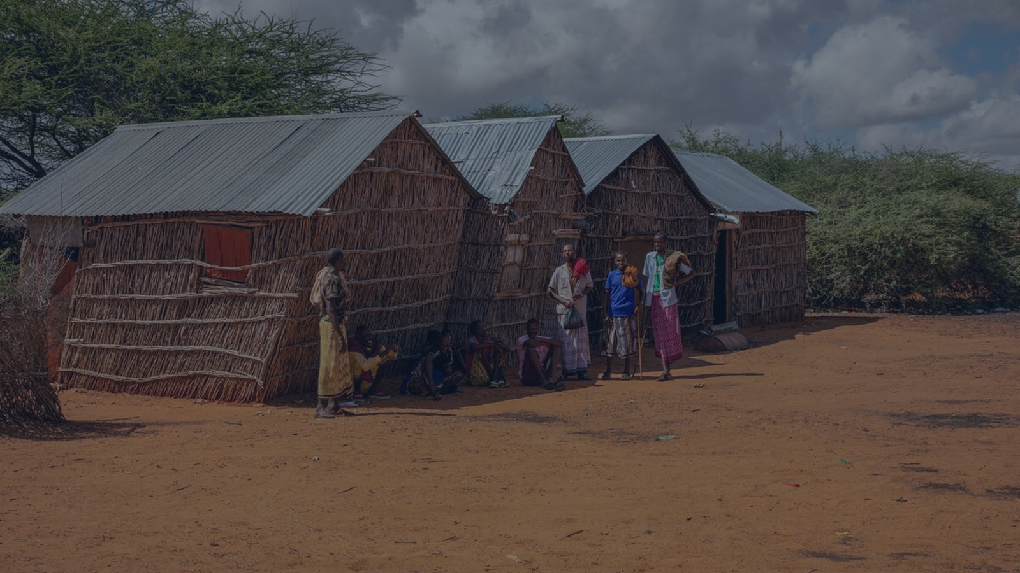
OPEN DISCUSSION
Where we would value your input
Overall, does the framing and scope feel right?
What is missing, and what needs expansion?
Are the four gaps correct and enough or shall we add more priorities to lead with?
Comments that needs to be addressed
High-level comments to be addressed before the light launch in Berlin
Next: Finalize a working version to present at the Global Dialogue Platform (Berlin) next week as a living document for a second round of feedback.
14

Slide 19
Proposed timeline and future
PHASE 0
PHASE 1
PHASE 2
PHASE 3
2026
late 2026–early 2027
2027–2030
2030
Living document
Validation & endorsement
Coordinated evidence generation
Synthesis & uptake
Open for comment; working version presented at the Global Dialogue Platform, Berlin.
Priorities validated, partners endorse, technical core group formed, module drafted.
Joint evaluations under the common module; mid-term stocktake in 2028.
Findings synthesised and communicated to inform scaling and financing decisions.
11

Slide 20

NEXT STEPS
See you at the Global Dialogue Platform
We look forward to seeing you in Berlin and continuing the discussion in person.
Soft launch. Niccolò Lombardi and Kamran Khan Niazi will soft-launch this document in a plenary session on 21 October.
Session 21. A dedicated session on joint evidence, what it means to organizations and what organizations are prioritizing at their end is also scheduled at the Global Dialogue Platform on October 21 at 15.30 CEST.

