Slide 1
Tips & techniques for a more reproducible R environment
2023-06-27 Keboola

Slide 2
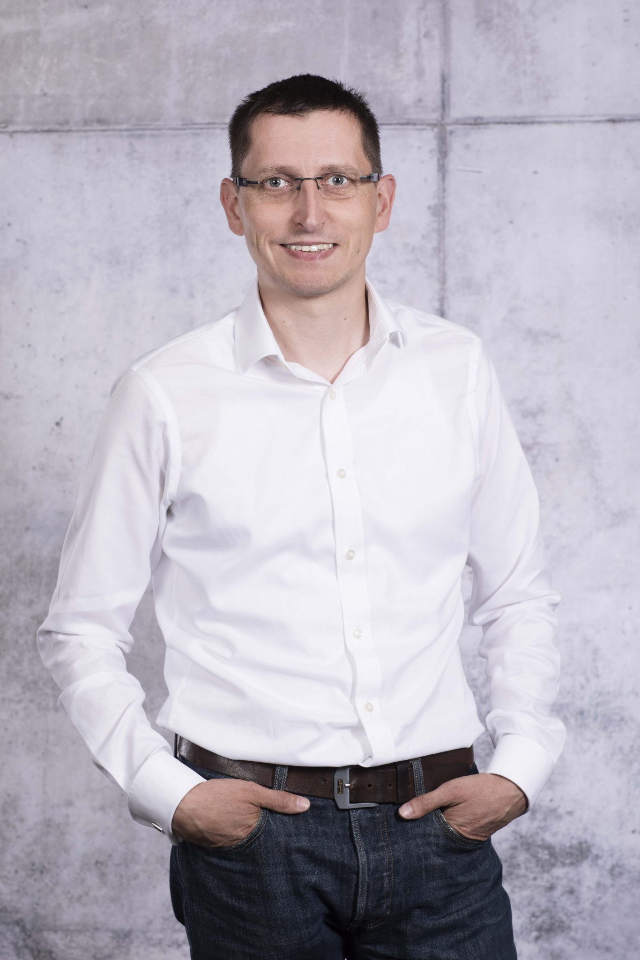
About me
Jindra Lacko
PhD student KEKO
 jindra@jla-data.net
 www.jla-data.net
  @jladata
 jlacko

Slide 3
The why of reproducibility
Tempora mutantur et nos mutamur in illis
The Times They Are A-Changin'
Both R itself, and the package ecosystem surrounding it, are actively developed
Resources – including maintainer's time – are finite, and complexity comes at a cost
One dev's errors are another dev's features

Slide 4
Evolution of R itself
x.y.0 release each spring, patch releases "as required"
Each x.y.0 release forces fresh install of packages
Complicated system of checks & balances ensuring all current CRAN package versions play along nicely

Slide 5
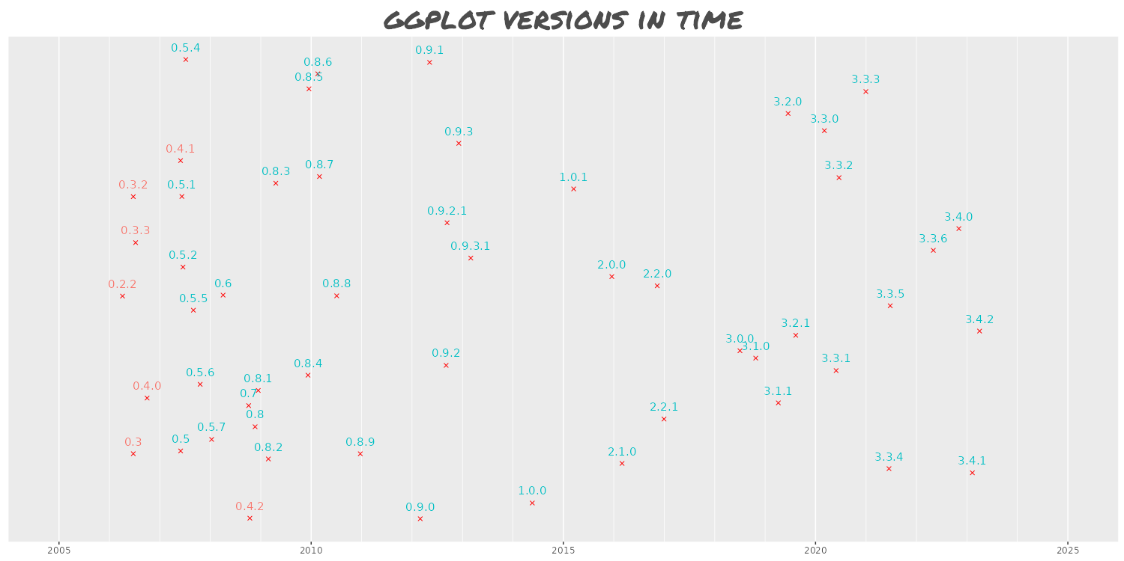
Evolution of a package

Slide 6
Evolution of a package
A nova-like outburst of initial creativity
  few early adopters
  breaking changes are common, including a fresh start
Growing up period
  user base builds up
  breaking changes are infrequent (but possible)
Plateau of stability
  package becomes a part of canon
  active development happens in extending packages

Slide 7
3 levels of reproduciblity
A piece of code (often someone else's) fails to run as expected
Bulletproofing a piece of code for future you to run the same forever
Preparing a piece of code for anyone to run & get expected output

Slide 8
Making sense of code past
Encountering old & buggy code in:
  Company codebase (including yours!)
  Supplement to a published paper
  Blog posts / Stack Overflow answers
Ask for sessionInfo() output (if possible)
Look for the date of creation / publishing

Slide 9
Turning back the time…
{groundhog} package
  groundhog = genus Marmota / svišť
  groundhog.library(package, "date")
Historized RStudio package archive
  install.packages(package, repos = "https://packagemanager.rstudio.com/cran/YYYY-MM-DD")

Slide 10
Known limitations
Both approaches work within the current R version (can't go safely too far) + operating system
groundhog will work in current session only (for good or bad)
RStudio package manager will install packages globally (for good or bad)
A chance of messing up your package install

Slide 11
Fixing R Environment
{renv} package
  Creates lockfile renv.lock (a JSON) describing currently used packages
  Works on project basis = tied to RStudio IDE
  Call renv::init() to set up
  renv::snapshot() to create and
  renv::restore() to restore from lockfile

Slide 12
Stabilizing at OS level
Docker
  Fully eliminates the "it works on my machine" excuse
  Creates a fully isolated image of OS level libraries, R, installed packages, your data + scripts (full stop)
  Plays nicely with other IDEs (VS Code)

Slide 13
Benefits of fixing versions
The chance of unexpected code output is greatly minimized
Less work on maintaining old code, more time to play
Fewer surprises – especially in public

Slide 14
Costs of fixing versions
Things happen for a reason – including breaking changes in R packages
No shiny new features!
Loss of contact with R community
Complexity of living both in past and present maintaining old + creating new

Slide 15
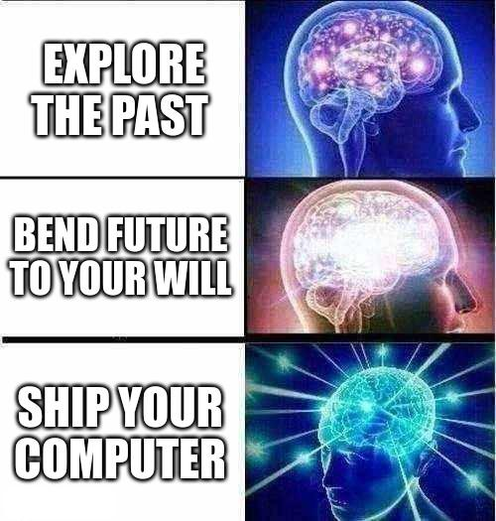
Summary

Slide 16
Thank you
https://github.com/jlacko/r-meetup-reproducibility

