Slide 1
Outcomes of Riot: League of Legends Patch Changes
Josh Lacy, Yates Robinson, Devon Gilliard

Slide 2
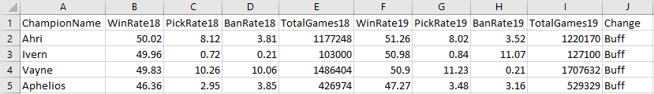
Dataset
•The data we are using comes from the game Riot: League of Legends
•League of Legends is a MOBA with many playable characters
•Riot makes patch changes every few weeks to try and balance the playable characters
•The data we used is from a patch change analyzing the change

Slide 3
Story Idea
•There has been a growing issue with whether or not the patch changes Riot makes will result in their intended outcome
•We chose to analyze one patch changes and compared the changed playable characters side by side
•In order to analyze whether or not Riot’s changes were intended for a specific purpose (balancing win-rate), we used visualizations to try and evaluate a simple trend

Slide 4
Website
The website breaks the story down into 5 core parts. It uses an introduction and conclusion to push our project idea and 3 additional tabs to share our graphs. The introduction and conclusion pages don’t actually include any interactivity.

Slide 5
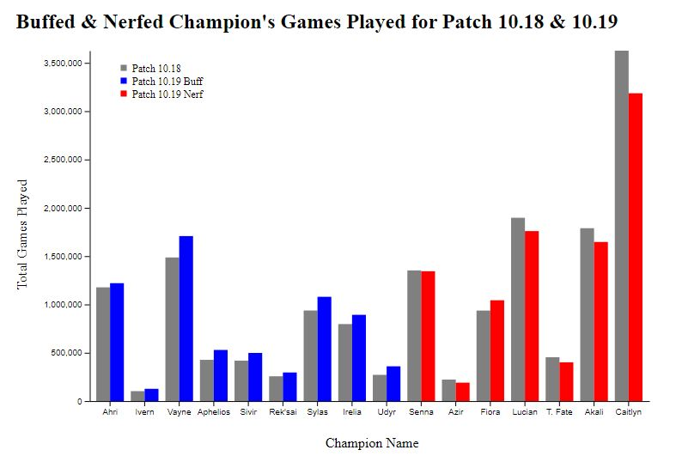
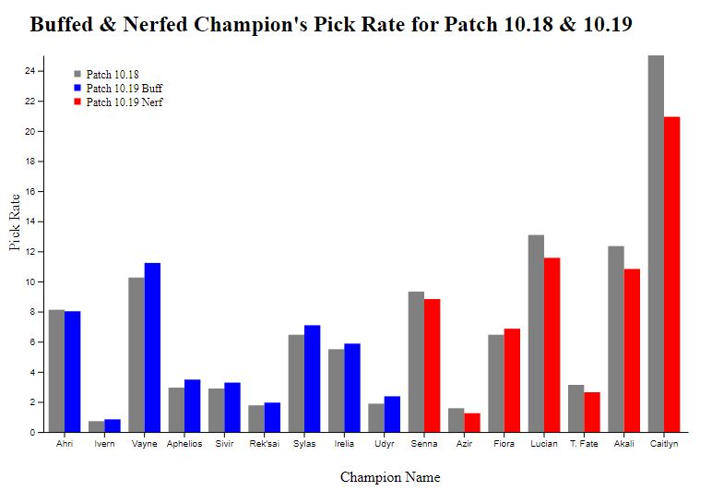
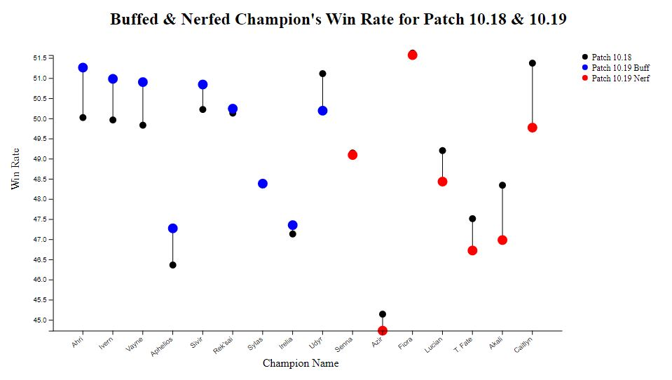
Website
Our graphs are relatively simple as they are just breakdowns of the data
Graph 1 is the number of total games played for each champion
Graph 2 is the number of games played for each champion as a percentage
Graph 3 each champions win rate as a percentage

Slide 6
Findings
Characters with a buff deem eye candy to new and inexperienced players
Win-rate is the more important statistic when deciding on a buff/nerf
Pick-rate can affect the decision but doesn’t have a huge impact

