Slide 1
Sequence and Structural Information of Autoreactive Antibodies/ Antibody Bioinformatic Tools
Notes:
Autoreactive definition
Candidate autoreactive sequences selected by Catherine
Understand what makes them autoreactive

Slide 2
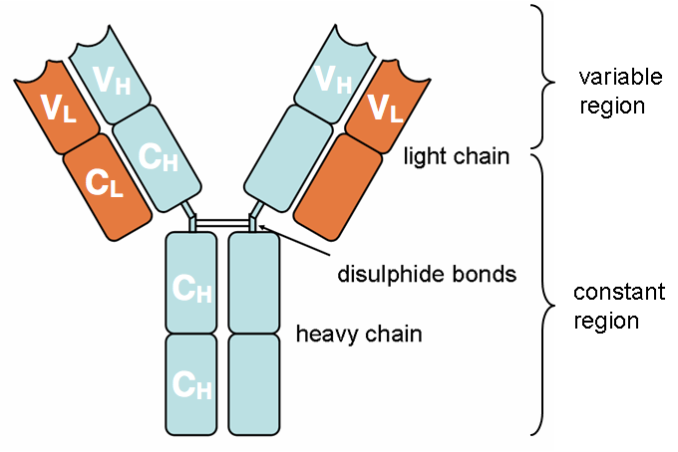
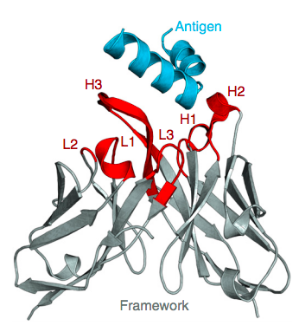

Slide 3
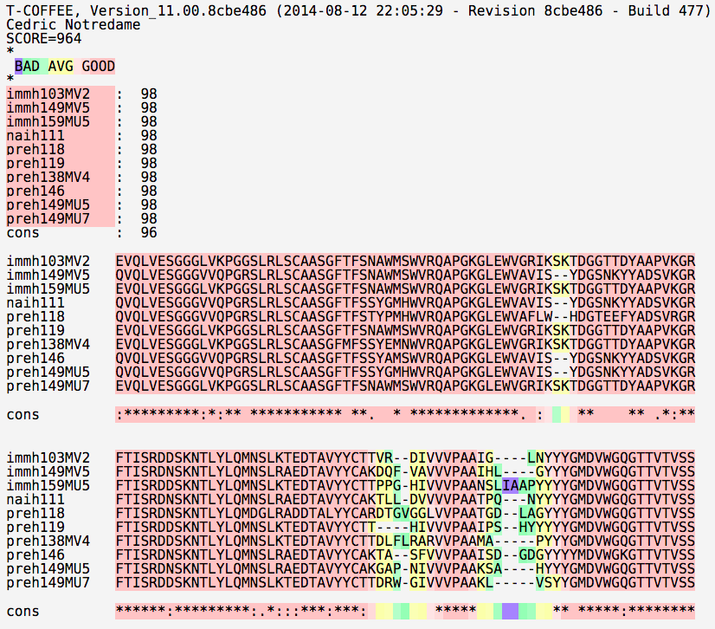

Slide 4
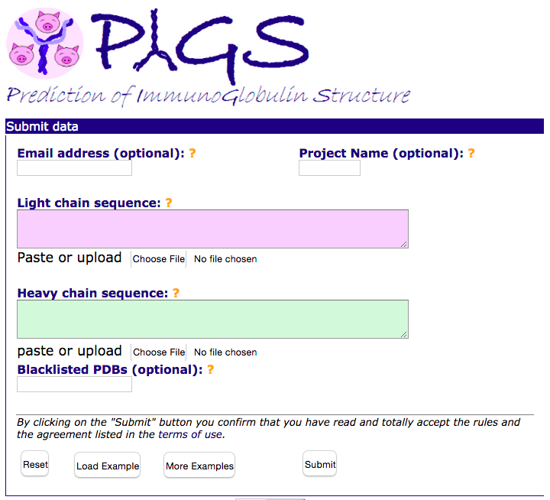
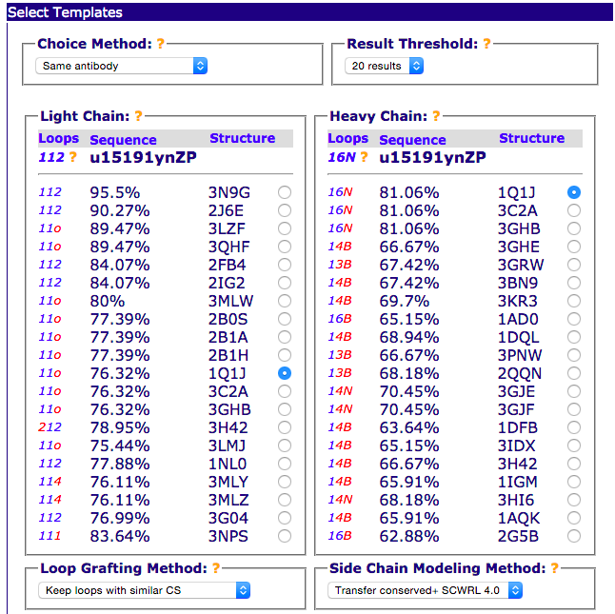
Prediction of Immunoglobulin Structure (PIGS)
V_{H}
V_{L}
Antibody Model
Notes:
Chain packing
same antibody avoids undesired packing effects
Canonical structure conformation matches where possible
the structure of HV loops are the least predictable and the most important in antibody binding. Providing same canonical structure helps to produce accurate model as far as possible
Still high sequence identity
And (next page) CDRH3 loop coverage maximised.

Slide 5
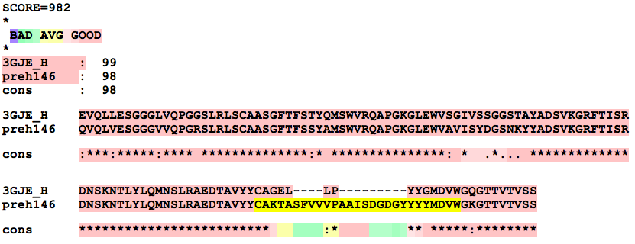
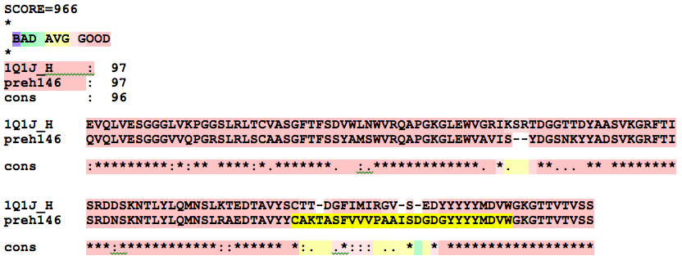
BLAST method
PIGS method

Slide 6
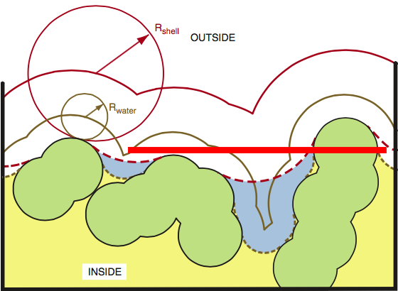
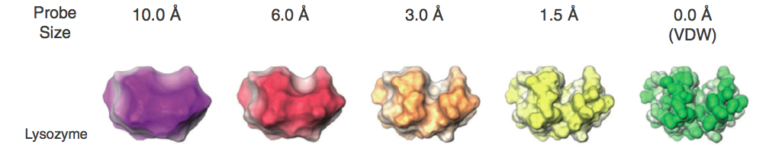
Antigen Size
Voss and Gerstein, 2010
Notes:
3V rolling probe method

Slide 7
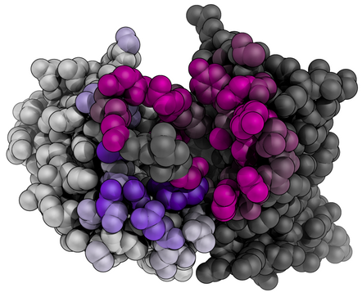
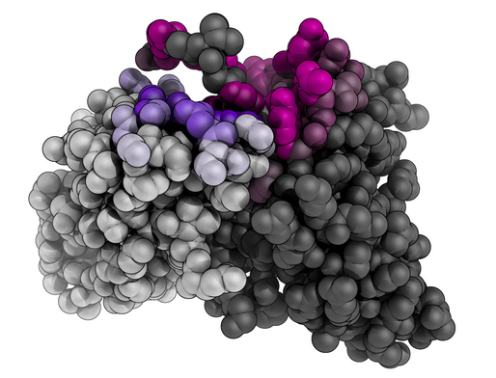
ProABC model
Top view
Side view

Slide 9
