Slide 1

Personas

Slide 2
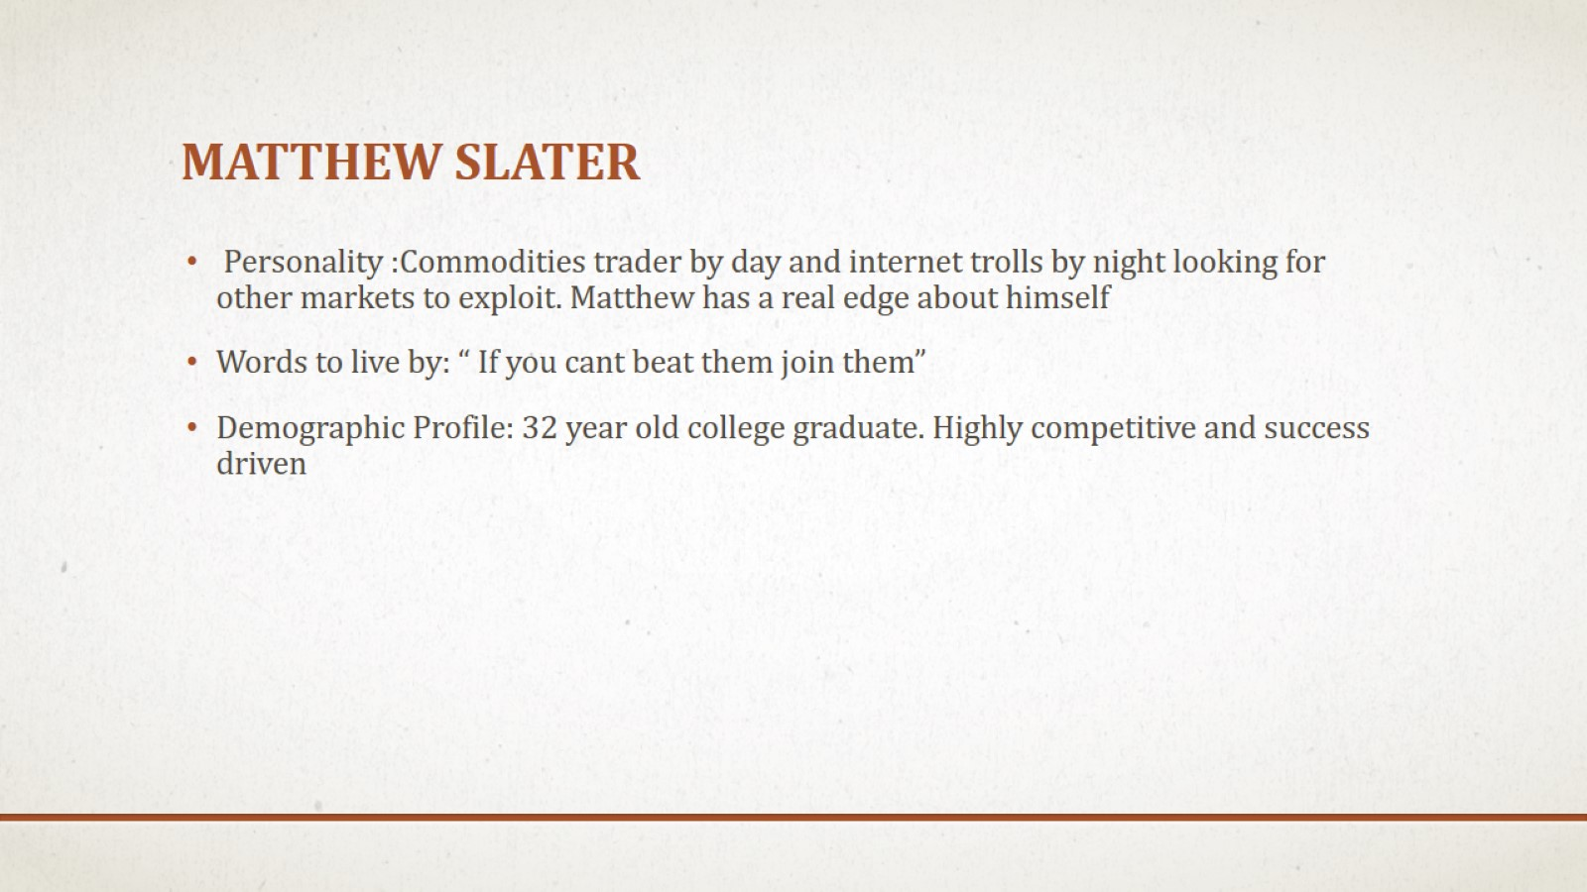
Matthew slater

Slide 3

Supreme Motivator

Slide 4
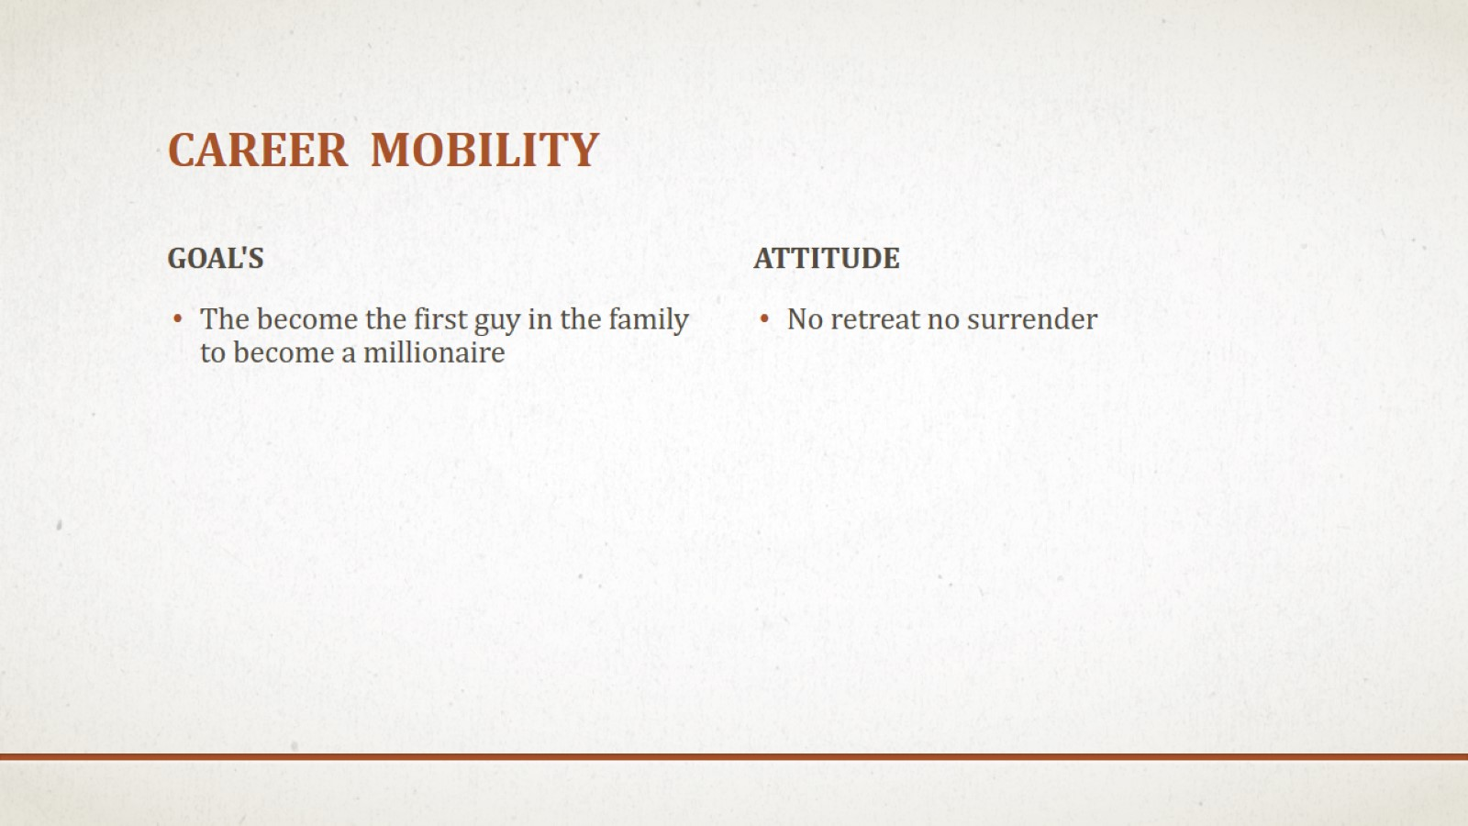
Career mobility

Slide 5
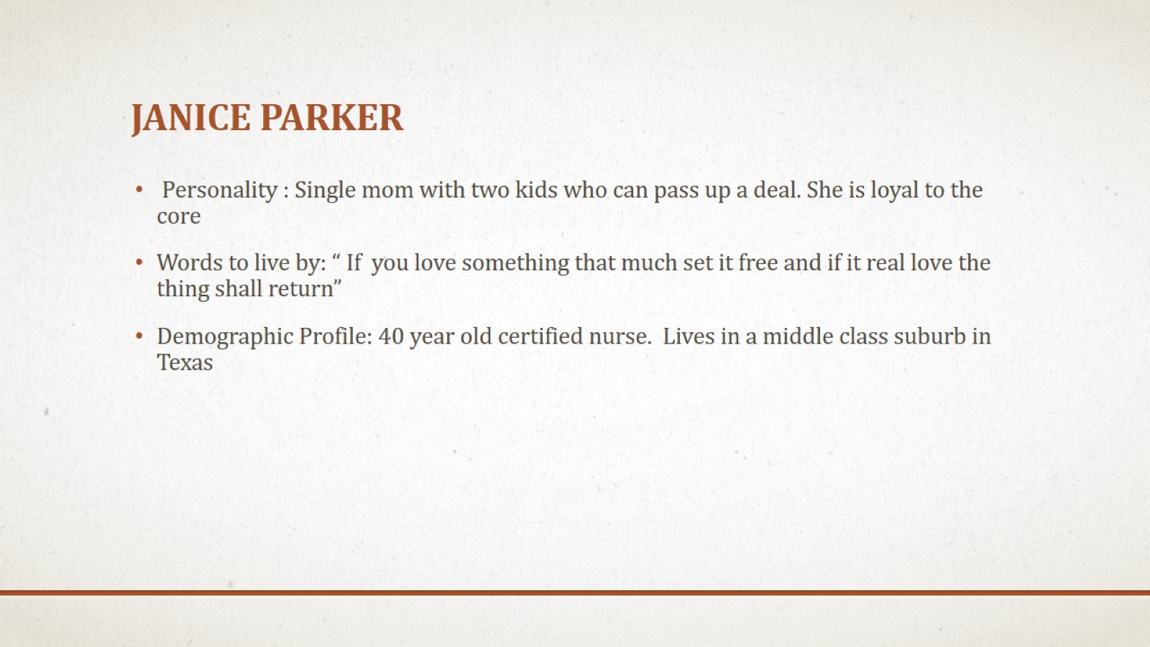
Janice Parker

Slide 6

Supreme Motivator

Slide 7
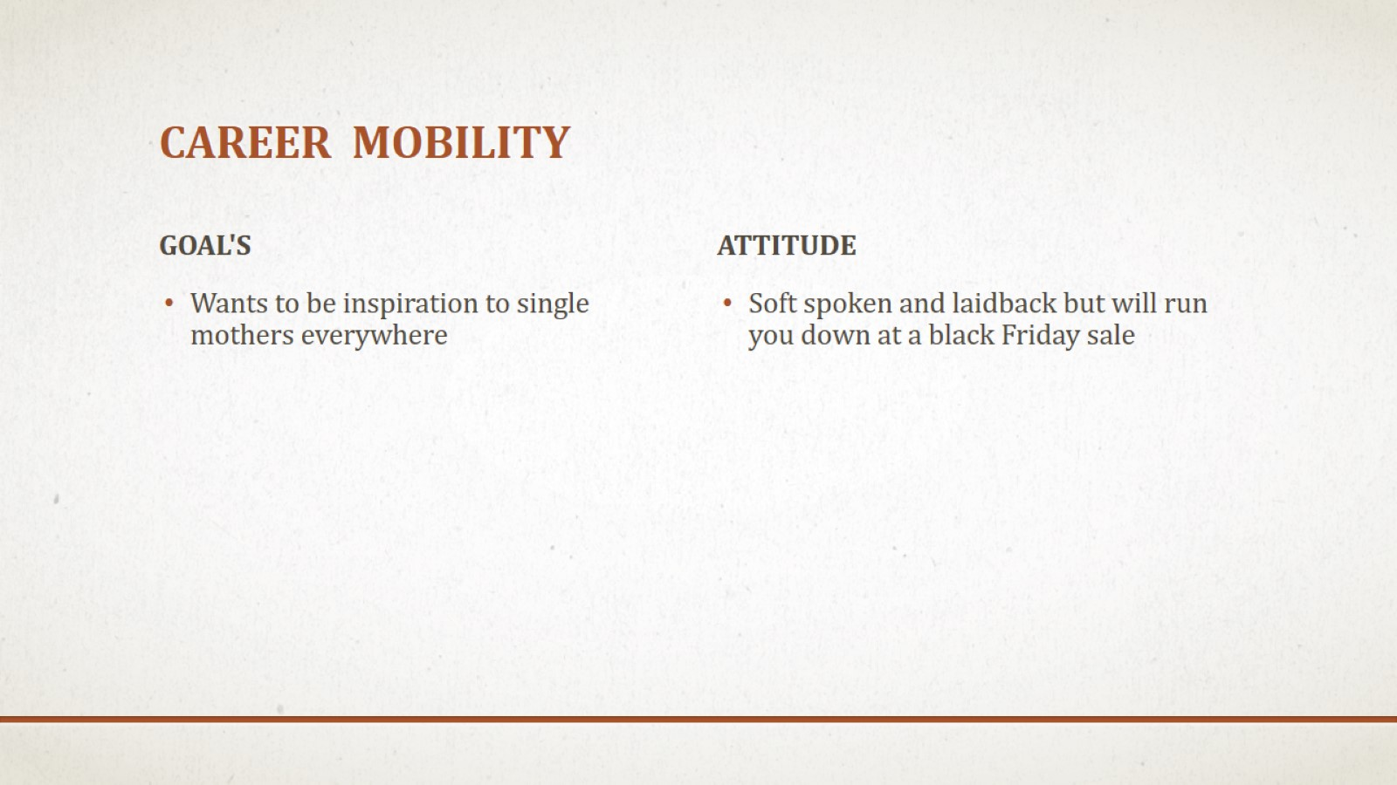
Career mobility

