Slide 1
Workshop #1
HTML CSS JavaScript

Slide 2
How we Started
We started off as a group of students that enjoyed participating in CTFs.
We grew into a club that deals with all sorts of cyber security topics.
Bitcoins
Encryption
Ethical Hacking
And of course, CTFs

Slide 3
What are CTFs?
Two types: Jeopardy or Attack-Defence
Jeopardy: will have many tasks in fields such as Web, Forensic, Crypto, Binary
Attack-Defence: protect your own server while finding exploits in others

Slide 4
Example Question:
Crypto:
My favorite number is 13!
Can you decode my message?
guvf vf na rknzcyr bs n pnrfne pvcure
Misc:
I his the flag in this image! (flag is in flag{} format)
postimg.org/image/gttxn3f03

Slide 5
Introduction
Purpose of this workshop
Introduction to Web and HTTP
Difference between Internet and Intranet
Understand and know basic structure of web development.
HTML (Structure)
CSS (Presentation)
JavaScript (Behavior)
Bootstrap (Framework)
Create a personal website/portfolio
Git, Heroku, Name Cheap, theme

Slide 6
Preparation
Requires to install/register in following
Git Hub/ Git – register required
PhpStorm (or similar IDE) – JetBrains account required.
Heroku – register required
Name Cheap – register required

Slide 7

To get started, we will first learn Git
What is Git?
Git is a Version Control software
Simple way to upload your files to the internet
Useful for collaborations on a project
Download Git:
git-scm.com
Notes:
So, Git is a “version control system,” what’s that mean? When developers are creating something (an application, for example), they are making constant changes to the code and releasing new versions, up to and after the first official (non-beta) release.
Version control systems keep these revisions straight, and store the modifications in a central repository. This allows developers to easily collaborate, as they can download a new version of the software, make changes, and upload the newest revision. Every developer can see these new changes, download them, and contribute.
Similarly, people who have nothing to do with the development of a project can still download the files and use them. Most Linux users should be familiar with this process, as using Git, Subversion, or some other similar method is pretty common for downloading needed files, especially in preparation for compiling a program from source code (a rather common practice for Linux geeks).

Slide 8
More about git
Version control
Git projects are called a Repository (Repo)
Development can be reverted to a previous state
Since it allowing merging, multiple people can work at once on the same codebase

Slide 9
Github
GitHub is a code hosting platform for version control and collaboration. It lets you and others work together on projects from anywhere.
Create a github account for free:
Github.com

Slide 10
Download Git Desktop
You can install GitHub Desktop on Microsoft Windows 7 or later .
Visit the GitHub Desktop download page.
Choose Download for Windows.
In your computer's Downloads folder, double-click GitHub Desktop.
In the pop-up window, click Install.
After the program has been installed, click Run.

Slide 11
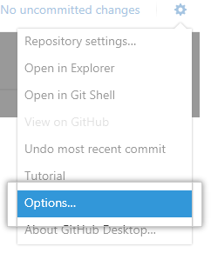
Setup Github Desktop
Add your GitHub.com or GitHub Enterprise account information to GitHub Desktop so you can access your repositories.
1. In the upper-right corner of the app, click on the settings icon.
2. Choose options

Slide 12
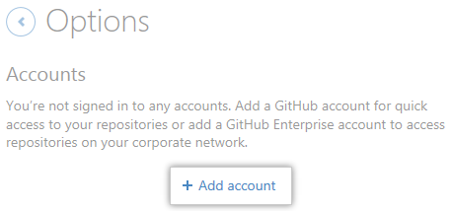
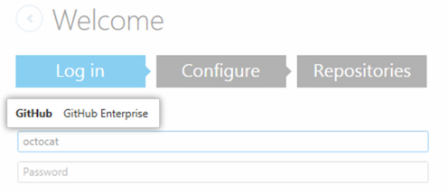
Setup Github Desktop
3. Under Accounts, click Add account.
4. Under Log in, choose GitHub.
5. Type your credentials, then click Log in.

Slide 13
Create your project
Go back to Github.com
In the upper right corner, next to your avatar, click and then select New repository.
Name your repository hello-world.
Write a short description.
Select Initialize this repository with a README.

Slide 14
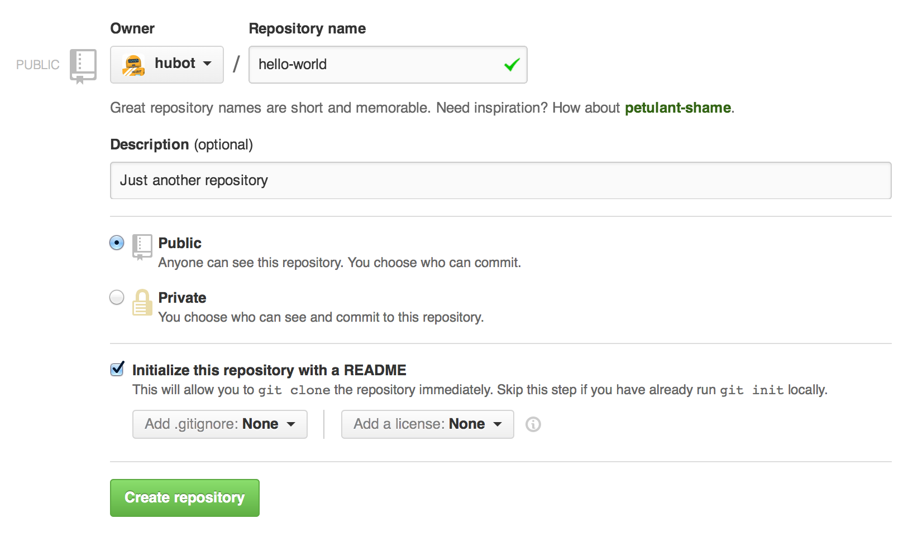

Slide 15
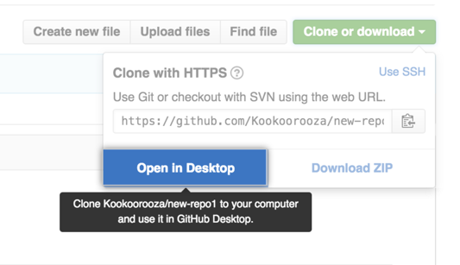
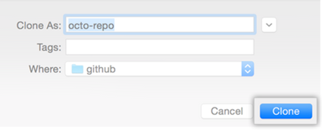
Download the project to your computer
On GitHub, navigate to the main page of the repository.
Under your repository name, click Clone or download.
Click Open in Desktop to clone the repository and open it in GitHub Desktop.
Choose where you want to save the repo .

Slide 16
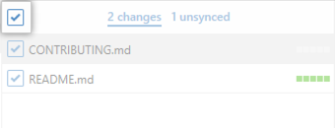
How to use Github desktop
As you work on your new project, your progress will be tracked locally
To upload your progress to GitHub, you will need to “commit” your changes
Committing is basically creating a snapshot of your current changes
To add all changes in all files to a single commit, keep the checkbox at the top of the list selected.

Slide 17
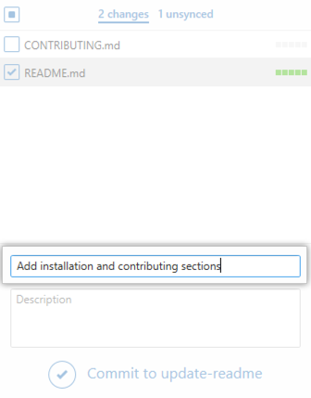
Committing your work in Github Desktop
At the bottom of the list of changes, in the Summary field, type a commit message (usually a description of what you changed).
When you are ready, under the Description field, click Commit to BRANCH.

Slide 18

Uploading your changes to GitHub
When you're ready to sync your commits with the remote repository, in the upper-right corner of the app, click Sync.
Now your Github project is up to date with your local changes

Slide 19
Web
A Web Page is consist of Objects.
Objects can be HTML file, JPEG image, Java applet, Video file, Audio file, etc.
Web page is consist of Base HTML-file which includes several referenced objects.
Each object is addressable by a URL.
ex: www.westerncyber.club/somefolder/thisispicture.jpg
Host Name
Path Name

Slide 20
HTTP
HyperText Transfer Protocol is a web’s application layer protocol.

Slide 21


HTML
Hyper Text Markup Language
For creating web pages and web applications.
Unlike scripting or programming languages that uses scripts to perform functions, Markup language uses “Tags” (‘<>’ : angled brackets)
It has “start tag” and the “end tag”
Ex: <p> </p>
Simple example : A person

Slide 22
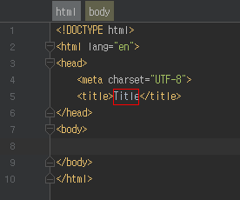
Basic Structure of HTML
<!DOCTYPE html>
Declaration defines this document to be HTML.
<html>
An element that is the root element of an HTML page.
<head>
An element contains meta information about the document.
<body>
An element contains the visible page content.

Slide 23
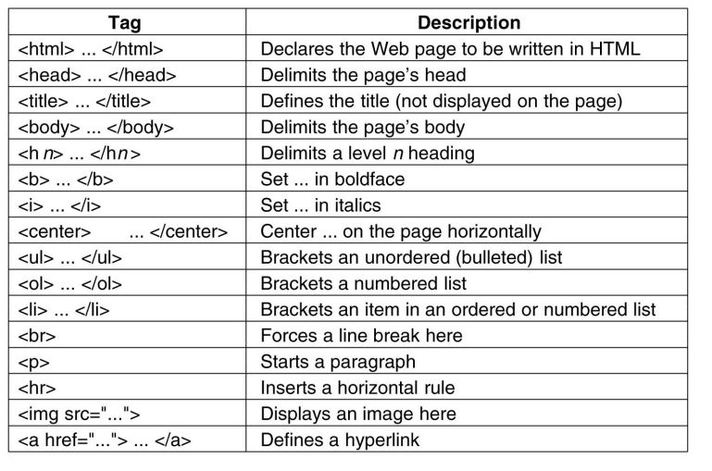
Elements
HTML documents are made up of HTML elements.
It is written using a “Start Tag” and an “End Tag,” and with the “Content” in between.
Elements with no content are called empty elements. Empty elements do not have an end tag. Ex: <br>
(Which indicated a line break).

Slide 24
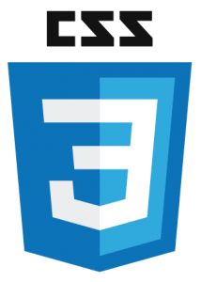
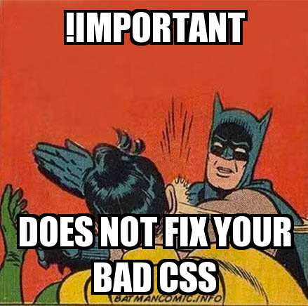
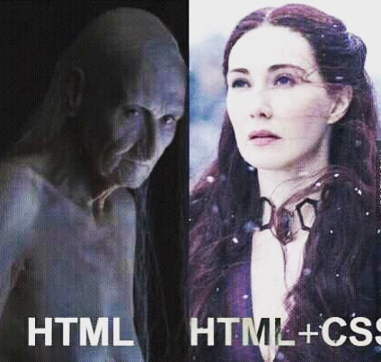
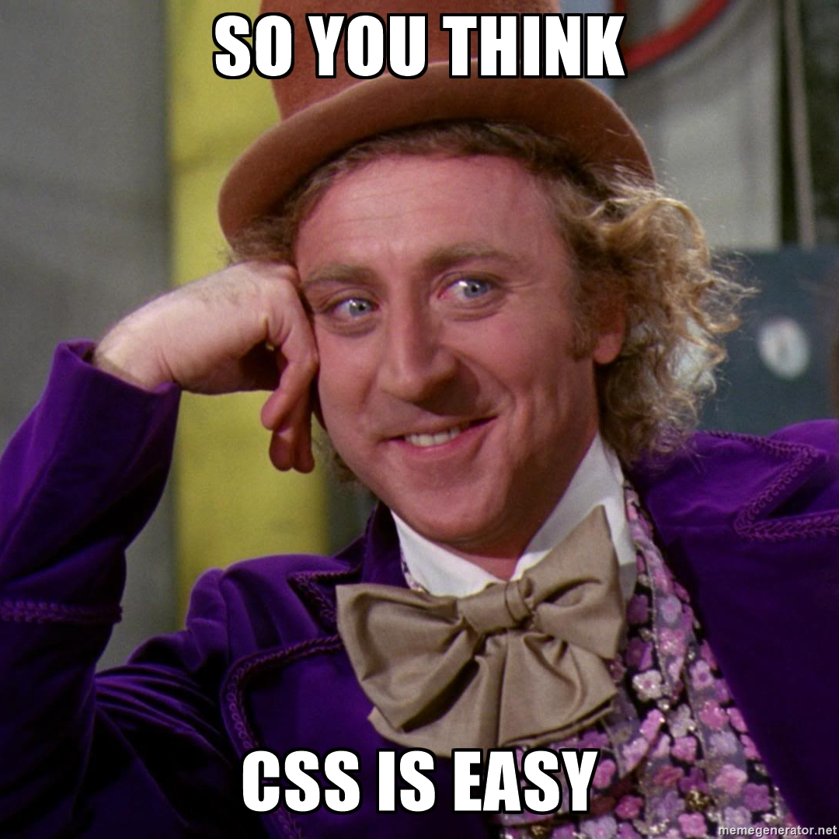
CSS
Cascading Style Sheet
Cascading refers to the way CSS applies one style on top of another.
Style Sheets control the look and feel of web document.
CSS and HTML work hand in hand
HTML: Sorts out the page structure
CSS: Defines how HTML elements are displayed.

Slide 25
Why Use CSS?
CSS allows you to apply specific styles to specific HTML elements.
The main benefit of CSS is that it allows you to separate style from content.
Using just HTML, all the styles and formatting are in the same place, which becomes rather difficult to maintain as the page grows.
The style definitions are normally saved in external .css files. With an external stylesheet file, you can change the look of an entire website by changing just one file! (as long as its names are consistent).

Slide 26
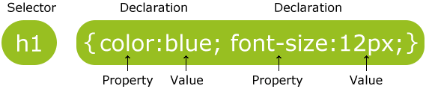
How CSS works
The selector points to the HTML element you want to style.
The declaration block contains one or more declarations separated by semicolons.
Each declaration includes a CSS property name and a value, separated by a colon.
A CSS declaration always ends with a semicolon, and declaration blocks are surrounded by curly braces.

Slide 27
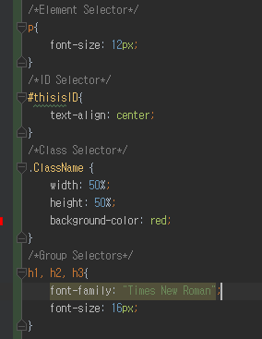
Selector
Element Selector
Name of the element
id Selector
Name of the element
Followed by #
Class Selector
Name of the element
Followed by ‘.’ (period)
Grouping Selectors
Name of the element
Followed by ‘,’ (comma)

Slide 29

Javascript
Also known as ‘JS’

Slide 30

Bootstrap
Bootstrap is the most popular HTML, CSS and JavaScript framework for developing responsive, mobile-first websites.
It is completely free to download and use!
Bootstrap includes HTML and CSS based design templates for typography, forms, buttons, tables, navigation, modals, image carousels and many other!
(plus JS plugins)

