Slide 1
Hosting your website
In order to have your website available on the internet, we need a place to host it.
There are many hosting companies available, they will lend you server space and allow your website to be seen by others.
Most hosting web hosting providers will include other services (based on how much you pay):
Firewall
Technical Assistance
Email services
Website templates

Slide 2
Heroku
Heroku is a hosting platform that focuses on hosting and deploying web applications
You can make scalable web applications in Ruby on Rails, Python, Node.js and others
You do not have to worry about setting up and maintaining the server, Heroku will do that for you.
Heroku’s functionalities include:
Instant Deployment with Git push
Processes scaling
Heroku is relatively expensive compared to other hosts because of their added functionality, but you can make free apps with limited features.

Slide 3
Create a Heroku Account
Sign up on Heroku.com
Click on “Create New App”
Name it whatever you want
Create the app

Slide 4
Link your GitHub Repo to Heroku
Before we do this, create a php file in the same folder as your html file.
Name it index.php
Put the text as: <?php include_once(“index.html"); ?>
Why do we do this? Because Heroku does not recognize html projects as apps, so we are tricking it.
Now, go to PHPstorm, go to assets folder.
Create a file called composer.json
In the file, put: {}

Slide 5
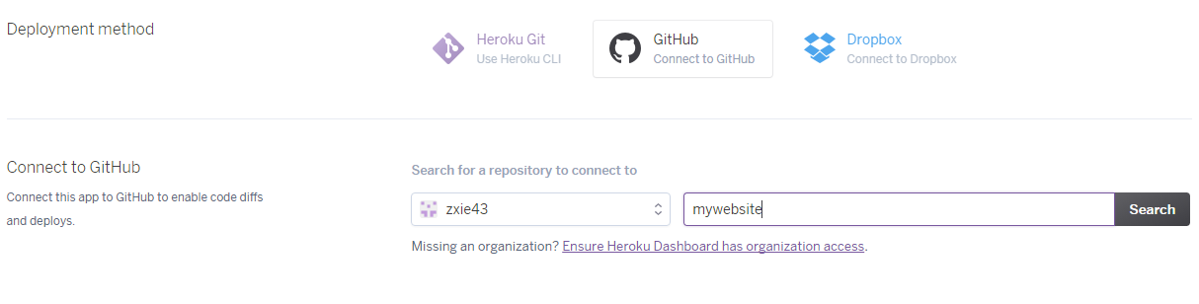
Deploy on Heroku
Go to Deploy on your Heroku dashboard.
In Deployment Method, select GitHub, and link your GitHub account.
Search for your github repo, and connect it.

Slide 6
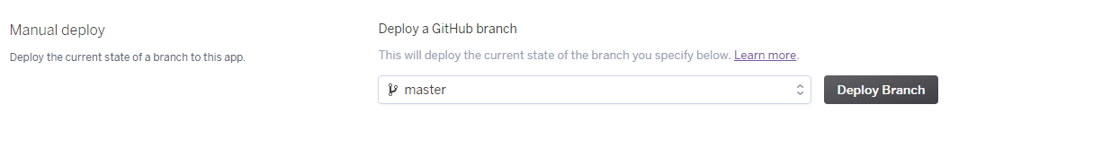
Deploy your Website
Under Manual deploy, click on “Deploy Branch”

Slide 7
Your website is now successfully deployed!
You can click on “Open App” in the top right corner or type in the url to access your website.
Now, time to get your custom domain name!

Slide 8

Domain Name
Namecheap offers a free .me domain name for students.
Go to nc.me to claim it.

Slide 9
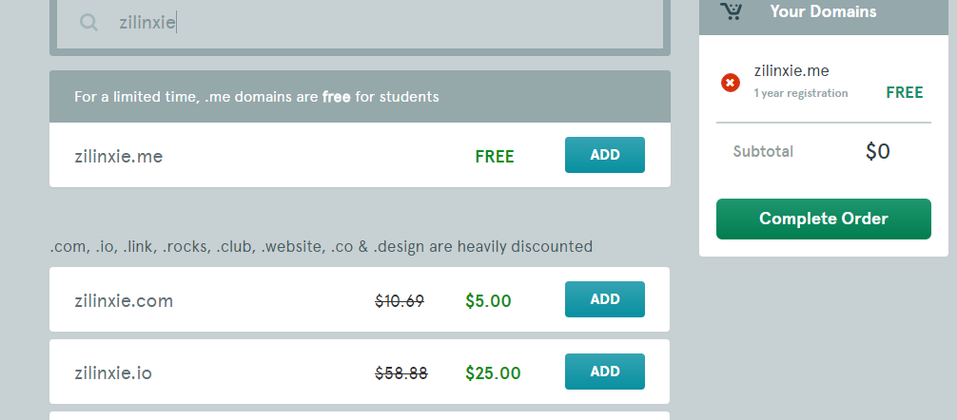
nc.me

Slide 10
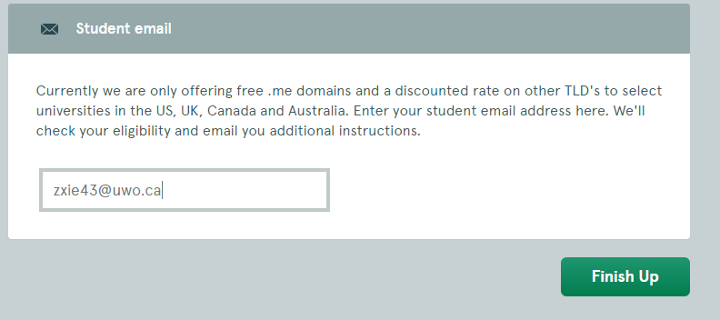
nc.me
Once you’ve selected your domain, register with your student email.

Slide 11
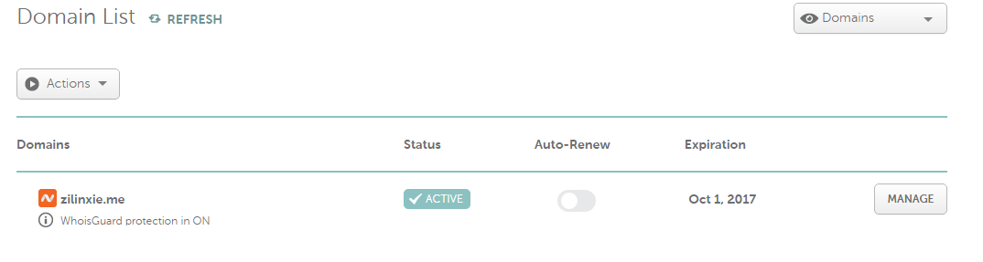
nc.me
Once, you’ve verified your school email, register an account.
Now, once you go to namecheap.com and log in, your new domain should appear.

Slide 12
Configuring on Heroku side
Under settings, go to Domains, and click on “Add Domain”

Slide 13
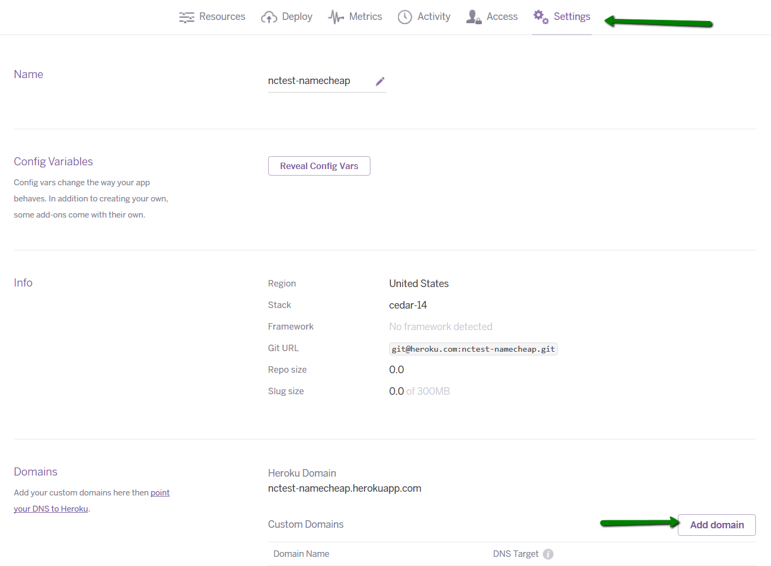

Slide 14
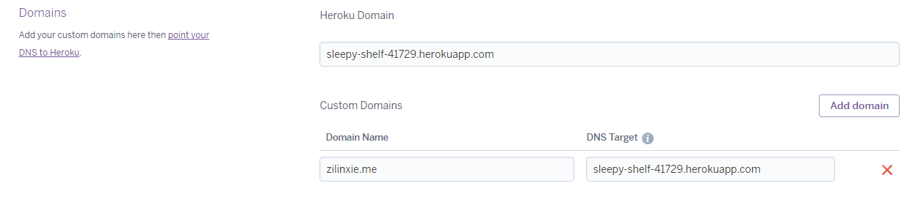
Type the name of your domain.

Slide 15
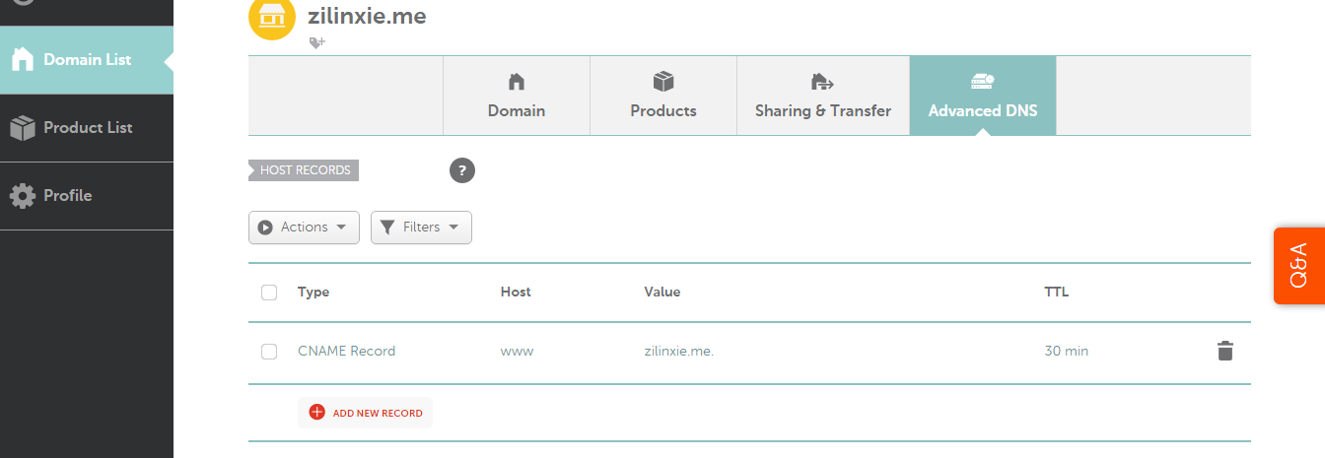
Namecheap side:
Go to namecheap and go to your Domain List tab.
Click on Advanced DNS

Slide 16
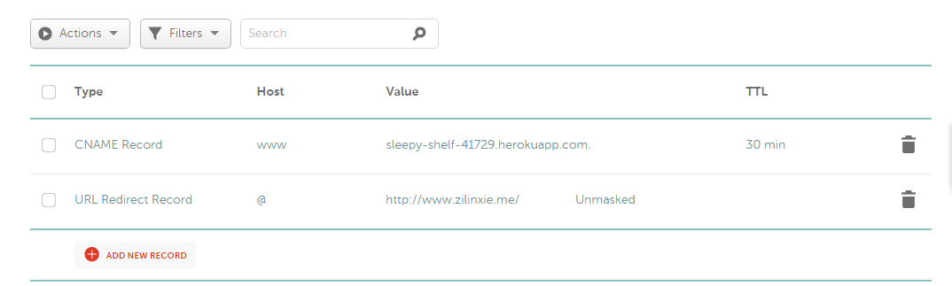
To use your custom domain, the following host records should be created:
URL Redirect Record for @ to forward to http://www.[yourdomain.me]
CNAME Record for www mapped to your Heroku Domain [name of app].herokuapp.com

Slide 17
Namecheap side:
You are done now. It may take as long as 30 minutes for your custom domain to take affect.

