Slide 1
Nonlinear projections
of intrinsic dimension weights
onto model weights
Jonathan Lam, Richard Lee
Notes:
The fully trained network is one parameterization of a network
We have a smaller parameterization that through some function can map to this larger parameterization.
If we allow our function to be more complex, we can perhaps use an even smaller parameterization
Practical application is compression

Slide 2
Preliminary directions
Midterm project: Recreating MobileNets
Continue in some form of compression/model optimization
Knowledge distillation? Low-rank approximations of matrices?
Estimating computation based on some measure of “complexity”

Slide 3
“Measuring the Intrinsic Dimension of Objective Landscapes”
Is the minimal description of a neural network the set of all its weights?
Is the complexity of a problem determined by the number of weights?
If not, how can we find the number of weights in the problem?
(See toy problem)
arXiv:1804.08838

Slide 4
General idea of intrinsic dimension
D = d_int + s
D model weights (Dimension) = intrinsic dimension + degrees of freedom
General idea: only train d_int “psuedo-weights,” use some sort of (random) mapping/projection to map them onto the set of all D model weights

Slide 5
General idea of intrinsic dimension, cont’d.
theta^D = theta_0^D + P * theta_int
P is a random matrix ⇒ random linear mapping; authors state that how to choose the mapping is amenable to further research
each weight in theta = (some random offset) + (a random linear combination over theta_int)
only theta_int gets trained, everything else is fixed
model doesn’t change, inference doesn’t change -- only training is different

Slide 6
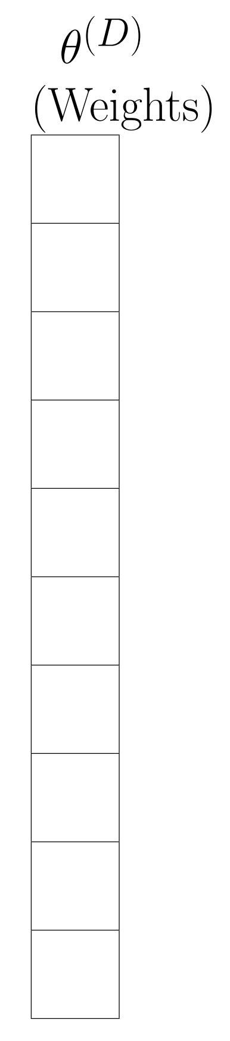
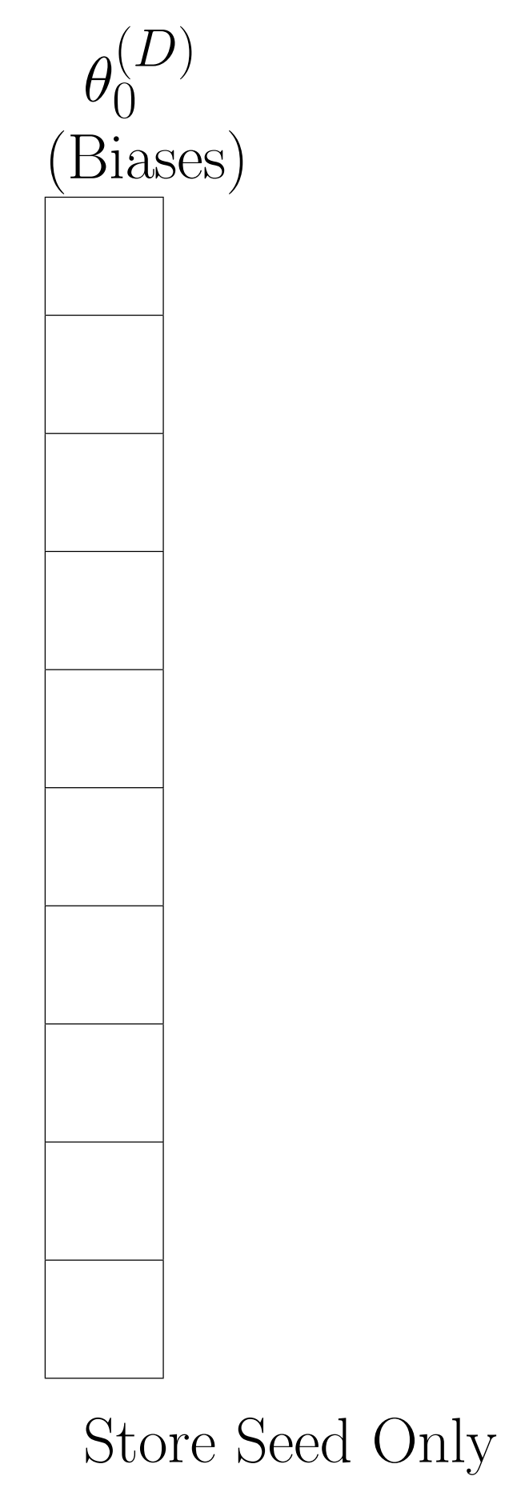
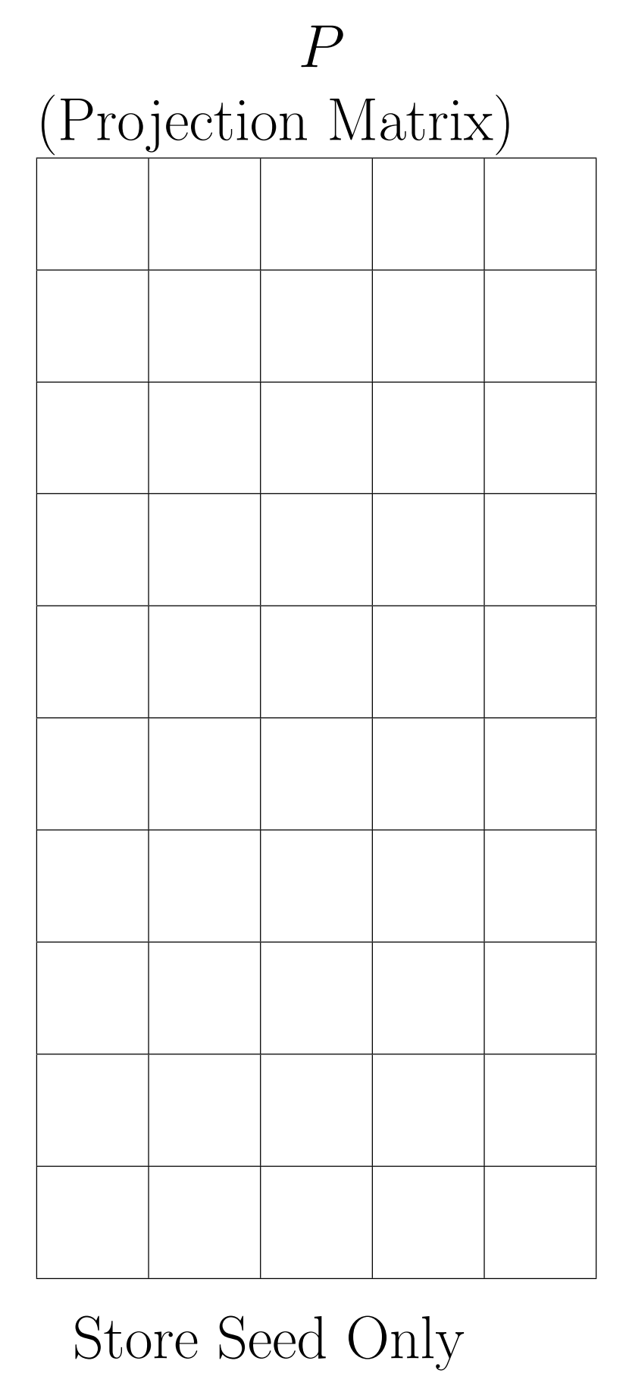
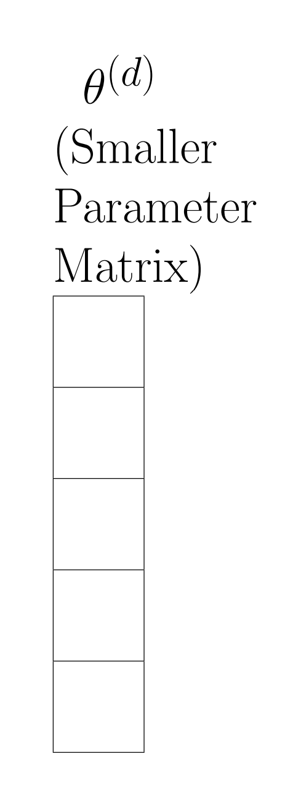
=
+
x

Slide 7
Why this business? Why not just shrink/change the model?
network architectures (and especially convolution structure) and size are useful, don’t want to arbitrarily change the network
more like we’re attempting to encode redundancies in the extra degrees of freedom in the projection function

Slide 8
Intrinsic dimension for compression
Model is totally defined by its structure and weights
Weights (D weights) are totally defined by the initial biases (random seed to generate theta_0), projection function/matrix (random seed to generate P), and intrinsic dimension psuedo-weights (d weights)
Relative space is d/D (can be in the factors of hundreds)
(Note: does not reduce computation, only storage/representation size)

Slide 9
What we would experiment with
Change projection function from a simple linear projection (i.e., matrix multiply) to more complex nonlinear relationship
Goal: see if we can further reduce intrinsic dimension (also might expose interesting redundancies between model weights)
Random Fourier Features (original report, interesting application): learn multi-frequency relationships easily; apply cosines to products of pseudo-weights with random “frequencies”
Also possible: arbitrary polynomials & other cheap nonlinear functions

Slide 10
Progress / Next steps
Forked repo from GitHub, got base model to work
Able to recreate default MNIST model using example in GitHub README
MNIST FC ~1M params (direct) → FC 1K intrinsic params w/ 94% accuracy
Easily able to get >80% in 100 epochs w/ only 150 params on MNIST CONV
Uses Python 2/TF 1.7 ⇒ might want to upgrade/simplify model for our needs (Lots of general boilerplate code -- need to fully understand more of it)
Need to start rewriting keras layer to use this special optimization method

