Slide 1
ECE467: Natural Language Processing
Word Embeddings, Neural Language Models, and Word2vec

Slide 2
If you are following along in the book…
Chapter 6 of the textbook (current draft) is called "Vector Semantics and Embeddings"
However, they include things such as conventional TF*IDF vectors to represent documents as part of this topic (of course, we already covered things like that that in previous topics)
We will start by briefly cover conventional methods of creating vector representations of words (this material is not from the textbook)
Section 7.5 is about neural language models; we will cover this before we cover modern word embeddings such as word2vec
Section 6.8 is about word2vec, and the sections 6.9 – 6.10 also concern modern word embeddings; we will cover the material from these sections
Section 6.11 is about biases in word embeddings; we will cover this as part of a future topic
In general, some of the material scattered throughout this topic comes form an earlier draft of the textbook, and some is based on my own knowledge
An earlier draft of the textbook covered neural networks before word2vec
Because of that, they were able to use neural networks to conceptually explain word2vec; we will do that, because I think it helps understand the intuition behind the process

Slide 3
An Older Technique
The representation of words as vectors, often called word embeddings, has played a significant role in revolutionizing the field of natural language processing (NLP)
Before discussing modern techniques to produce word embeddings, I want to briefly discuss an older technique
Latent semantic analysis (LSA) is a decades-old technique that produces vectors representing abstract concepts based on a set of documents
All text-based sequences (including documents, queries, and single words) can be represented as weighted sums of these concepts
In theory, similar, or related, words/queries/documents should have similar representations
When LSA is used in the context of information retrieval (IR), the approach is known as latent semantic indexing
My own impression: LSA is very interesting, but at least when I was a graduate student, it didn’t seem to lead to great results for various NLP tasks

Slide 4
Revisiting the Term-document Matrix
In a term-document matrix (which we learned about in a previous topic), rows represent words and the columns represent documents
The value in row i, column j, represents the weight of the i^{th} word in the j^{th} document of a corpus
The weights are typically counts (i.e., the number of times the word appears in the document), but other weights could be used
The matrix is generally sparse, so in practice, we typically use an inverted index to store the information

Slide 5
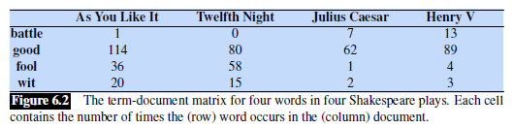
Term-document Matrix Example

Slide 6
Interpreting a term-document matrix
We can think of each column as being a bag-of-words representation of the document (as mentioned during our previous topics)
Additionally, we can also think of each row as being a representation of a word
It seems reasonable to assume that similar words will occur in many of the same documents
More generally, the distributional hypothesis predicts that words with similar semantic meaning will occur in similar contexts
LSA involves the use of singular value decomposition (SVD) applied to the term-document matrix (or to a matrix related to it)

Slide 7
Modern Word Embeddings
The vector representations of words created by modern approaches are often referred to as word embeddings
Some sources refer to the vectors as word embedding vectors, or simply word vectors
The idea is to create a d-dimensional vector, with a fixed d, for each word in a vocabulary
Typically, d is in the range of 50 to 500
These word embeddings are learned from a corpus using an unsupervised learning approach

Slide 8
Pre-word-embedding Neural Networks
Consider neural networks (NNs) applied to NLP tasks (e.g., text categorization) without word embeddings
A typical conventional approach was to have an input node for every word in the vocabulary
That is, if the size of the vocabulary is V, there would be V input nodes for the neural network; this would typically be a rather large input layer
The values of the inputs could be Boolean values, word counts, or TF*IDF weights
This was a bag-of-words approach; the order of the words in the input document does not affect the input to the neural network
Optionally, other input features could also be included, in addition to the words

Slide 9
Problems with Pre-word-embedding NNs
There are a lot of weights between the inputs and the first hidden layer; this could lead to overfitting
There is no simple way to incorporate word order into the methodology
Even using bigrams would blow up the number of input nodes
Two very similar words are represented by entirely different nodes
Of course, stemming or other text normalization techniques could be used
Still, any two tokens would be treated as being identical or totally different
It is my impression that, before word embeddings, NNs did not achieve state-of-the-art results for most (possibly all) NLP tasks

Slide 10
Advantages of Embeddings for NNs
The number of input nodes is related to d, the dimension of the word embeddings
For different tasks and architectures, the input might be one word embedding at a time or a fixed number of word embeddings at a time
For convolutional neural networks (e.g., applied to sentence classification), word embeddings from one padded sentence at a time might be the input
For recurrent neural networks, typically one word embedding at a time is used as input, and the words of a sentence are traversed in a sequence
For transformers, the word embeddings for a sentence or other short sequence of text is typically used as input at one time
Similar (but non-identical) words will have similar word embeddings

Slide 11
Neural Language Models
To help explain the usefulness of word embeddings, we are going to start by examining neural language models (NLMs)
Recall that a language model, in general, is a model that assigns a probability to a sequence of text
Conventionally, N-grams were used for this purpose
We will consider a neural network architecture that considers three sequential words at a time and predicts the next word
We will be looking at feedforward neural language models
Modern neural language models use recurrent neural networks or transformers (these architectures will be covered in future topics)
The next slide shows our first example of a neural language model
This is doing something similar to what a conventional 4-gram model would do, but without using conventional N-grams

Slide 12
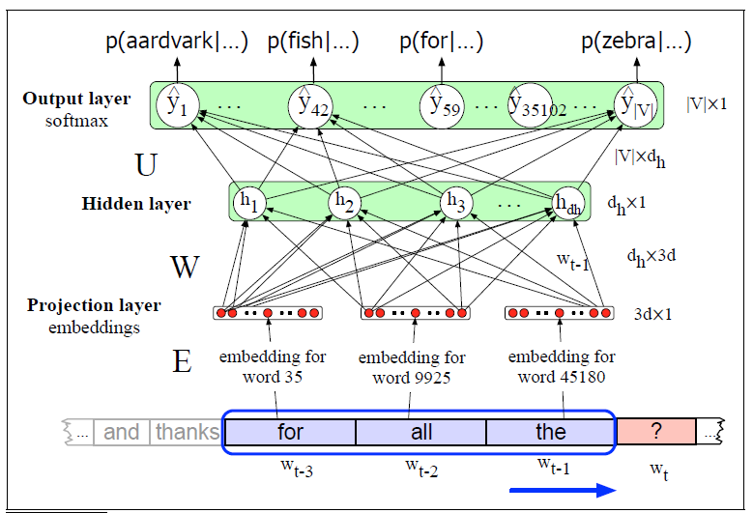
Neural Language Model: Example 1

Slide 13
Notes About the First NLM’s Architecture
The projection layer (which, for now, is also the input layer) of the example NN consists of 3*d nodes, where d is the dimension of each word embedding vector
There are |V| output nodes, where V is the set of vocabulary words
The output layer is a softmax layer
The output of the i^{th} output node is interpreted as the probability that the i^{th} vocabulary word is the next word
This figure is simplified in that it is not considering the bias weights that would lead into the hidden layer
For now, we are assuming here that there is a known mapping from each word in the vocabulary to a word embedding vector for that word
In other words, we are assuming that the embeddings have already been learned using some other algorithm; this is a form of pretraining
Using precomputed word embeddings has been standard in NLP
It is also possible to learn word embeddings for the current task (we'll see how to do that soon), or to use contextual word embeddings (covered in a future topic)

Slide 14
Advantages of Neural Language Models
No smoothing of probabilities is necessary (a softmax layer never outputs a 0 exactly)!
The neural network has a good chance has a good chance of generalizing based on similar words to the current words
The neural network has a good chance of predicting the next word after trigrams (or more general N-grams) that have never been seen
This also allows neural language models to consider longer N-grams compared to conventional language models
In practice, neural language models make better predictions than conventional N-gram models
Recall that we can evaluate a language model by multiplying together the predicted probabilities of actual words according to a test set
In practice, we instead add log probabilities to avoid issues with finite precision, or we use a related metric such as perplexity

Slide 15
Training Such a Network
Assuming a fixed mapping between words and embeddings, we could train such a network using stochastic gradient descent and backpropagation
The book only discusses training for the next architecture, which also learns the embeddings
However, we can use the same sort of approach for the current example
In principle, we could compute the ideal probability model for each N-gram and then train the model, but that is not what would happen in practice
In practice, we would loop through a large corpus, and for each N-gram:
We map the first n-1 words to embeddings and concatenate these to form the input
For the output, we treat the probability of the actual word as 1, and all other probabilities as 0
The formula for the cross-entropy loss function becomes: L = -log P(w_{t} | w_{t-1} … w_{t-n+1})
Looping through all the N-grams in the entire training set would be one epoch of training
Multiple epochs would be applied, until there is some sort of convergence

Slide 16
Using the NN to Learn the Embeddings
By adding one additional layer to our network:
The network can learn the word embeddings, along with learning how to predict the probabilities of the next words
Such a network is learning embeddings specifically for the task of serving as a neural language model
We will see that embeddings learned for one purpose can be used for many other tasks as well
Note that, in practice, training a neural network is not the actual method used to learn embeddings
The next slide shows an updated example of a neural language model that also learns the word embeddings

Slide 17
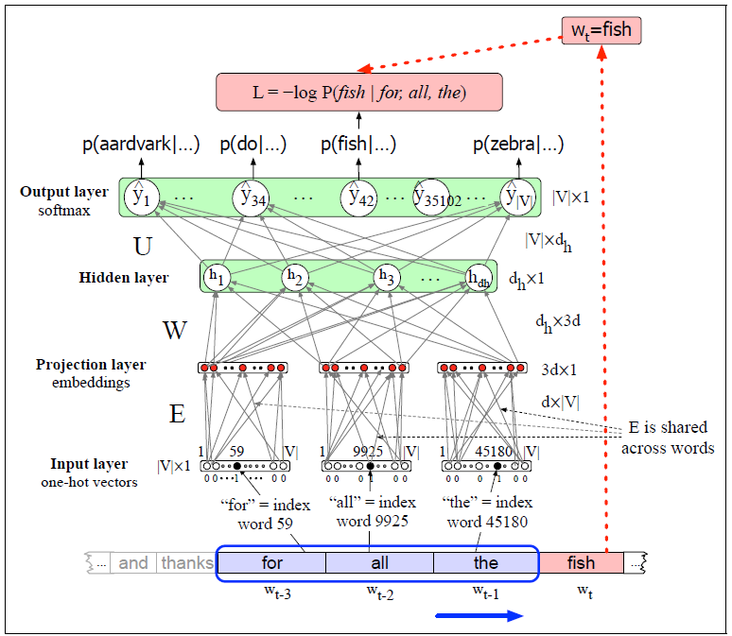
Neural Language Model: Example 2

Slide 18
Notes About the Second NLM’s Architecture
The input layer now consists of three |V|-dimensional one-hot vectors, including a single 1, representing (in this case) a specific word, and 0s everywhere else
To get from the input layer to the projection layer, a shared set of shared weights is used to convert each one-hot vector to a word embedding vector
That is, each one-hot vector at the input layer is being multiplied by the same weight matrix, E, to produce a word embedding vector in the projection layer
The big difference between the two neural networks is that E is now being learned along with the rest of the network's weights
The training of the updated network can proceed similar to the last one, using stochastic gradient descent and backpropagation
For each N-gram of a large corpus, we concatenate N-1 one-hot vectors to form the input
For the output, we treat the probability of the actual word as 1, and all other probabilities as 0 (the same as for the previous network)
The loss function is the same as for the previous network: L = -log P(w_{t} | w_{t-1} … w_{t-n+1})

Slide 19
Advantages of Word Embeddings in General
In Section 6.8 of the textbook (titled "Word2vec"), they claim: "It turns out that dense vectors work better in every NLP task than sparse vectors."
Next, they state, "While we don’t completely understand all the reasons for this, we have some intuitions."
Reasons they list (which are related to the advantages of using word embeddings with neural networks that we looked at earlier) include:
It is easier to use dense vectors as features for machine learning systems (i.e., they lead to fewer weights, as we previously mentioned)
They may help to avoid overfitting (this is related to fewer weights)
The book says they "may do a better job at capturing synonymy"; really, the more general point is that related words will have similar vectors

Slide 20
Word2vec
In 2013, a team at Google (Mikolov et. al.) created and released a group of related models for producing word embeddings
Together, these models are known as word2vec
The word2vec models train a classifier to predict whether a word will show up close to specific other words
The learned weights become word embeddings
It is often claimed that these embeddings seem to capture something about the semantics of words (we’ll see why)
The embeddings can simply be used to compute the similarity between words, and they are useful for many NLP tasks
IMO, it would be difficult to overstate the significance of word2vec on the field of NLP
Since the creation of word2vec, other similar, perhaps even better, methods of producing word embeddings have been developed (e.g., GloVe)
Contextual word embeddings (e.g., those produced by BERT) do better still

Slide 21
Two word2vec models
Implementations of word2vec can use either of two methods for determining word embeddings
One of the two approaches is known as the skip-gram algorithm, a.k.a. the continuous skip-gram model
The general goal of the skip-gram approach is to predict context words based on the current word
The other word2vec approach is known as the continuous bag-of-words (CBOW) model
The general goal of the CBOW approach is to predict the current word based on context words
According to an earlier draft of the textbook, the two models are similar, and they create similar embeddings
However, "often one of them will turn out to be the better choice for any particular task"

Slide 22
The Skip-gram Model Learns Two Embeddings
The skip-gram method learns two embeddings for each word, w
One is called the target embedding, t, which basically represents w when it is the current word, or center word, surrounded by other context words
The other is called the context embedding, c, which basically represents w when it appears as a context word around another target word
A target matrix, T, contains all the target embeddings
The i^{th} row of T is a 1 x d vector, t_{i}, for the i^{th} word of the vocabulary, V, where d is the dimension of the word embeddings
A context matrix, C, contains all the context embedding
The j^{th} column of C is a d x 1 vector, c_{j}, for the j^{th} word of the vocabulary, V

Slide 23
Learning the Skip-Gram Model Matrices
During training, we only consider context words within some small window of size, L, of each target word
The probability of seeing w_{j} in the context of w_{i} (i.e., within the window) can be donted as P(w_{j} | w_{i})
This probability is related to the dot product of the target vector for w_{i} and the context vector for w_{j}; i.e., t_{i} ∙ c_{j}
During training:
The target embeddings of words are pushed closer to the context embeddings of words they appear close to (within the window)
The target embeddings of words are pushed away from other context embeddings
After training, it is possible to keep just use the target embeddings (i.e., the rows of the T matrix) as the final embeddings
However, it is more common to sum, average, or concatenate the target embeddings and the context embeddings (the columns of the C matrix) to produce the final vectors
The figure on the next slide (from an earlier draft of J&M) depicts an example of the T and C matrices

Slide 24
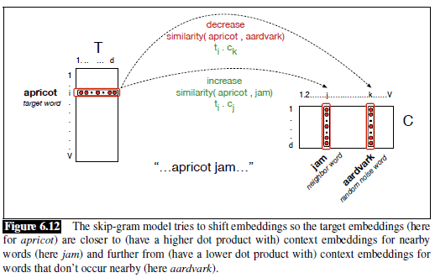
Word2vec Matrices (from older draft of J&M)

Slide 25
Word2vec Skim-gram Model as a NN
The word2vec skip-gram model can be implemented as a (simple) neural network (see the next slide, with a figure from an earlier draft of J&M)
The earlier draft called the target embedding the word embedding, and they referred to the target matrix, T, as the word matrix, W, but I think this is misleading
The input layer is a one-hot vector (treated in the figure as a row vector)
Therefore, the hidden layer (also a row vector) contains one row of W (i.e., a single target/word embedding); there is no activation function applied at this layer
The input to the output layer is the dot product of the target embedding with every context embedding (stored in the columns of C)
If the output layer is a softmax layer, the dot products are converted to probability estimates
To train the network, every epoch could loop through every target word / context word pair, treating the probability of the context word as 1 and all other probabilities as 0
Training the network (adjusting the weights) learns the target embeddings and context embeddings, which are then typically combined to create the final embeddings
In practice, this is not how the skip-gram model is implemented for efficiency reasons

Slide 26
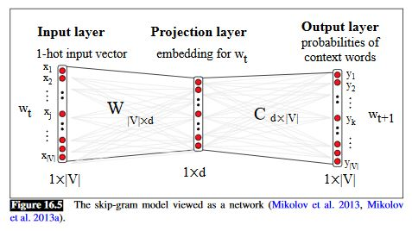
Word2vec as NN (from older draft of J&M)

Slide 27
Skip-gram with Negative Sampling
The neural network would have to compute the dot product of each target embedding with every context embedding for every update
It is more efficient to use a method known as skip-gram with negative sampling (SGNS)
For each context word within the windows size, we choose k negative sampled words
Typical values of k range from 5 to 20, with smaller datasets requiring higher values of k to achieve good results
The k negative sampled words are typically chosen with probabilities proportional to their unigram frequencies raised to the power of 0.75
The exact value of the exponent is somewhat arbitrary, but 0.75 has been shown to work well in practice
Raising the frequencies to such a power gives rare words a higher chance of being selected, compared to sampling words based on their frequencies directly

Slide 28

Negative Sampling Example
Assume the window-size is L=2
Then, for one instance of the target word “apricot”, we may see these four context words:
Now assume that k=2 (although values of 5 to 20 are more common);
Then, we may randomly choose the following 8 negative sampled words (k for each context word):

Slide 29
Estimating Probabilities using SGNS
We are no longer viewing the model as a neural network, and no longer using the softmax function
Instead, it is typical to compute probability estimates using the sigmoid function: σ(x) = 1 / (1 + e^{-x})
Not that it is easy to show algebraically that σ(-x) = 1 - σ(x)
This gives us: P(+|t, c) = 1 / (1 + e^{-t∙c}) and P(-|t, c) = 1-P(+|t, c)
We want the probabilities of actual context words to be high and the probabilities of negative sampled words to be low
We assume independence among context words, so we can multiply probabilities or add log probabilities

Slide 30
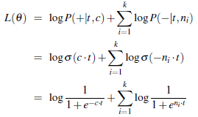
Training SGNS
For each target/context pair (t, c) with k negatively sampled words n₁…n_{k}, the objective function is:
Unlike a loss function, which is something we want to minimize, an objective function is something we want to maximize
We will not cover the formulas, but we start with randomly initialized T and C matrices, then use SGD to maximize the object objection function
We proceed through multiple epochs over the training set

Slide 31
Embeddings for Word Similarity
Note that word2vec word embeddings have specifically been trained for the purpose of predicting near by words
It turns out that they are useful for several additional things
One thing that word embeddings can simply be used for is to compute word-to-word similarity
We can simply compute the dot product between two embeddings
We can also look for the closest embeddings in the d-dimensional space to that of any particular specified word
For example (from a PowerPoint presentation associated with an earlier draft of J&M):
It may seem odd that some of the terms here contain multiple words, but there are various techniques that can be applied during text normalization to treat common phrases as single tokens

Slide 32
Visualizing Word Embeddings
To help with visualization of word embeddings, the d-dimensional vectors can be mapped to two dimensions
One approach to do this is principal component analysis (PCA)
Today, a more popular method is known as t-SNE
These t-SNE plots can also help visualize differences between embeddings
In fact, differences between embeddings also seem to be meaningful!
An example of two t-SNE plots of word embeddings is shown on the next slide (the example is discussed further on the following slide)

Slide 33
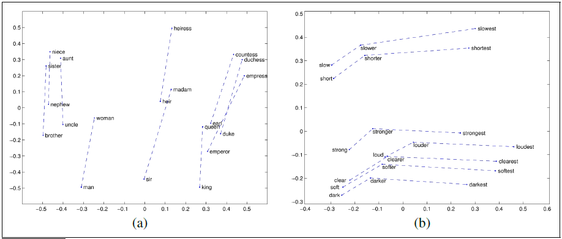
Word Embeddings Visualized (t-SNE plot)

Slide 34
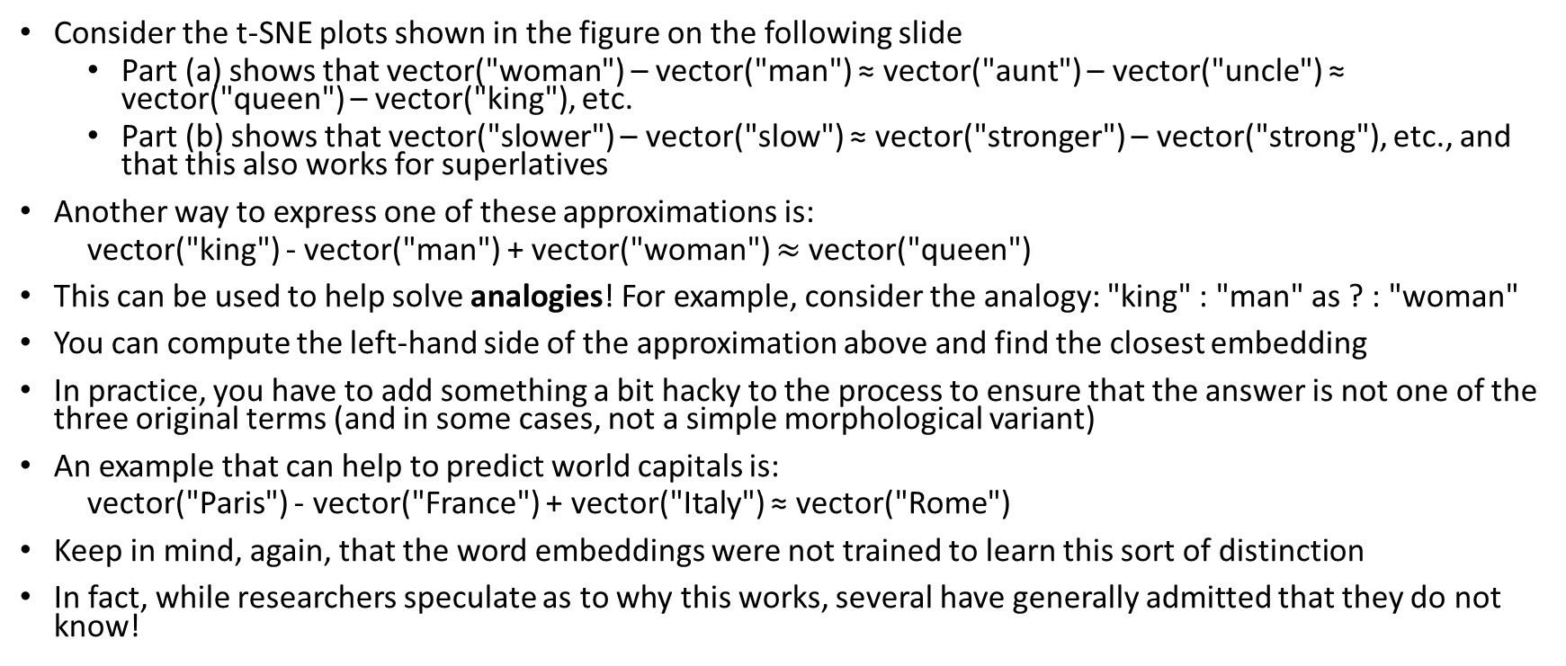
Differences Between Embeddings (examples)
Consider the t-SNE plots shown in the figure on the following slide
Part (a) shows that vector("woman") – vector("man") ≈ vector("aunt") – vector("uncle") ≈ vector("queen") – vector("king"), etc.
Part (b) shows that vector("slower") – vector("slow") ≈ vector("stronger") – vector("strong"), etc., and that this also works for superlatives
Another way to express one of these approximations is:
vector("king") - vector("man") + vector("woman") $≈$vector("queen")
This can be used to help solve analogies! For example, consider the analogy: "king" : "man" as ? : "woman"
You can compute the left-hand side of the approximation above and find the closest embedding
In practice, you have to add something a bit hacky to the process to ensure that the answer is not one of the three original terms (and in some cases, not a simple morphological variant)
An example that can help to predict world capitals is:
vector("Paris") - vector("France") + vector("Italy") ≈ vector("Rome")
Keep in mind, again, that the word embeddings were not trained to learn this sort of distinction
In fact, while researchers speculate as to why this works, several have generally admitted that they do not know!

Slide 35
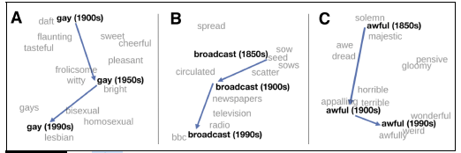
Historical Semantics and Embeddings
By learning embeddings using related corpora from different time periods, we can study how meanings of some words have changed over time
This figure demonstrates that by showing portions of relevant t-SNE plots

Slide 36
Evaluating Word Embeddings
There are various ways to evaluate word embeddings
Obviously, they can be evaluated on the exact track they are trained for
For example, word2vec can be evaluated based on how well it predicts nearby words
However, this would not be particular useful, and it would not allow us to fairly compare word2vec to other types of embeddings trained for different purposes
Word similarity scores can be correlated to human judgements of word similarity (this has a fairly common way to evaluate them in practice)
The embeddings can be evaluated with word analogy tasks
The embeddings can be used for other, more complex tasks, and the performance on those tasks can then be evaluated
Examples of tasks that rely on embeddings include sentence classification, machine translation, question answering, etc.
Arguably, this last method, which is clearly an example of extrinsic evaluation as opposed to intrinsic evaluation, is the most important
We will discuss the use of word embeddings for various tasks in our later topics

Slide 37
Other Methods of Producing Embeddings
Since word2vec, various other methods of producing word embeddings have been created
Another popular method is called Global Vectors for Word Representation (GloVe), developed by a research group at Stanford
GloVe is similar to word2vec in that it produces static word embeddings for each word or token in a vocabulary
We are not going to cover the method used by GloVe, but it is based on ratios of word co-occurrence probabilities
Other methods build word embeddings out of character embeddings or other sub-word embeddings; one example is called fasttext
We will not cover fasttext in this course, but we will cover character and sub-word embeddings in a future topic
More recently, there are methods produce contextual word embeddings; examples include ELMo (which uses LSTMs) and BERT (which uses transformers)
We will cover both of these methods for producing contextual word embeddings as part of a future topic

