Slide 1
ASP.NET Core API Styles

Slide 2
An application programming interface (API) is a computing interface which defines interactions between multiple software intermediaries.
It defines the kinds of calls or requests that can be made, how to make them, the data formats that should be used, the conventions to follow, etc.
Notes:
It can also provide extension mechanisms so that users can extend existing functionality in various ways and to varying degrees.^{[1]} An API can be entirely custom, specific to a component, or it can be designed based on an industry-standard to ensure interoperability. Through information hiding, APIs enable modular programming, which allows users to use the interface independently of the implementation.

Slide 3
The History of Distributed APIs:
Dawn of distributed computing
1981 RPC
~1970~ RPC concept Messaging Queuing
Notes:
Zacznijmy w 1970 I okolicach bo wtedy powstalo wiele konceptow api
RPC – pierwsza implementacja 81, ale concept pojawil sie w latach 70
RPC concept – jeden component rozmawia z drugim componentem tak jakby po drodze nie bylo polaczenia internetowego. Udaja ze nie ma (wszytko co potrzebne do komunikacji jest zaszyte pod spodem protokolu)

Slide 4
The History of Distributed APIs:
Object oriented APIs
1993 RDA
1998 XML-RPC
1981 RPC
1991 CORBA
~1970~ RPC concept Messaging Queuing
Notes:
RDA – remote data access – client quering interface
XML-RPC – formalna specyfikacja oparta o XML od Microsoftu
Common Object Request Broker Architecture (CORBA) is a standard defined by the Object Management Group (OMG) designed to facilitate the communication of systems that are deployed on diverse platforms. CORBA enables collaboration between systems on different operating systems, programming languages, and computing hardware. CORBA uses an object-oriented model although the systems that use the CORBA do not have to be object-oriented. CORBA is an example of the distributed object paradigm.

Slide 5
The History of Distributed APIs:
Balancing between SOAP and REST
1993 RDA
1998 XML-RPC
1999 SOAP
2000 REST
1981 RPC
1991 CORBA
~1970~ RPC concept Messaging Queuing
Notes:
RPC – pierwsza implementacja 81, ale concept pojawil sie w latach 70
SOAP – implementacja SOA (nadal oparta o zasady rpc -> bardzo silne wymuszanie kontraktow.
SOAP mial byc uniwersalny, ale nikt nie chcial go zaimplementowac u siebie I komunikacja miedzy roznymi serwisami nie byla prosta.
potrzebna byla reczna implementacja koperty komunikacyjnej XML ktora byla ogromna I skomplikowana
REST – Roy Filding w 2000 roku napisal prace o tym jak budowac API ktore zyly by w harmoni z tym jak dziala web I HTTP
REST I SOAP przez pare lat rownolegle sie sprawdzaly
Ale powoli Soap tracil na popularnosci na rzecz RESTa . Wlasciwie gdy Fb I Twitter wypuscily swoje API jako REST. To bylo duzym punktem zwrotnym dla RESTA
-> to byl czas gdy api powstawalo dla jednego klienta.

Slide 6
The History of Distributed APIs:
JSON is taking over XML
1993 RDA
1998 XML-RPC
1999 SOAP
2000 REST
2005 JSON-RPC
2007 Odata
1981 RPC
1991 CORBA
~1970~ RPC concept Messaging Queuing
Notes:
W 2005 JSON bierze gore nad XMLem
A w 2007 Microsoft powraca do koncepcji RDA I wypuszcza oData ktore jest jezykiem zapytan od strony klienta tlumaczonym bezposrednio na zapytania do bazy danych wykorzystujac po drodze EF
oData oddaje wladze na strone klienta. Mozemy tworzyc zapytania od strony klienta o dane ktorych potrzebujemy, nie musimy sie trzymac zalozen RESTa

Slide 7
The History of Distributed APIs:
Old ideas, new mutations
1993 RDA
1998 XML-RPC
1999 SOAP
2000 REST
2005 JSON-RPC
2007 Odata
2015 GraphQL
2016 gRPC
1981 RPC
1991 CORBA
~1970~ RPC concept Messaging Queuing
2011 WebSocket
Notes:
GraphQL – ponownie oddanie wladzy na strone klienta
gRPC – ponownie nowa implementacja. Koncentruje sie na wydajnosci I generowaniu kodu. Ma byc uzyteczna dla wszystkich
Granica 2010 -> to web 2.0 I szeroko dostepne, generyczne API przeznaczone dla wielu klientow, konsumerow (zjadaczy api) I partnerow
. Wazna elastycznosc
Kolejna fala to bedzie wiecej API rozmawiajacych ze soba (stad powrot grpc) I automatycznych API

Slide 8
The History of Distributed APIs:
1993 RDA
1998 XML-RPC
1999 SOAP
2000 REST
2005 JSON-RPC
2007 Odata
2015 GraphQL
2016 gRPC
1981 RPC
1991 CORBA
~1970~ RPC concept Messaging Queuing
2011 WebSocket
Notes:
Mamy wiec :
Niebieski -> RPC concept – jeden component rozmawia z drugim componentem tak jakby po drodze nie bylo polaczenia internetowego. Udaja ze nie ma (wszytko co potrzebne do komunikacji jest zaszyte pod spodem protokolu)
Czerwony -> query APIs, skoncentrowane na danych I oddajace wladze klientom
Zielony -> Web APIs – wykorzystujace bardzo mocno protocol sieciowy
a przy okazji sa one obiektowe – resourcowe, opieraja sie na transporcie obiektow z pelnym wykorzystaniem protokolu sieciowego.
Do tego mamy jeszcze
Flat File System – przesylanie plikow, nadal wykorzystywane.
Fiolet Streaming – tutaj gRPC implementuje obecnie, a wczesniej wiem ze byla taka opcja w soap. I wszystko co oparte o WebSockety – czyli np SignalR

Slide 9
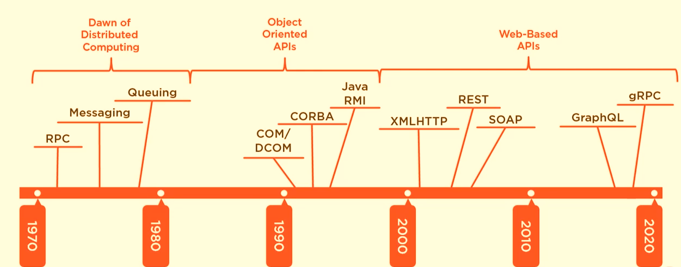
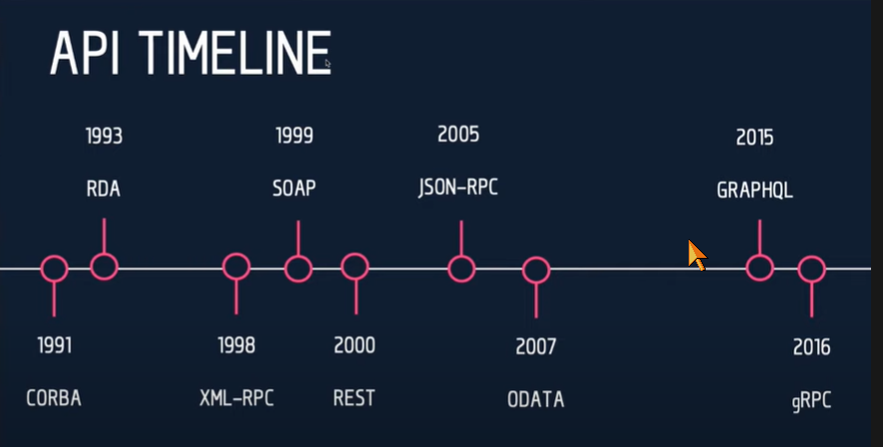
The History of Distributed APIs
Notes:
API community is small

Slide 10

REST API
Notes:
So what is .NET?

Slide 11
REST(ful)
REST
architecture type that’s using the existing web infrastructure
RESTful
services that implement REST architecture
Strict and pragmatic approach
Notes:
More like guidelines
parle

Slide 12
REST
Stateless
Cacheable
Uniform interface
Identification of resources
Manipulation of resources through representations
Self-descriptive messages
Hypermedia and the engine of application state (HATEOAS)
Layered system
Client-server separation
https://restfulapi.net/
Notes:
Client–server – By separating the user interface concerns from the data storage concerns, we improve the portability of the user interface across multiple platforms and improve scalability by simplifying the server components.
Stateless – Each request from client to server must contain all of the information necessary to understand the request, and cannot take advantage of any stored context on the server. Session state is therefore kept entirely on the client.
Cacheable – Cache constraints require that the data within a response to a request be implicitly or explicitly labeled as cacheable or non-cacheable. If a response is cacheable, then a client cache is given the right to reuse that response data for later, equivalent requests.
Uniform interface – By applying the software engineering principle of generality to the component interface, the overall system architecture is simplified and the visibility of interactions is improved. In order to obtain a uniform interface, multiple architectural constraints are needed to guide the behavior of components. REST is defined by four interface constraints: identification of resources; manipulation of resources through representations; self-descriptive messages; and, hypermedia as the engine of application state.
Layered system – The layered system style allows an architecture to be composed of hierarchical layers by constraining component behavior such that each component cannot “see” beyond the immediate layer with which they are interacting.
Code on demand (optional) – REST allows client functionality to be extended by downloading and executing code in the form of applets or scripts. This simplifies clients by reducing the number of features required to be pre-implemented.

Slide 13
REST(ful)
REST
architecture type that’s using the existing web infrastructure
RESTful
services that implement REST architecture
Web resources – identified with URL address
Resource A – create not CreateResource(A)
HTTP verbs
GET, POST, PUT, DELETE, PATCH…
JSON or XML
Notes:
Tak naprawde wszystkie wojny o rest sa bez sensu :D
Wykorzystuje sie HTTP ale to z wygody porownania. Ale nie dlatego ze tak ma byc
Cutting edge of REST
HAL
JSON-API
Ion

Slide 14
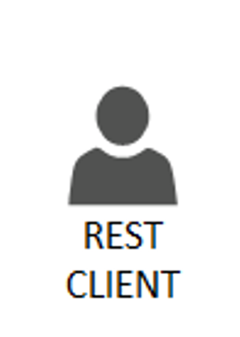

HTTP REST Verbs
C
R
U D
Http POST resource + payload
201 + location
Http GET resources
200 + payload list
Http GET resource/{id}
200 + payload
Http PUT or PATCH resource/{id}
200 or 204
Http DELETE resource/{id}
200
Notes:
Get list – to jest juz restish
Ale daje to problem n+1 zapytan

Slide 15
HTTP Status Codes
1xx: Information
2xx: Success
3xx: Redirection
4xx: Client Error – You did screw up
5xx: Server Error – I did screw up
HTTP Status Codes: https://http.cat/
Notes:
http://swapi.py4e.com/

Slide 16
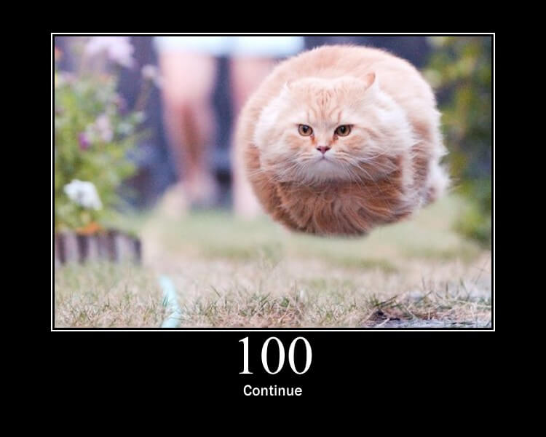
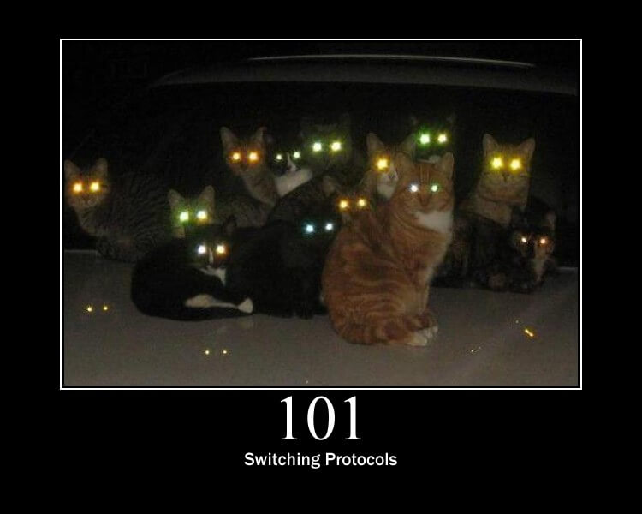
Notes:
200 OK When the response what processed with success, and usually has a response body.
201 Created – As a response for a POST request that has the effect of creating a new resource. This should be accompanied by a Location header indicating the location for the newly created resource 202 Accepted – For scenarios where there is no need for a response body. e.g for queuing something for later processing. Also, this works very fine with the Location header, for polling scenarios, where you call the endpoint from time to time to see the status of a resource processing 204 No Content – usually as a response for a DELETE request
4xx – Client errors
400 – Bad Request Bad Request is in my opinion, one of the most miss-used status codes. I’ve seen it returned when due to some business logic the request couldn’t be processed, but the request was well formed. Think about it – when the request is well-formed, it has the parameters, the body and everything all good, but is a business rule on the backend that prevents that request from being processed….is not a Bad Request. Is anything but a Bad Request. When you see a Bad Request, the tendency is to look at the content of the request to see what is wrong, fix that, and issue the request again.
Dummy Scenario: Online Store. You can’t create 2 products with the same name and brand. 401 – Unauthorized, 403 – Forbidden 404 – Not Found – resource is not there, or maybe it was deleted. 406 – Not acceptable – when the server can’t return a response that matches the Accept header of the request. To force .NET to take the Accept header into consideration you will need to set a flag to true:
services.AddControllers(setupAction => { setupAction.ReturnHttpNotAcceptable = true; })Copy
C#
Copy
409 – Conflict – When there is a business rule that prevents you from creating that resource as a result of a POST. Another scenario can be with using PUT to update a specific resource, and due to its state, you can’t. For this, the RFCs mention the fact the PUT requests might have versions and updating one might give you conflict.
410 – Gone – used to mark something as not available anymore; like promotions…or out of stocks..maybe… or simply to show a soft delete 415 – Unsupported Media-Type; When the server can’t understand the body of the request, due to a wrong Content-Type header, or limited capabilities on the server. For example, if you try to send an XML in the request but the server doesn’t know how to read XML, you should get this status code. 422 – Unprocessable Entity – the server understands the request, the request is well-formed but due to some rules, it can’t be processed. It can be used instead of 409 – Conflict and also covers a lot of ground. You can configure this inStartup.cs by leveraging ApiBehaviourOptionslike this:

Slide 17
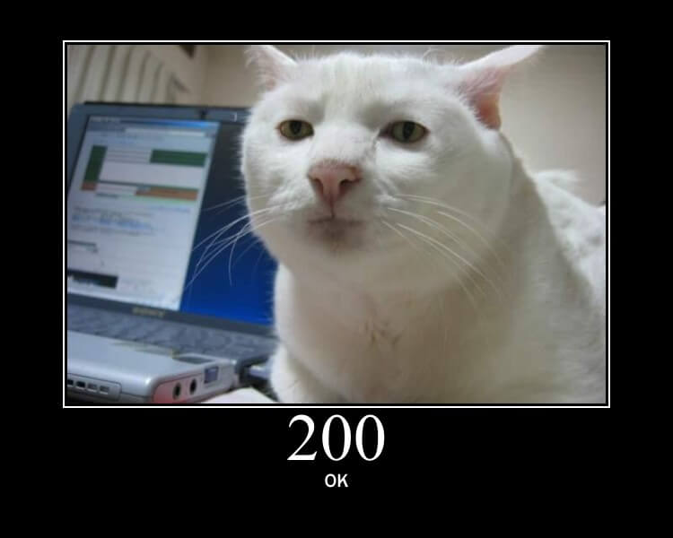
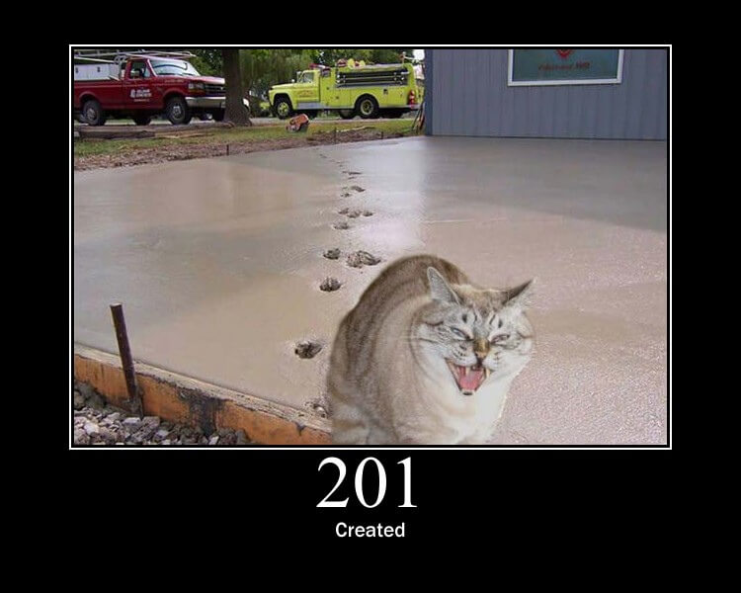
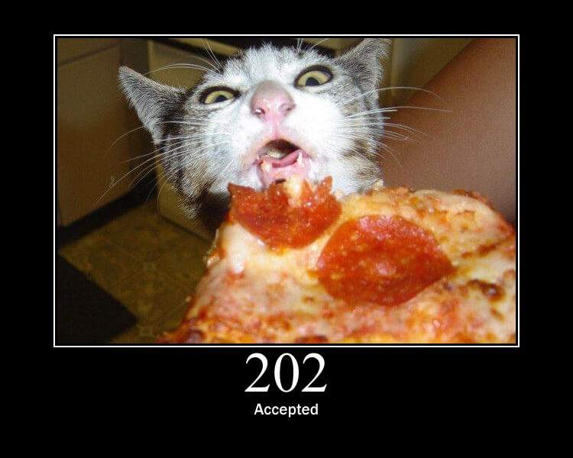
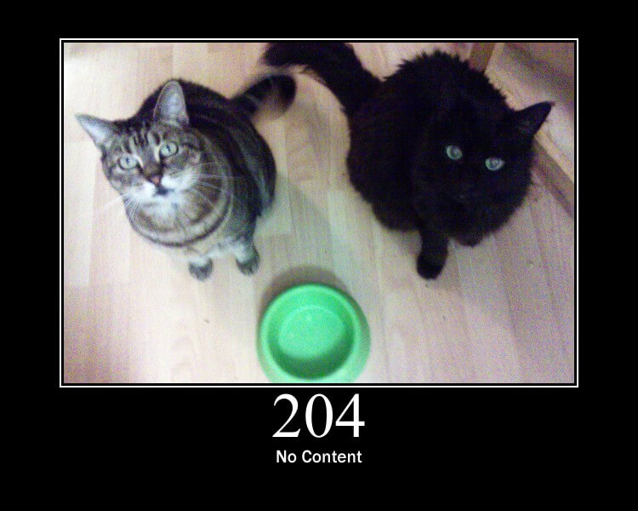
Notes:
200 OK When the response what processed with success, and usually has a response body.
201 Created – As a response for a POST request that has the effect of creating a new resource. This should be accompanied by a Location header indicating the location for the newly created resource 202 Accepted – For scenarios where there is no need for a response body. e.g for queuing something for later processing. Also, this works very fine with the Location header, for polling scenarios, where you call the endpoint from time to time to see the status of a resource processing 204 No Content – usually as a response for a DELETE request
100 continue
101 switching protocols
200 ok
201 created
202 Accepted
204 no content

Slide 18
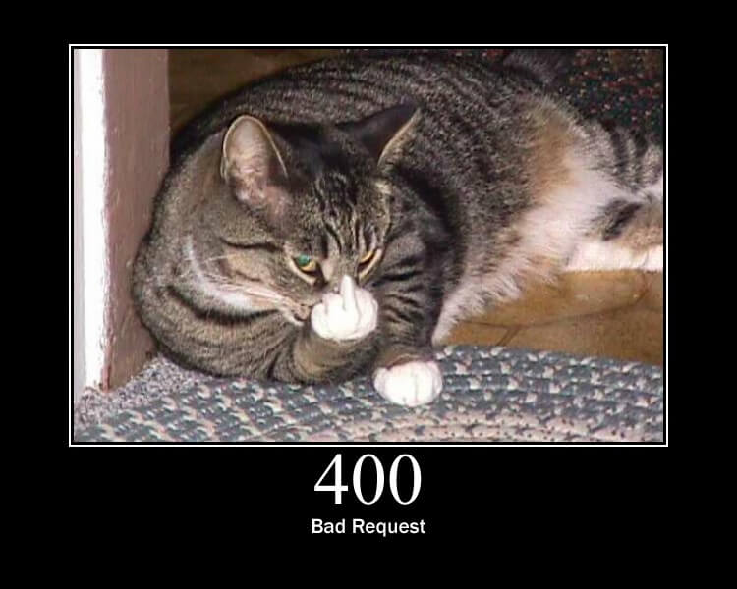
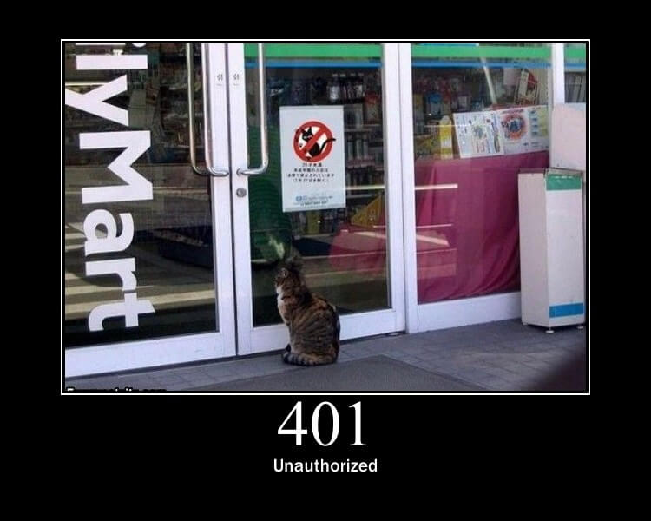
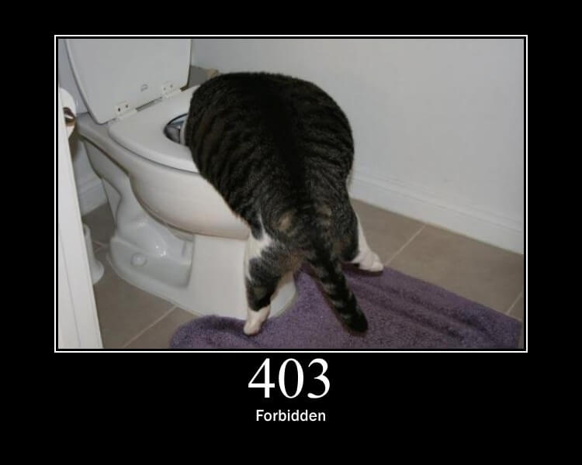
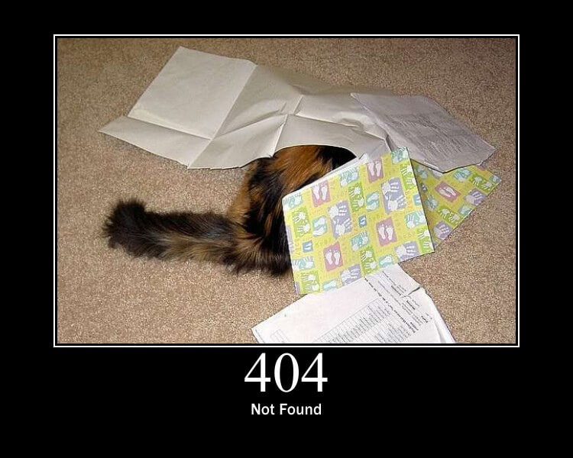
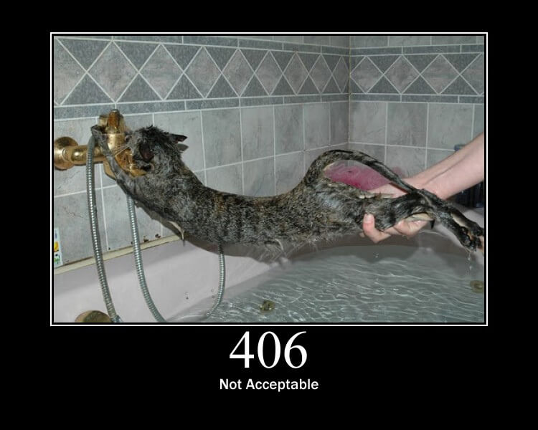
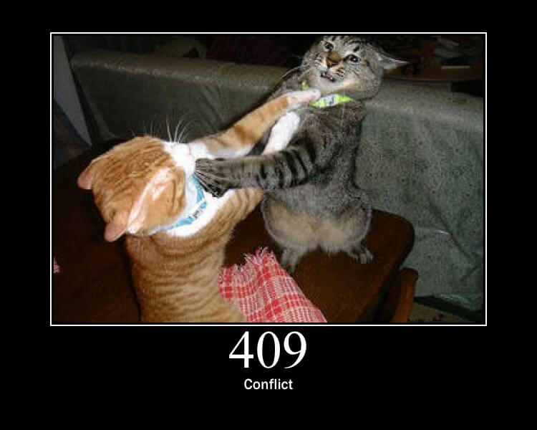
Notes:
400 – Bad Request Bad Request is in my opinion, one of the most miss-used status codes. I’ve seen it returned when due to some business logic the request couldn’t be processed, but the request was well formed. Think about it – when the request is well-formed, it has the parameters, the body and everything all good, but is a business rule on the backend that prevents that request from being processed….is not a Bad Request. Is anything but a Bad Request. When you see a Bad Request, the tendency is to look at the content of the request to see what is wrong, fix that, and issue the request again.
Dummy Scenario: Online Store. You can’t create 2 products with the same name and brand. 401 – Unauthorized, 403 – Forbidden 404 – Not Found – resource is not there, or maybe it was deleted. 406 – Not acceptable – when the server can’t return a response that matches the Accept header of the request. To force .NET to take the Accept header into consideration you will need to set a flag to true:
services.AddControllers(setupAction => { setupAction.ReturnHttpNotAcceptable = true; })Copy
C#
Copy
409 – Conflict – When there is a business rule that prevents you from creating that resource as a result of a POST. Another scenario can be with using PUT to update a specific resource, and due to its state, you can’t. For this, the RFCs mention the fact the PUT requests might have versions and updating one might give you conflict.

Slide 19
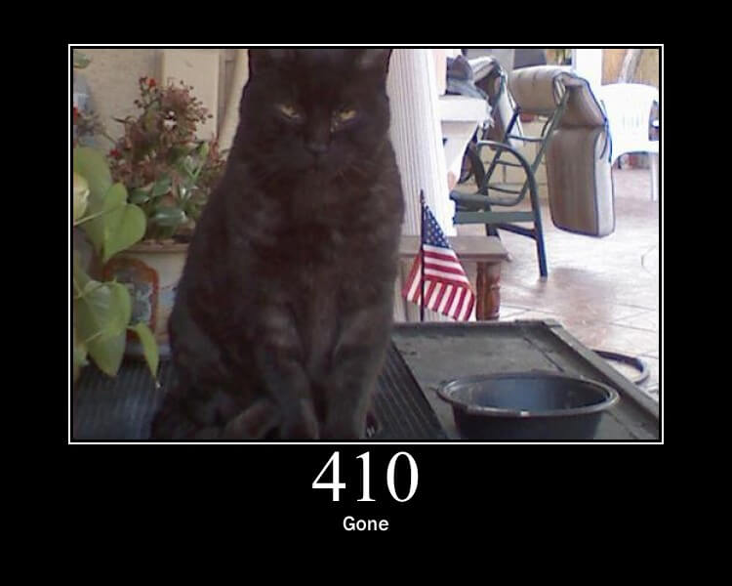
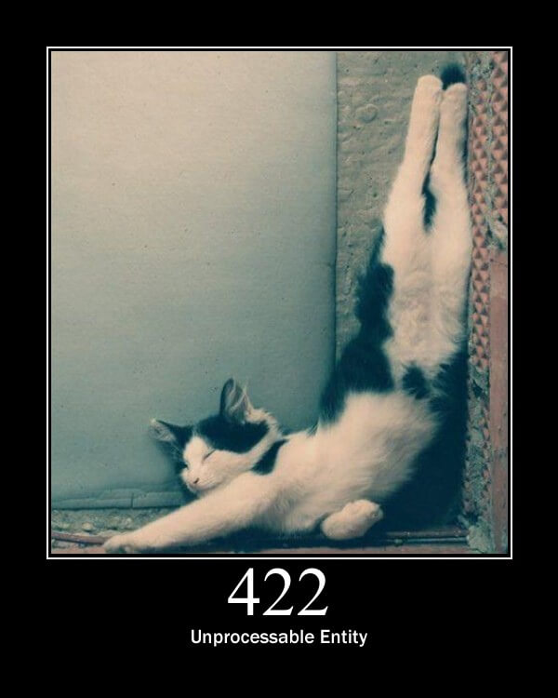
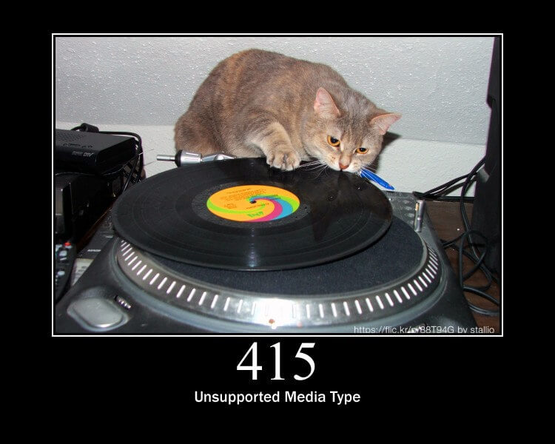
Notes:
410 – Gone – used to mark something as not available anymore; like promotions…or out of stocks..maybe… or simply to show a soft delete 415 – Unsupported Media-Type; When the server can’t understand the body of the request, due to a wrong Content-Type header, or limited capabilities on the server. For example, if you try to send an XML in the request but the server doesn’t know how to read XML, you should get this status code. 422 – Unprocessable Entity – the server understands the request, the request is well-formed but due to some rules, it can’t be processed. It can be used instead of 409 – Conflict and also covers a lot of ground. You can configure this inStartup.cs by leveraging ApiBehaviourOptionslike this:

Slide 20
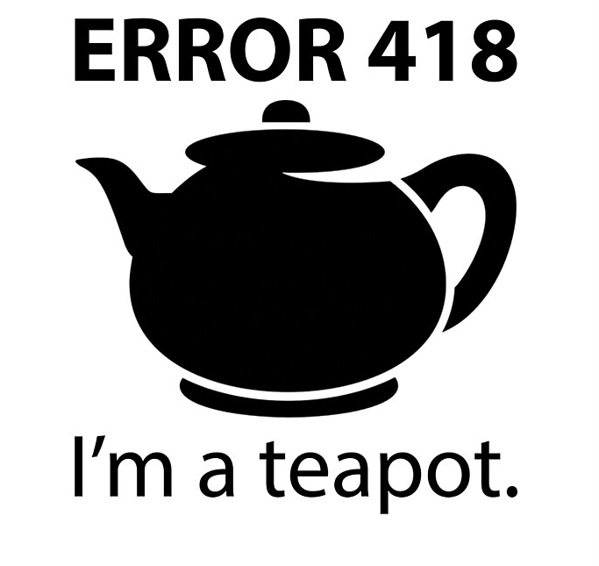

Slide 21
REST => Longevity &
Reduced Client-Coupling

Slide 22
Pros Cons
Decoupled client and server
API can evolve over time
Reuses HTTP
Well known architecture
Self descriptive messages and metadata => great discoverability
Easy versioning
Evolvable
No single specification, only architectural guides
Big payloads
Over-fetching
Under-fetching
N+1 requests problem
A lot of REST-ish implementations
No actions, no subscriptions
Notes:
http – verbs, caching, tools
Under-fetching – dociaganie danych kolejnymi requestami

Slide 23
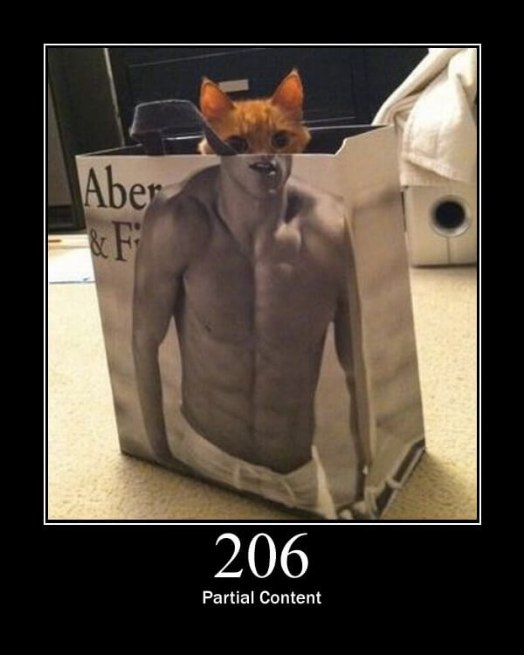
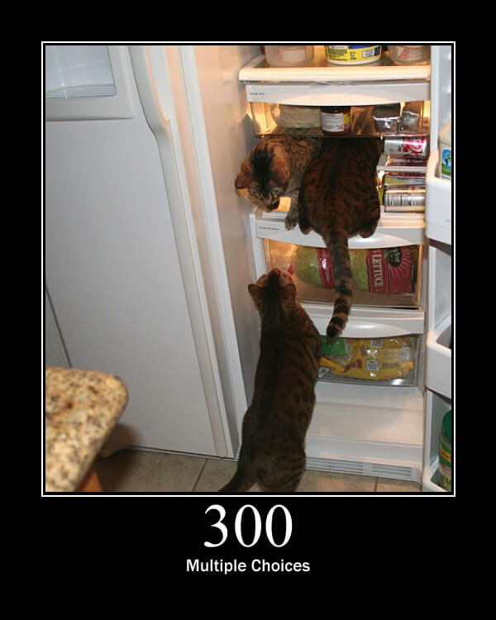
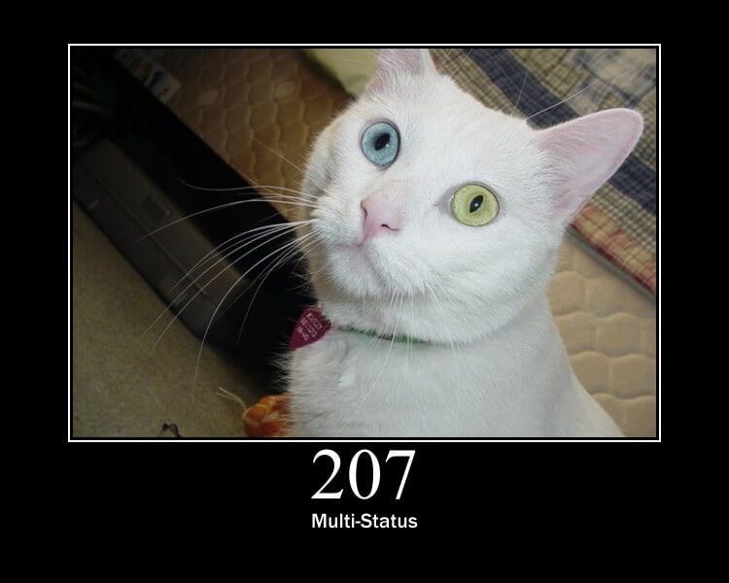
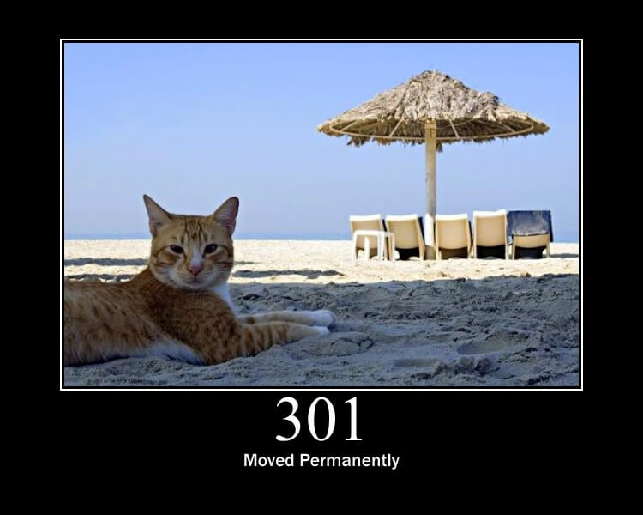
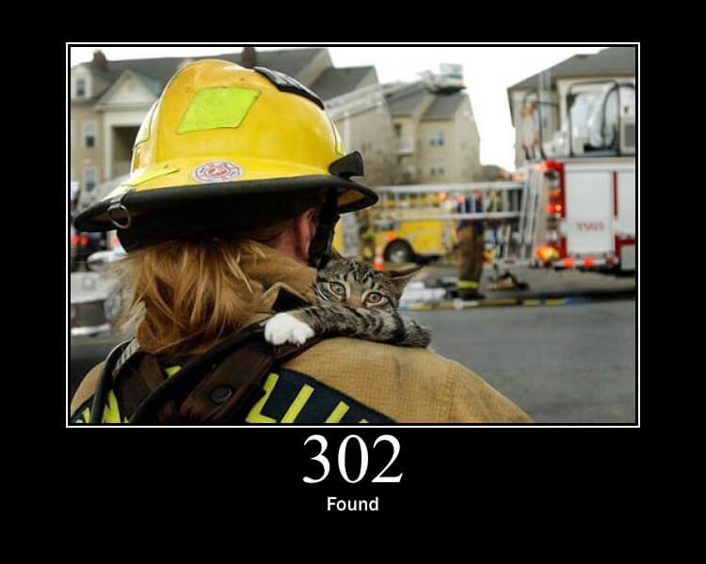
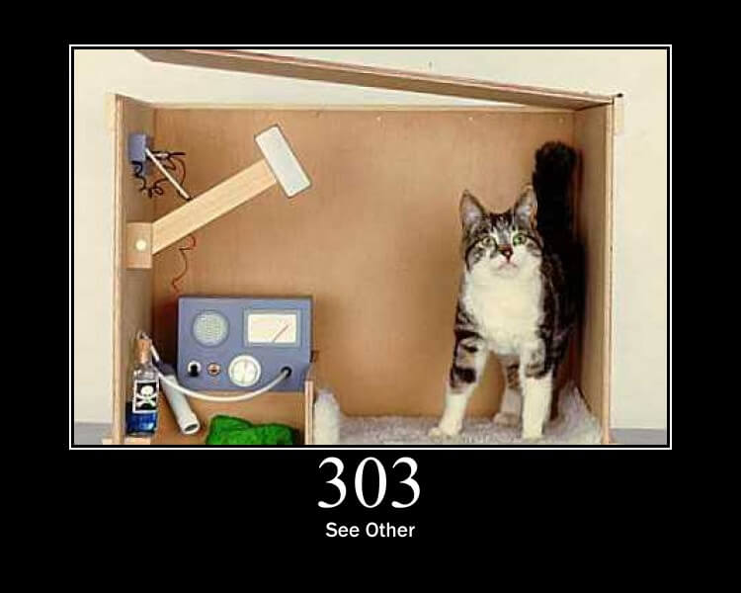
Notes:
206 partial content
207 multistatus
300 multiple choices
301 moved permamently
302 found
303 see other

Slide 24
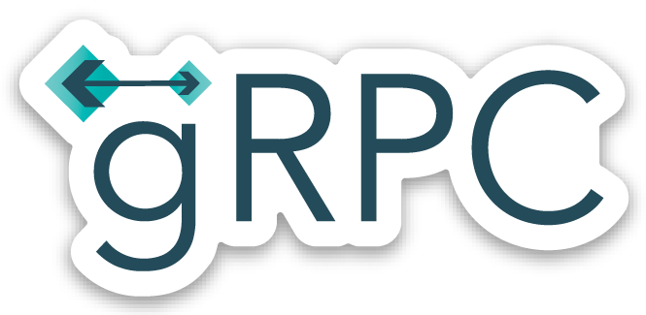
gRPC

Slide 25
What is gRPC?
Transport
HTTP/2 + PROTOBUF = gRPC
Interface definition language + Data Format
Notes:
One way or two way streaming

Slide 26
What is gRPC?
Binary communication
Secure by default (requires HTTP/2, TLS, SSL)
Uni and Bi directional streaming
Transport
HTTP/2 + PROTOBUF = gRPC
Interface definition language + Data Format
Contract-based
Available across ecosystems
Notes:
One way or two way streaming

Slide 27
gRPC for the Web
HTTP/2 – most browsers don’t suport it yet
Binary format – harder for JS to parse
Required contracts – that’s not so great for Web apps

Slide 28
gRPC so where?
IoT
Containers
Service to service communication

Slide 29
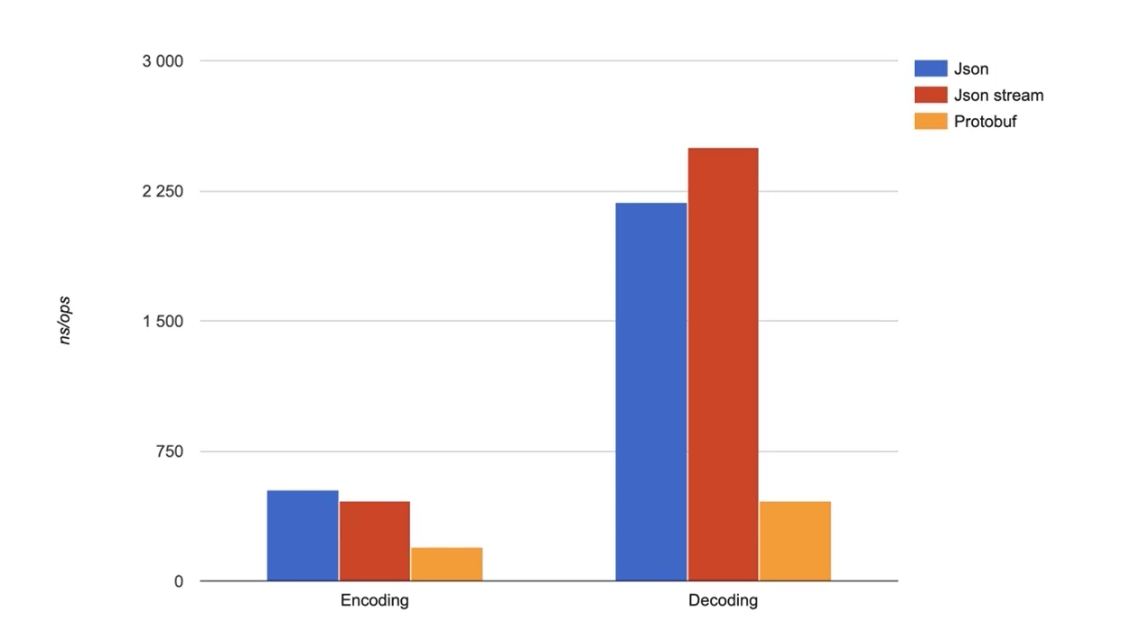
ProtoBuf is fast

Slide 30
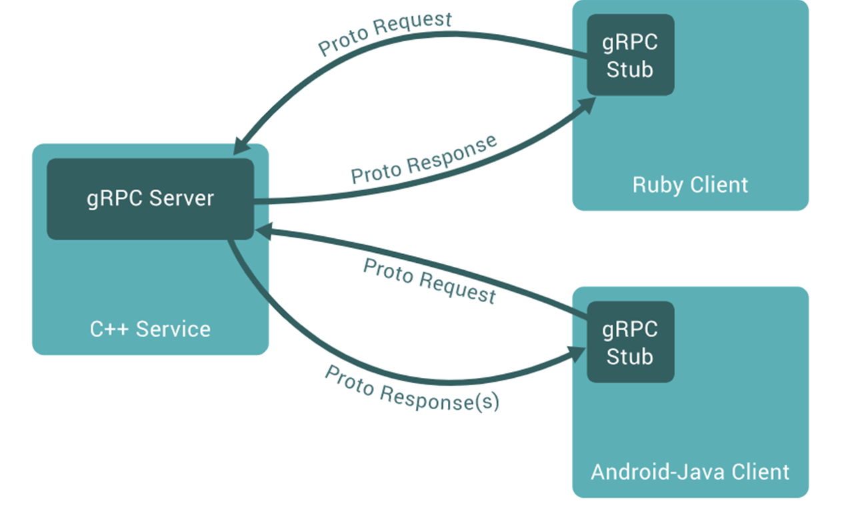
gRPC so where?
IoT
Containers
Service to service communication
Across ecosystems

Slide 31
Contracts
Generated clients/servers
Uses interface definitione language Protocol Buffers (ProtoBuf)
Language independent
message Person
{
string name = 1;
int32 id = 2;
bool has_ponycopter = 3;
}
https://docs.microsoft.com/en-us/aspnet/core/tutorials/grpc/grpc-start?view=aspnetcore-3.1&tabs=visual-studio

Slide 32
Contracts
Generated clients/servers
Uses interface definitione language Protocol Buffers (ProtoBuf)
Language independent
message Person
{
string name = 1;
int32 id = 2;
bool has_ponycopter = 3;
}
import "google/protobuf/timestamp.proto";
import "google/protobuf/empty.proto";
https://docs.microsoft.com/en-us/aspnet/core/tutorials/grpc/grpc-start?view=aspnetcore-3.1&tabs=visual-studio
Notes:
message SalesOrder { int32 SoId = 1; google.protobuf.Timestamp DeliveryDate = 2;
https://visualstudiomagazine.com/articles/2020/01/16/grpc-well-known-types.aspx
public override Task<Empty> DeleteQuize(QuizeIdMessage request, ServerCallContext context)
{
//…code to delete a customer…
return Task.FromResult(new Empty());
}

Slide 33
// The greeter service definition.
service Greeter {
// Sends a greeting
rpc SayHello (HelloRequest) returns (HelloReply) {}
}
// The request message containing the user's name.
message HelloRequest {
string name = 1;
}
// The response message containing the greetings
message HelloReply {
string message = 1;
}

Slide 34
// The greeter service definition.
service Greeter {
// Sends a greeting
rpc SayHello (HelloRequest) returns (HelloReply) {}
}
// The request message containing the user's name.
message HelloRequest {
string name = 1;
}
// The response message containing the greetings
message HelloReply {
string message = 1;
}

Slide 35
Example .NET
syntax = "proto3";
option csharp_namespace = "GrpcExampleService";
package johoot;
// The greeting service definition.
service QuizeDefinition {
rpc SayHello (HelloRequest) returns (HelloReply);
rpc GetQuizeByID (QuizeIdMessage) returns (QuizeMessage);
rpc CreateQuize (QuizeMessage) returns (QuizeIdMessage);
}
// The request message containing the user's name.
message HelloRequest {
string name = 1;
}
message QuizeIdMessage{
int64 id = 1;
}
message QuizeMessage{
int64 id =1;
string name=2;
string description =3;
repeated QuestionMessage QuestionList =4;
}
message QuestionMessage{
int64 id = 1;
string text =2;
map<bool, string> answers = 3;
}
// The response message containing the greetings.
message HelloReply {
string message = 1;
}
syntax = "proto3";
option csharp_namespace = "GrpcExampleService";
package johoot;
// The greeting service definition.
service QuizeDefinition {
rpc SayHello (HelloRequest) returns (HelloReply);
rpc GetQuizeByID (QuizeIdMessage) returns (QuizeMessage);
rpc CreateQuize (QuizeMessage) returns (QuizeIdMessage);
}
// The request message containing the user's name.
message HelloRequest {
string name = 1;
}
message QuizeIdMessage{
int64 id = 1;
}
message QuizeMessage {
int64 id =1;
string name=2;
string description =3;
}
// The response message containing the greetings.
message HelloReply {
string message = 1;
}
Spacing matters
Many methods in one service
Simple types

Slide 36
Pros Cons
Simple and easy to understand
Autogenerated from protobuf
Lightweight payloads
High performance
Tight coupling
Low discoverability
Function explosion
Easy to add new function
Add new function for everything
Not all types make sense in .NET

Slide 37
ASP.NET Core configuration
public void ConfigureServices(IServiceCollection services)
{
services.AddGrpc();
}
public void Configure(IApplicationBuilder app, IWebHostEnvironment env)
{
if (env.IsDevelopment())
{
app.UseDeveloperExceptionPage();
}
app.UseRouting();
app.UseEndpoints(endpoints =>
{
endpoints.MapGrpcService<QuizeDefinitionService>();
endpoints.MapGet("/", async context =>
{
await context.Response.WriteAsync("Communication with gRPC endpoints
must be made through a gRPC client. To learn how to create a client,
visit: https://go.microsoft.com/fwlink/?linkid=2086909");
});
});
}

Slide 38
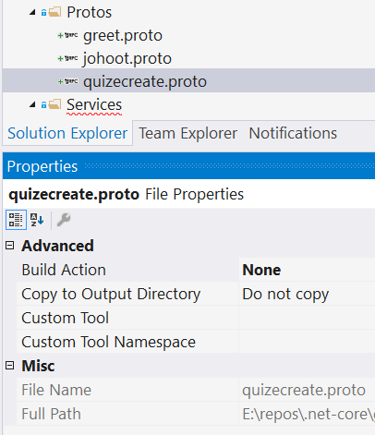
Add proto
Adding new file is not telling DotNet that it’s gRPC
https://docs.microsoft.com/en-us/aspnet/core/tutorials/grpc/grpc-start?view=aspnetcore-3.1&tabs=visual-studio

Slide 39
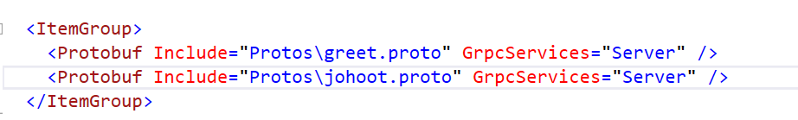
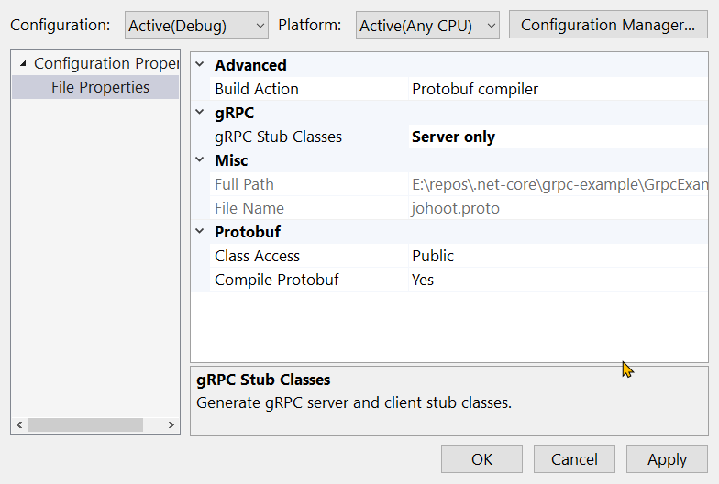
Introduce gRPC to generate classes

Slide 40
Other types
message QuizeMessage{
int64 id =1;
string name=2;
string description =3;
repeated QuestionMessage QuestionList =4;
}
message QuestionMessage{
int64 id = 1;
string text =2;
map<bool, string> answers = 3;
}
var result = new QuizeMessage
{
Id = 19,
Name = "Bla bla quize",
Description = "some more bla bla ",
QuestionList =
{
new QuestionMessage {
Id=21,
Text="question1"},
new QuestionMessage {
Id=23,
Text="question3",
Answers={
{true,"this is good" },
{ false, "this is not so good"}
}
},
}
};

Slide 41
List = stream
rpc GetQuizeList (QuizeIdMessage) returns (stream QuizeMessage);
public override async Task GetQuizeList(
QuizeIdMessage request,
IServerStreamWriter<QuizeMessage> responseStream,
ServerCallContext context)
{
var result = new List<QuizeMessage>() {new QuizeMessage{…}};
foreach (var item in result)
{
await responseStream.WriteAsync(item);
}
}

Slide 42
gRPC Client
Any app – eg. ConsollApp
Include *.proto files
Nugget
Install-Package Grpc.Net.Client
Install-Package Google.Protobuf
Install-Package Grpc.Tools

Slide 43
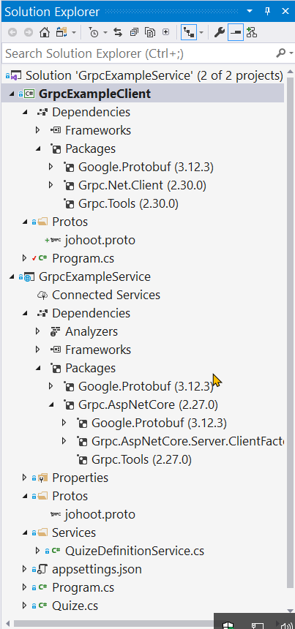
gRPC Client
Any app – eg. ConsollApp
Include *.proto files
Nugget
Install-Package Grpc.Net.Client
Install-Package Google.Protobuf
Install-Package Grpc.Tools

Slide 44
gRPC Client call service
class Program
{
static void Main(string[] args)
{
Console.WriteLine("Hello World!");
// The port number(5001) must match the port of the gRPC server.
var channel = GrpcChannel.ForAddress("https://localhost:5001");
var client = new QuizeDefinition.QuizeDefinitionClient(channel);
var request = new QuizeIdMessage { Id = 1 };
var reply = client.GetQuizeByID(request);
Console.WriteLine($"{reply.Id}, {reply.Name}, {reply.Description}");
Console.WriteLine("Press any key to exit...");
Console.ReadKey();
}
}
}

Slide 45
gRPC Client for stream
// The port number(5001) must match the port of the gRPC server.
var channel = GrpcChannel.ForAddress("https://localhost:5001");
var client = new QuizeDefinition.QuizeDefinitionClient(channel);
var request = new QuizeIdMessage { Id = 1 };
var quizeItems = new List<QuizeMessage>();
using (var call = client.GetQuizeList(request))
{
while (await call.ResponseStream.MoveNext())
{
var item = call.ResponseStream.Current;
quizeItems.Add(item);
Console.WriteLine($"{item.Id}, {item.Name}, {item.Description},
{item.QuestionList?.Count}");
}

Slide 46
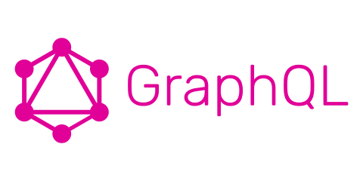
GraphQL

Slide 47
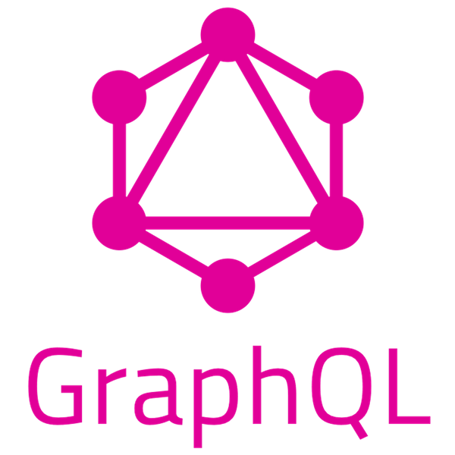
Ask for exactly
what you want
GraphQL is a query language that solves the issue with over/under-feching
Notes:
https://devblogs.microsoft.com/odata/experimenting-with-odata-in-asp-net-core-3-1/
Fundamental unit: Query
Wymyslon yprzez facebook
Popularny na froncie
It enables clients to specify exactly what data is needed, makes it easier to aggregate data from multiple sources and uses a type system to describe data

Slide 48
GraphQL
One endpoint
One request (POST)
No over- or under-fetching
Type system
No versioning
Documentation (from schema and type system)
Real-time
Simplicity
Notes:
Strongly typed schema
Like sending sql query to your API
Only POST verb
We have headers

Slide 49
Schema building blocks
Queries
Mutations
Subscriptions
Get data
Add/ Update/ Delete data
Subscribe to event
Fields
Resolvers
Types
Notes:
Query – Queries enable you to consume data efficiently. The consumer or the client can mention the field or fields it needs in lieu of getting data for all fields from a particular type. Note that the client can only consume the fields that have been exposed by the API.
Mutation – In GraphQL mutations are used to send data to the server, i.e., you can take advantage of mutations to add, edit, or delete data. The client can only take advantage of the mutations that have been exposed by the schema to modify the data. It should be noted here that if there are no mutations in a GraphQL schema, the client cannot manipulate the data in the API.
Subscription – Subscriptions allow a server to send data to its clients, hence notifying them when events occur. Subscriptions provide support for event-driven architectures and for real-time notifications they take advantage of WebSockets.
GraphQL Object Types
The most fundamental components of a GraphQL schema are object types, which in turn are used to represent the type of object you can retrieve from your API. Object Types in GraphQL are represented by the GraphQL.Types.ObjectGraphType class and contain Fields and Methods. While the former is a property in the class, the latter is used to modify field values when needed based on a client query.
https://www.red-gate.com/simple-talk/dotnet/net-development/building-and-consuming-graphql-api-in-asp-net-core-3-1/

Slide 50
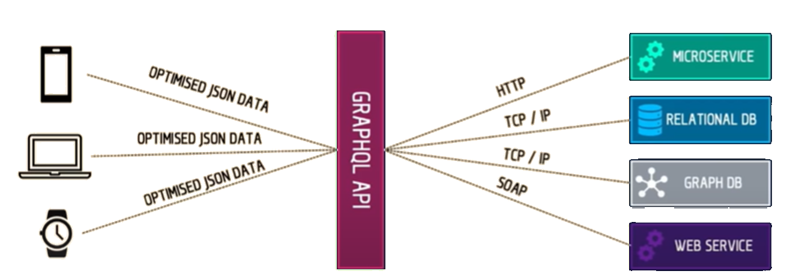
GraphQL
is DataSource agnostic
excels when you have multiple clients with heterogenous data requirements

Slide 51
Setup steps
Install-Package GraphQL
Install-Package GraphQL.Server.Transports.AspNetCore
Install-Package GraphQL.Server.UI.Playground
Add middlewares
Create Schema
Resolve Query
Resolve Mutations

Slide 52
And then even more to define
Your graph entities
Every available query
Every mutation
Schema and mutations

Slide 53
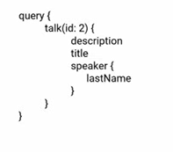
Query
Is everything that can be ‘questioned’ from the outside
You need to define the query type
{
“data”: {
“speakers”: [
{
“companyName”:”Microsoft”,
“lastName”:”Hanselman”,
“firstName”:”Scott”,
“twitter”:””
},
…
]
}
}
query{
speakers{
companyName
lastName
firstName
twitter
}
}
Notes:
Can have headers
You can run multiple queries in parallel
http://slidedeck.io/OlegIlyenko/presentation-graphql-introduction

Slide 54
Pros Cons
Low network overhead
Typed schema
Fits graph-like data very well
No versioning
No over-fetching
Great discoverability based on schema
Data Source agnostic
Complexity
Caching
No versioning
Still early
Community is not decided how it should work

Slide 55
Comparition

Slide 56
What is important choosing API style?
Caching
Performance: Over/Under Fetching
Versioning
Coupling
Client complexity
Discoverability

Slide 57
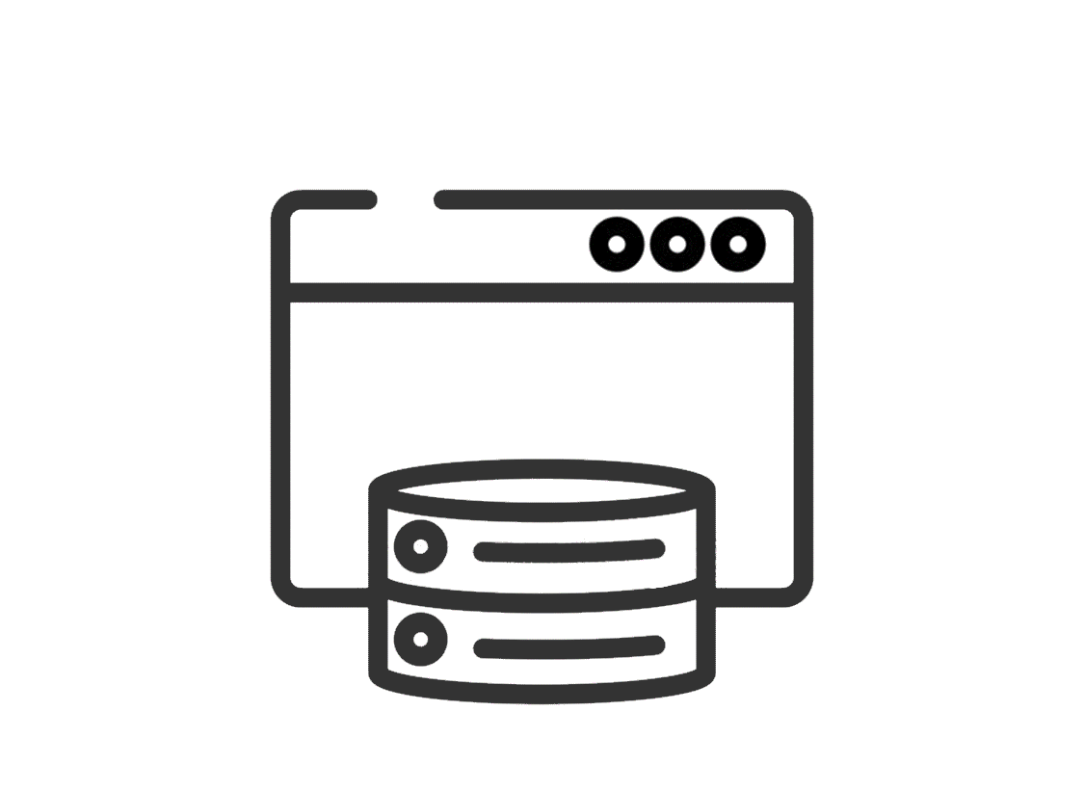
Caching
The closes to API consumer the shorter rout for light
There are many kinds of caching: Client, Server and Network
Highly customizable APIs benefit less from HTTP caching
If network caching is valuable then consider REST
Best practices are still emerging for GraphQL and gRPC

Slide 58

Performance: Over/Under Fetching
Over-fetching: spare fields and fildsets
Under-fetching: compound documents = many API calls
Slowest field dictates overall response time
Notes:
Compound documents – zlozone- zlozone z wielu requestow
Dzieki http2 ustanowienie polaczenia – poczatkowy handshake nie jest juz tak drogi jak byl w 1
http2 – client push jak cos mozliwe ze bedzie potrzebowal to server moze cos doslac np dzieci

Slide 59
Performance: Over/Under Fetching
With HTTP/1.X the cost of a Handshake was high
HTTP/2 removes the need for compound documents
Server push creates new possibilities
gRPC uses HTTP/s heavily for streaming methods
Notes:
Compound documents – zlozone- zlozone z wielu requestow
Dzieki http2 ustanowienie polaczenia – poczatkowy handshake nie jest juz tak drogi jak byl w 1
http2 – client push jak cos mozliwe ze bedzie potrzebowal to server moze cos doslac np dzieci

Slide 60
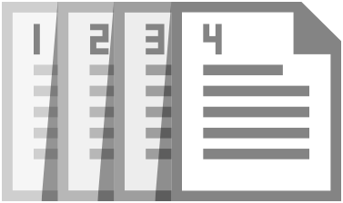
Versioning
Versioning is a strategy not a requirement
It’s technique to manage breaking changes
Should be a last resort, prefer graceful evolution
Is not a substitute for communicating with users
Doesn’t protect against consumers depending on implicit interface behavior (eg. Bugs)
Graceful evolution should be the goal

Slide 61

Graceful evolution
Don’t add required inputs
Don’t remove outputs or make them optional
Don’t change the type of a field
Follow the robustness principle / Postel’s law
"Be conservative in what you send, be liberal in what you accept“
Contract first design
Schema – GraphQL
Protocol buffer – gRPC
Open API = Swagger, RAML, Blueprint - REST
Notes:
In other words, the data that is sent out of our system should be kept to the minimum that is necessary. A message sender must conform to the message contract, and reducing the amount of data that an API exposes lessens the chances that a breaking change may be necessary for the ...
Be specific what you send
Bardzo duza dyscyplina api
Komunikuj sie z consumerem. (komunikacja w teamie?) Bez naglowkow, bez deprykacji (a deprecated uzywa graphQL)
Nie psuj consumerowi zycia
https://apiblueprint.org/
https://raml.org/

Slide 62

Coupling
How abstract the API must be
How much implementation information can leak from abstraction
Who is consuming our API

Slide 63

Discoverability
How to know what to call
Getting to know next required call from the current one
Documentations
Contract standardization
Metadata with API description

Slide 64
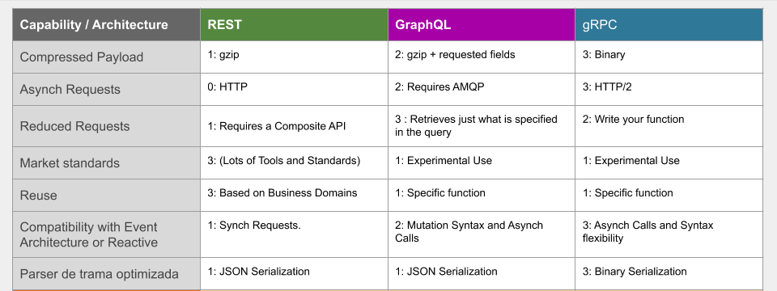
Pick your poison
https://sensedia.com/en/api/apis-rest-graphql-or-grpc-who-wins-this-game/
Notes:
https://sensedia.com/en/api/apis-rest-graphql-or-grpc-who-wins-this-game/

Slide 65
API Styles
API styles address different problem spaces
Restish APIs would most likely be better as GraphQL or RPC
gRPC is perfect for synchronous communication between internal services
Notes:
REST jest stosunkowo trudny I powoli sie zwraca napisanie dobrze zrobionego api
Rest ma bardzo okreslona specyfikacje.

Slide 66


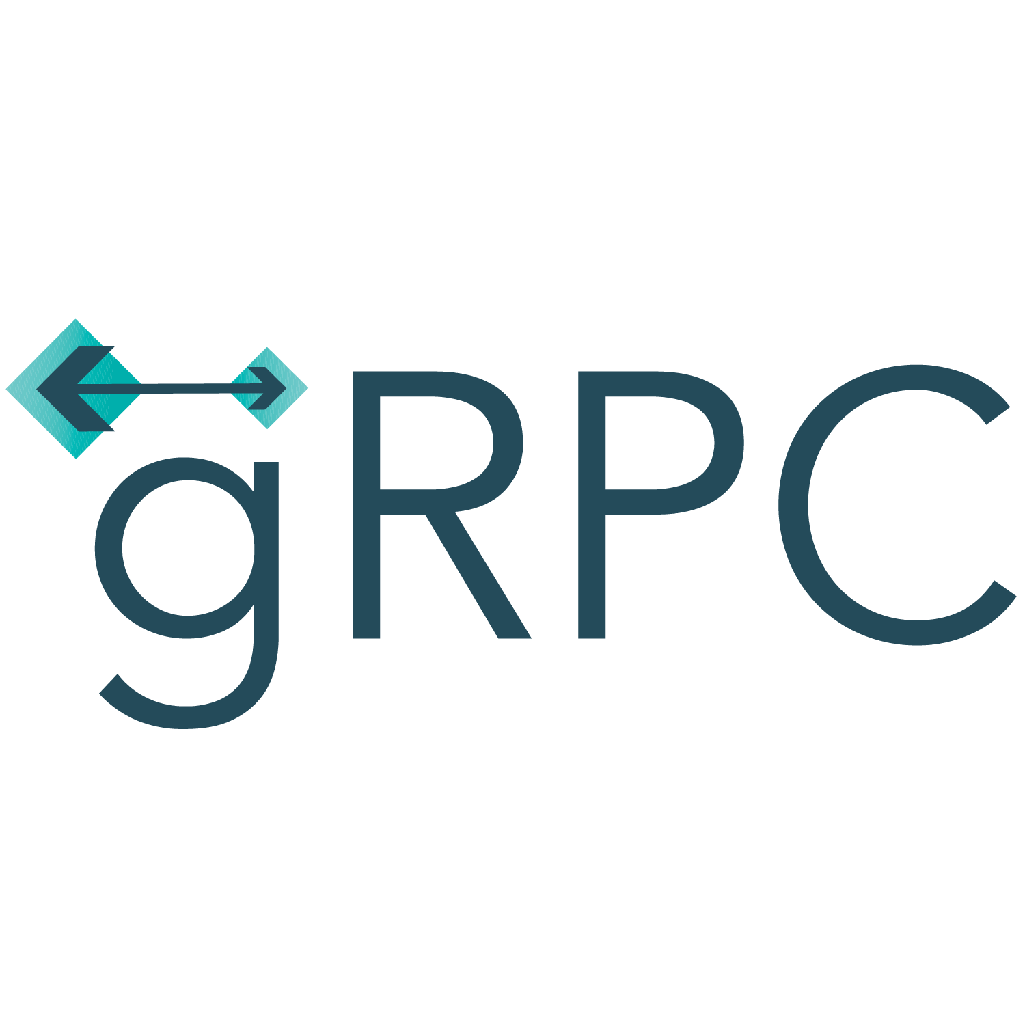
Matching communication to technology
REST: CRUD and purely web apps
SignalR: Multicasting and web messaging
GraphQL: Open querying of large datasets
OData: Open querying relational data
gRPC: Streaming, low resource clients, inter- data center
Notes:
https://devblogs.microsoft.com/odata/experimenting-with-odata-in-asp-net-core-3-1/

Slide 67
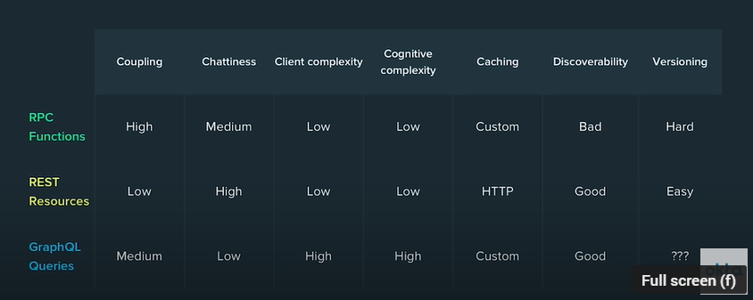
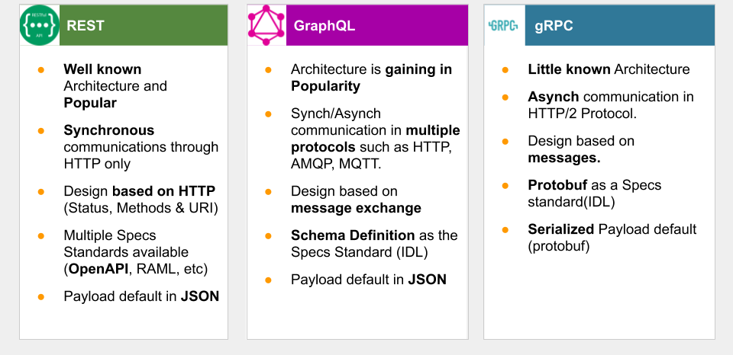

Slide 68
Further reading
https://github.com/microsoft/api-guidelines
Specifications
HATEOAS – Hypermedia as the Engine of Application State
https://ionwg.org/ - The ION Hypermedia Type
http://jsonapi.org/ - JSON API Specification
http://json-schema.org/ - JSON (Hyper-)Schema...
http://graphql.org/ - GraphQL
APIs
https://dev.twitter.com/rest/public - Twitter REST
https://developer.github.com/v3/ - GitHub REST / v4 GraphQL
https://stripe.com/docs/api - Stripe
https://www.twilio.com/docs/api/rest - Twilio
Notes:
https://www.youtube.com/watch?v=IvsANO0qZEg&t=701s
https://www.youtube.com/watch?v=0Aqy8h0W3RQ&t=2043s

Slide 69
Thanks! Questions?

