Slide 1
REST API
Notes:
So what is .NET?

Slide 2
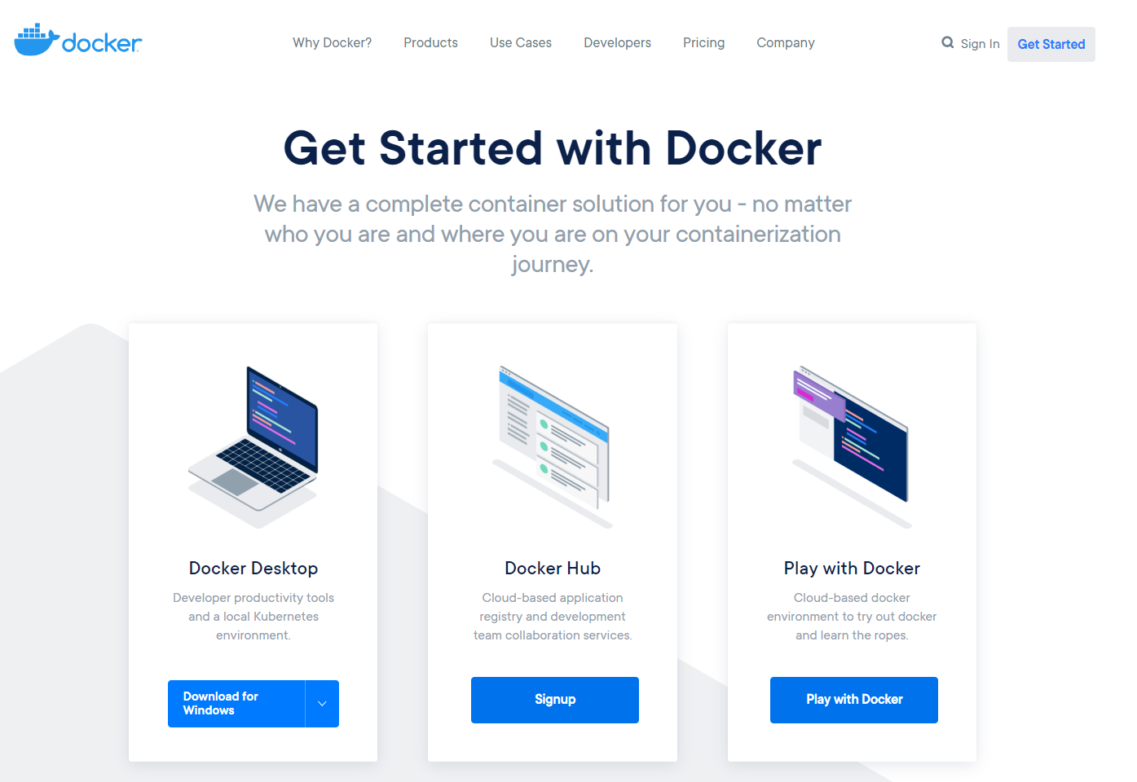

Slide 3
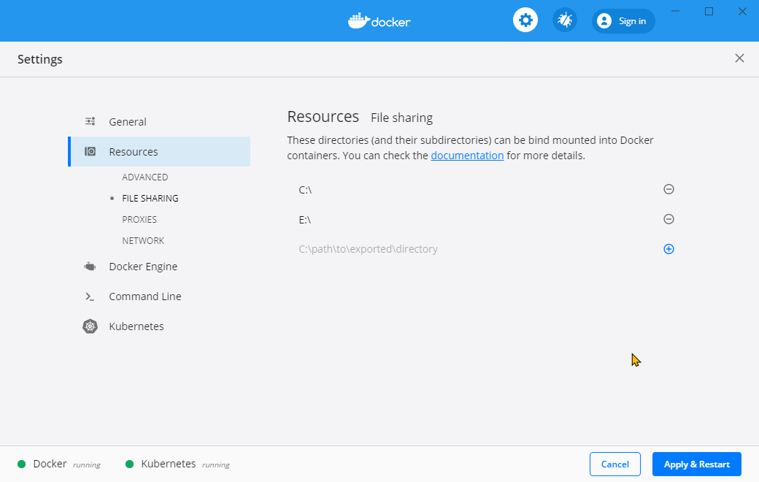

Slide 4
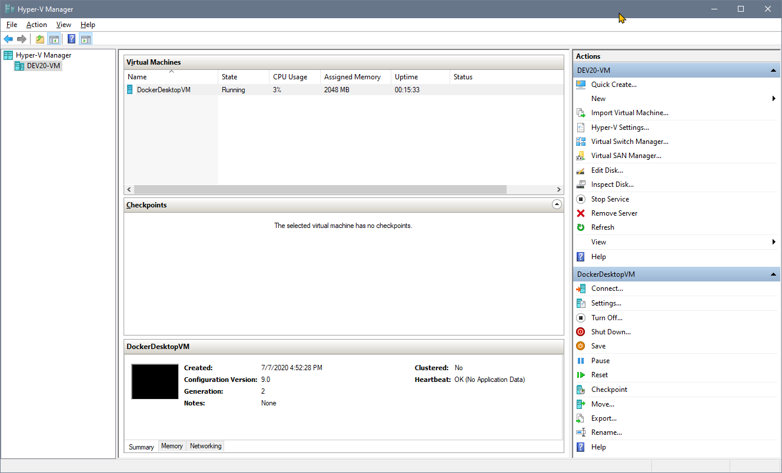

Slide 5
What we will do
Pull a .NET Core image
Create a container from it
Manipulate the image inside of the container
Create a new image from that to distribute

Slide 6
docker
docker version

Slide 7
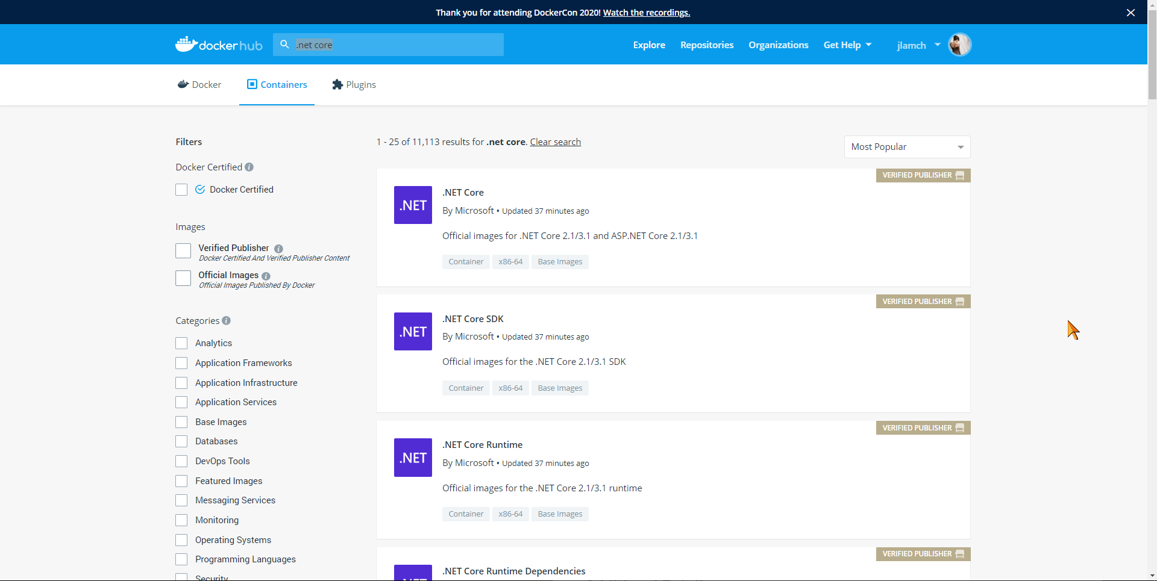

Slide 8
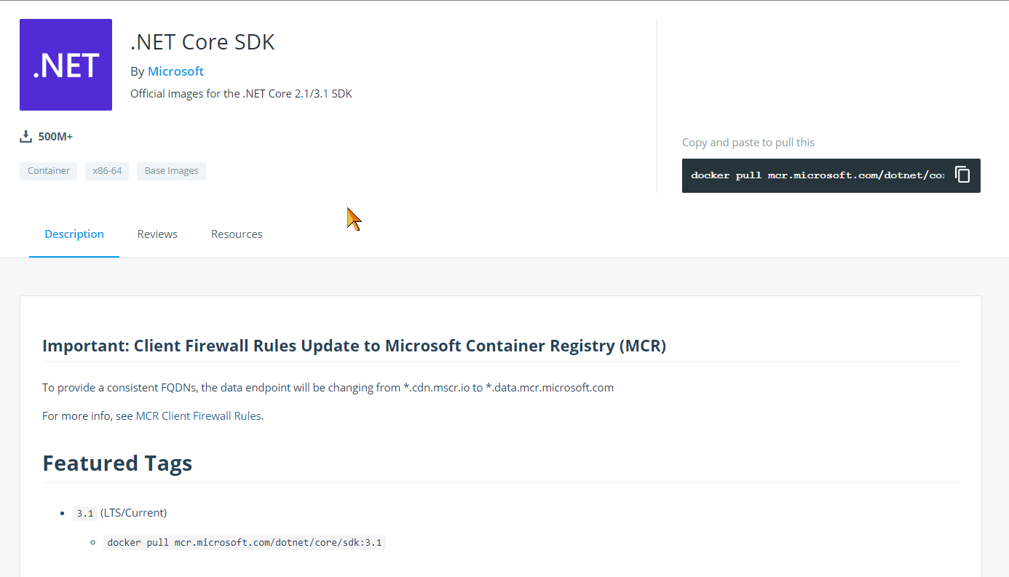
docker pull

Slide 9
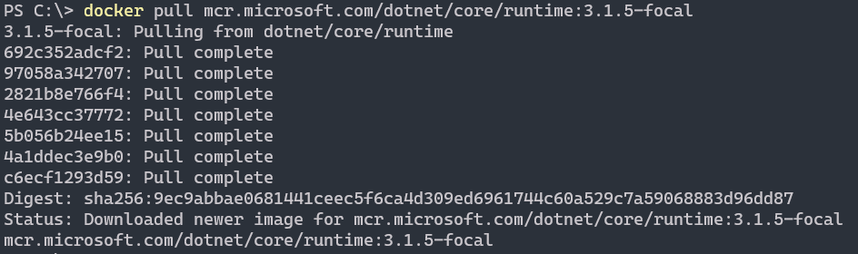
.net core runtime on Ubuntu 20

Slide 10
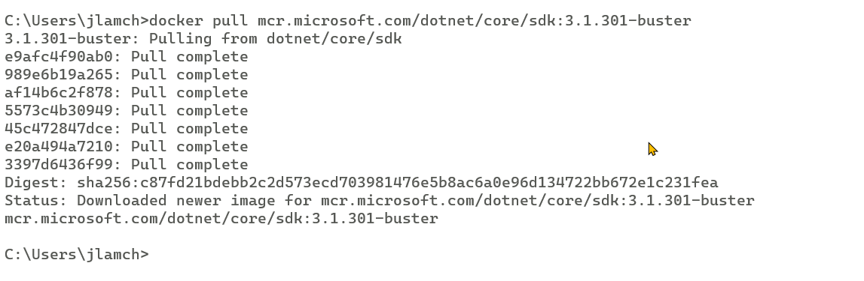
docker pull .net core SDK on debian

Slide 11
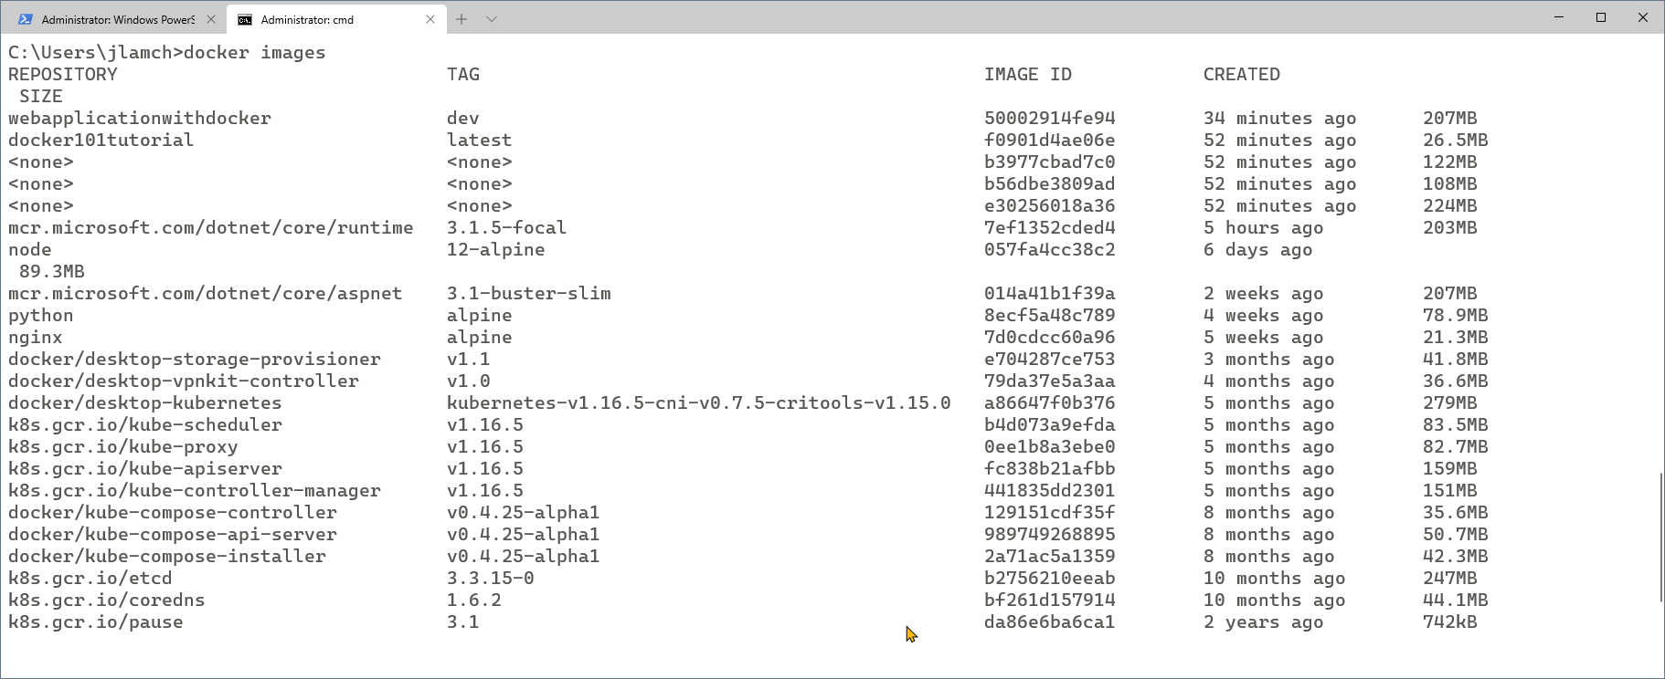
List available images

Slide 12
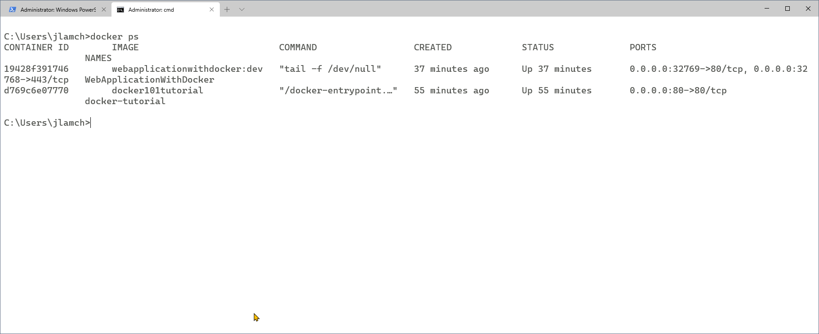
Check running containers

Slide 13
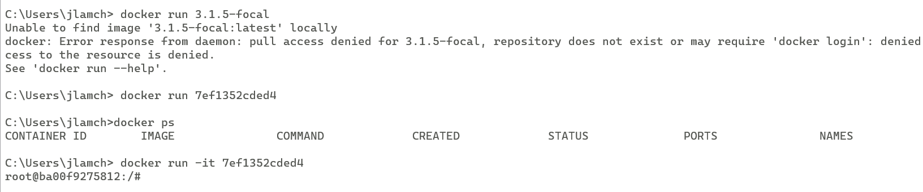
docker run
Notes:
-it -> wchodzimy do konsoli
Jak tylko wychodzimy z konsoli od razu zamyka się proces

Slide 14
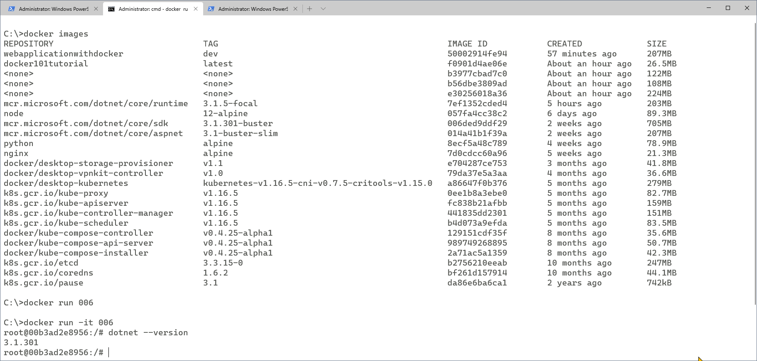
docker run .net SDK image

Slide 15
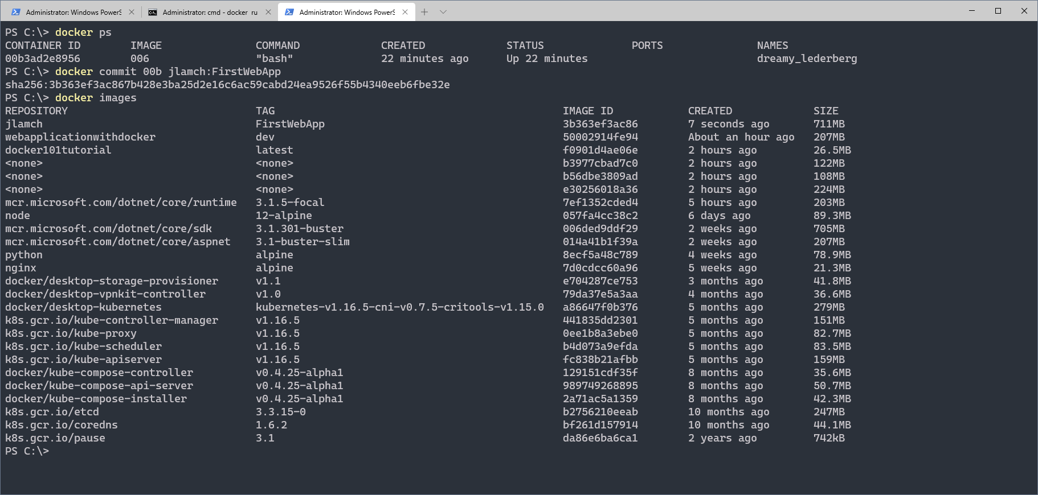
Make some changes and save as new image

Slide 16
Add docker to WebApi project
Add docker
See docker file
Add controller names
Run API in docker
public IEnumerable<string> Get()
{
return new[] { Environment.MachineName };
}

Slide 17
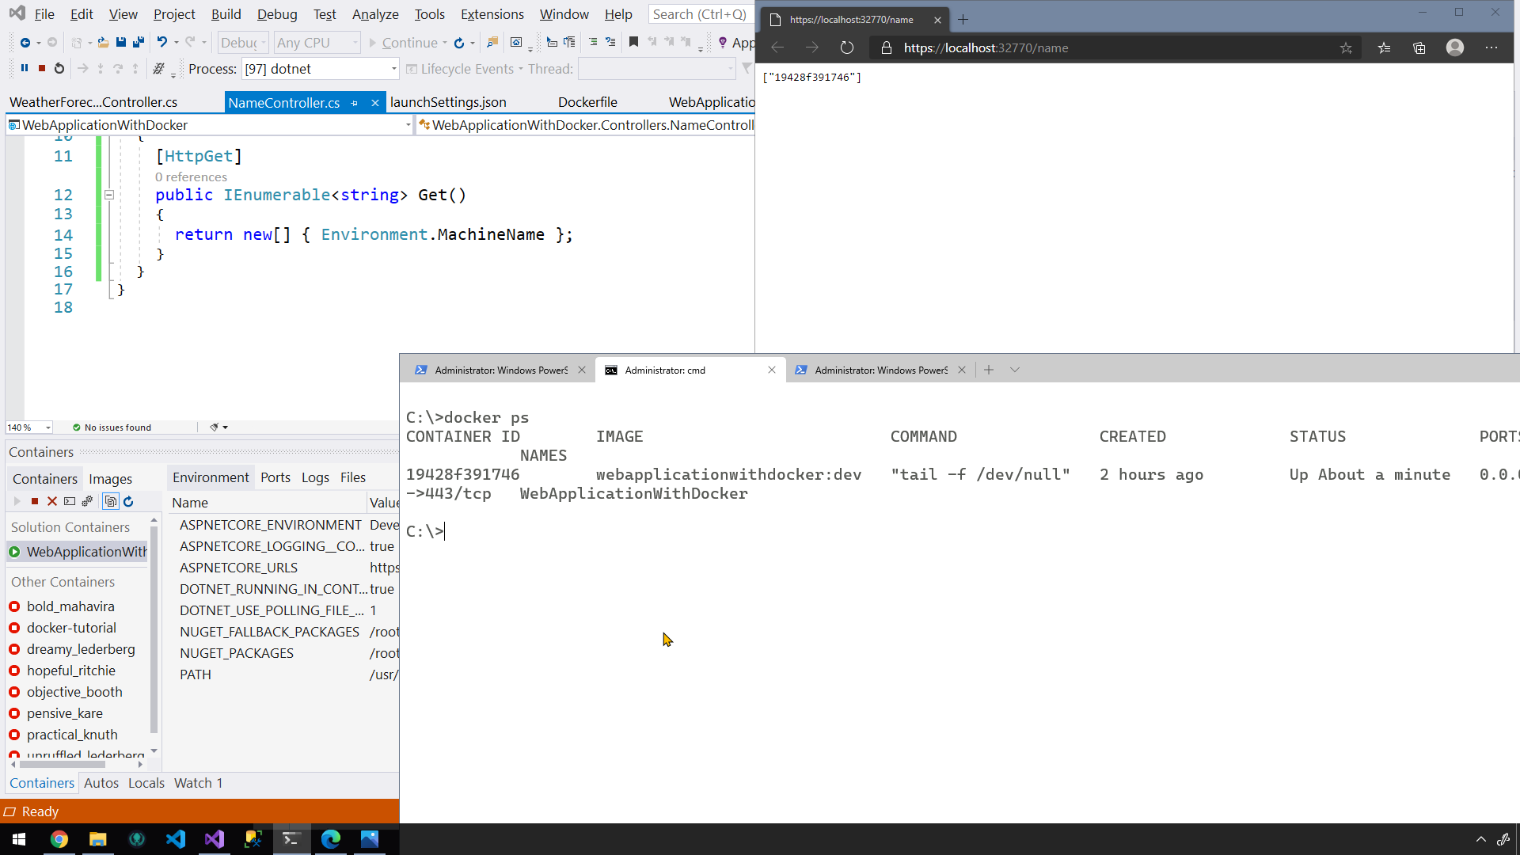

Slide 18
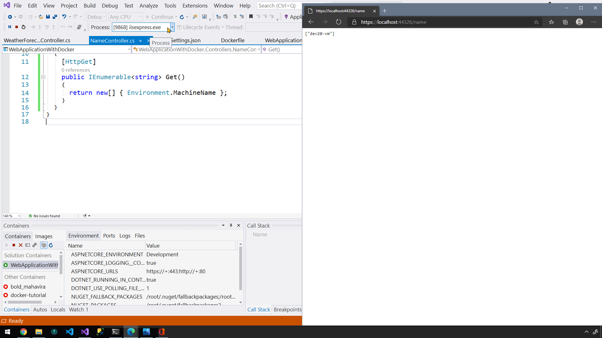

Slide 19
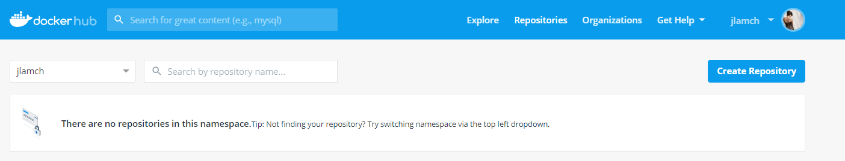
docker push
Login to Docker Hub
Create Docker Hub repository

Slide 20
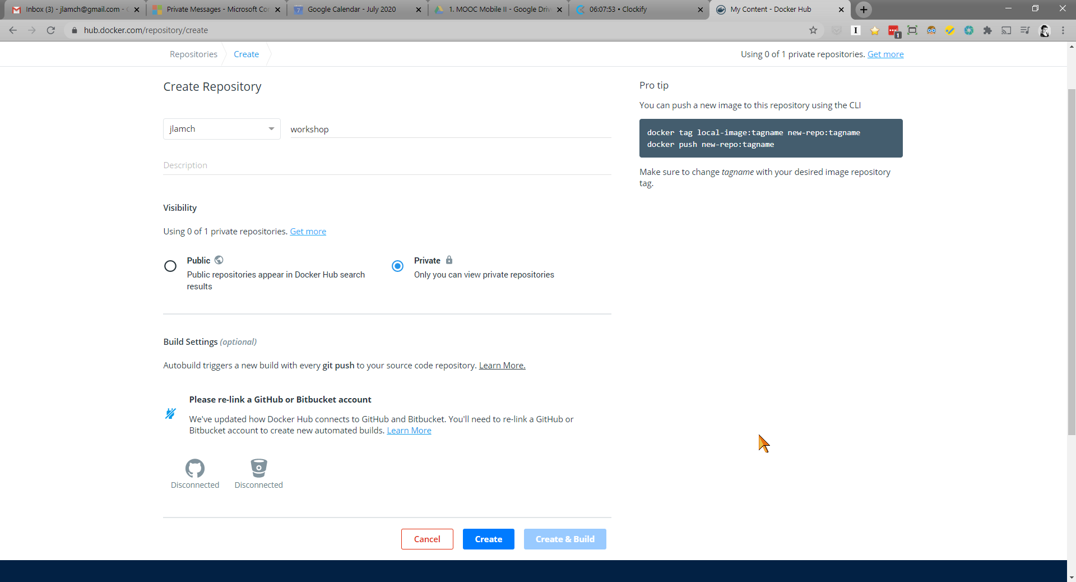

Slide 21
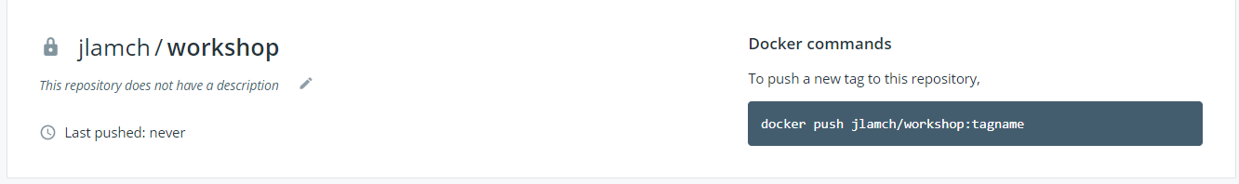
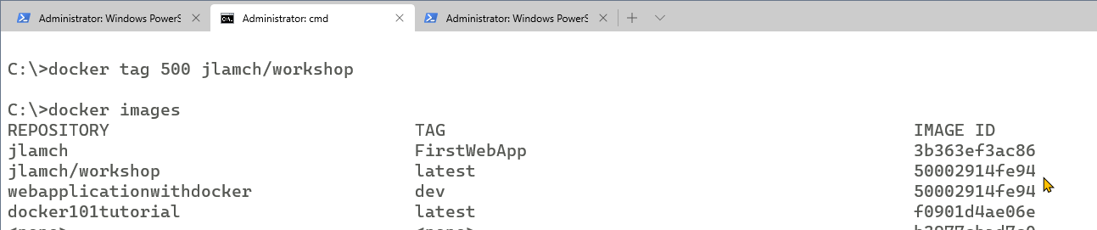
add tag to your image with your repo name
Docker tag imageID jlamch/workshop

Slide 22
Thanks! Questions?

