Slide 1
REST API
Notes:
So what is .NET?

Slide 2
REST(ful)
REST
architecture type that’s using the existing web infrastructure
RESTful
services that implement REST architecture
Strict and pragmatic approach

Slide 3
REST
Stateless
Cacheable
Uniform interface
Identification of resources
Manipulation of resources through representations
Self-descriptive messages
Hypermedia and the engine of application state (HATEOAS)
Layered system
Client-server separation
https://restfulapi.net/
Notes:
Client–server – By separating the user interface concerns from the data storage concerns, we improve the portability of the user interface across multiple platforms and improve scalability by simplifying the server components.
Stateless – Each request from client to server must contain all of the information necessary to understand the request, and cannot take advantage of any stored context on the server. Session state is therefore kept entirely on the client.
Cacheable – Cache constraints require that the data within a response to a request be implicitly or explicitly labeled as cacheable or non-cacheable. If a response is cacheable, then a client cache is given the right to reuse that response data for later, equivalent requests.
Uniform interface – By applying the software engineering principle of generality to the component interface, the overall system architecture is simplified and the visibility of interactions is improved. In order to obtain a uniform interface, multiple architectural constraints are needed to guide the behavior of components. REST is defined by four interface constraints: identification of resources; manipulation of resources through representations; self-descriptive messages; and, hypermedia as the engine of application state.
Layered system – The layered system style allows an architecture to be composed of hierarchical layers by constraining component behavior such that each component cannot “see” beyond the immediate layer with which they are interacting.
Code on demand (optional) – REST allows client functionality to be extended by downloading and executing code in the form of applets or scripts. This simplifies clients by reducing the number of features required to be pre-implemented.

Slide 4
REST(ful)
REST
architecture type that’s using the existing web infrastructure
RESTful
services that implement REST architecture
Web resources – identified with URL address
Resource A – create not CreateResource(A)
HTTP verbs
GET, POST, PUT, DELETE, PATCH…
JSON or XML
Notes:
Tak naprawde wszystkie wojny o rest sa bez sensu :D
Wykorzystuje sie HTTP ale to z wygody porownania. Ale nie dlatego ze tak ma byc

Slide 5
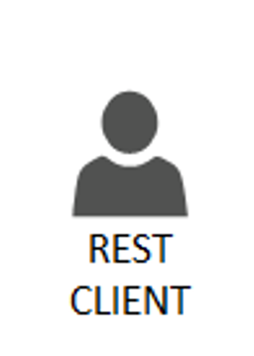

HTTP REST CRUD
C
R
U D
Http POST routing + payload
201 + location
Http GET routing
200 + payload list
Http GET routing/{id}
200 + payload
Http PUT routing/{id}
200
Http DELETE routing/{id}
200

Slide 6
HTTP Codes
1xx: Information
2xx: Success
3xx: Redirection
4xx: Client Error – You did screw up
5xx: Server Error – I did screw up

Slide 7
gRPC

Slide 8
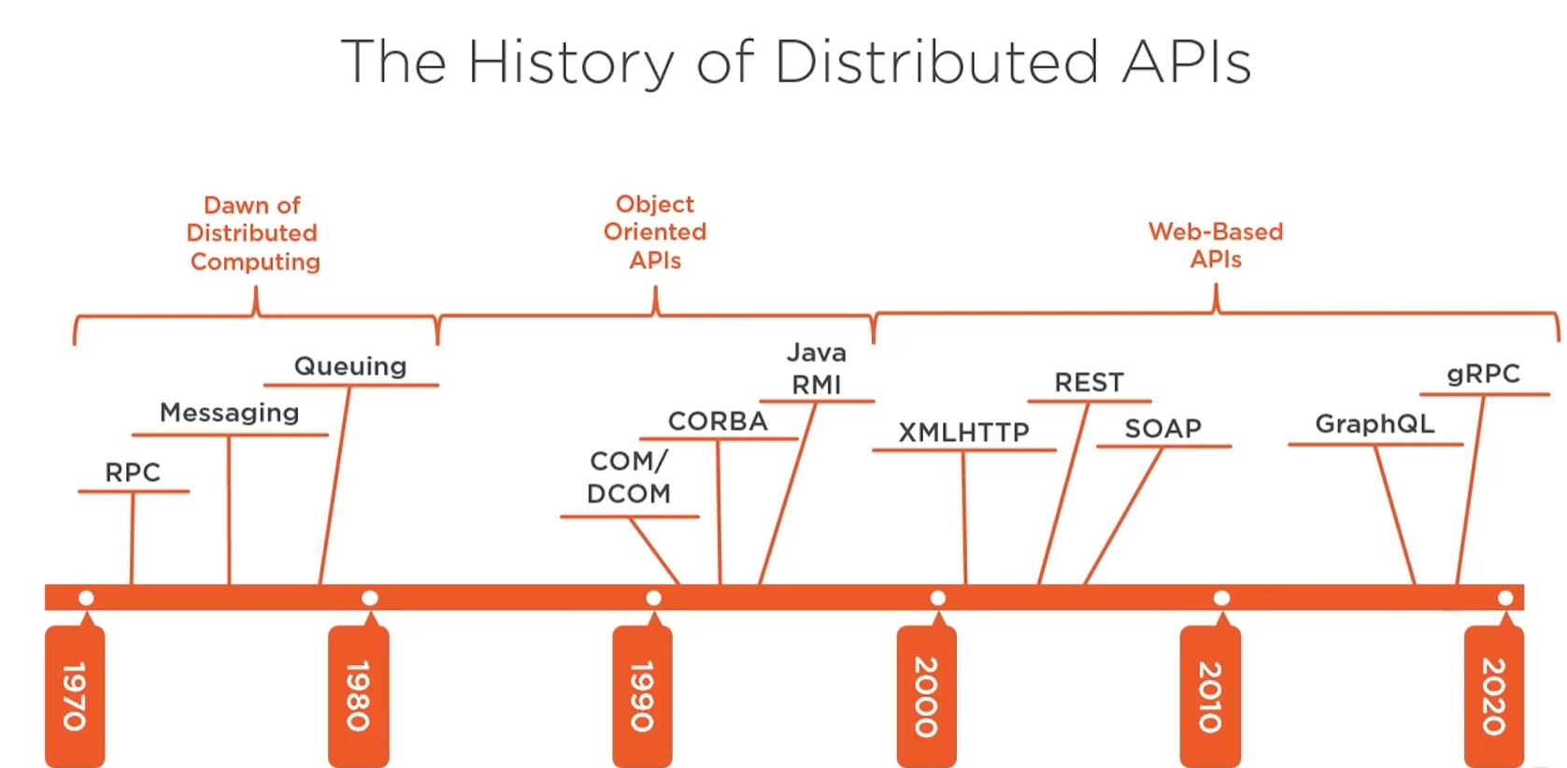

Slide 9
What is gRPC?
Binary communication
Contract-based
Available across ecosystems
Secure by default (requires HTTP/2, TLS, SSL)
Uni and Bi directional streaming
Notes:
One way or two way streaming

Slide 10
gRPC for the Web
HTTP/2 – most browsers don’t suport it yet
Binary format – harder for JS to parse
Required contracts – that’s not so great for Web apps

Slide 11
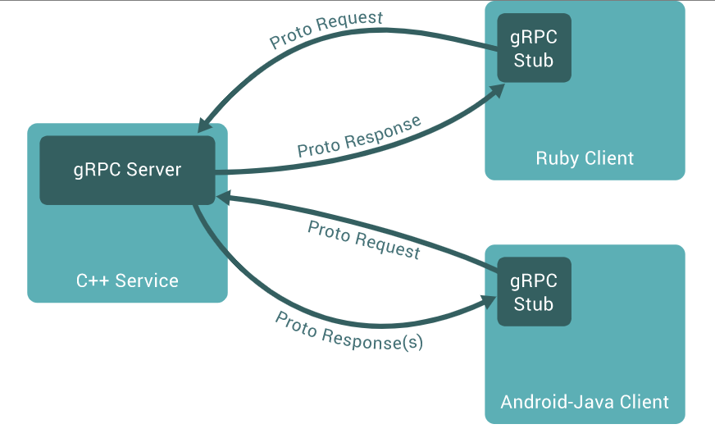
gRPC so where?
IoT
Containers
Service to service communication

Slide 12
Contracts
Generated clients/servers
Uses interface definitione language Protocol Buffers (ProtoBuf)
Language independent
message Person
{
string name = 1;
int32 id = 2;
bool has_ponycopter = 3;
}
https://docs.microsoft.com/en-us/aspnet/core/tutorials/grpc/grpc-start?view=aspnetcore-3.1&tabs=visual-studio

Slide 13
// The greeter service definition.
service Greeter {
// Sends a greeting
rpc SayHello (HelloRequest) returns (HelloReply) {}
}
// The request message containing the user's name.
message HelloRequest {
string name = 1;
}
// The response message containing the greetings
message HelloReply {
string message = 1;
}

Slide 14
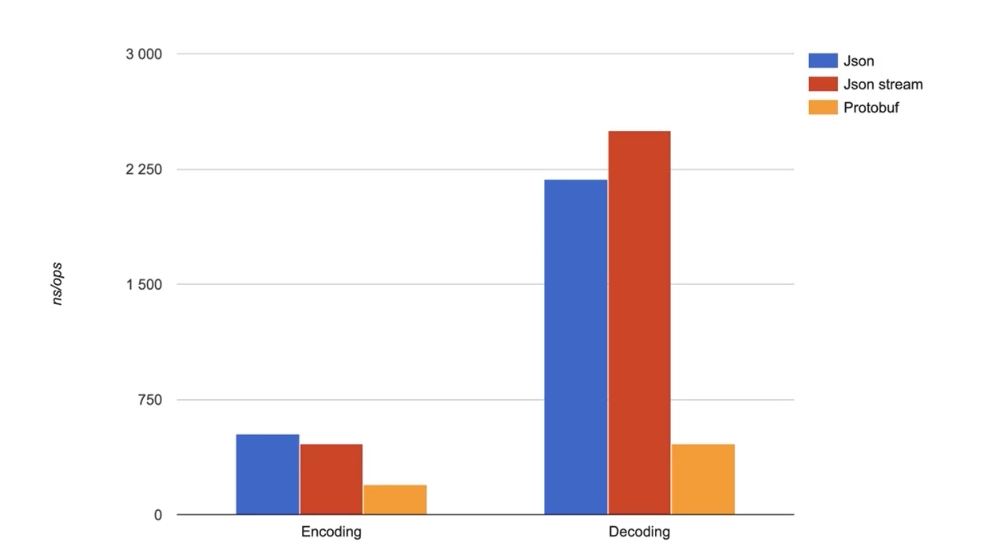
ProtoBuf is fast

Slide 15
Example .NET
syntax = "proto3";
option csharp_namespace = "GrpcExampleService";
package johoot;
// The greeting service definition.
service QuizeDefinition {
rpc SayHello (HelloRequest) returns (HelloReply);
rpc GetQuizeByID (QuizeIdMessage) returns (QuizeMessage);
rpc CreateQuize (QuizeMessage) returns (QuizeIdMessage);
}
// The request message containing the user's name.
message HelloRequest {
string name = 1;
}
message QuizeIdMessage{
int64 id = 1;
}
message QuizeMessage{
int64 id =1;
string name=2;
string description =3;
repeated QuestionMessage QuestionList =4;
}
message QuestionMessage{
int64 id = 1;
string text =2;
map<bool, string> answers = 3;
}
// The response message containing the greetings.
message HelloReply {
string message = 1;
}
syntax = "proto3";
option csharp_namespace = "GrpcExampleService";
package johoot;
// The greeting service definition.
service QuizeDefinition {
rpc SayHello (HelloRequest) returns (HelloReply);
rpc GetQuizeByID (QuizeIdMessage) returns (QuizeMessage);
rpc CreateQuize (QuizeMessage) returns (QuizeIdMessage);
}
// The request message containing the user's name.
message HelloRequest {
string name = 1;
}
message QuizeIdMessage{
int64 id = 1;
}
message QuizeMessage {
int64 id =1;
string name=2;
string description =3;
}
// The response message containing the greetings.
message HelloReply {
string message = 1;
}
Spacing matters
Many methods in one service
Simple types

Slide 16
ASP.NET Core configuration
public void ConfigureServices(IServiceCollection services)
{
services.AddGrpc();
}
public void Configure(IApplicationBuilder app, IWebHostEnvironment env)
{
if (env.IsDevelopment())
{
app.UseDeveloperExceptionPage();
}
app.UseRouting();
app.UseEndpoints(endpoints =>
{
endpoints.MapGrpcService<QuizeDefinitionService>();
endpoints.MapGet("/", async context =>
{
await context.Response.WriteAsync("Communication with gRPC endpoints
must be made through a gRPC client. To learn how to create a client,
visit: https://go.microsoft.com/fwlink/?linkid=2086909");
});
});
}

Slide 17
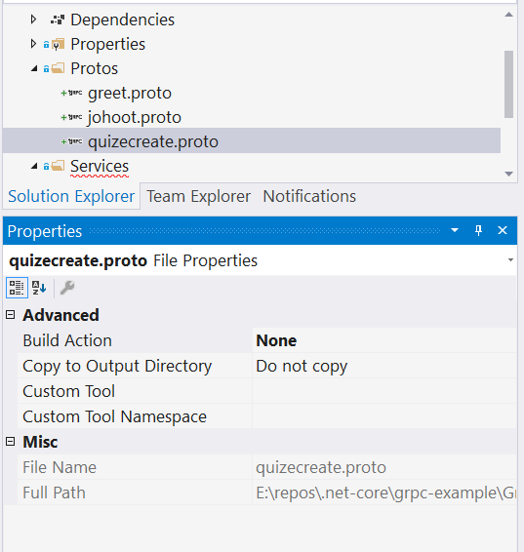
Add proto
Adding new file is not telling DotNet that it’s gRPC
https://docs.microsoft.com/en-us/aspnet/core/tutorials/grpc/grpc-start?view=aspnetcore-3.1&tabs=visual-studio

Slide 18
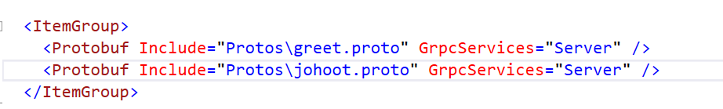
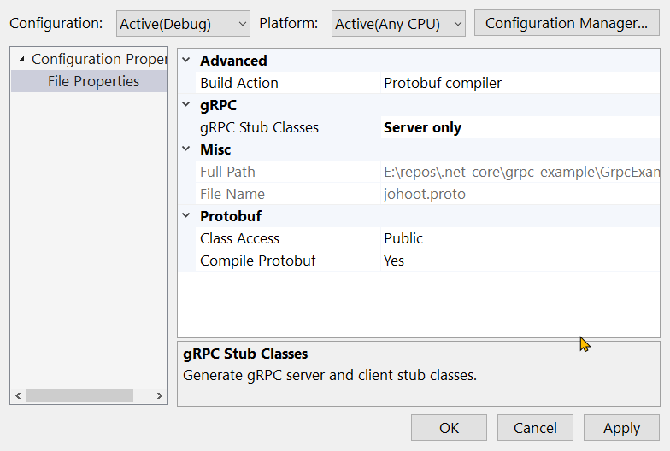
Introduce gRPC to generate classes

Slide 19
Other types
message QuizeMessage{
int64 id =1;
string name=2;
string description =3;
repeated QuestionMessage QuestionList =4;
}
message QuestionMessage{
int64 id = 1;
string text =2;
map<bool, string> answers = 3;
}
var result = new QuizeMessage
{
Id = 19,
Name = "Bla bla quize",
Description = "some more bla bla ",
QuestionList =
{
new QuestionMessage {
Id=21,
Text="question1"},
new QuestionMessage {
Id=23,
Text="question3",
Answers={
{true,"this is good" },
{ false, "this is not so good"}
}
},
}
};

Slide 20
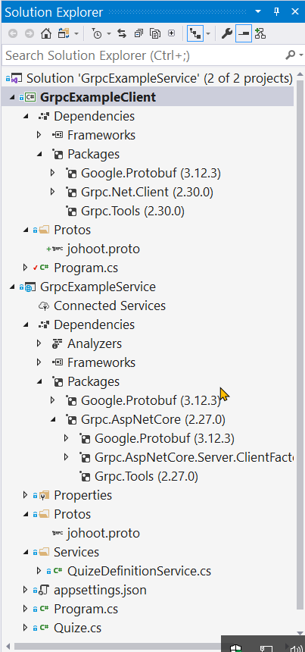
gRPC Client
Any app – here ConsollApp
Include *.proto files
Nugget
Install-Package Grpc.Net.Client
Install-Package Google.Protobuf
Install-Package Grpc.Tools

Slide 21
gRPC Client call service
class Program
{
static void Main(string[] args)
{
Console.WriteLine("Hello World!");
// The port number(5001) must match the port of the gRPC server.
var channel = GrpcChannel.ForAddress("https://localhost:5001");
var client = new QuizeDefinition.QuizeDefinitionClient(channel);
var request = new QuizeIdMessage { Id = 1 };
var reply = client.GetQuizeByID(request);
Console.WriteLine($"{reply.Id}, {reply.Name}, {reply.Description}");
Console.WriteLine("Press any key to exit...");
Console.ReadKey();
}
}
}

Slide 22
GraphQL

Slide 23
Notes:
https://devblogs.microsoft.com/odata/experimenting-with-odata-in-asp-net-core-3-1/

Slide 24
Comparition

Slide 25
Matching communication to technology
REST: CRUD and purely web apps
SignalR: Multicasting and web messaging
GraphQL: Open querying of large datasets
OData: Open querying relational data
gRPC: Streaming, low resource clients, inter- data center
Notes:
https://devblogs.microsoft.com/odata/experimenting-with-odata-in-asp-net-core-3-1/

Slide 26
REST + .NET Core

Slide 27
Additional ASP.NET Core Benefits for REST APIs
Endpoint routing - defining URLs
Support for HTTP verbs
Model binding
Content negotiation (JSON, XML, …)
Middleware / action filters
OAuth 2.0 support

Slide 28
Additional ASP.NET Core Benefits for REST APIs
Conventions
[ApiController]
ActionResult<T>
Convention definitions
Roslyn analyzers
Swagger support
SPA authentication with Identity Server

Slide 29
Production-ready APIs?

Slide 30
Best practices
IActionResult, ActionResult<T>
View Models
Model / input validation
Exception handling
Logging
Paging

Slide 31
Security
HTTPS
OAuth 2.0
JWT token based authentication
Access grant with PKCE recommended
Identity Server 4.0
https://identityserver.io/
Third party
Auth0 - https://auth0.com/
Okta - https://developer.okta.com/
…

Slide 32
Testing
Unit testing
Integration testing
Manual testing
Tools (Postman, Insomnia, Fiddler, …)
Stress / load testing
https://loader.io/
https://artillery.io/
https://gatling.io/
http://websurge.west-wind.com/

Slide 33
Documentation
http://swagger.io/ -> https://www.openapis.org/
Swagger -> Open API Specification 3.0
API framework
Docs
Define an API
Automate API testing
Code generation
...
Swashbuckle or NSwag and Swagger UI
Notes:
API Analyzers - Microsoft.AspNetCore.Mvc.Api.Analyzers

Slide 34
Usage limiting
Limit per token
With middleware or action filter
https://github.com/stefanprodan/AspNetCoreRateLimit
Limit per Client IP
Limit per Client ID header

Slide 35
Versioning
URL, also with namespacing
/api/v2/games/
Query string
/api/games?api-version=2
Custom request header
api-version: 2
Accept header
Accept: application/json;v=2
Microsoft.AspNetCore.Mvc.Versioning
Supports all types, query string by default (?api-version=2)

Slide 36
Monitoring
Simple logging – errors, logs
Performance tracking
Usage tracking
Azure – Azure Monitor, Application Insights, Log Analytics …
ASP.NET Core Health Checks
https://github.com/Xabaril/AspNetCore.Diagnostics.HealthChecks/
Third-party monitoring services
https://newrelic.com/
https://stackify.com/
https://www.monitis.com/
https://www.runscope.com/
…

Slide 37


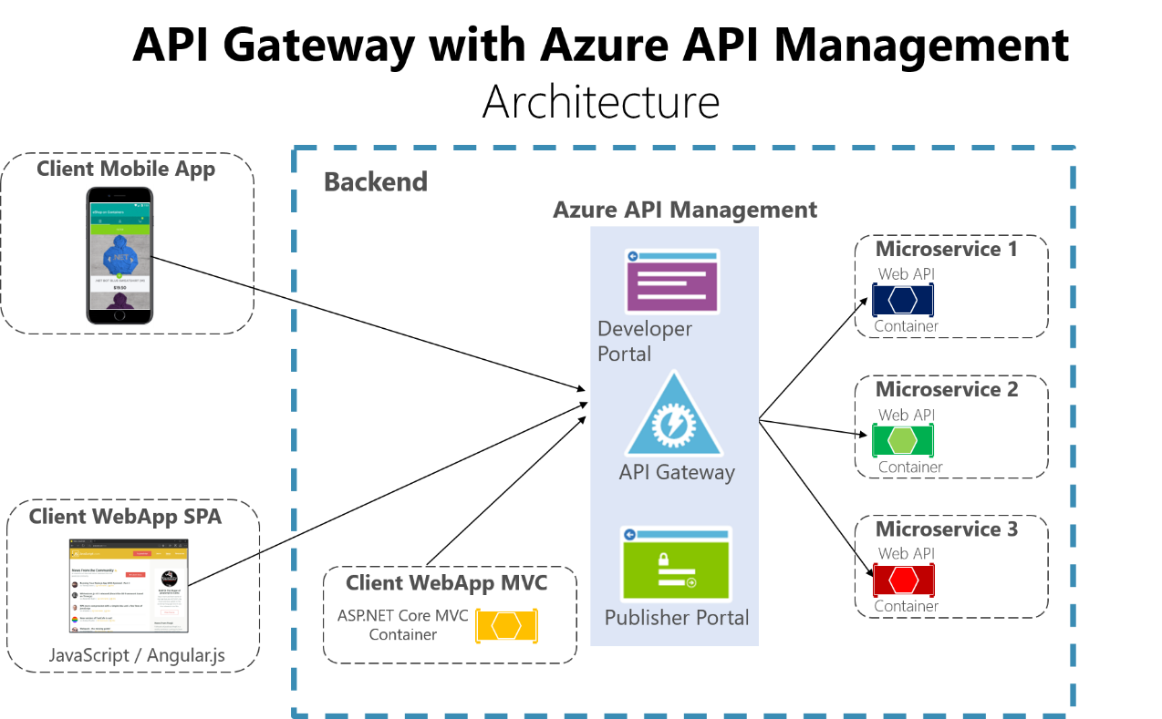
API Gateways
Features
Routing
Request Aggregation
Service Discovery with Consul & Eureka
Service Fabric
Kubernetes
WebSockets
Authentication
Authorisation
Rate Limiting
Caching
Retry policies / QoS
Load Balancing
Logging / Tracing / Correlation
Headers / Query String / Claims Transformation
Custom Middleware / Delegating Handlers
Configuration / Administration REST API
Platform / Cloud Agnostic

Slide 38
Closing up

Slide 39
Summary
Basics – REST, ASP.NET Core
Best practices
Security
Testing
Documentation
Limiting
Versioning
Monitoring
API Gateways

Slide 40
Further reading
https://github.com/microsoft/api-guidelines
Specifications
HATEOAS – Hypermedia as the Engine of Application State
https://ionwg.org/ - The ION Hypermedia Type
http://jsonapi.org/ - JSON API Specification
http://json-schema.org/ - JSON (Hyper-)Schema...
http://graphql.org/ - GraphQL
APIs
https://dev.twitter.com/rest/public - Twitter REST
https://developer.github.com/v3/ - GitHub REST / v4 GraphQL
https://stripe.com/docs/api - Stripe
https://www.twilio.com/docs/api/rest - Twilio

Slide 41
Thanks! Questions?

