Slide 1
Logging
Notes:
So what is .NET?

Slide 2
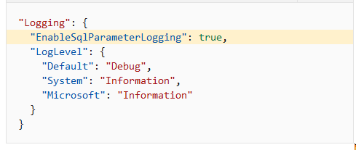


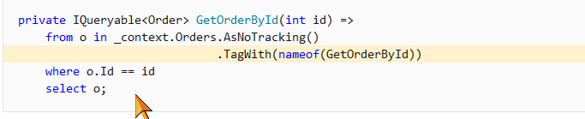
Enable SQL logging with EF
https://docs.microsoft.com/en-us/learn/modules/persist-data-ef-core/7-enable-sql-logging?pivots=linq
Notes:
https://docs.microsoft.com/en-us/learn/modules/aspnet-logging/

Slide 3
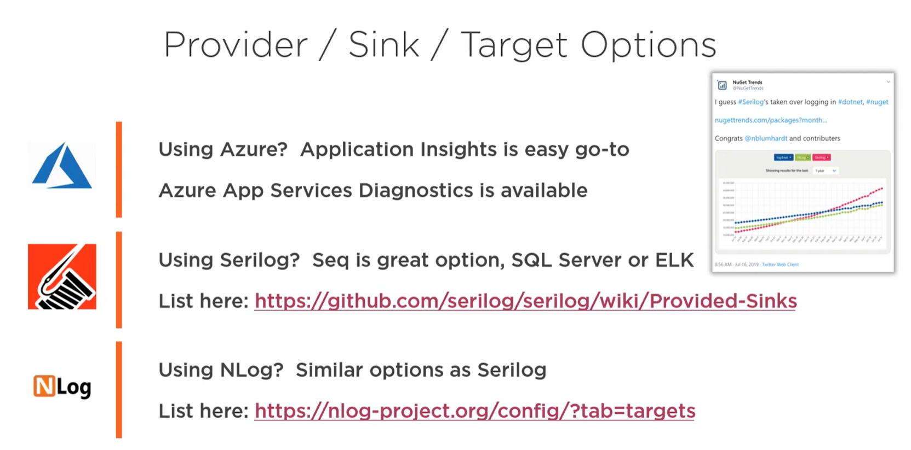

Slide 4
Thanks! Questions?

