Slide 1
Overview
Bias-Variance Tradeoff
Managing the Bias-Variance Tradeoff for Linear Regression
Subset predictors: Stepwise
Shrinkage/Regularization: Lasso, Ridge
Dimension Reduction: PCA (not covered today)

Slide 2
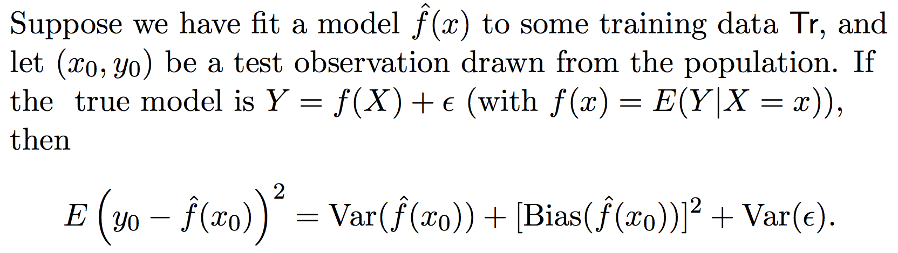
Bias-Variance Tradeoff
Ok….what is going on here?
Applies to modeling in general, beyond Linear Regression
Want your model to minimize the expected test MSE on LHS. But how?
Var(ε), or “Irreducible Error”. Can’t do anything about that!
Can reduce Variance
Can reduce Bias

Slide 3
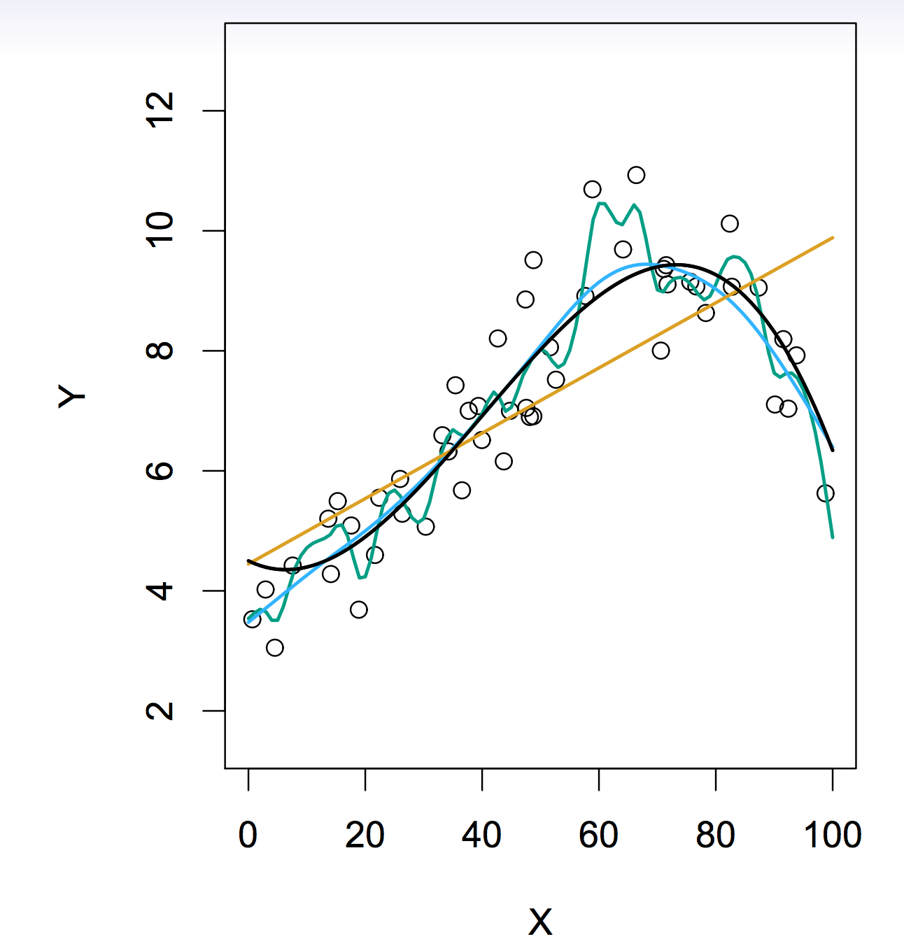
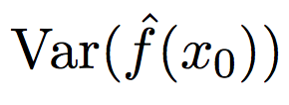

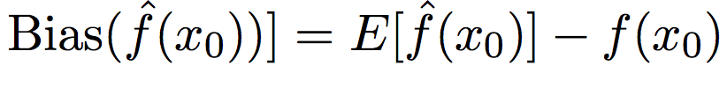
Bias-Variance Tradeoff
Amount by which would change if estimated it using a different training dataset
Difference between expected prediction of our model and correct value we are trying to predict
Generally speaking, the more flexible the model, the greater the variance.
Notes:
Green Line has high variance, low bias
Orange Line has low variance, high bias
Blue has it down

Slide 4
Managing the Bias-Variance Tradeoff with Linear Regression
Subset selection - choose subset of p predictors
I want to pare down my model, reducing the variance!
Regularization – keep p predictors, shrink coefficient estimates towards 0
(some variable selection for Lasso)
Dimension Reduction – Project p predictors into M-dim space where M < p

Slide 5
Subset Selection
Best subset: Try every model. Every possible combination of p predictors
Computationally intensive, especially for p large
Also, huge search space. Higher chance of finding models that look good on training data but have little predictive power on future data
Stepwise
In practice, what people do!
Forward, Backward, Forward + Backward

Slide 6
Subset Selection - Forward Stepwise
M0 → M1 → M2 → …. → Mp
+1 predictor with
smallest RSS ⬄ largest R^2
+1 predictor with
smallest RSS ⬄ largest R^2
Now we have p candidate models
Are RSS and R^2 good ways to decide amongst the p candidates?

Slide 7
Subset selection
Choosing among p candidate models…
Cross-validation - always a great standby
Mallow’s Cp
AIC
BIC
Adjusted R^2

Slide 8
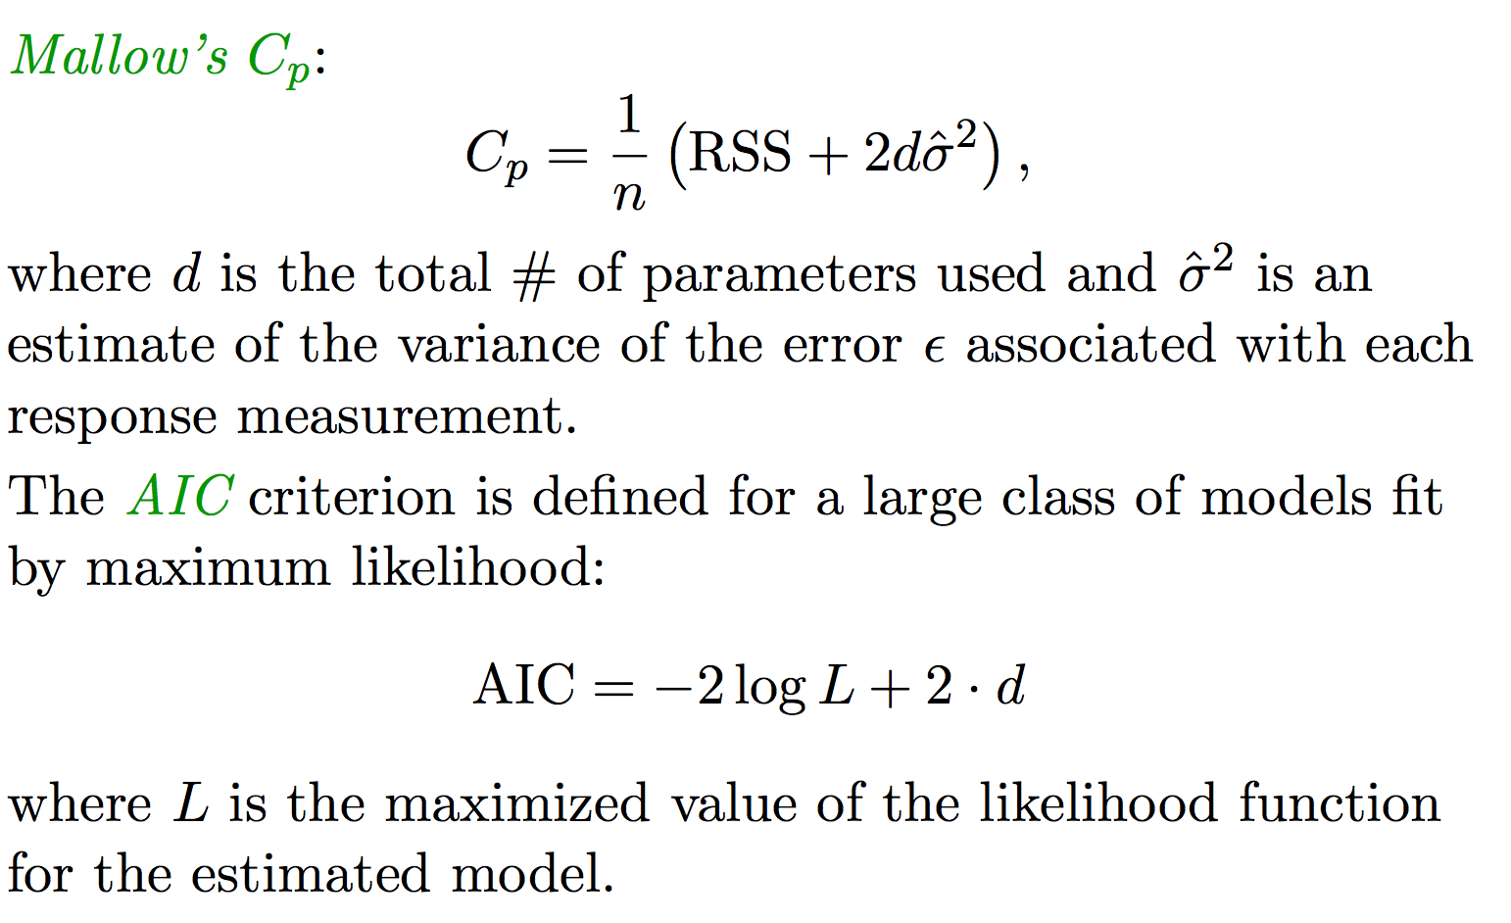
Subset selection
Can show AIC and Mallow’s Cp are equivalent for linear case

Slide 9
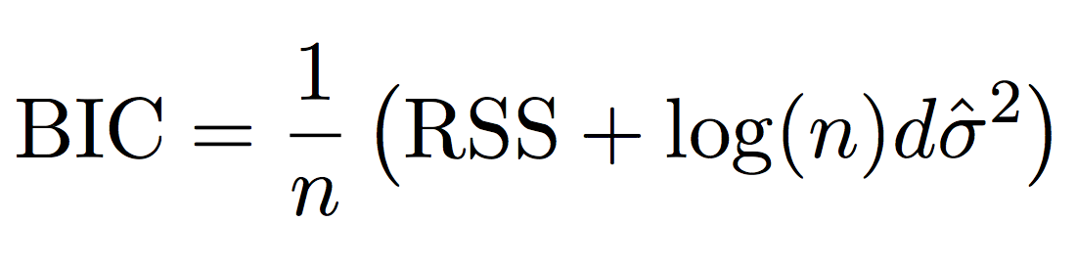
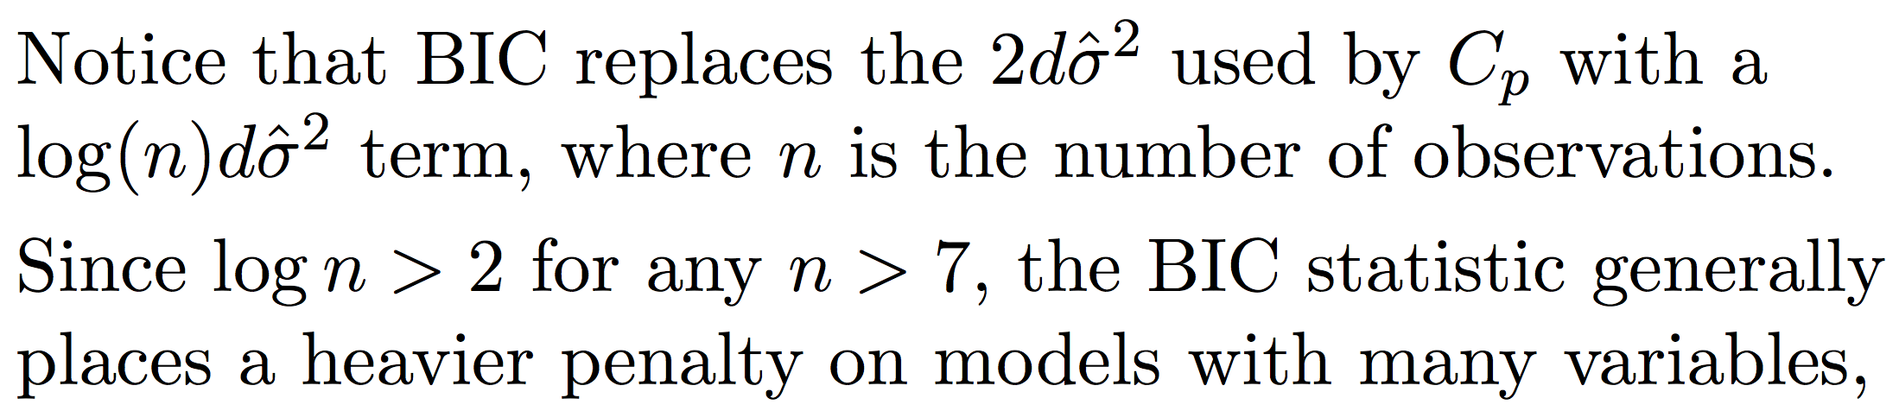

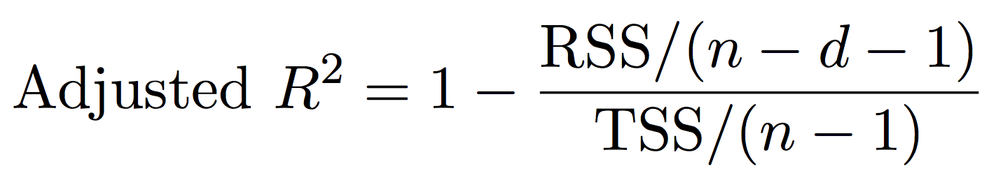
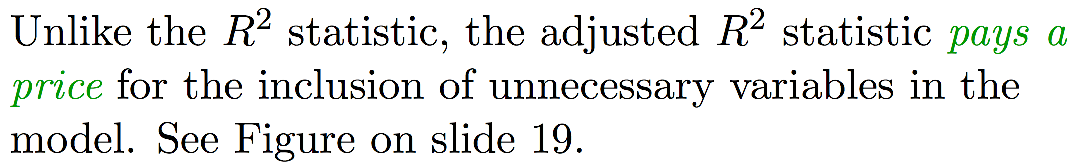
Subset selection
Notes:
As d increases,

Slide 10
Managing the Bias-Variance Tradeoff with Linear Regression
Subset selection - choose subset of p predictors
I want to pare down my model, reducing the variance!
Regularization – keep p predictors, shrink coefficient estimates towards 0
(some variable selection for Lasso)
Dimension Reduction – Project p predictors into M-dim space where M < p

Slide 11
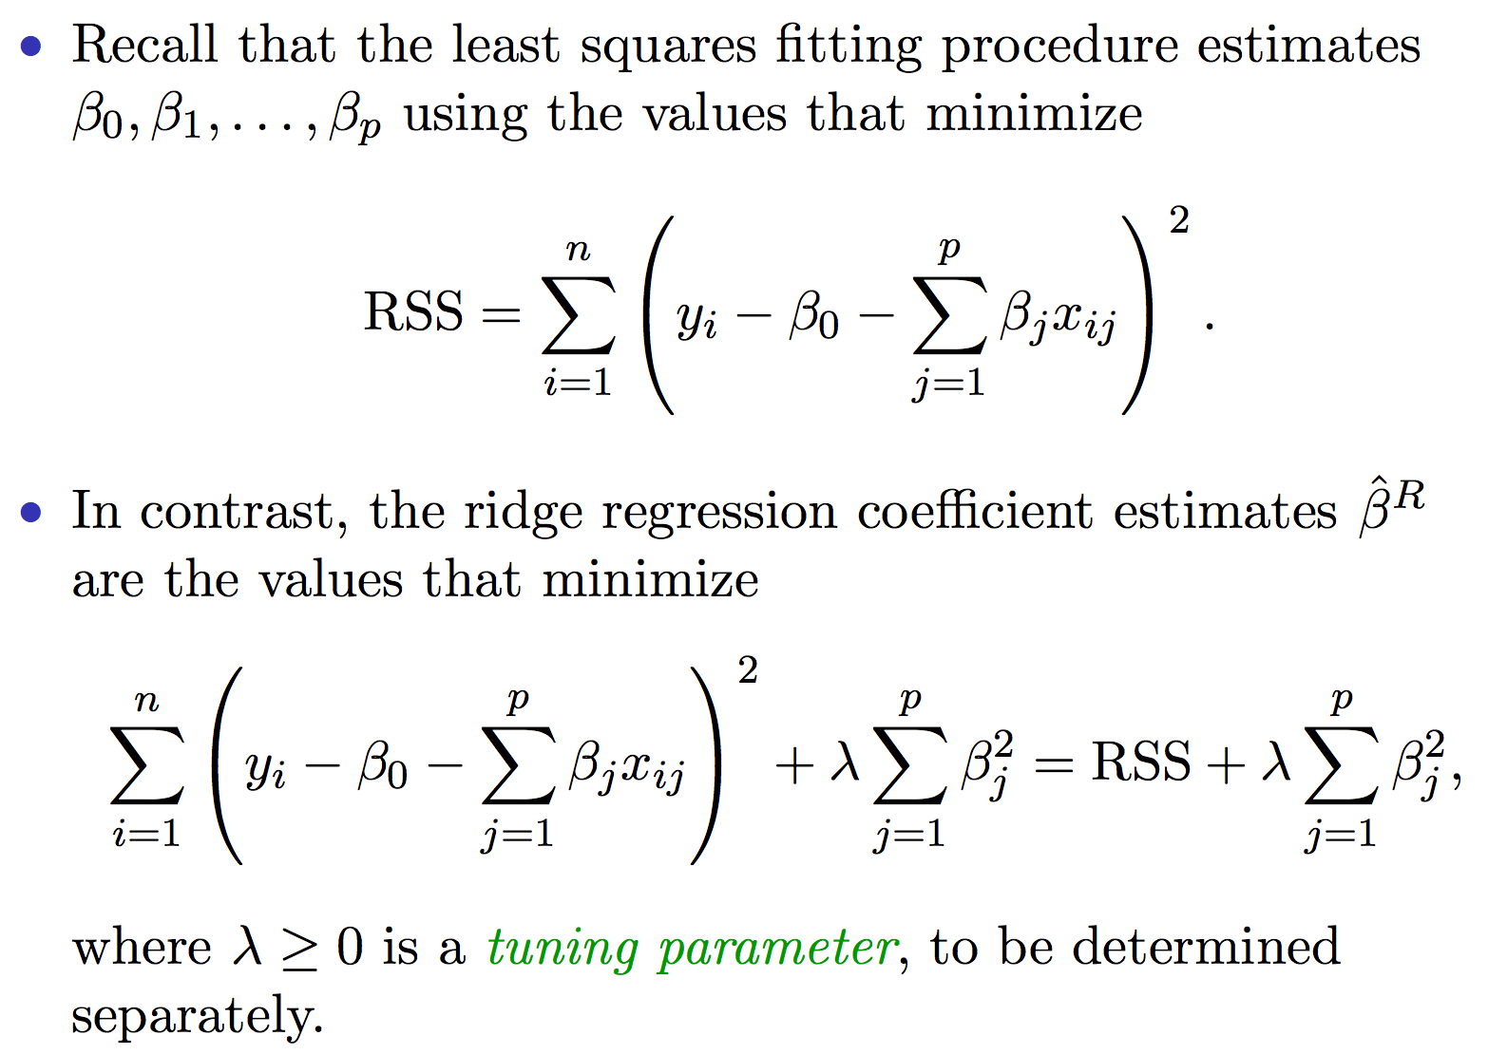
Regularization – Ridge regression

Slide 12
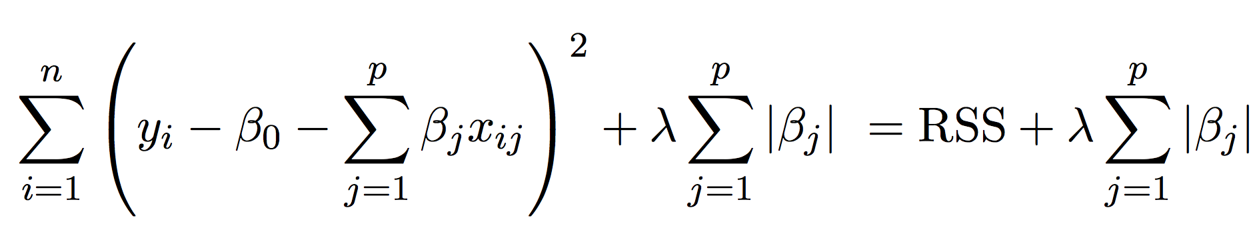
Regularization – Lasso regression

Slide 13
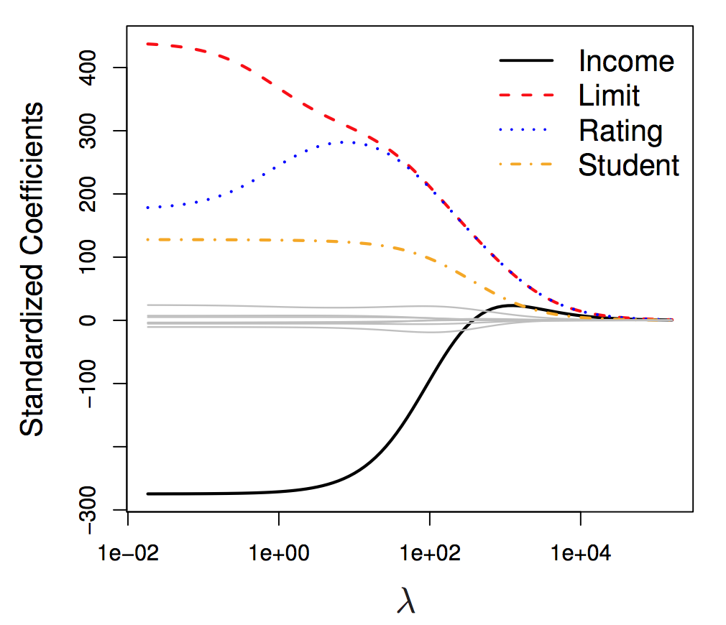
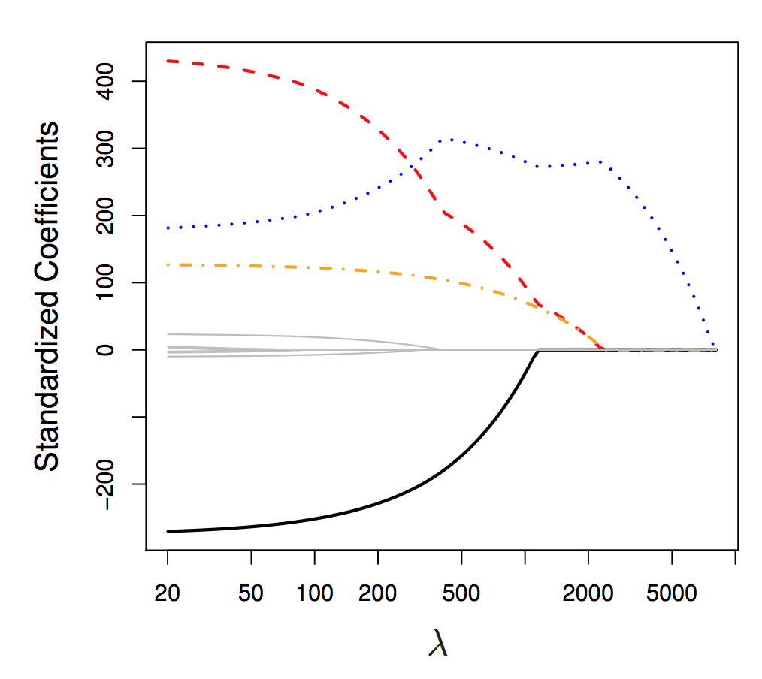
Ridge vs. Lasso
When λ = 0, we simply have linear models.
As λ increases, both models become less flexible, reducing variance, but increasing bias.
Lasso has the advantage of variable selection as well (especially nice when p is large)
Neither universally dominate, but in general one might expect Lasso to do better when response is function of relatively few predictors.
Of course you never actually know this, so use your friend, cross-validation!

Slide 14
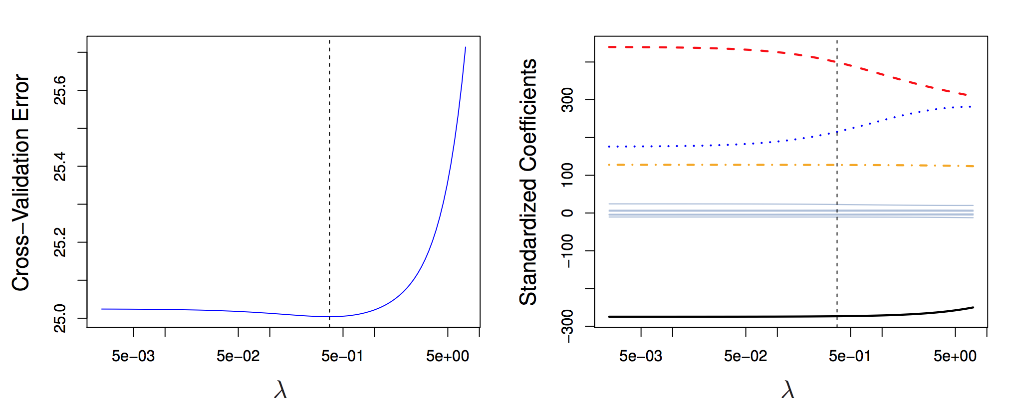
Choosing λ
Just increment λ along, fit a large number of models per increment, and choose λ which minimizes cross-validated error, and voila! You have your corresponding optimized model for Ridge Regression.

Slide 15
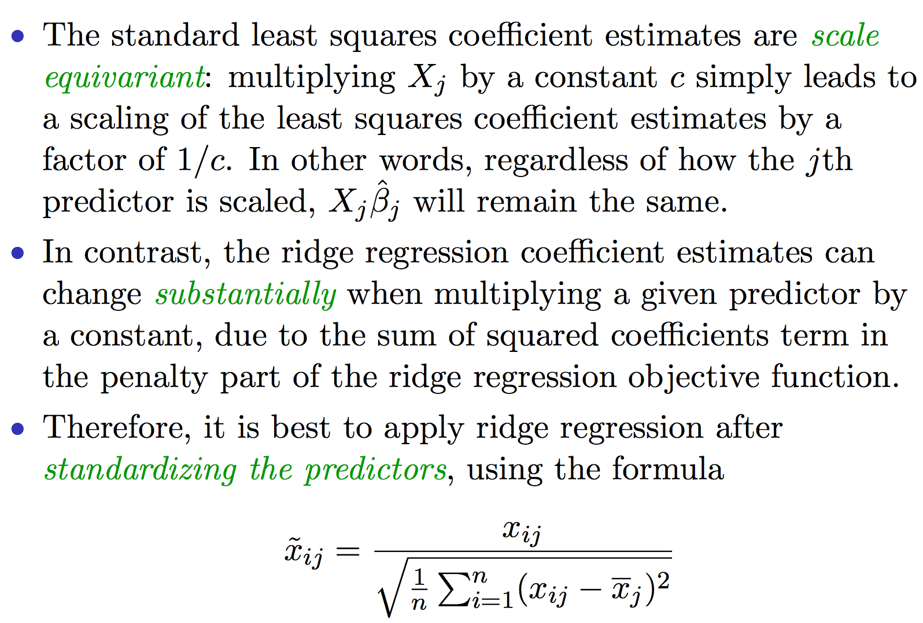
Don’t forget….

