Slide 1
My Automatic Presentation
Yeah, PowerPoint can be automated as well!

Slide 2
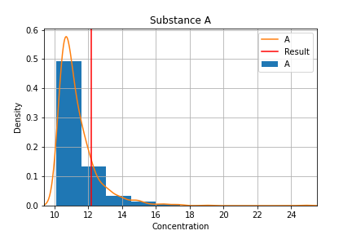
About substance A
Key points about A
Mainly...
Which is a concern

Slide 3
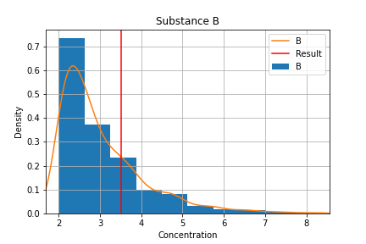
About substance B
Key points about B
Mainly...
Which is a concern

Slide 4
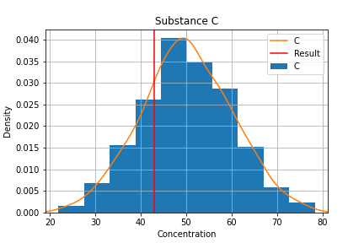
About substance C
Key points about C
Mainly...
Which is a concern

