Slide 1

Data Techniques for Engineers and Scientists
J.D. Landgrebe
Dept. of Chemical Engineering
University of Delaware

Slide 2
Lecture Outline Temp
Baseline Software for engineering work – data analysis and modeling
Exercise: install Anaconda/run intro to Pandas
Understand available Python packages for general work (and understand Anaconda interaction with them)
Nomenclature and data architecture for experiments
What is experiment Curation?
Data reshaping techniques Joining and summarizing an experiment –
Exercise with JMP Tables menu – Join, Concatenate
Parsing raw data – Exercise
Work a case study of analyzing an experiment – TBD based on Will input

Slide 3

Software for Engineers
Pick software by “use case” and use each software in its “lane” where it is best tool for the job
“Use cases” start with “I need to…” (or “my customer needs to…”)
My supervisor needs to be able to scroll through our raw data to understand the results
I need to create a correlation matrix for my raw material’s quality data
I need to build a validated calculation model for reaction kinetics
Use case focus
Avoids getting (yourself and others) distracted by things that software X is not good at – there is no perfect software tool
Puts a premium on making data portable across applications

Slide 4

“Top Level, Generalist” Software Recommendations by Use Case
JMP® software - design of experiments (DOE), exploratory analysis and data visualization with accompanying statistical analysis
Microsoft Excel® - make data democratically usable by others, generate “end of the pipeline” reports and for create spreadsheet models with calculations for use by non-coders
Python scripts for data reshaping and for developing coded models and data pipelines (possibly mixing in a little SQL)
https://datadelveengineer.com/the-right-modeling-and-analysis-tools-for-the-job/

Slide 5

Additional Software Recommendations
Python scripting tools - build model and data cleaning scripts
JupyterLab (Anaconda)
VS Code script and text editor
Github Copilot and Chat extensions VS Code ($$)
VBA Scripting Language – Excel automation
Advanced visualizations – Python Matplotlib
Github - Open sharing of projects, trainings etc.

Slide 6





Python Libraries to Extend Functionality
Useful Python libraries for Engineers and Scientists
You can get these with Anaconda installation!!
Pandas – Data reshaping and analysis
Numpy – Numerical calculations
Pytest – Test/Validate your scripts
OpenPyXL – Format outputs in Excel
Re (Regular Expressions aka Regex) – Parse text strings

Slide 7
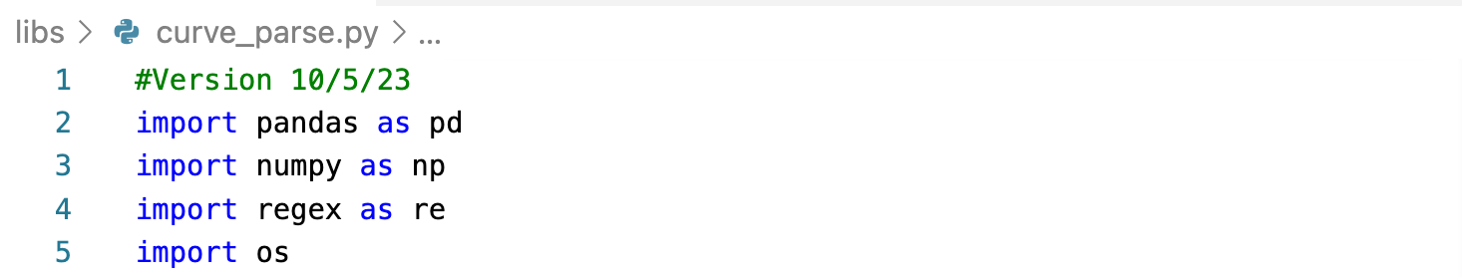
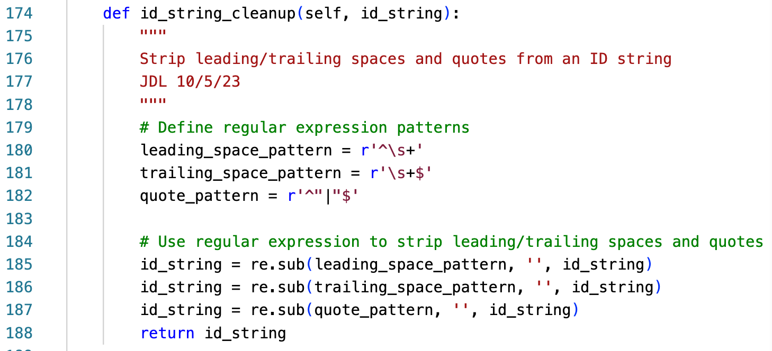
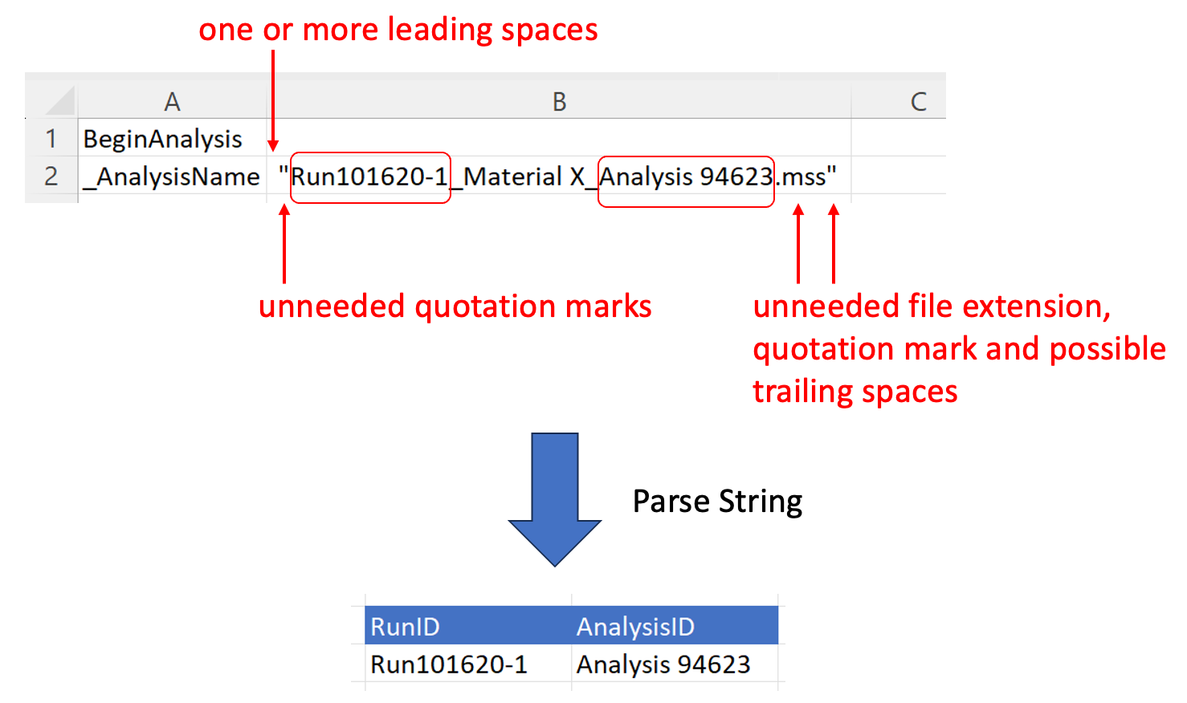
Example: Python Regex Package to Extract Strings
Lab instrument software outputs IDs in string needing cleanup
regex Python package can strip out unneeded quotation marks, spaces and (not shown) file extension
(Not shown) Either regex or Python split() command can break the string into pieces using underscore characters as delimiters
Regex code for ”zero or more spaces at beginning of string”
(“ChatGPT pls help!!”)

Slide 8
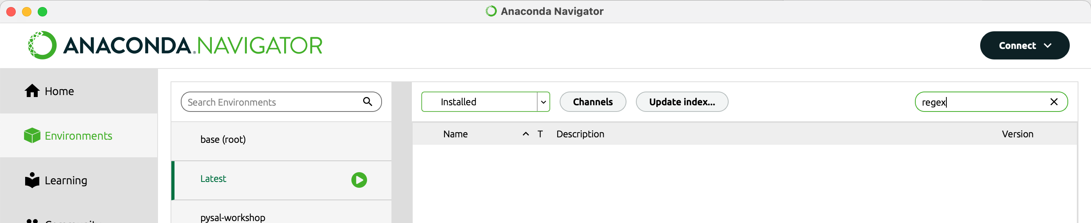
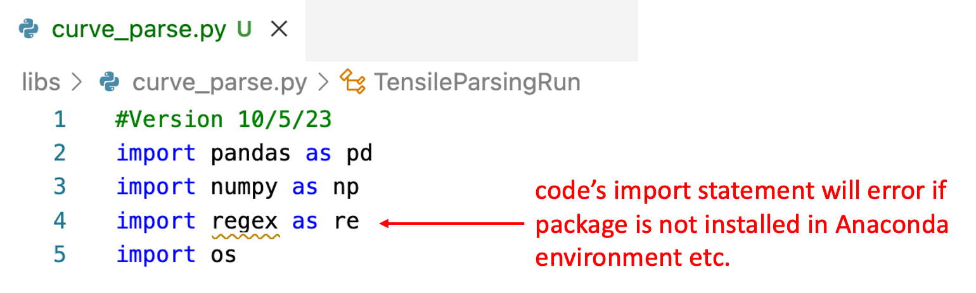
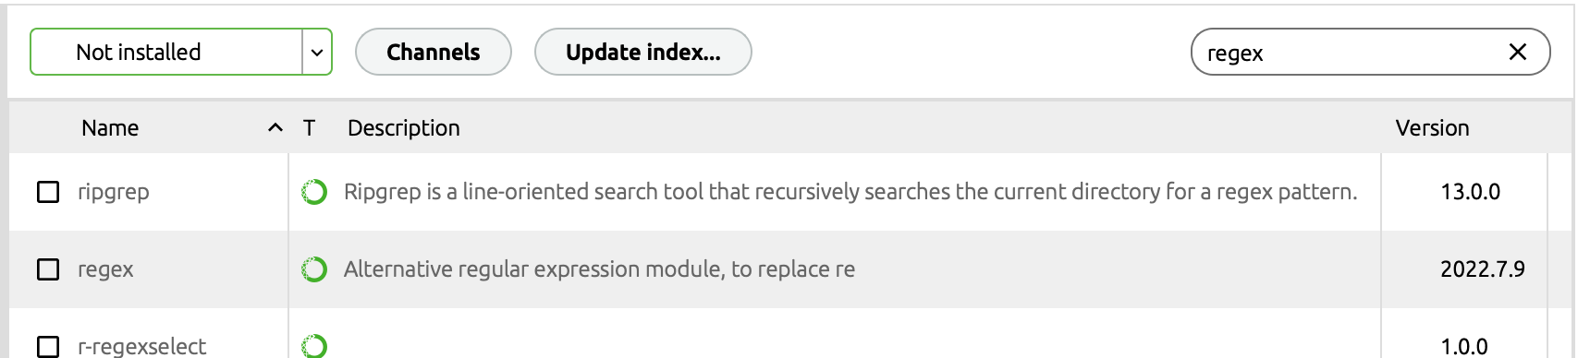
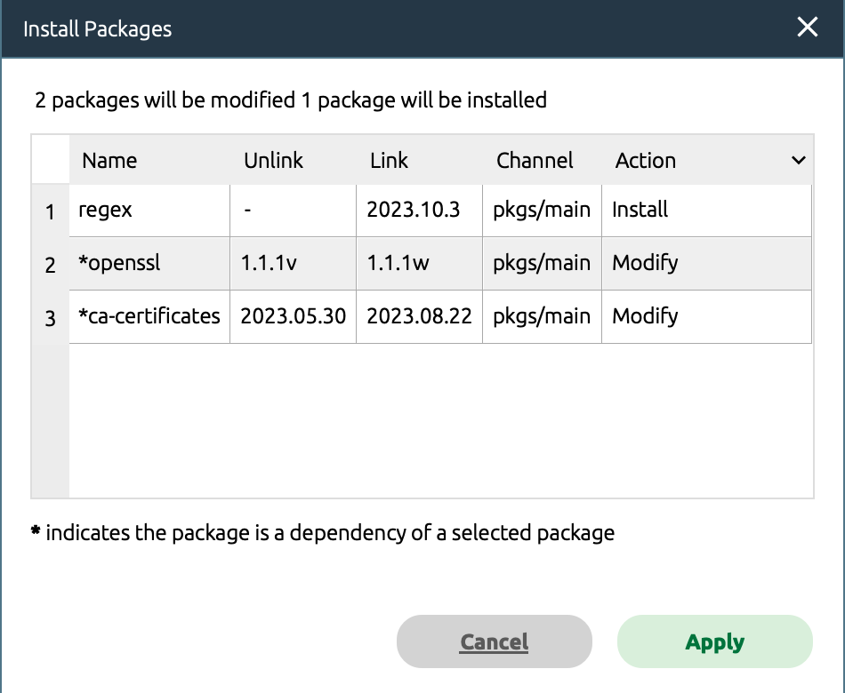
Installing Packages (AKA Libraries) In Anaconda
1
1a
=
** regex is not Installed in environment named “Latest” **
2
3
Anaconda selects related (aka “dependent”) packages needed by the selected package

Slide 9

Objectives
Experiments* have a common data structure (we will call it “architecture”).
Recognizing this lets us master common data techniques to analyze efficiently and have data in good formats for graphing
Objectives
Learn reusable terms for the data elements from experiments
Learn how use common software to do needed transformations to go from raw data to analyzed summary
Learn how to “curate” experimental data to make it easy to find and share
* Data don’t know whether they were generated in a lab or virtual experiment, so this applies to computer modeling data and physical experiments

Slide 10
What are Experiments?
Experiments Cover An amazing range for engineers and scientists!
Make a production or lab-scale batch of several product formulations
Run a packing line using pre-set conditions for a set amount of time
Crash a sensor-equipped car into a wall
Diaper a baby with several product designs
Drive a F1 car around a track with several various fuel mixtures
Ask a man to shave his face with 3 different types of razors on consecutive days
Make batches of cookies with different types of chocolate
Wash test, fabric swatches with different detergent formulations
Use different catalysts to run a chemical conversion with the same starting materials
Use PCR to replicate and sequence the DNA from multiple virus samples
Mop floors with mops using different cleaning solutions
Surgically implant artificial joints using different polymeric coatings

Slide 11

What Do these have in common?
Experiments (or ”studies”…we will use synonymously) are a building block for designing and confirming products.
Experiments have “runs” consisting of one or more conditions having controlled inputs such as the starting materials and test conditions
Each run can be described by a list of the “run variable” values which are the pre-set inputs and important ambient conditions recorded during the run.
Experiments generate “raw data” consisting of the original measurements to assess what happened (detailed speed versus time data for F1 car circuit around a track)
The raw data gets converted to “parameterized data” which is quantities reflecting the outcome (average speed for a complete track circuit)
The run variable values can be assembled into a “run matrix” with a row of values for each run

Slide 12
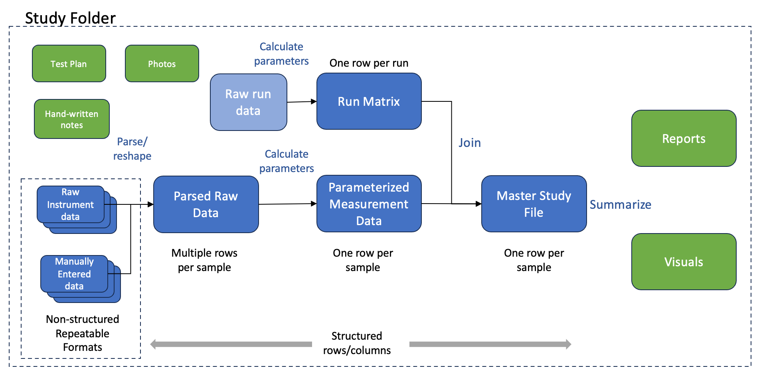
Experiment Data “Architecture”

Slide 13

Why does “Nomenclature” matter?
It is reusable ”lens” that you can use in any context
Identifies efficient, generic ways of converting the Run Matrix and Raw Data into analyzed data and conclusions
Parsers to convert raw data to structured tables
“Join” and “Concatenate” to bring data together into a “Master Study File”

