Slide 1
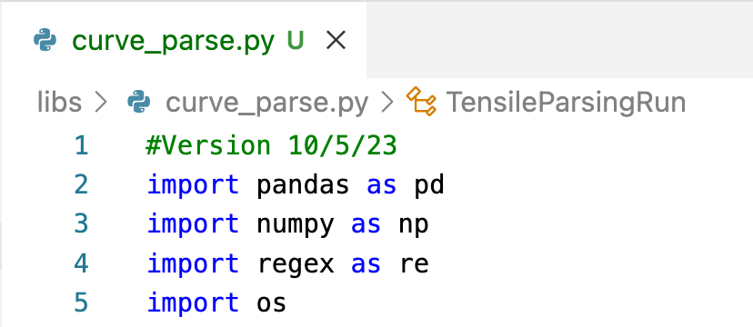
code’s import statement will error if package is not installed (in Anaconda environment etc.)

Slide 2
Study Folder
Test Plan
Photos
Calculate parameters
One row per run
Raw run data
Run Matrix
Hand-written notes
Reports
Parse/ reshape
Join
Calculate parameters
Raw Instrument data
Parsed Raw Data
Parameterized Measurement Data
Master Study File
Summarize
Multiple rows per sample
One row per sample
One row per sample
Visuals
Manually Entered data
Non-structured Repeatable Formats
Structured rows/columns

Slide 3
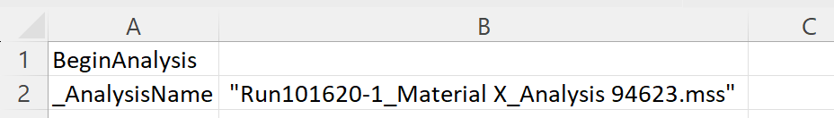

one or more leading spaces
unneeded quotation marks
unneeded file extension,
quotation mark and possible
trailing spaces
Parse String

