Slide 1
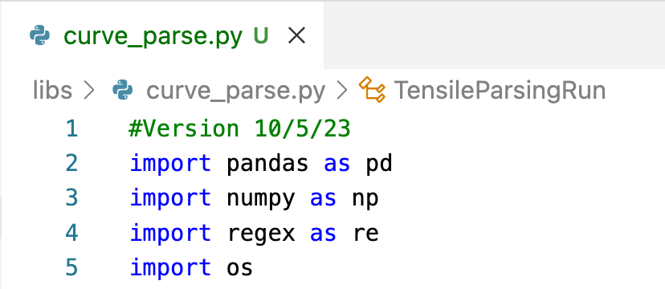
code’s import statement will error if package is not installed (in Anaconda environment etc.)

Slide 2
Study Folder
Calculate parameters
Photos
One row per run
Test Plan
Raw run data
Run Matrix
Database downloads
Report
Parse/ reshape
Join
Calculate parameters
Raw Instrument data
Parsed Raw Data
Parameterized Measurement Data
Master Study File
Summarize
Lab Sampling Plan
Visuals
Multiple rows per sample
One row per sample
One row per sample
Manually Entered data
Hand-written notes
Non-structured Repeatable Formats
Structured rows/columns

Slide 3
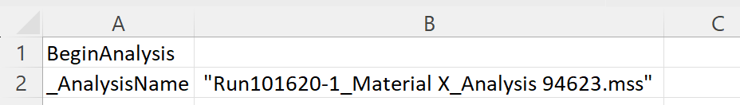

one or more leading spaces
unneeded quotation marks
unneeded file extension,
quotation mark and possible
trailing spaces
Parse String

Slide 4
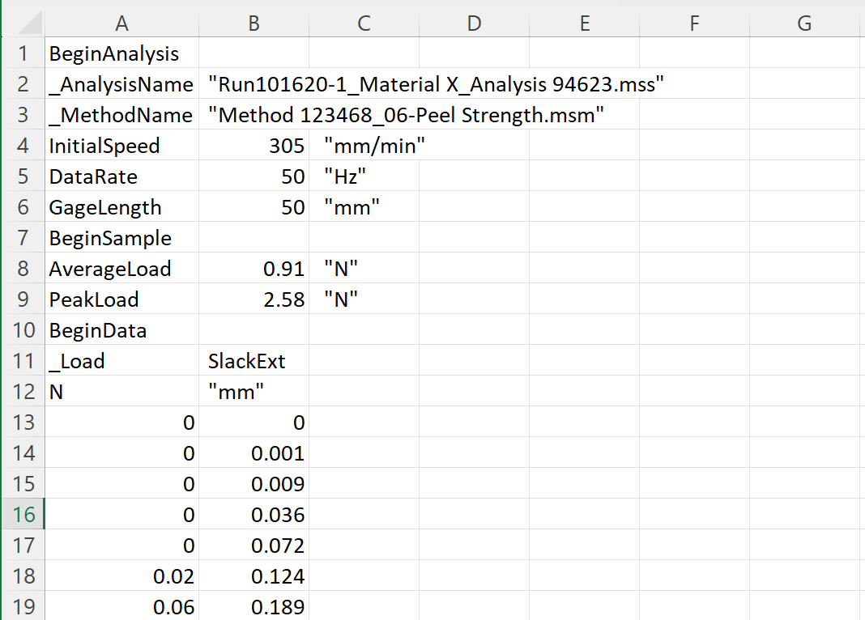
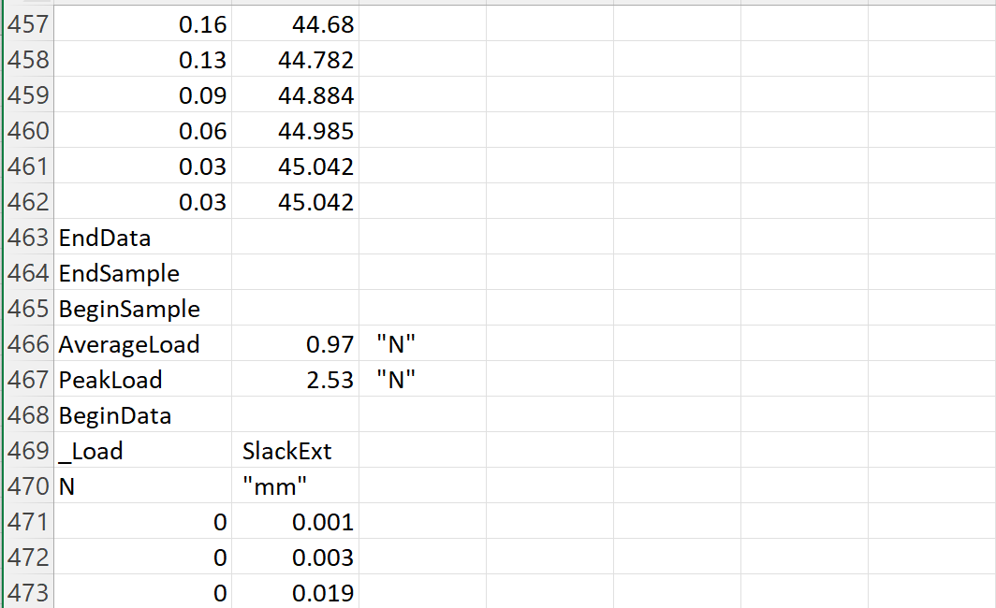
File header with metadata for Run
AnalysisID
RunID
Sample 1
Calculated parameter results for Sample 1
Load versus Extension data for Sample 1
Sample 2
Calculated parameter results for Sample 2
Etc.

Slide 5
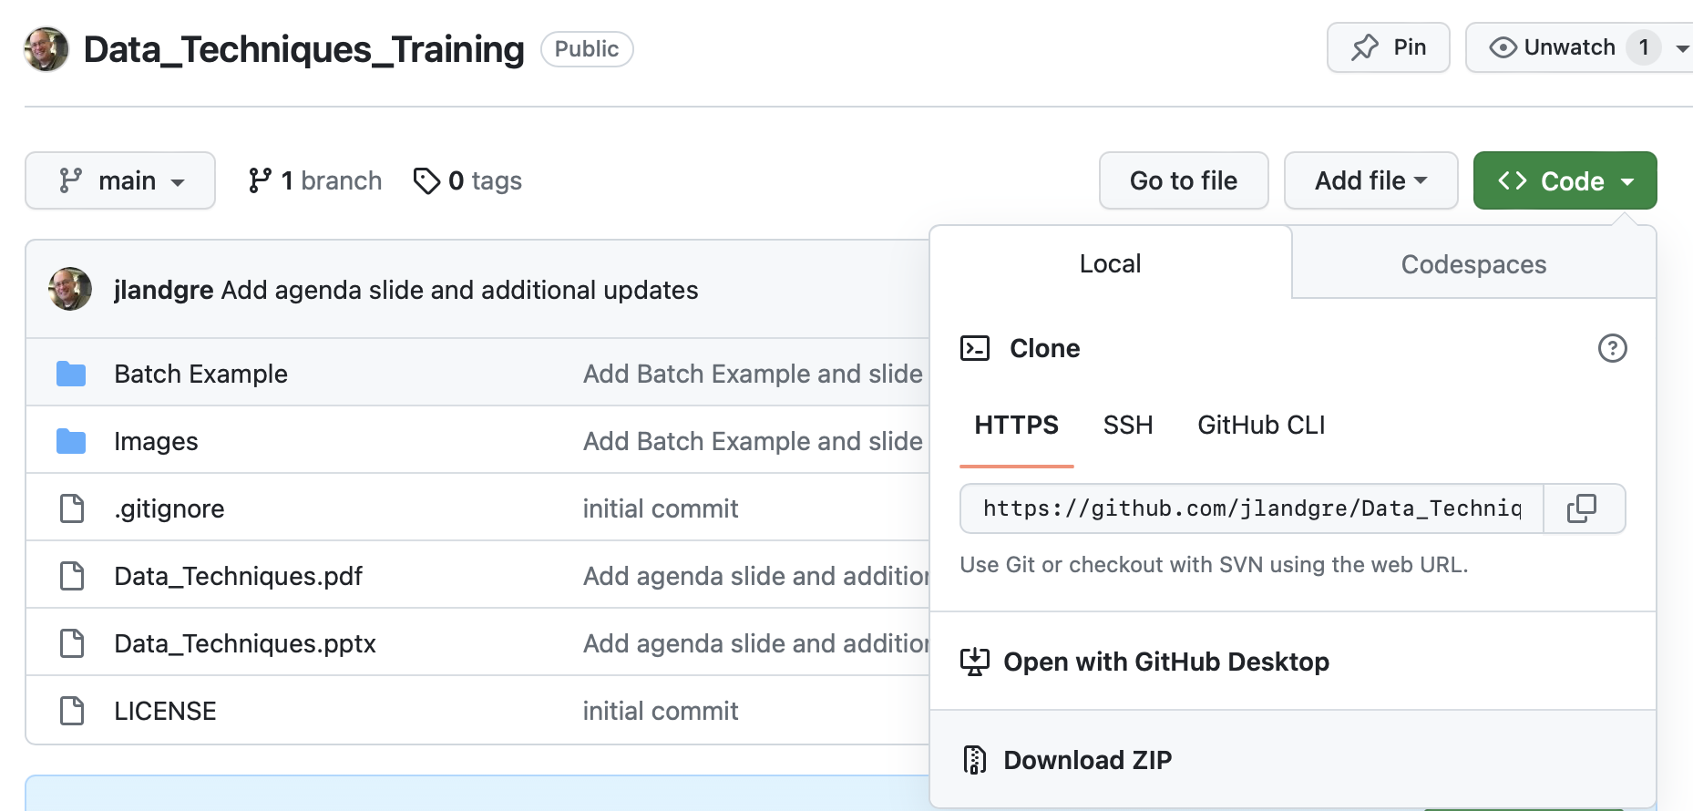
1
2

Slide 6

Don’t Overuse Jupyter Notebooks

