Slide 1

Building Robust and Collaborative Coded Engineering Models
J.D. Landgrebe, Data-Delve LLC
jdlandgrebe@data-delve.com
Former Principal Engineer, Procter and Gamble Co. Inc.
Colloquium on occasion of Professor Sotiris Pratsinis retirement
Particle Technology Laboratory. Department of Mechanical & Process Engineering, ETH Zürich, Switzerland
February 26, 2025

Slide 2
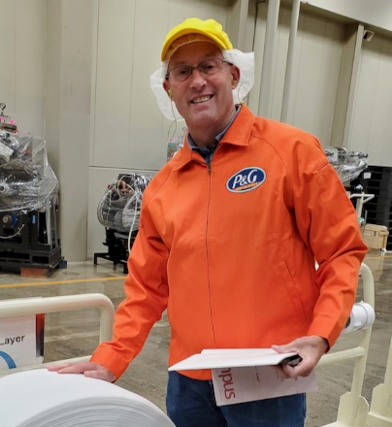


Intro
30+ years Procter and Gamble technologist/Principal Engineer – Consumer Packaged Goods R&D
BS ChE (Purdue University USA 1984)
MS ChE (U. of Cincinnati USA/Pratsinis 1989)
Thesis: Gas-phase Particulate Manufacture: The Interplay of Chemical Reaction and Aerosol Coagulation
Data science and technical modeling consulting practice (datadelveengineer.com)
Adjunct Professor, University of Delaware USA Chemical Engineering

Slide 3
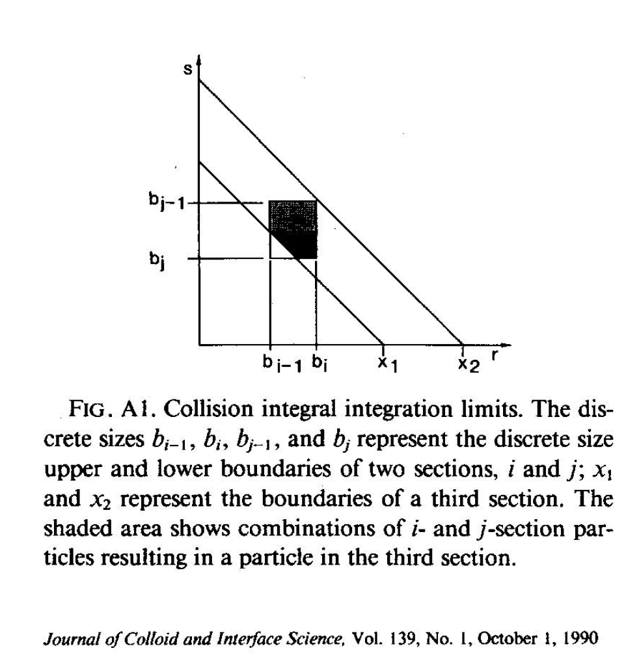

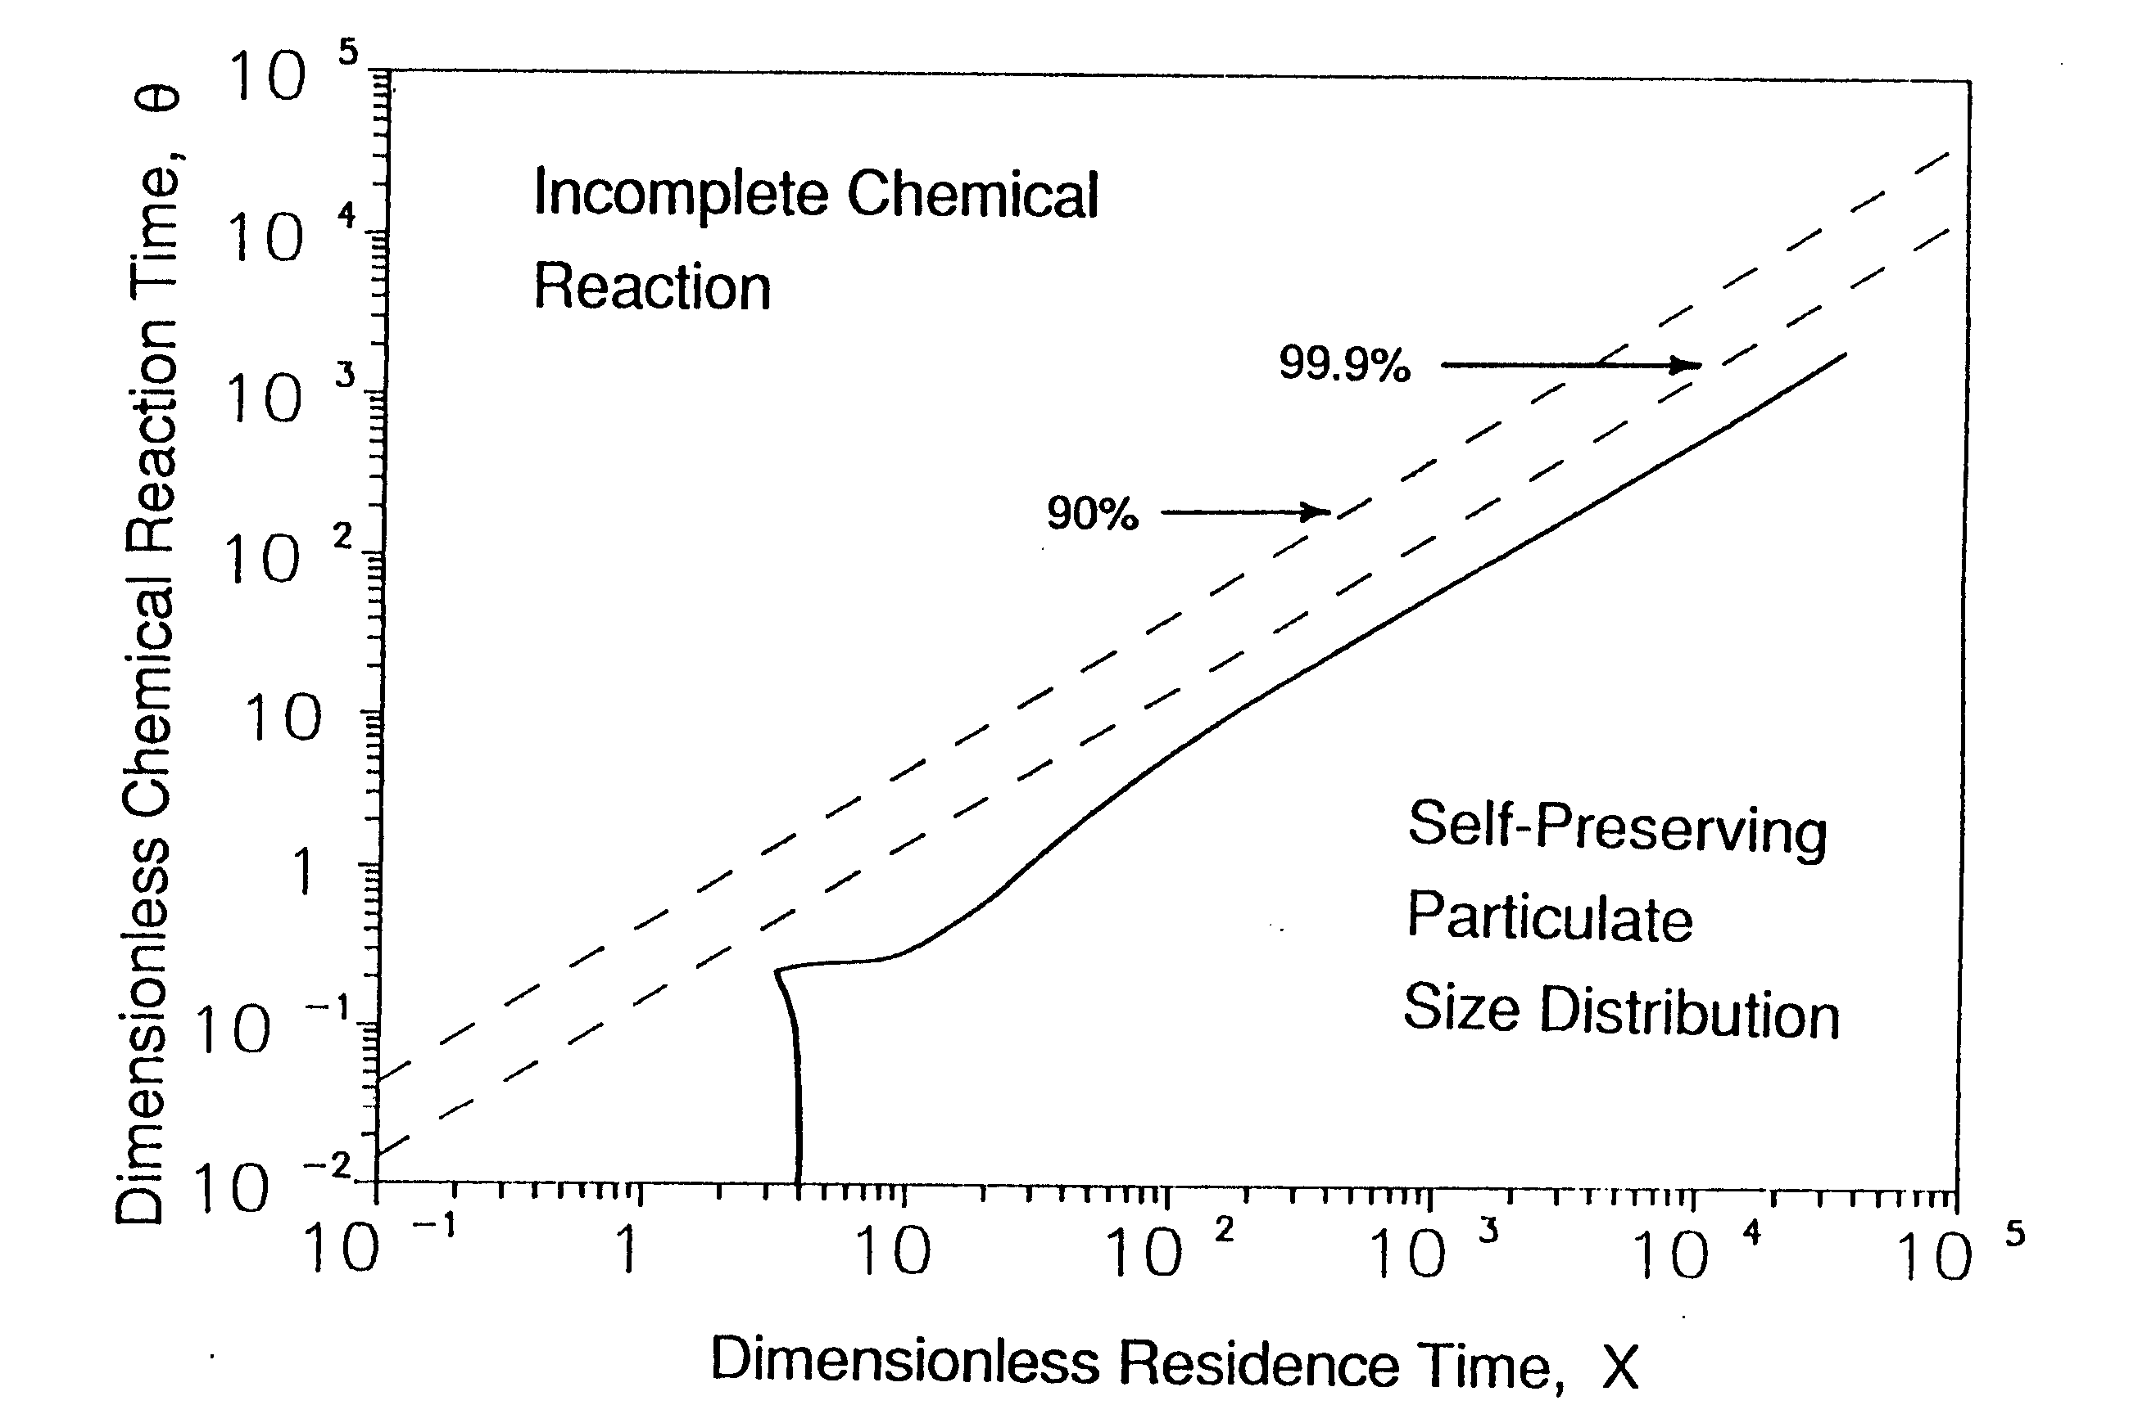
Some things I learned from “Dr. P”*
Penetrate technically to the full extent of the topic
Research is a team sport. Be collaborative and even friends with your colleagues wherever they may be
Great visuals rule the day (Corollary: “Say it with dimensionless numbers”)
Mentoring means giving your mentees/those under you a “seat at the table”
Conferences
Consulting
Lead a balanced life that pays full attention to our creator and to those around us
* My then newlywed wife’s name for Sotiris circa 1987
With congratulations, gratitude, and warmest best wishes to Sotiris and Eleni!!
Sue and J.D. Landgrebe

Slide 4
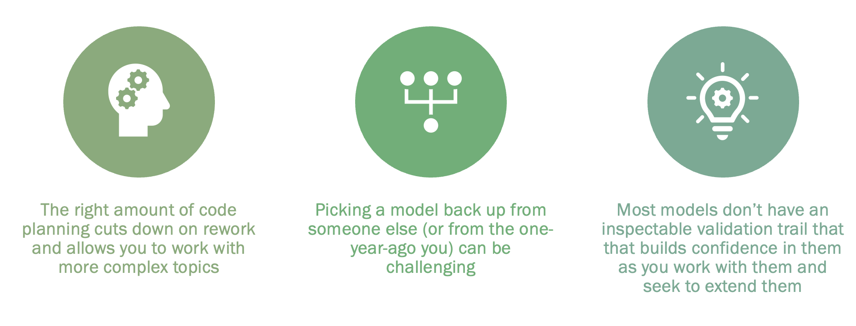
Why Best Practices for Coded Models?
Have you ever:
Picked up a colleague’s, former student’s (or your own 🤪😫) code and spent hours trying to understand it?
Had doubts/uncertainty about the validity of someone else’s model?
Had difficulty extending or scaling a previous model (your own or someone else’s?)
HUGE opportunity exists to set best practices individually, in research groups and corporate teams –it’s a leadership job!!!
Target audience:
Leaders of groups who want to lead setting culture for how things are done under their watch
Individual modelers –graduate students, practicing engineers and scientists. Anyone who builds coded models but is not full-time software engineer or member of software development team

Slide 5
Why Best Practices for Coded Models?
Objectives of Implementing best practices
Gain ability to create Curated coded models personally and in your team
(see The Fourth Paradigm: Data-Intensive Scientific Discovery, Hey et al., Microsoft Research, 2009)
Validate with rerunnable tests -- guard against future broken models
(see Test-Driven Design and here inspiration but that’s a deep and debated topic. Keep it practical!)
Learn to develop efficiently using AI tools to write the code and tests (≈90%)
See full story/tutorial at: https://github.com/jlandgre/Engineering_Model_Best_Practices
(If unfamiliar with Github, click on Readme.md doc for download instructions)
Best Practices for Models
Culture:
“This is how we do things around here”
aka TIHWDTAH

Slide 6
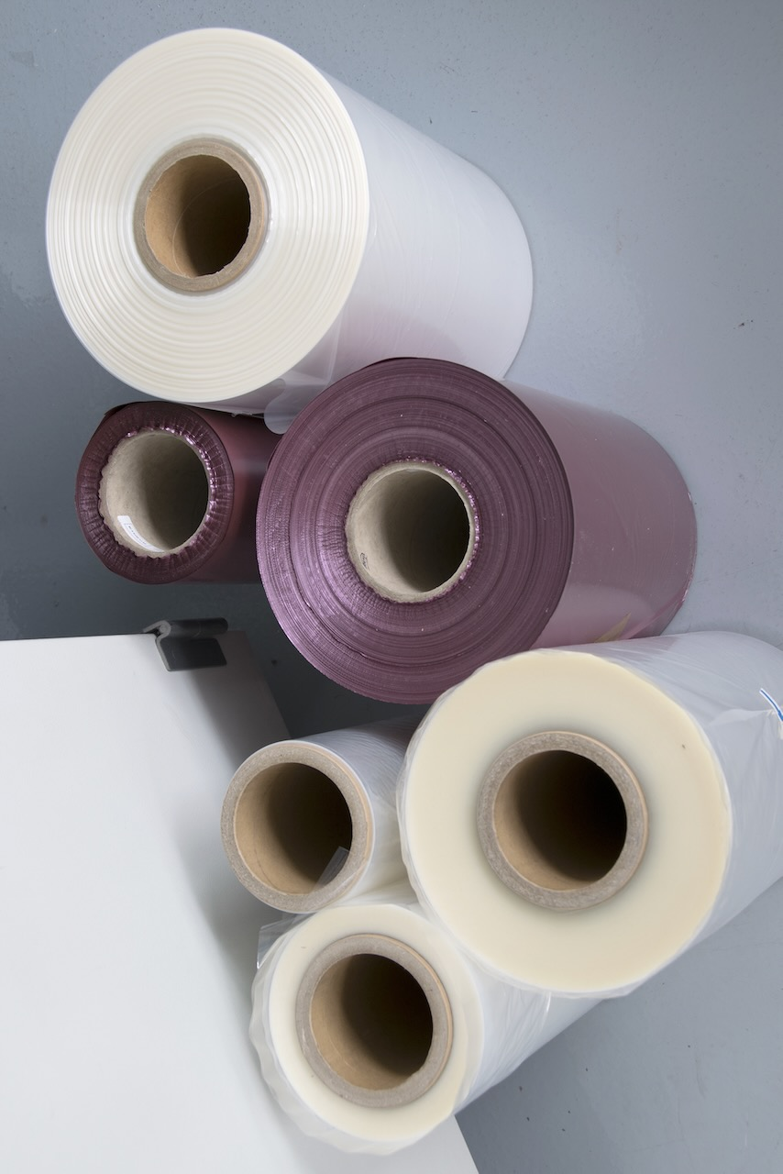
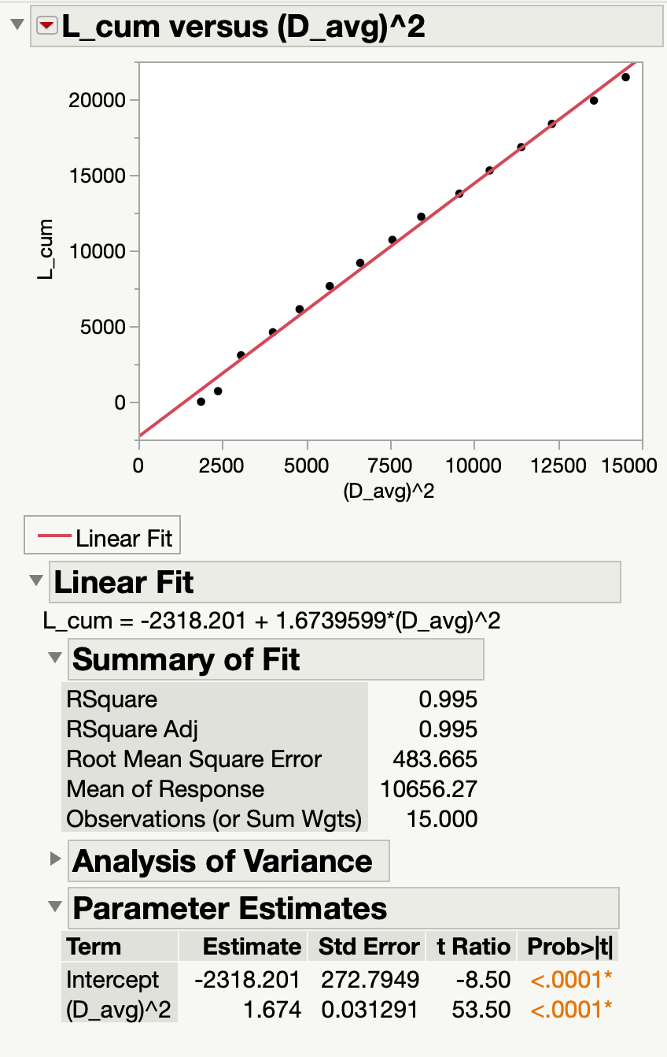
Best Practices – Python Model
Github has tutorial to build, curate and validate an industrially useful model for calculating substrate roll properties (Length, L vs. Diam., D)
A simple, technical example to teach software practices
Tutorial includes how to use AI to write code for the model and for rerunnable Python (Pytest) tests in separate files
C = material’s caliper or thickness

Slide 7
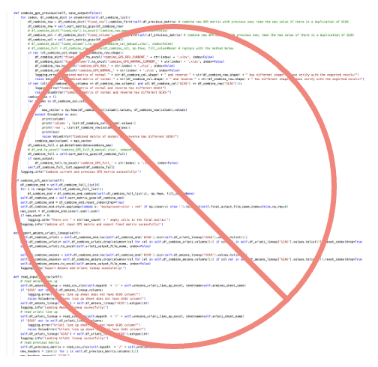
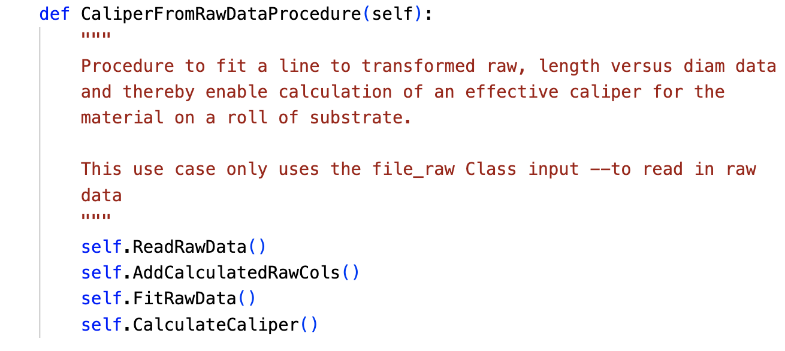
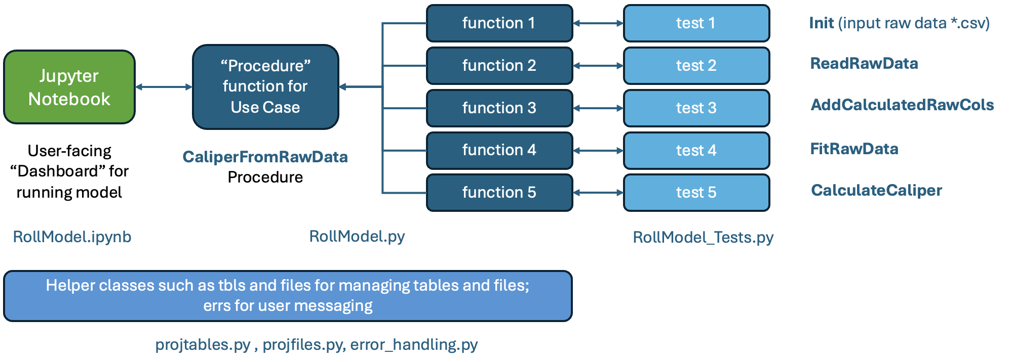
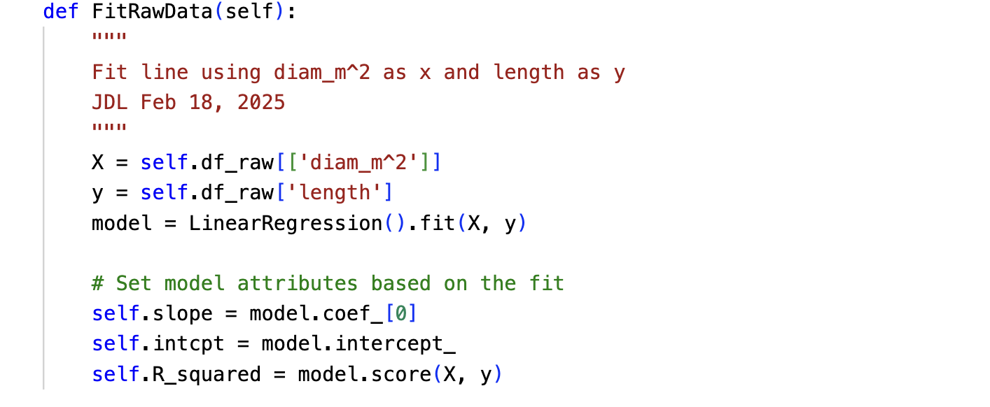
Curating – Python Model Example
Meandering, “spaghetti” code
Curating ≠ long, multi-step code with obscure names
Code should be easily inspectable by non-coding leader/manager
Macroscopic, predictable architecture helps curate
Single-action functions (Clean Code: A Handbook of Agile Software Craftsmanship”, R. Martin, 2008)
Easy to test
Easy for AI tool to write the code and write rerunnable test(s)
Object-oriented “Class-based”
Easy to bring in trusted, helper libraries for working with data etc.
Model’s instanced code objects are easy to inspect and debug
Multistep “Procedure”
Single-action Function
A Good Architecture for Model Code

Slide 8
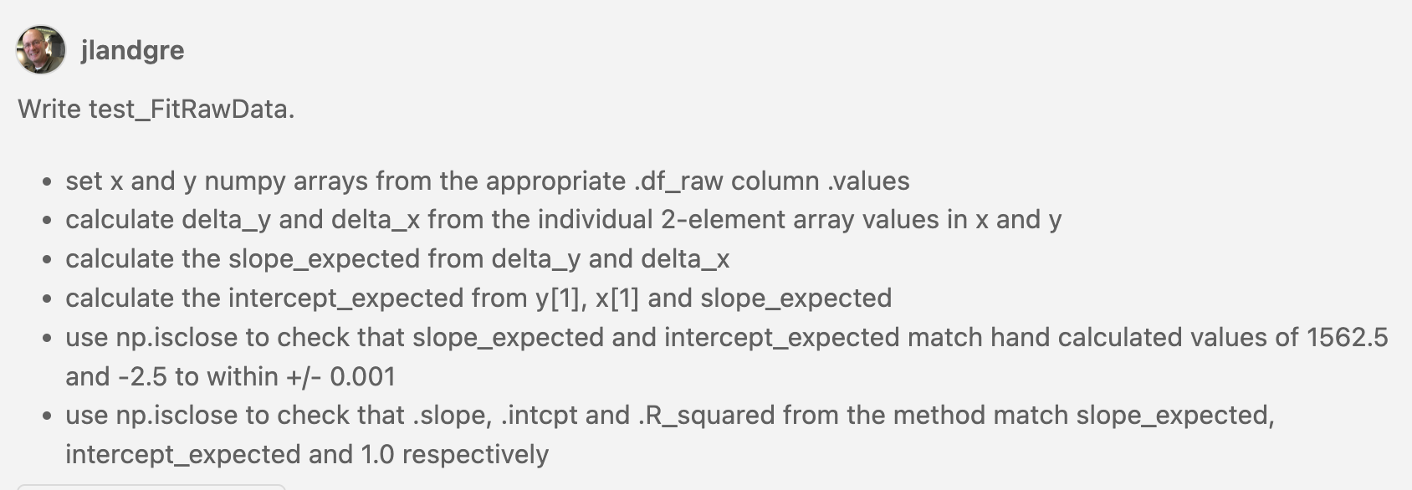
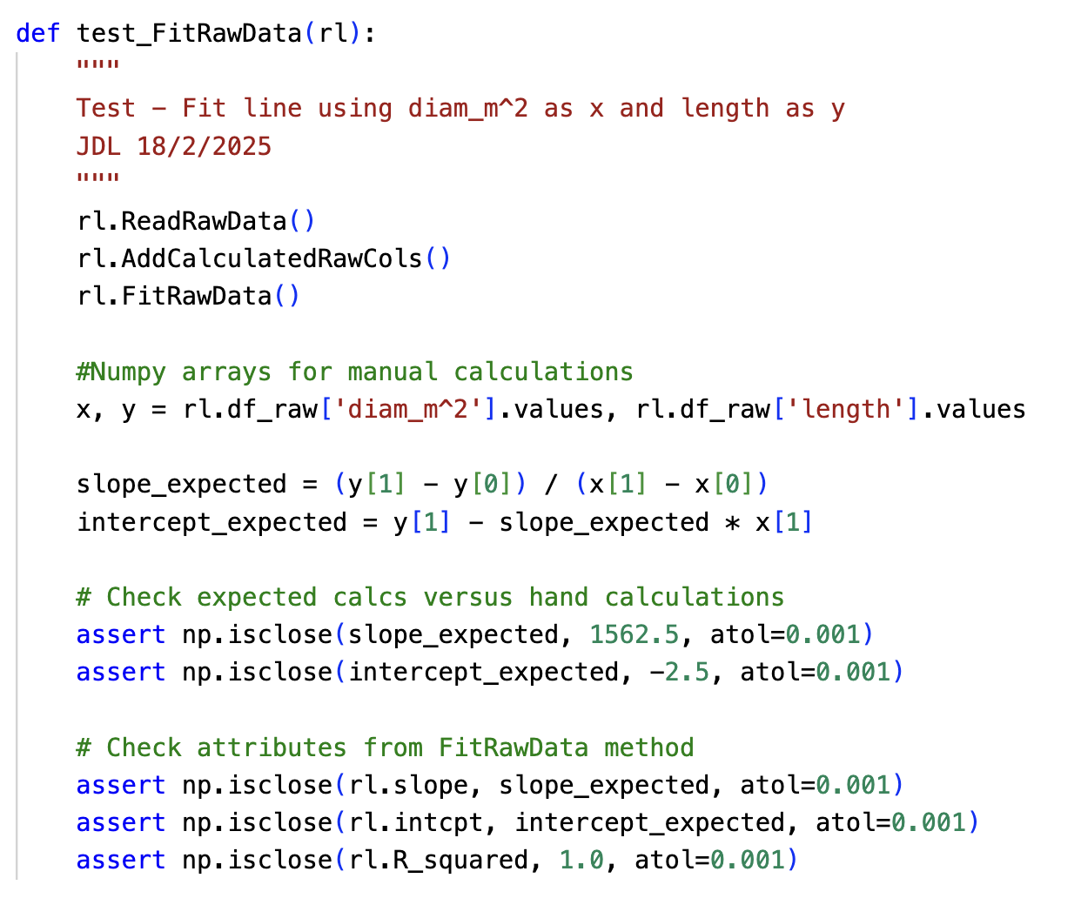
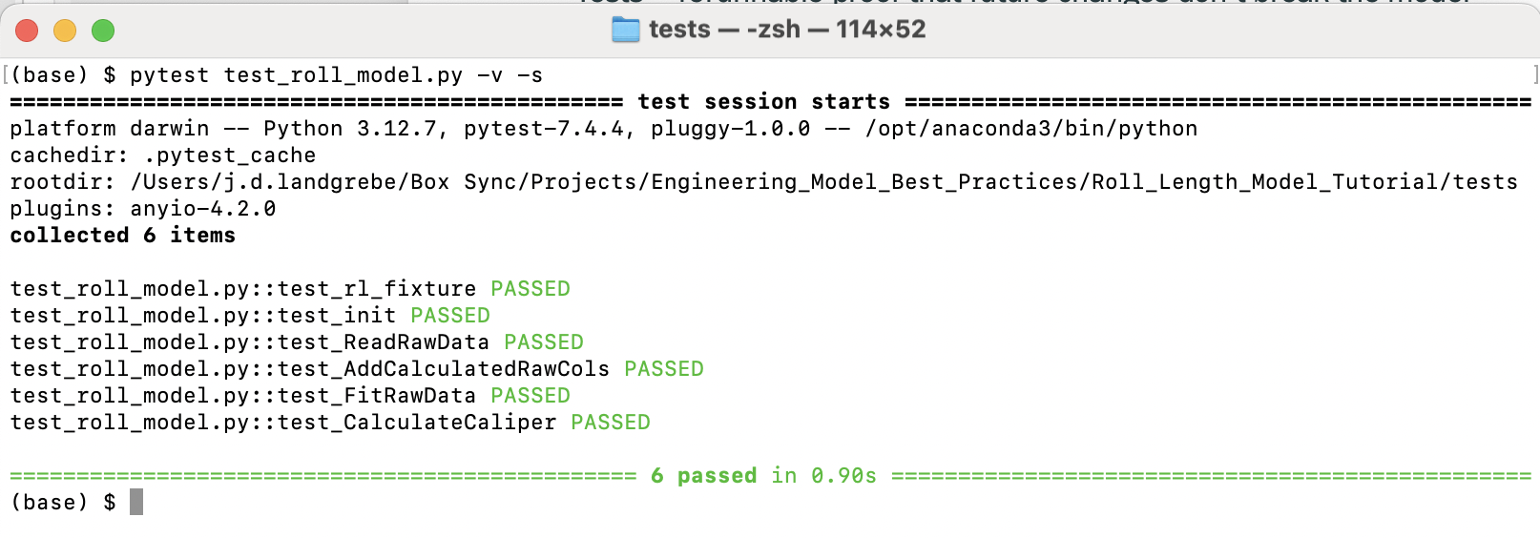
Testing/Validation
Github Copilot Prompt
Testing is under-utilized by engineers/scientists; yet easy to learn
Many “validations” consist of feeding a model some inputs, looking at the results and pronouncing it validated
Tests = rerunnable proof that future changes don’t break the model
Tests are documentation that explains how each function works
Standard Python Pytest library manages testing from *.py file separate from model code’s *.py
Advise minimum one test per model function
Resulting Pytest Function

Slide 9
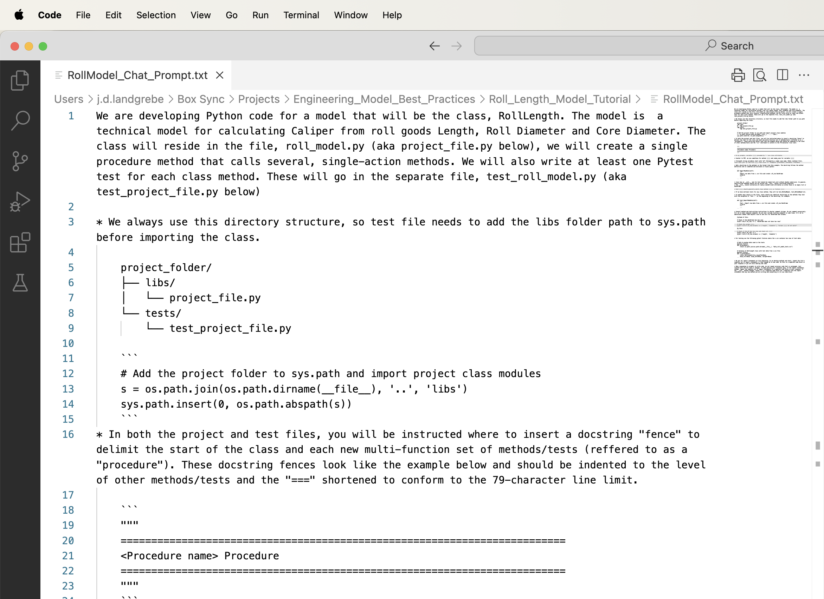
AI Tools For Coded Models
Organization should provide subscription and not-so-subtly encourage use (“Can you share your background prompt for Copilot?”)
Github Copilot Chat + Microsoft VS Code is one, strong option (can select AI model to use)
[Typical] Use Case 1 = one-time queries like “How to write a custom, Python iterator for to iterate over a range of DataFrame cells?”
[More valuable] Use Case 2 = “Write the FitRawData function and its Pytest test_FitRawData that creates mockup data…”
Previous best practices of object-oriented and modular, single-action functions + tests are an ideal fit with using current AI chat tools
Need to supply tool with background to explain “how life works.” This can be standard/pasteable text file (tutorial example)
For many modelers, requires more pre-planning than historical practices
Does not eliminate need for knowing coding –AI tools make mistakes and/or can stray from background intent

